Slide 1
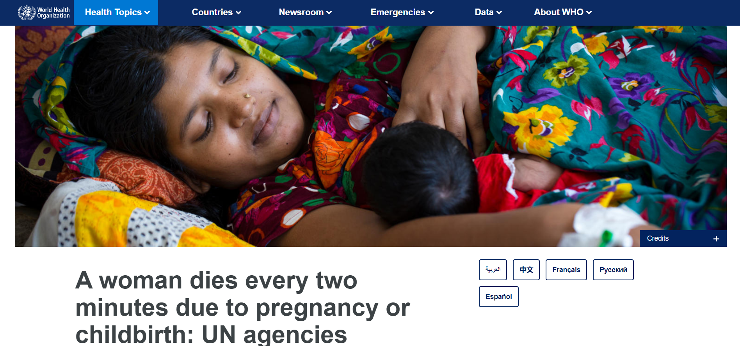
Source : https://WHO.com

Slide 2

AROGYAMAA
Your Trusted Motherhood Companion

Slide 3

Problem Statement: Addressing the unique healthcare challenges faced by pregnant women and new mothers during the pre-delivery phase and the post-delivery phase, in rural and urban areas of India.

Slide 4
OUTLINE
Introduction
About app
Development
Applications
Resources
Future scope

Slide 5





DEVELOPMENT AND EXECUTION
HEALTH ARTICLES
ANC1
ANC2
ANC3
ANC4
When the woman is in her 0-3 month pregnancy.
Required details will be provided by this window
When she’s undergoing 3-4 months
When she's on her 4-6 months stage
When she's on her last trimester
Articles to help out with diet, questions, confusions and motivation

Slide 6
ABOUT THE APP
Lab tests
Medicine prescription
Doctors appointment
Notifications and alerts
Order details
Health updates
Health articles

Slide 7
SOLUTIONS
All-in-One Convenience
Hastle-free Doctor appointments
24/7 Availability
Effortless Lab Tests scheduling
Evidence based Medical Advice
Telemedicine Integration
Prescription updates at your fingertips

Slide 8
INNOVATION
There are many apps in the health care sector for mothers, but limited to only multinational hospitals like Apollo and Manipal which are paid.
ADVANTAGES OF AROGYAMAA
Applicable to all pregnant women
Log-in and registration is completely free
Women can book appointments from anywhere just by a few clicks
They can get their lab tests done without traveling much and also get medicines home delivered
Health care notifications benefit them to keep them on regular check

Slide 9
APPLICATIONS
Can be used anywhere across country
Helps to follow a regular and balanced diet for pregnant women and their children up to the age of 2
Answers questions and motivates the woman using articles
Connect with hospitals
Book appointments
Safety measures, guidelines, Do’s and Don'ts inculcated in the same app

Slide 10
FUTURE SCOPE
Linking app with google voice assistant - to help the blind - people who cant type
Upgrade app using video conferencing - to help the deaf
Introducing multilingualism
Making it available for IOS
Government partnerships

