Slide 1
IC HACK 2.0
TEAM NAME:- KINGS
Name :- Kolluri Revanth
R.Likhith
College: Amrita School of Engineering Bangalore.

Slide 2
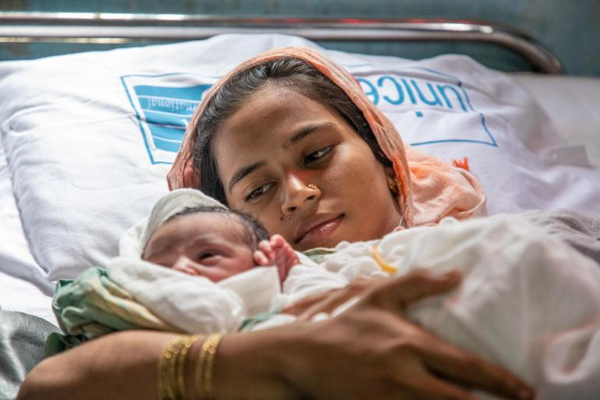
Problem Statement: The challenge before you is to envision and create an innovative Healthcare Ecosystem that sets new standards in patient health management, accessibility, and collaboration.
This ecosystem should not merely integrate data but should introduce groundbreaking features and capabilities, empowering patients and enabling healthcare providers to deliver more personalized, timely, and well-informed care

Slide 3
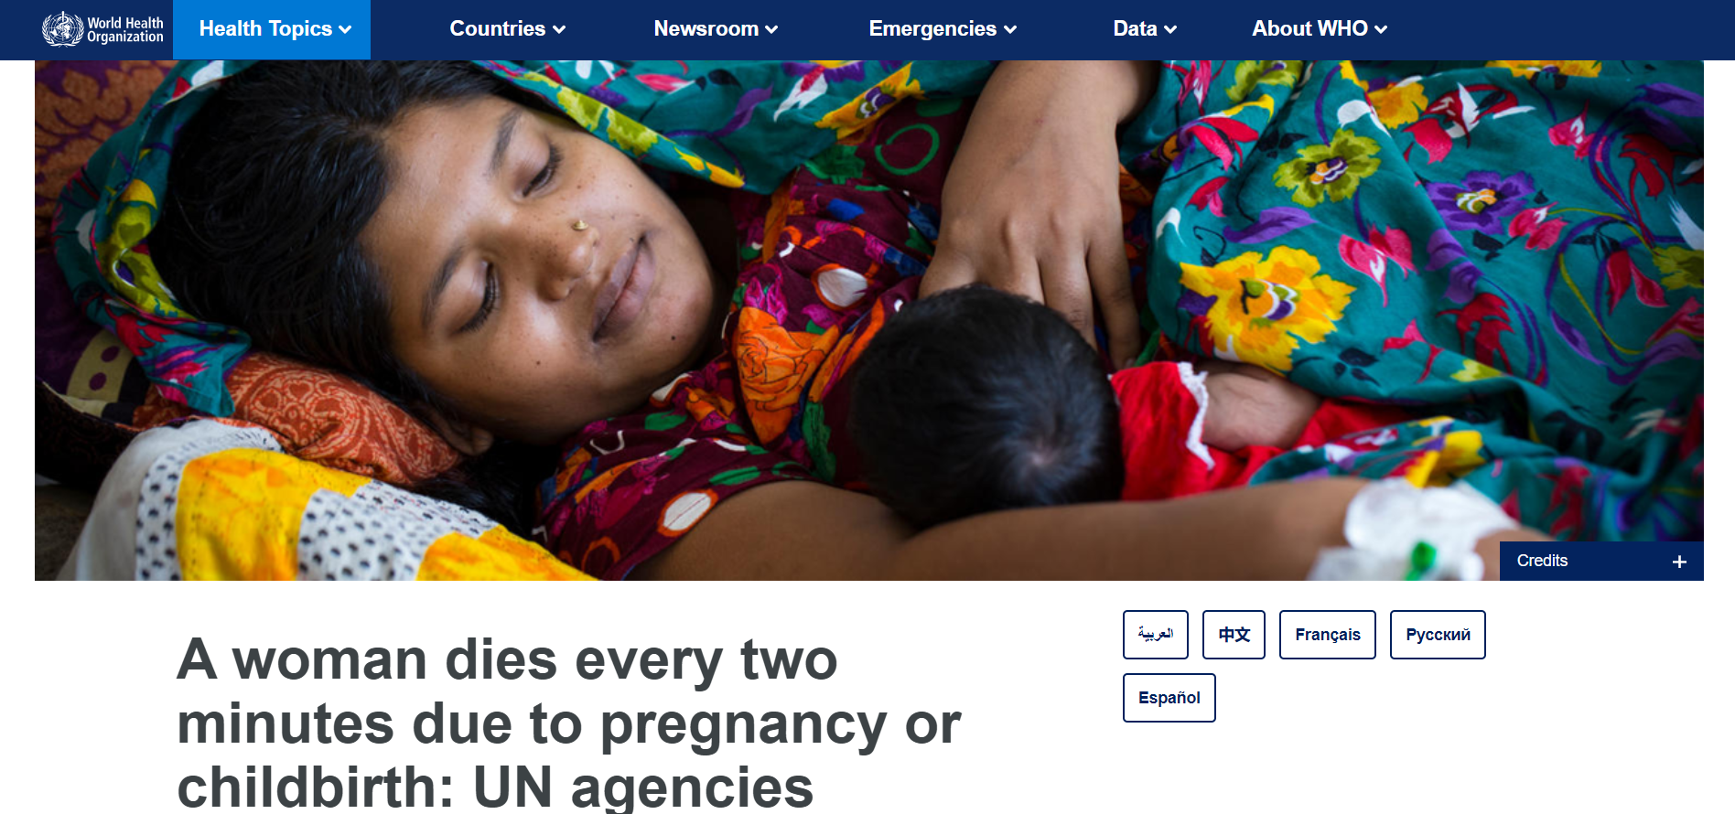
Why did we take this topic only ?
Source : https://WHO.com

Slide 4

AROGYAMAA
Your Trusted Motherhood Companion

Slide 5
FEATURES
Advanced Patient Empowerment :
( To help the mother and child, which is mother of the world ) Means involving patients actively in their healthcare by providing them with "information, tools, and support to make informed decisions, manage their health, and have a say in their treatment plans". It promotes shared decision-making, access to health records, and personalized care, aiming to improve outcomes and patient satisfaction.
AI-Driven Clinical Excellence –
Chat bot ( for any related queries and including the use of video conferencing)
3. Holistic Data Integration –
Unified process of combining, harmonizing, and analyzing data from various sources and formats to gain a complete and interconnected view of information for more informed decision-making.

Slide 6
REQUIRMENTS
1. Innovative Healthcare Ecosystem : it is a unique health care system to provide only the pregnant women and the child up to 0 to 2 years old.
2. Cutting-Edge Technology : easy to use and simply to login free at of cost
3. Functional Prototype : Working function i.e. an APP and an website.
4. Scalability and Practicality : 1) Asha worker
2) government sector,etc.

Slide 7
OUTLINE
Introduction
About app & website
Development
Applications
Resources
Future scope

Slide 8





DEVELOPMENT AND EXECUTION
HEALTH ARTICLES
ANC1
ANC2
ANC3
ANC4
When the woman is in her 0-3 month pregnancy.
Required details will be provided by this window
When she’s undergoing 3-4 months
When she's on her 4-6 months stage
When she's on her last trimester
Articles to help out with diet, questions, confusions and motivation

Slide 9
ABOUT THE APP
Lab tests
Medicine prescription
Doctors appointment
Notifications and alerts
Order details
Health updates
Health articles

Slide 10
SOLUTIONS
All-in-One Convenience
Hastle-free Doctor appointments
24/7 Availability
Effortless Lab Tests scheduling
Evidence based Medical Advice
Telemedicine Integration
Prescription updates at your fingertips

Slide 11
INNOVATION
There are many apps in the health care sector for mothers, but limited to only multinational hospitals like Apollo and Manipal which are paid.
ADVANTAGES OF AROGYAMAA
Applicable to all pregnant women.
Log-in and registration is completely free.
Women can book appointments from anywhere just by a few clicks.
They can get their lab tests done without traveling much and also get medicines home delivered.
Health care notifications benefit them to keep them on regular check.

Slide 12
APPLICATIONS:
Can be used anywhere across country.
Helps to follow a regular and balanced diet for pregnant women and their children up to the age of 2.
Answers questions and motivates the woman using articles.
Connect with hospitals .
Book appointments
Safety measures, guidelines, Do’s and Don'ts inculcated in the same app

Slide 13
FUTURE SCOPE
Linking app with google voice assistant - to help the blind - people who cant type
Upgrade app using video conferencing - to help the deaf
Introducing multilingualism
Making it available for IOS
Government partnerships

Slide 14
THANK YOU

