Slide 1
EPISODE 1 · A SAVANNA STORY ABOUT JOB HUNTING
Hakuna Matatah
No worries, we've got your job hunt. Matatah finds the roles that fit you, writes a packet that's 10/10 for that role, and applies for real — waiting for the “thank you” before it ever says Applied.
Find the job · Write the packet · Apply for real

Slide 2

WATCH · 2 MINUTES
Kiki & Tembo meet Matatah
An oxpecker who sent 411 applications with the same résumé, and an elephant who never forgets a deadline.
Original characters and story, made for Matatah. The captcha beat shows the bot stopping and handing off to the human — that is the real product behaviour.

Slide 3
THE PROBLEM
Same résumé, four hundred times
411
3
1
APPLICATIONS SENT
REPLIES
WAS A NEWSLETTER
Job seekers lose on three fronts at once: they can't see which postings actually fit, every packet reads like everyone else's, and applying takes 20 minutes of clicking per role. Kiki's numbers are made up; the pattern is not.

Slide 4
WHAT MATATAH DOES
Find. Write. Apply for real.
1
Find
2
Write
3
Apply
Reads 600,000+ live postings from 90,000+ verified career boards and ranks them against your profile — fresh postings blended in, because the first days of a listing convert best.
A résumé and cover letter built for this role: a one-line thesis about you, the proof that matters to this reader, nothing invented — checked by a QA gate before it can ship.
Fills every step, presses Submit, waits for the confirmation, marks Applied, moves on. Stops and hands you the wheel for captchas, logins and questions only you can answer.

Slide 5
FIND
The right postings, newest first
Every board, every day
Posting age is real data
Greenhouse, Lever, Ashby, Workday, iCIMS, SmartRecruiters and 30 more ATS families, plus company career pages. Descriptions embedded so matching is by meaning, not keywords.
Every listing carries when it was posted and when Matatah first saw it. Recommendations blend the best-fitting postings with the best-fitting new ones, and a fresh posting wins a near-tie.
Already applied? Gone.
Closed? Skipped.
The same role on another board, or a retitled repost, never comes back once you've applied or dismissed it.
Expired, 404 and email-only postings are skipped with a reason and remembered — no dead ends in the queue.

Slide 6
WRITE · THE 10/10 PACKET
One job description, three different people
The same Senior PM posting at a clinic-software company. Each thesis is only true of that person — and every claim traces to their own record.
RF ENGINEER → PM
MARKETPLACE SENIOR PM
CLINICAL NLP SCIENTIST
“RF engineer turned product manager … rare depth across the device hardware, the HL7 integration, and the nurse-facing software on top.”
“Seven years owning marketplace surfaces used daily by tens of thousands of professionals — including a merchant API at scale …”
“Scientist who owned the full documentation surface … with FHIR/EHR depth that most PMs borrow from engineers.”
Before the engine, the old generator had quietly retitled the scientist “Senior Product Manager with 5+ years”. That is exactly what the gate now refuses.

Slide 7
WRITE · THE QA GATE
A packet ships only when all eight checks pass
✓
ATS name, email, phone, employers, titles, dates in a fixed single-column layout
✓
Truth every bullet cites its source; every number is in that source (or plain arithmetic on it)
✓
Thesis two sentences, specific to this person and role family, no adjective soup
✓
Proof ranking the leading bullets are the ones ranked highest for this job description
✓
Level titles untouched; no “head of” language on an IC record
✓
Company the cover builds on a concrete line from the posting, never “your mission”
✓
Differentiation the rare combination surfaces; buzzwords banned
✓
Polish no placeholders, no encoding glitches, one email, a clean filename
Role families come from a registry: 35 seeds, and a new family is generated from an unseen job description once, checked, saved, and reused.

Slide 8
WRITE · COVER 10/10
The cover letter, held to the same bar
BEFORE — template + light tailor
AFTER — Cover 10/10 pipeline
“I am excited about your mission and believe I would be a great fit…” Interchangeable, no company-specific line, ~7/10.
Thesis line (first 2 sentences) · one company-specific insight grounded in the posting · exactly 2 proofs from your record · level-matched voice · soft CTA.
Gate blocks on factuality; rubric p50 10/10, factuality 100% on the golden set. No template letter ever ships.

Slide 9
APPLY · BOT APPLY
Success, or a reason. Nothing in between.
Continuous mode fills every step — including multi-page Workday flows — presses Submit, and then waits. Only a confirmation counts.
queued
→
navigating
→
filling
→
submitting
→
confirmed
→
applied
→
next
needs you
captcha · login · code · a fact nobody has
skipped
closed · no form · email-only · wall not cleared in 20 min
failed
submit never confirmed · form still rejecting
“Fields filled” is not an outcome. The queue never advances until one of the three verdicts above is recorded — and Applied only ever follows a confirmation.

Slide 10
APPLY · THE HANDOFF
It stops. You take the wheel. It resumes.
Live view
Take over
Never sneaks past
Watch the form being filled, with a running trail of every decision — on your laptop, or from your phone when it runs in the cloud.
One tap freezes the filler. Solve the captcha, type the code, answer the question. Hand back, and the same application continues to Submit.
No captcha solving, no stealth browsers, no proxy tricks. A security check is always a human moment; if nobody clears it, the job is skipped with the reason.

Slide 11
HOW IT'S BUILT
One engine, many hands
Apply Engine (matatah.com)
Queue, state machine, evidence rules, challenge handoffs, Mark Applied. Every client reports to it; none of them can mark a job applied without evidence.
Web
Chrome extension
Desktop app
Matches, Bot Apply, live view, admin.
Fills in your own browser.
Runs the queue on your machine, with your logins.
Cloud session
Mobile / iPad
Same worker, headless, streamed to web + phone.
Watch, take over, chat, fill soft forms, from anywhere.
The filler is one content.js shared by every client, so a fix lands everywhere at once.

Slide 12
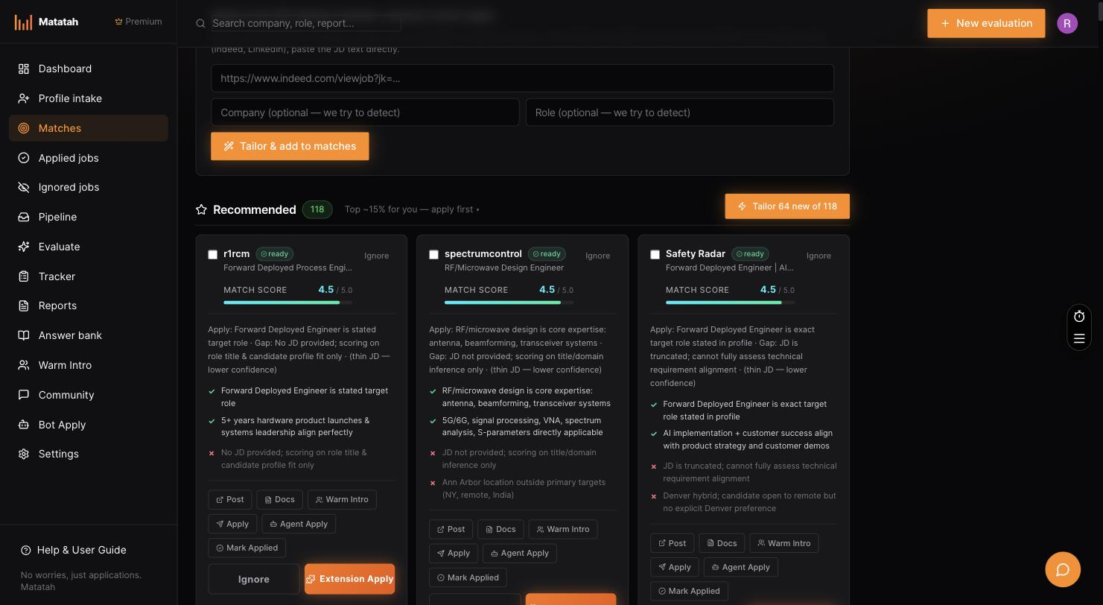
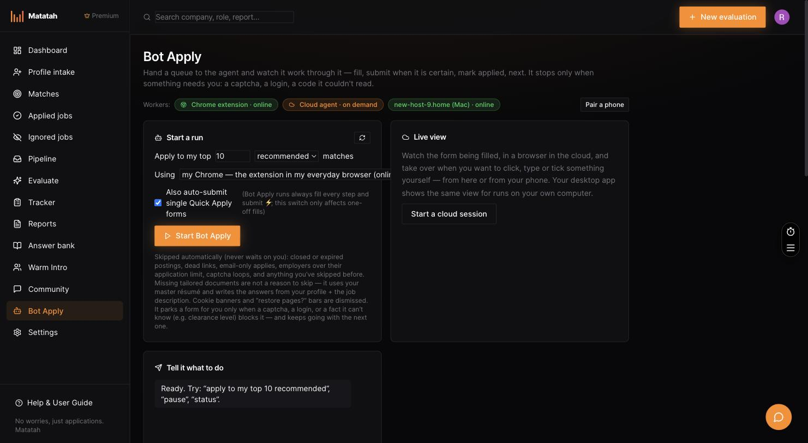
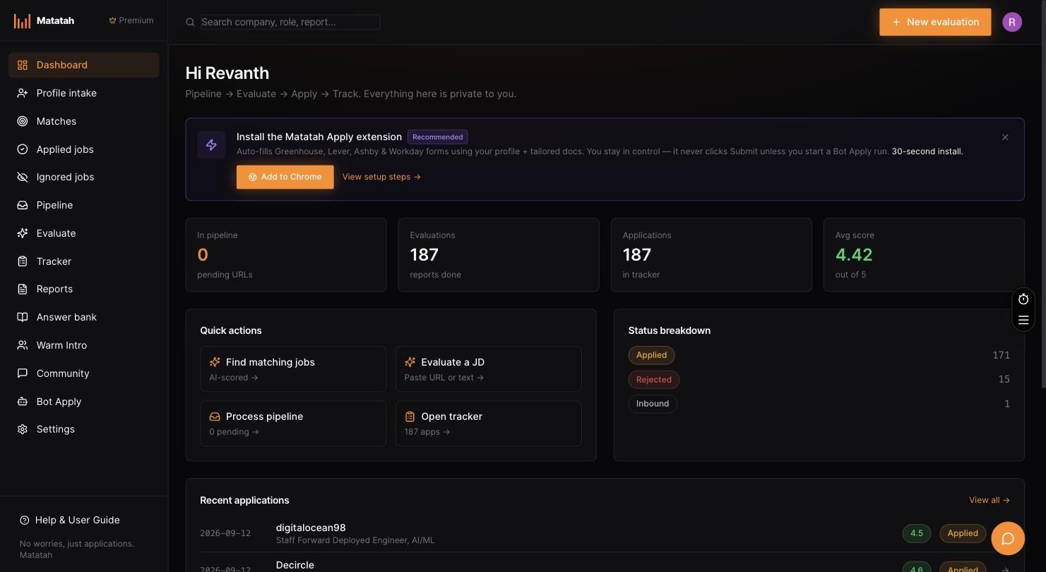
REAL PRODUCT · MATATAH.COM, LIVE ACCOUNT
What it looks like today
Matches — 118 recommended, each with a fit score, reasons, and Apply / Bot Apply
Bot Apply — workers online, run picker defaulting to “my Chrome”, live view
Dashboard — 187 evaluations, 187 applications tracked, 171 applied
Screens captured from the presenter's own account on 13 Sep 2026; the pool spans 119,000+ employer career pages.

Slide 13
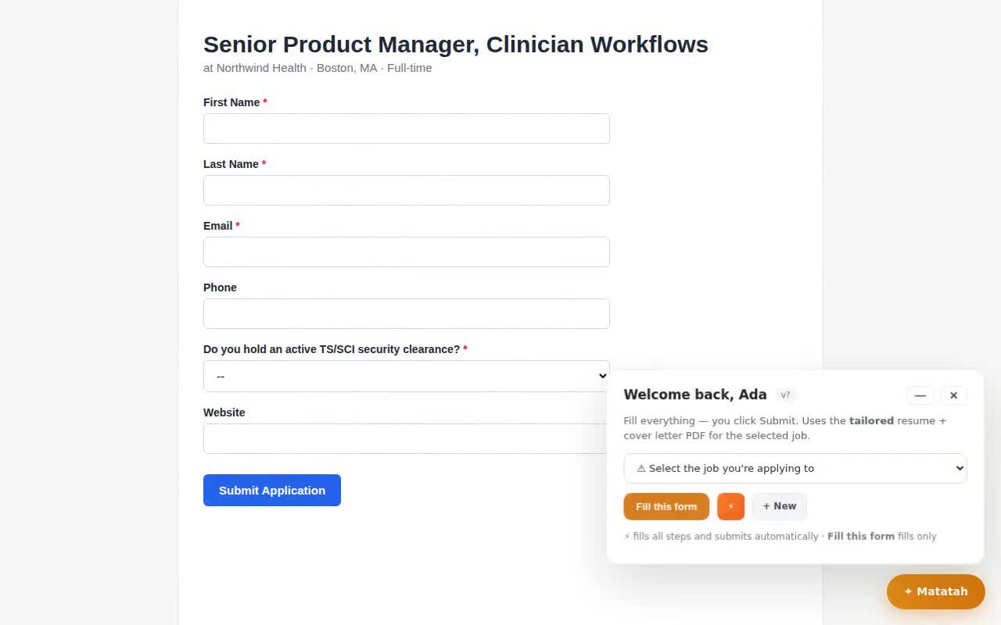
REAL ENGINE · RECORDED, NOT STAGED
The filler working a Greenhouse-style form
1. Fill — name, email, phone from the profile; every filled field gets a green outline.
2. Agent pass — a required question nobody can answer (“active TS/SCI clearance?”) goes to the model, which says it doesn't have it.
3. Needs you — the run pauses on missing_info instead of guessing or moving on.
4. Human answers — the select is set to “No”, Continue is pressed.
5. Submit → confirmation — “Thank you for applying” is detected; only then marked applied.

Slide 14
TECH STACK
Boring where it should be, sharp where it matters
Web & API
Data
Next.js 16 (App Router, TS) on Vercel · Vercel Cron · Blob for PDFs
Postgres on Neon + pgvector (768-d, ivfflat) · Drizzle · 600k+ listings
Models
Apply Engine
Claude for scoring/tailoring/agent + OpenRouter–Groq–NVIDIA fallback · OpenAI embeddings · prompt caching
State machine + evidence rules in Postgres; Mark Applied only on confirmation
Filler
Clients
One content.js: field mapping, learning, repeaters, agent loop, human-cadence typing
Chrome MV3 · Electron (Playwright + CDP screencast) · Node/Playwright cloud on Render · Expo mobile
Integrations
Quality
Gmail API (codes from the inbox) · Stripe · Google / GitHub sign-in
Playwright harnesses vs mock ATS pages · fake engine flags early queue advance · QA gate on every packet

Slide 15
LIVE DEMO · 6 MINUTES
What to show, in order
1
Matches — open the list; point at the fit score and “posted 1 day ago”; dismiss one — it never returns.
2
Tailor — pick a match, generate the packet; read the thesis aloud; open the QA report (pass, 10/10).
3
Bot Apply — start a continuous run on the desktop app; show the live view filling a multi-page form.
4
Handoff — on the captcha posting, show “Needs you”, Take over, clear it, Hand back; watch it turn green.
5
Phone — open the Live tab on the phone while a cloud session runs; tap Take over from there.
6
Close — the run summary: applied / skipped (with reasons) / needs you. Nothing filled and forgotten.

Slide 16
CLOSE
Hakuna Matatah
Find the job. Write the packet. Apply for real. No worries.
matatah.com · Bot Apply is currently limited to admins while the success loop is verified on live boards. Matatah never solves captchas or bypasses security checks — those moments are always handed to you.

