Slide 1
Phase 15 : Applying ML and Deep Learning
Supervised By
Dr Sabah Mohammad
Presented By
Revanth Yenugudhati

Slide 2
Preprocessing Images:
Using Contours and masks with Gaussian blur and Otsu have given better results when compared to the previous approach by using just Gaussian blur and Otsu algorithm.
Spots identified as background has been reduced resulting in better focusing on the plant.
Divided the images into the health and unhealth folders

Slide 3
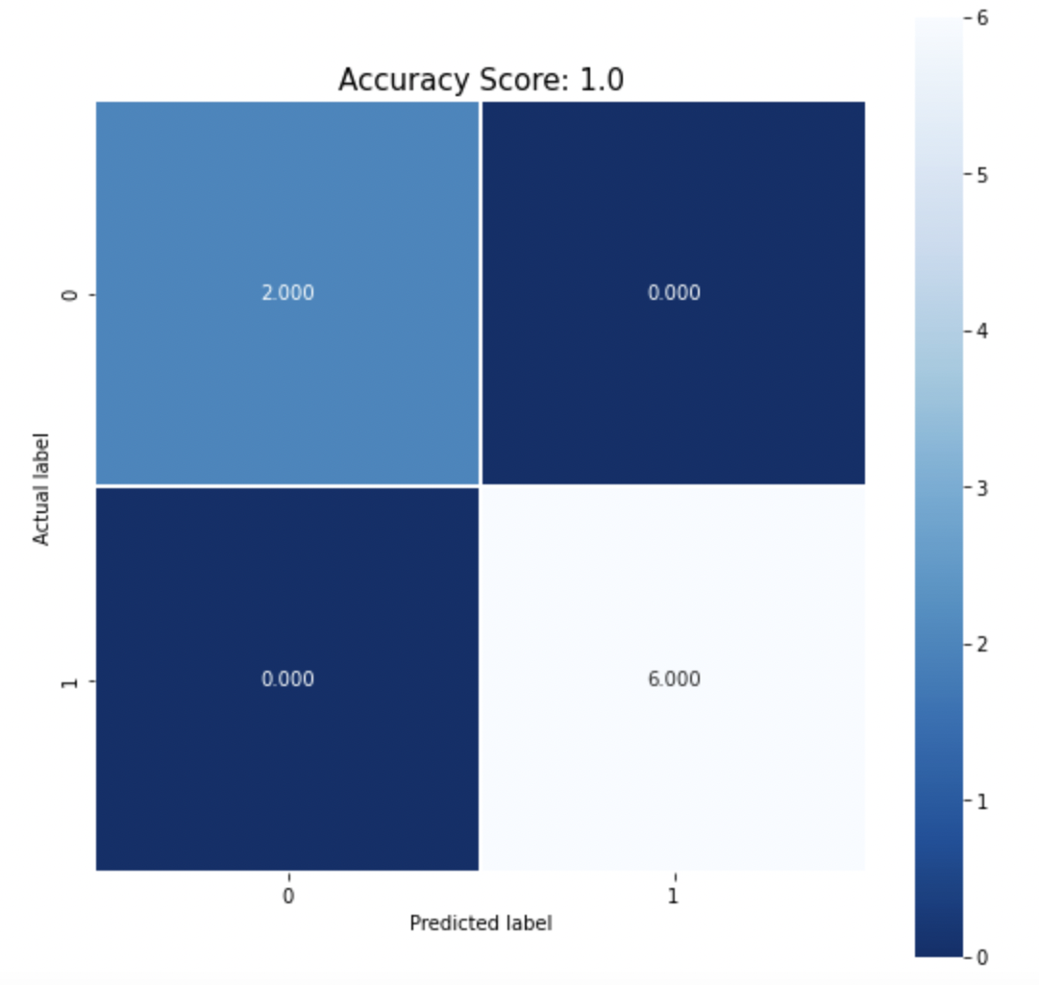
ML / Deep Learning models:
The dataset consisting of images have been divided into train and test.
For working on the preprocessed images, By using sklearn the images are passed into the models for training and testing.
Support Vector Machine
Logistic Regression
KNN classifier
The models were able to predict the values.

Slide 4
Thank You!

