Slide 1
Phase 12: Choosing Application Area for Proposal
Supervised By
Dr Sabah Mohammad
Presented By:
Revanth Yenugudhati

Slide 2
Introduction:
The main aim of the project is to build a mobile application which takes the input of a plant image and process it for the identification of the plant health and reporting it to the user.
Dataset is built by taking the images of the crops like Soybeans and corn from fields.
Mobile application is developed using React Native and the backend part like health detection is taken care by python by extracting colour bands. Heroku is being used for running the backend part.

Slide 3
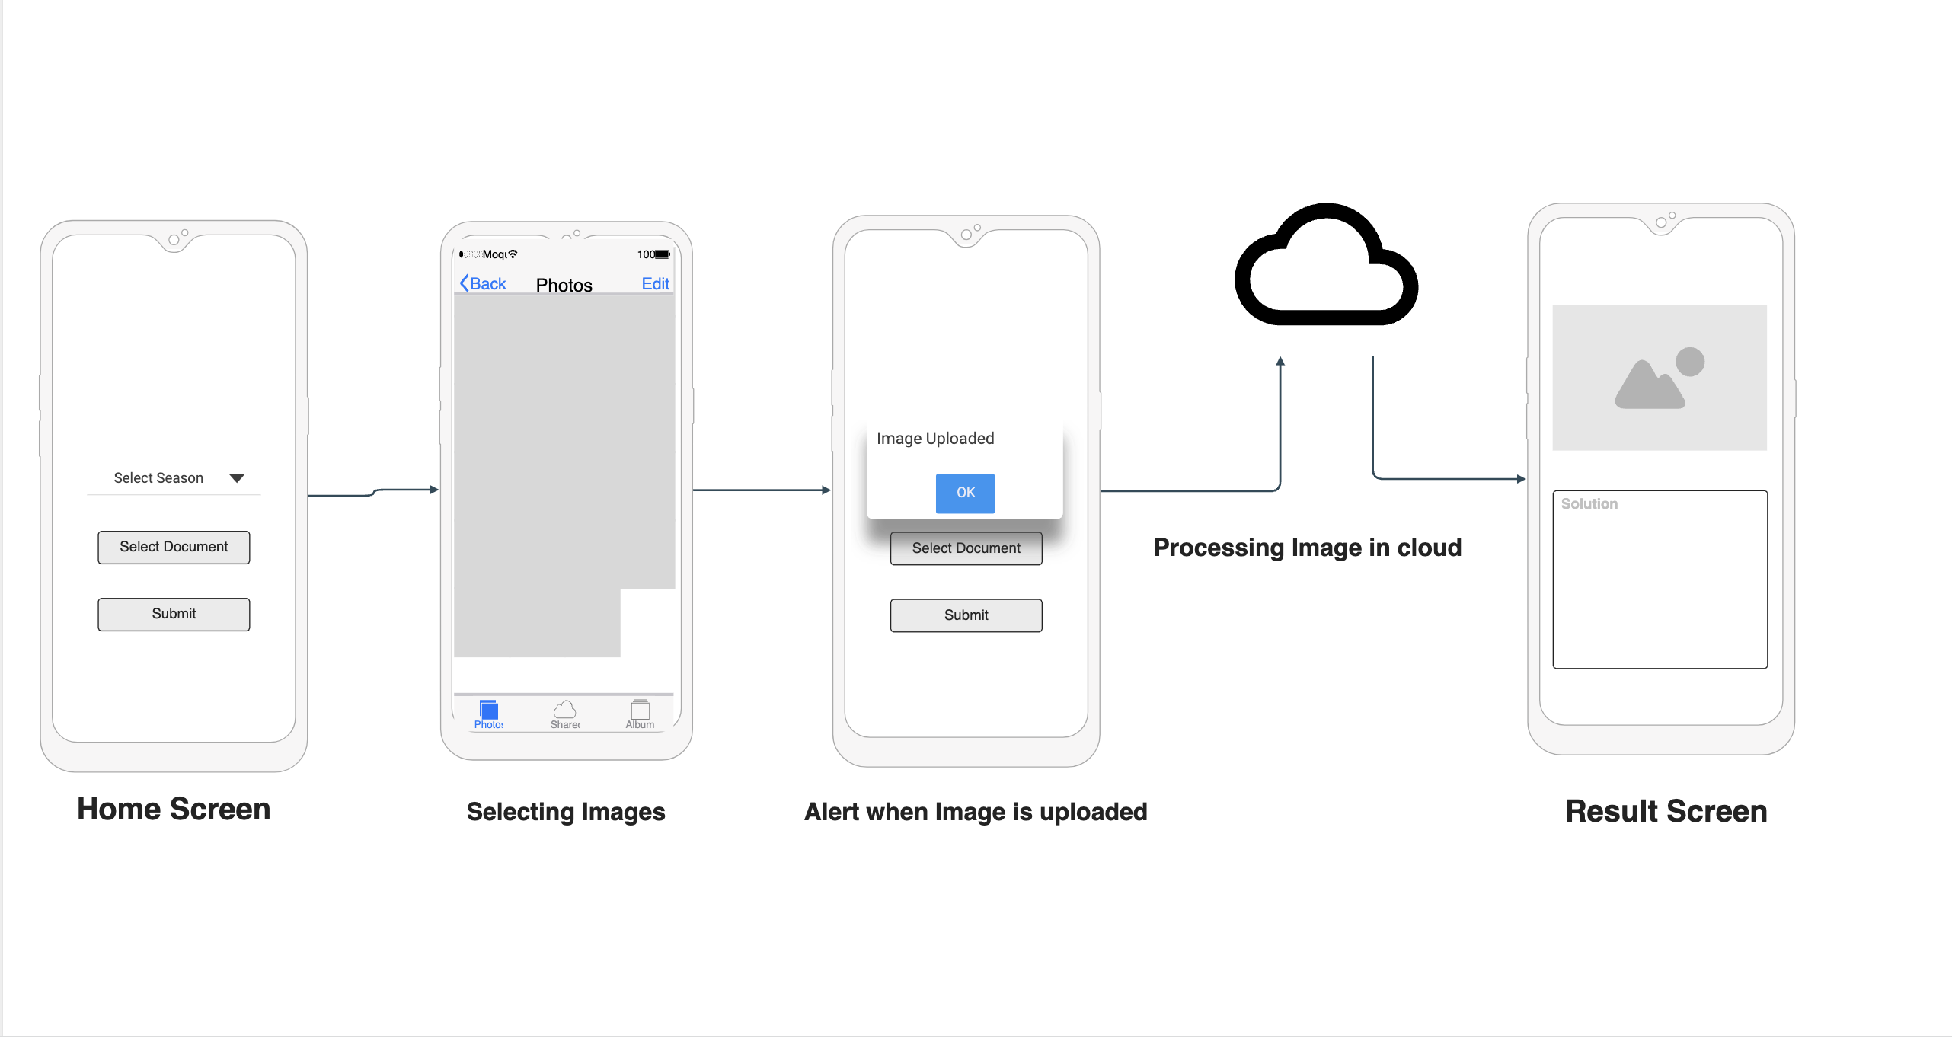
Prototype:

Slide 4
Github:
Link: https://github.com/revanthyenugudhati/Crop
Repository consists of folders like references and phases presenting the papers referred and steps followed for the proposal
It also consists of code files and requirement file in which the requirements are specified for the project.
Dataset Link: https://drive.google.com/drive/folders/1V7bVyctR7bo-qddO98gbZ-ObTRH-6AU7?usp=sharing

Slide 5
Thank You!

