Slide 1
Can You Guess These Logos?

Slide 2
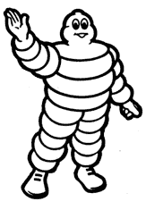
LOGO # 1

Slide 3

LOGO # 1

Slide 4

LOGO # 2

Slide 5

LOGO # 2

Slide 6

LOGO # 3

Slide 7

LOGO # 3

Slide 8

LOGO # 4

Slide 9

LOGO # 4

Slide 10

LOGO # 5

Slide 11

LOGO # 5

Slide 12

LOGO # 6

Slide 13

LOGO # 6

Slide 14

LOGO # 7

Slide 15

LOGO # 7

Slide 16

LOGO # 8

Slide 17

LOGO # 8

Slide 18

LOGO # 9

Slide 19

LOGO # 9

Slide 20

LOGO # 10

Slide 21

LOGO # 10

Slide 22

LOGO # 11

Slide 23

LOGO # 11

Slide 24

LOGO # 12

Slide 25

LOGO # 12

Slide 26

LOGO # 13

Slide 27

LOGO # 13

Slide 28

LOGO # 14

Slide 29

LOGO # 14

Slide 30

LOGO # 15

Slide 31


LOGO # 15

