Slide 1

Mini Project External Review
Batch No: 12
Project Title: Financial Fraud Detection Using Machine Learning
S.No | Regd.No | Student Name
1 | 21A81A0553 | S.MADHURI
2 | 21A81A0564 | Y.REVATHI
3 | 21A81A0551 | S.S.D.LAVANYA
4 | 22A85A0506 | M.KARTHEEK
5 | 21A81A0502 | A.CHANDRA NAGA SAI
Project Guide:
Mrs. N. Hiranmayee , M.Tech

Slide 2
CONTENTS
Abstract
Introduction
Literature Survey
Problem Statement in Existing System
Proposed System
Objectives
Project domain
Requirement analysis
- Functional Requirements
- Non-Functional Requirements
- Software Requirements
- Hardware Requirements
System Architecture
Methodology
Project Plan
Design
Implementation
Result Analysis
Attainment of objective
Conclusion
Future scope of Project

Slide 3
ABSTRACT
Financial fraud is a unwelcome and costly issue that troubles the global financial industry. The rise of digital transactions and online banking has created new opportunities for fraudsters to exploit vulnerabilities. Machine learning has emerged as a powerful tool for detecting and preventing financial fraud, as it can analyze vast amounts of data and identify complex patterns that humans alone might miss. This abstract provides an overview of the key components and methodologies involved in the development of a financial fraud detection system using machine learning.
In this research, a comprehensive approach is presented, incorporating various machine learning techniques, data preprocessing, and feature engineering to effectively detect fraudulent activities. The system is trained on the dataset contains transactions made by credit cards in September 2013 by European cardholders. Features V1,V2….V28 are the principal components obtained with PCA transformation. Feature ‘Class’ is the target variable which takes value 1 in case of fraud and 0 otherwise.

Slide 4
INTRODUCTION
We are living in a world which is rapidly adopting digital payments systems. In the fast-paced world of finance, where countless transactions occur every second, ensuring the safety of financial systems and protecting hard-earned money is of utmost importance. This is where the power of machine learning steps in to act as a vigilant guardian against fraudulent activities. An effective fraud detection system should be able to detect fraudulent transactions with high accuracy and efficiency. Designing an accurate and efficient fraud detection system that is low on false positives but detects fraudulent activity effectively is a significant challenge for researchers. Fraud is a problematic issue in many industries, including finance, insurance, e- commerce, and internet banking, especially. Fraudulent activities, such as identity theft, money laundering, and credit card fraud, can result in significant financial losses for individuals and organizations.ML algorithms can analyze vast amounts of data and identify patterns that may indicate fraudulent activities. In this report, we will explore how ML is being used in fraud detection, its benefits and limitations.ML in actuality, are bunch of clever algorithms which are mostly used to find patterns in a data stream of any kind, to provide helpful information, such as the kind of fraud committed, future patterns.

Slide 5
LITERATURE SURVEY
Sno. | Author | Published Year | Title | Technique
1 | Samaneh Sorournejad , Zojah and Atani | 2016 | A survey of Credit Card Fraud Detection Techniques | Data and Technique oriented perspective
2 | Wedge , Canter , Rubio | 2017 | Solving the False positives problem in fraud prediction | Automated featured engineering
3 | T.Singh , F.Di Troia , C.Vissagio | 2015 | Support Vector Machines and malware detection | Linear SVM and SVM based on RBF Kernel
4 | Aditya Oza | 2019 | A Survey on Fraud Detection | Machine Learning

Slide 6
EXISTING SYSTEM
The problem statement for an existing system focused on financial fraud detection using logistic regression technique in machine learning.
Financial fraud poses a significant threat to both individuals and institutions, leading to substancial monetary losses and erosion of trust.
The existing system faces challenges in accurately identifying fraudulent transactions while minimizing false positives.
Existing system deals with entire set of transactions as a whole to train the models.
Limitations: Unable to handle large data sets and missing values efficiently. There arises a problem of overfitting and struggles to identify complex patterns in the data.
Currently we are creating user specific models which are based on user’s previous transactional behaviour and use them to further improve our decision making process.
Leveraging the power of machine learning this project aims to create a more effective and accurate system for detecting financial fraud.

Slide 7
PROPOSED SYSTEM
Data Collection and Preprocessing: Gather historical transaction data from various sources, clean and preprocess the data to remove noise, handle missing values, and normalize features.
Model Selection: Choose appropriate machine learning algorithms for fraud detection such as logistic regression, decision trees, random forests etc. Here we used Random Forest Classifier. It is a scikit-learn ensemble learning technique. It is a supervised learning algorithm.
The model Architecture’s Personalization: Credit card transactions are highly unbalanced where legitimate transactions may dominate over fraudulent transactions. To build the effective model handling unbalanced data is necessary. It can be achieved by applying oversampling techniques(SMOTE).
Training the model: The supervised Machine Learning algorithm Random Forest is used to effectively and efficiently identify fraudulent transactions. Training a model on credit card fraud detection requires pre-processed data without any errors and fine tuning to make the model user-friendly.
Detection: This Trained model is capable of detecting fraudulent transactions. In this Predictive Modelling we generated a binary result: Fraud or Not Fraud.

Slide 8
OBJECTIVES
Pre-processing of the dataset
Feature extraction
Training the model
Classify Fraud and Non Fraud
Detection of Fraudulent transactions
Performance Analysis
Pre
processing
Feature
Extraction
Classifier section
Detection

Slide 9
PROJECT DOMAIN
Machine Learning:
The domain for a project on financial fraud detection in machine learning would fall under the category of "Finance" and "Machine Learning." It involves using machine learning techniques to develop models that can identify and predict instances of financial fraud within transactions or activities. It involves creating sophisticated models that leverage machine learning algorithms to analyze vast amounts of financial data, looking for patterns and anomalies that could indicate fraudulent activities. This domain requires a deep understanding of both financial transactions and machine learning techniques to build accurate and efficient detection systems that can safeguard against various types of fraud, such as credit card fraud.

Slide 10
REQUIREMENT ANALYSIS
FUNCTIONAL REQUIREMENTS:
Data Collection and Integration: The system should be able to gather data from various sources such as transactions, user behavior, and external databases. It should be able to integrate and preprocess this data for analysis.
Feature Engineering: The system should automatically extract relevant features from the collected data to be used as input for the machine learning models.
Machine Learning Models: Implement various machine learning algorithms (e.g., supervised, unsupervised, anomaly detection) to identify patterns and anomalies in the financial data. Train and update the models periodically to adapt to evolving fraud patterns.
Anomaly Detection: Identify unusual and suspicious patterns that could indicate fraud, such as unexpected transaction amounts or locations.
User Profiles and Behavior Analysis: Develop user profiles based on historical data to better understand typical user behavior and identify deviations.

Slide 11
REQUIREMENT ANALYSIS
NON-FUNCTIONAL REQUIREMENTS:
Accuracy and Precision: The system should achieve a high level of accuracy and precision in identifying fraudulent transactions to minimize false positives and negatives.
Scalability: The system should be able to handle a large volume of transactions and data as the user base grows.
Real-time Processing: The system should process transactions in real-time to provide timely fraud detection and prevention.
Security and Privacy: Ensure that the sensitive financial data and user information are securely stored and processed to adhere to data protection regulations.
Reliability and Availability: The system should be reliable and available around the clock to prevent any disruptions in fraud detection services.

Slide 12
REQUIREMENT ANALYSIS
SOFTWARE REQUIREMENTS:
OS :Windows 7(32bit)
Programming languages: Python
Libraries: Scikit learn and other machine learning frameworks for training models. Pandas for data manipulation, Seaborn, Matplotlib for data Visualization.
Visual Studio Code: For experimenting code and visualizing results.
HARDWARE REQUIREMENTS:
Processor :Intel i3
RAM :4GB
Memory :512GB

Slide 13
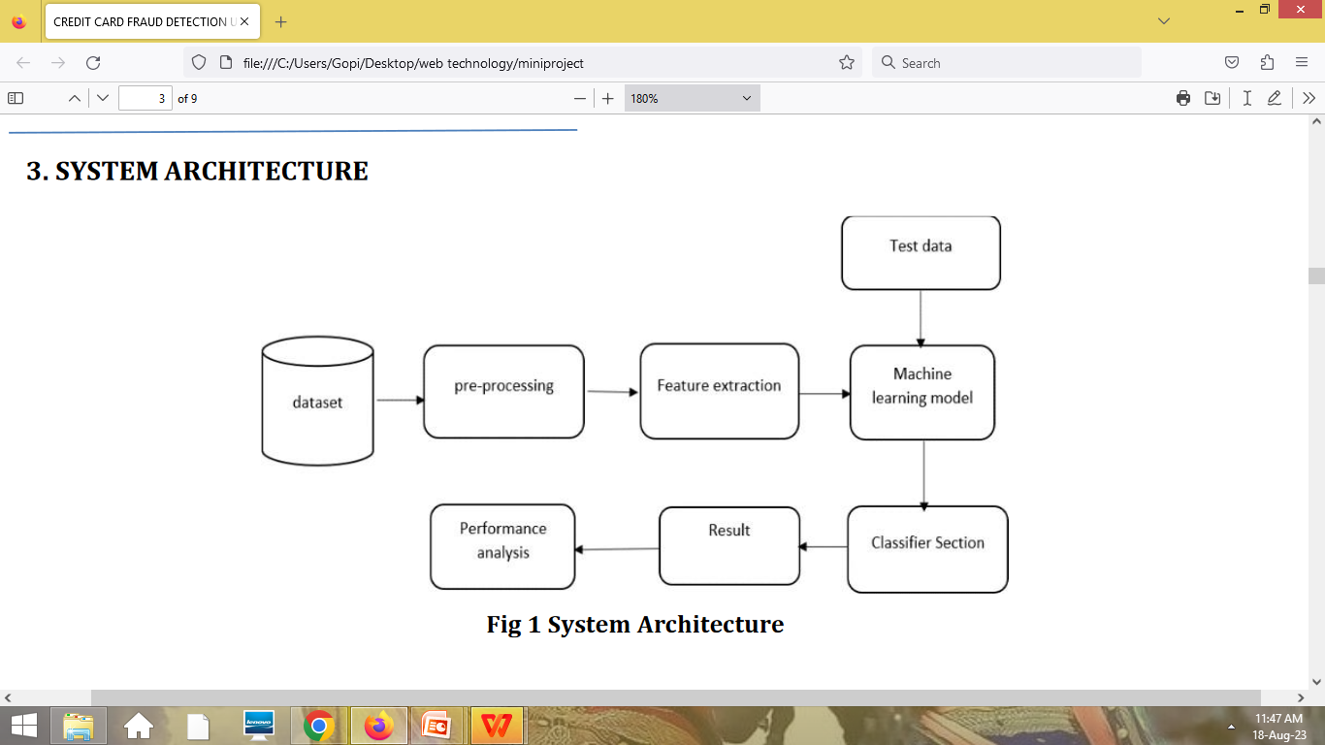
SYSTEM ARCHITECTURE
No
Yes
Start
Image Acquisition
Face Detection
Face Image?
Database
Face Identification
Data Training
Finish

Slide 14
METHODOLOGY
Our proposed methodology aims to recognize the fraudulent transactions of a financial company. We have considered a set of transactions of certain company within a certain period. The case's data is stored in a CSV file with around 2,80,000 rows and 31 columns. We imported the data from the csv file and perform some analysis on it to find certain trends. In this propose, we trained a model on transactional dataset. In this approach, the computer is trained based on the information labeled as good or bad. This fraud detection machine learning model involves predictive data analysis and its accuracy depends on the accuracy of training data.

Slide 15
PROJECT PLAN
TASK NAME | DURATION(IN WEEKS)
LITERATURE SURVEY | 1
METHODOLOGY AND DESIGN | 2
CODING | 4
IMPLEMENTATION | 3
TESTING | 2
OBSERVATION | 2

Slide 16
DESIGN
Data Collection
Remove unwanted attributes
.
Data Preprocessing
Feature Extraction
Apply Sampling techniques
Splitting dataset
Training data
Testing data
Fit the model using RandomForest
Fraud
1
Result Analysis
Perform predictions
Normal
0

Slide 17
IMPLEMENTATION
1.Install following libraries using pip
• pip install numpy
• pip install pandas
• pip install matplotlib.pyplot
• pip install seaborn
• pip install scikit-learn
• pip install joblib
• pip install imbalanced-learn

Slide 18
IMPLEMENTATION
2.Make necessary imports
from sklearn.preprocessing import StandardScaler
import matplotlib.pyplot
import seaborn
import pandas
import numpy
from sklearn.model_selection import train_test_split
from imblearn.over_sampling import SMOTE
from sklearn.ensemble import RandomForestClassifier
from sklearn.metrics import accuracy_score, precision_score, recall_score,f1_score

Slide 19
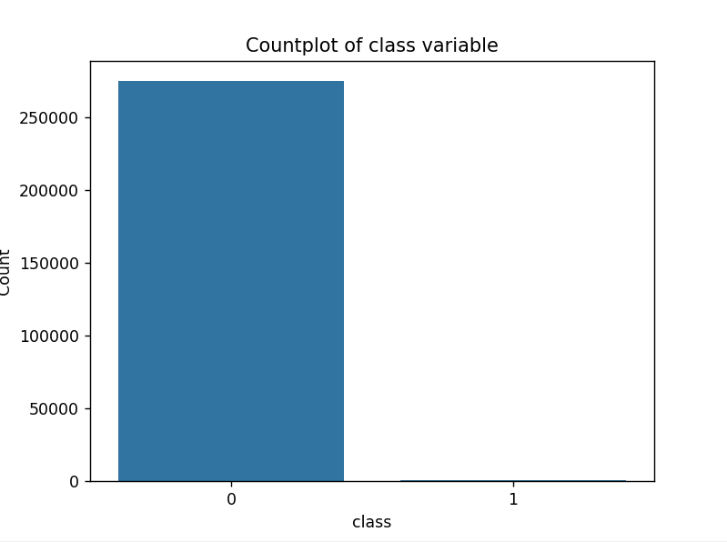
IMPLEMENTATION
3.Now lets read our dataset into a DataFrame
It is an imbalanced dataset, where the normal transactions are highly dominated over fraudulent transactions.
data=pd.read_csv('creditcard.csv')

Slide 20
IMPLEMENTATION
4.Perform preprocessing of the missing values and apply oversampling techniques to handle imbalanced data.
5.Split the dataset into training and testing datasets.
from imblearn.over_sampling import SMOTE
X_res,y_res=SMOTE().fit_resample(X,y)
Where X=data.drop('Class’,axis=1)
y=data['Class']
X_train,X_test,y_train,y_test=train_test_split(X_res,y_res,test_size=0.20,random_state=42)

Slide 21
IMPLEMENTATION
6.Now train the data using RandomForestClassifier algorithm
7.Saving the model using joblib library
model=RandomForestClassifier()
model.fit(X_res, y_res)
joblib.dump(model, 'trained_model.pkl')

Slide 22

IMPLEMENTATION
8.In a new script file, load the trained model and make the predictions using loaded model.
The metric scores results as follows:
loaded_model = joblib.load('trained_model.pkl’)
predictions = loaded_model.predict([transaction instance])

Slide 23
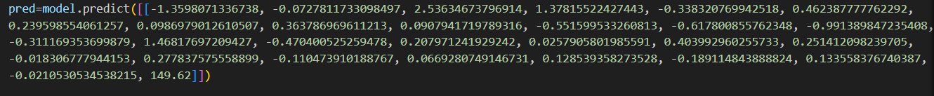
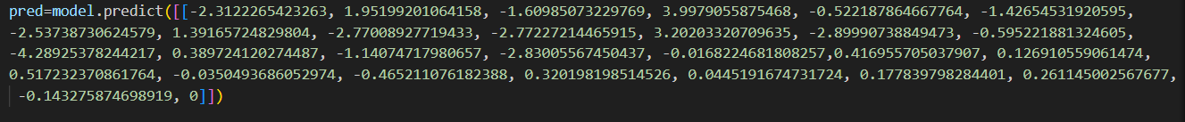
RESULT ANALYSIS
Let’s give inputs to find whether a transaction is fraud or not.
OUTPUT:
OUTPUT:

Slide 24
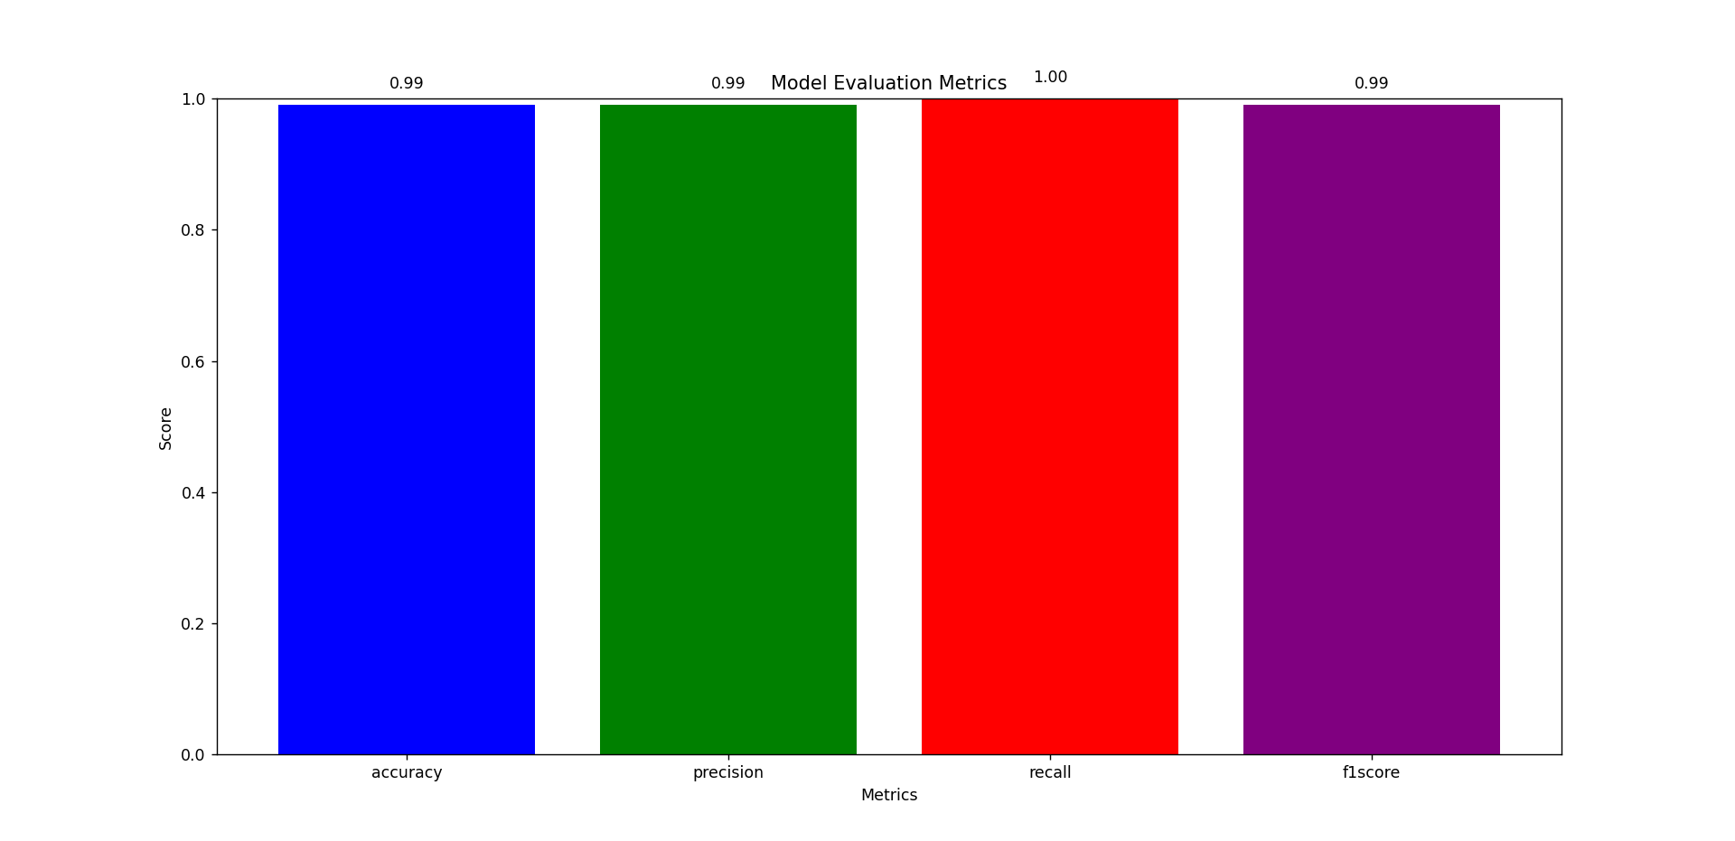
RESULT ANALYSIS
This dataset presents transactions that occurred in two days, where we have 492 frauds out of 284,807 transactions. The dataset is highly unbalanced, the positive class (frauds) account for 0.172% of all transactions.
Yet, this Random Forest model predicts the output with an accuracy score of 99.9%.
The feature ‘Class’ is the target variable which takes 1 in case of fraud and 0 otherwise.
It exhibited high precision, recall, and F1-score, which are critical for minimizing false positives and false negatives in fraud detection.

Slide 25
ATTAINMENT OF OBJECTIVE
The primary attainment objective of using a Random Forest model for financial fraud detection is to effectively and accurately identify instances of fraud within financial transactions or systems.
We attained high accuracy of 99.9% and it minimizes false positives and false negatives.
Our model is efficient and capable of processing large volumes of data.
We have used Random Forest which is a popular bagging ensemble method that uses decision trees as base models to enhance the overall performance.
It introduces randomness in the model building process, such as selecting a random subset of features for each tree and random subsets of the training data.

Slide 26
CONCLUSION
Our financial fraud detection project employing a Random Forest model offers a powerful and effective approach to mitigating financial fraud risks. The Random Forest model has proven its capability in accurately detecting financial fraud. Its ensemble learning technique combines multiple decision trees to deliver robust results, reducing both false positives and false negatives. While Random Forest models are known for their predictive power, they also offer a degree of interpretability, helping fraud investigators understand why certain transactions are flagged as potentially fraudulent. In real time, it is an ongoing process to monitor continuously emerging frauds.

Slide 27
FUTURE SCOPE OF THE PROJECT
The use of more advanced machine learning algorithms and techniques may further improve the accuracy and efficiency of fraud detection.
Implementing continuous model monitoring and adaptation strategies to detect and respond to emerging threats.
Collaborating with cybersecurity teams to address the convergence of cyber threats and financial fraud.
Exploring the use of deep learning models, such as convolutional neural networks (CNNs) and recurrent neural networks (RNNs), for fraud detection, especially in scenarios with large and complex data.
Addressing the unique challenges posed by blockchain and cryptocurrency transactions, which have become a target for fraud and money laundering.

Slide 28

.

