Slide 1
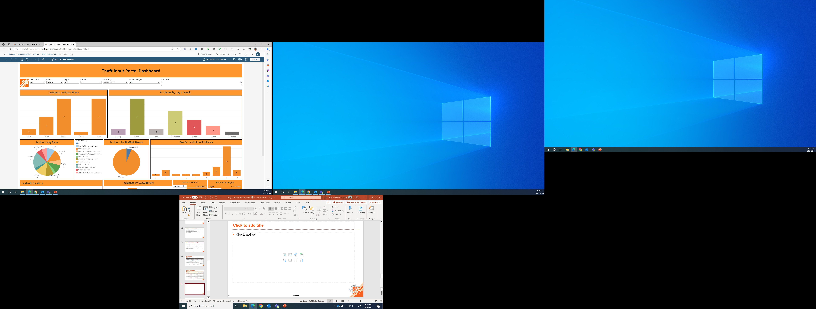
Theft Input Portal Dashboard (Sample Data)

Slide 2
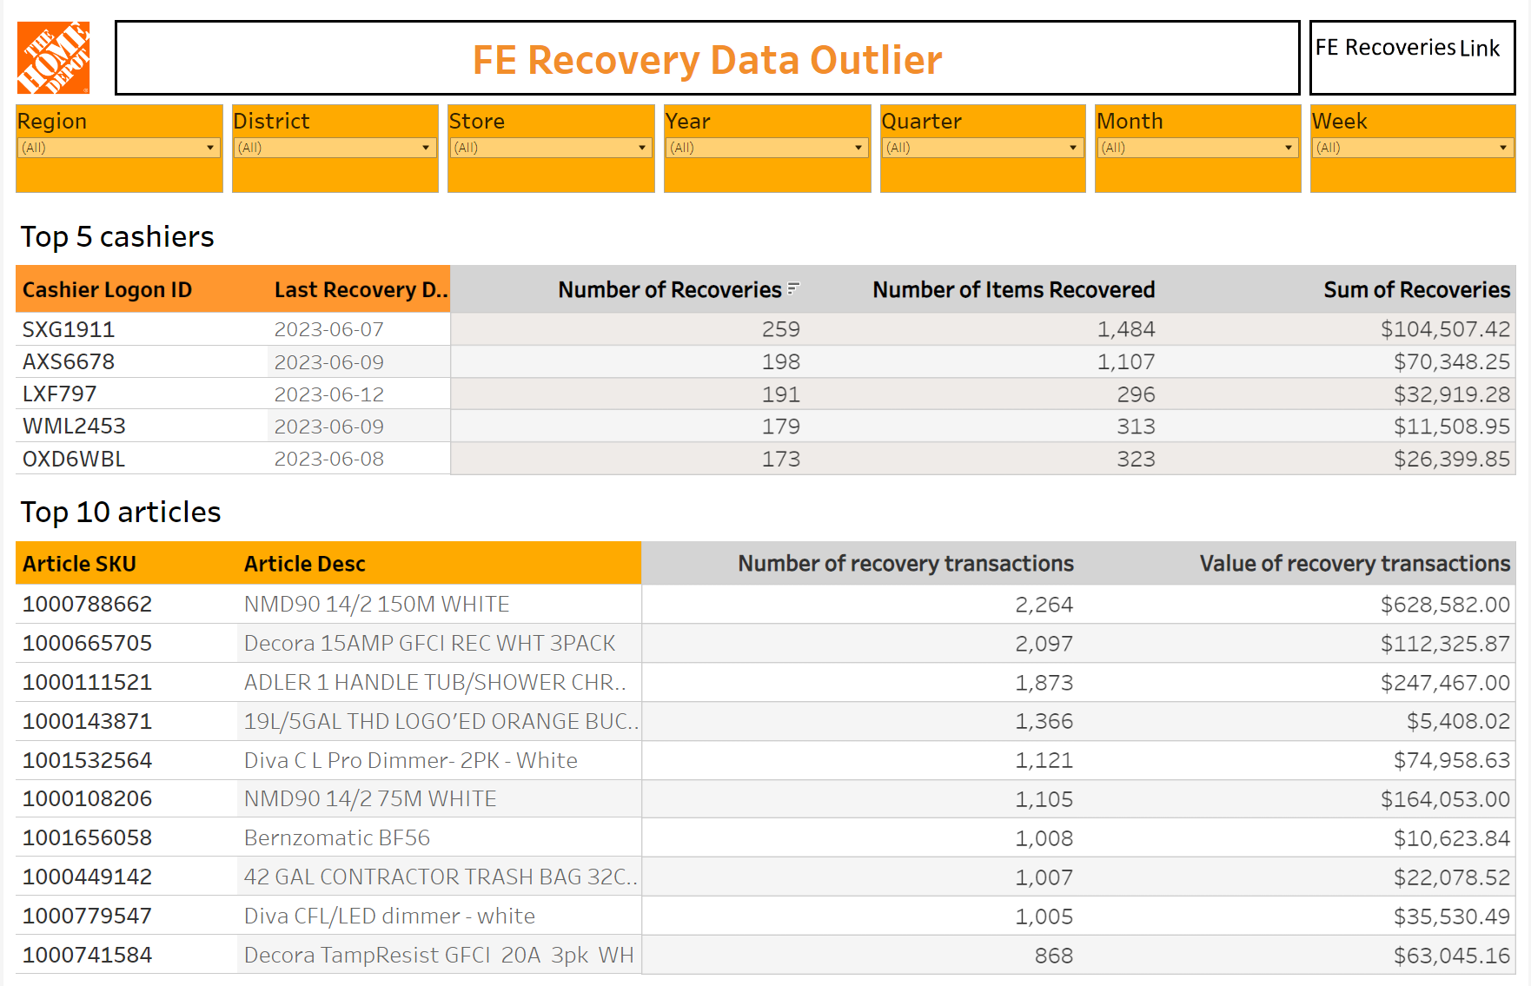
FE Recovery Data Outlier Dashboard

