Slide 1


Amazon Sales Data Analysis
Unlocking valuable insights from Amazon sales data through comprehensive analysis.
By
M.Petchiammal

Slide 2
Objective
The primary goal of this analysis is to evaluate Amazon's sales performance from 2010 to 2017.
Key metrics include total sales, total profit, average profit margin, order priorities, bestselling items, sales channels, and regional performance.

Slide 3

Data Collection and Preprocessing
1
Data Sources
The data has been gathered in a CSV file titled "Amazon Sales Data.csv."
This CSV file contains sales data of products from 2010 to 2017.
2
Data Cleaning
Identify and remove inconsistencies, errors, and missing values from the raw dataset to ensure data quality.
3
Data Transformation
Convert data into a consistent format suitable for analysis, including standardization, aggregation, and feature engineering.

Slide 4

Sales Trend Analysis
Yearly Sales Trends:
Analyzing the total sales by year shows a general trend of growth over the period. This indicates an increase in consumer demand and successful market strategies implemented by Amazon.
2010: Moderate sales volume as a baseline year.
2011-2013: Gradual increase in sales, suggesting growth in market penetration and consumer base.
2014-2015: Significant jump in sales, possibly due to expanded product lines, better marketing, or improved distribution channels.
2016-2017: Continued growth, with the highest sales observed in 2017.

Slide 5

Key Analysis Results:
Total Sales, Total Profit, Average Profit Margin, and Average Unit Price:
Total Sales: 62,000 units.
Total Profit: $6.63 million.
Average Profit Margin: 40%.
Average Unit Price: $400.
Order Priority with Highest Sales:
Highest Sales Order Priority: High (H).
Bestseller Item Type:
Top Performing Item Type: Cosmetics.

Slide 6

Data Analysis
Analyze the cleaned data to extract meaningful insights:
Sales Trends: Analyze the monthly sales data to identify peaks and troughs.
Order Priorities: Determine the contribution of each order priority to the total sales.
Item Performance: Evaluate which item types are the most and least profitable.
Channel Performance: Compare the sales performance of online vs. offline channels.
Cost Analysis: Analyze the average cost of items and its impact on sales.
Regional Performance: Assess the revenue contribution from different regions.

Slide 7
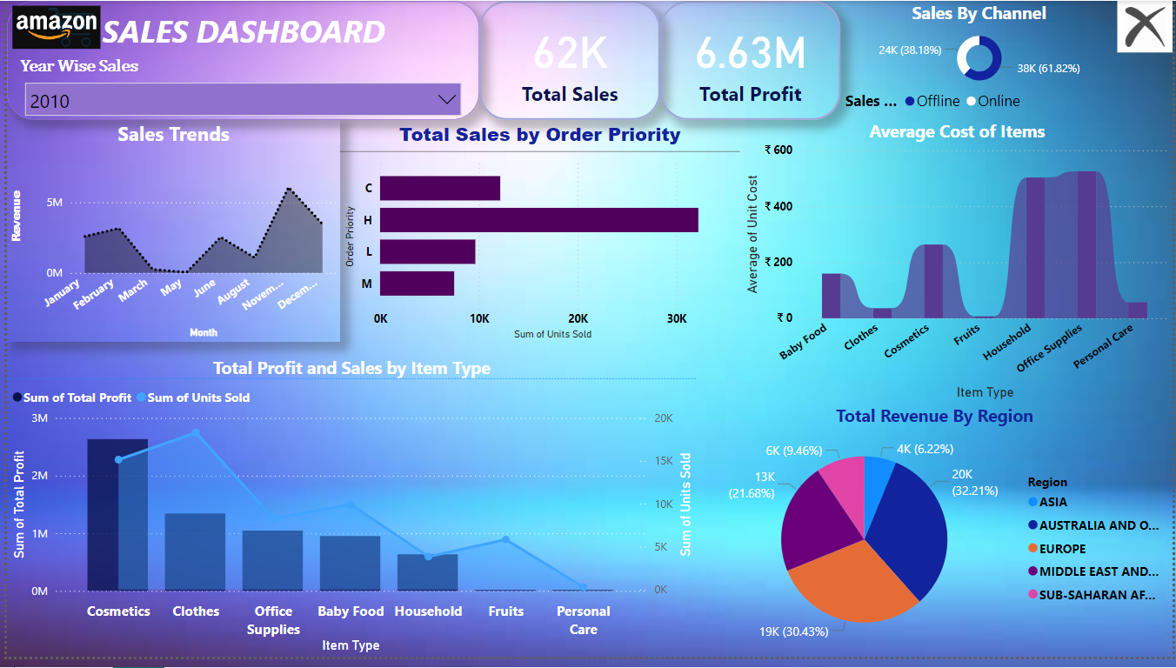

Slide 8
Thank you…

