Slide 1



EMPLOYEE ATTRITION ANALYSIS REPORT
By
M.Petchiammal

Slide 2
Problem Statement
XYZ company, established a few years ago, is experiencing a persistent 15%
attrition rate, which is significantly affecting various aspects of the business. To
understand the reasons behind employee departures and to reduce the attrition rate,
XYZ company has approached an HR analytics consultancy. As the HR analyst for
this project, you are tasked with building a dashboard to help the organization make
data-driven decisions

Slide 3
Introduction:
The purpose of this report is to analyze the employee attrition dataset to identify key factors that contribute to employees leaving the company. The dataset contains various attributes related to employee demographics, job roles, satisfaction levels, and work experience.

Slide 4
Data Overview
The dataset comprises 4,300 records and 29 columns, detailing employee information, including demographics, job roles, and satisfaction levels. Below are key descriptive statistics:
Age: Average age is 36.93 years.
Monthly Income: Average monthly income is $65,059.84.
Total Working Years: Average total working years is 11.29.
Years at Company: Average years at the company is 7.01.

Slide 5
Data Cleaning
  Missing values in columns such as Number Companies Worked, Total Working Years, Environment Satisfaction, Job Satisfaction, and Work Life Balance were addressed.
  After removing records with missing values, the dataset was reduced to 4,300 records.
  No duplicate records were found.

Slide 6
Departments:
Research & Development: 2,772 employees
Sales: 1,596 employees
Human Resources: 132 employees
Attrition:
Research & Development: 15.78%
Sales: 15.15%
Human Resources: 29.03%

Slide 7
Analysis by Demographics
Attrition by Marital Status
Single employees have a higher attrition rate compared to married employees.
1
Attrition by Age Group: Employees aged 25-34 and 35-44 have the highest attrition rates.
Attrition by Years at Company: Attrition peaks at around 1-2 years and then gradually decreases.
2
Attrition by Monthly Income: Employees with lower monthly incomes tend to have
Higher attrition rates.
Attrition by Job Satisfaction: Employees with lower job satisfaction ratings have
higher attrition rates.
3

Slide 8
Data Analysis
The analysis was conducted using Power BI and Python to explore the relationships between various factors and employee attrition. Key metrics and visualizations were created to aid in understanding the data. Here are some of the primary analyses performed:
Descriptive Statistics:
  Summary statistics for numerical variables such as age, monthly income, and total working years.
  Frequency distributions for categorical variables such as job role, marital status, and attrition status.

Slide 9
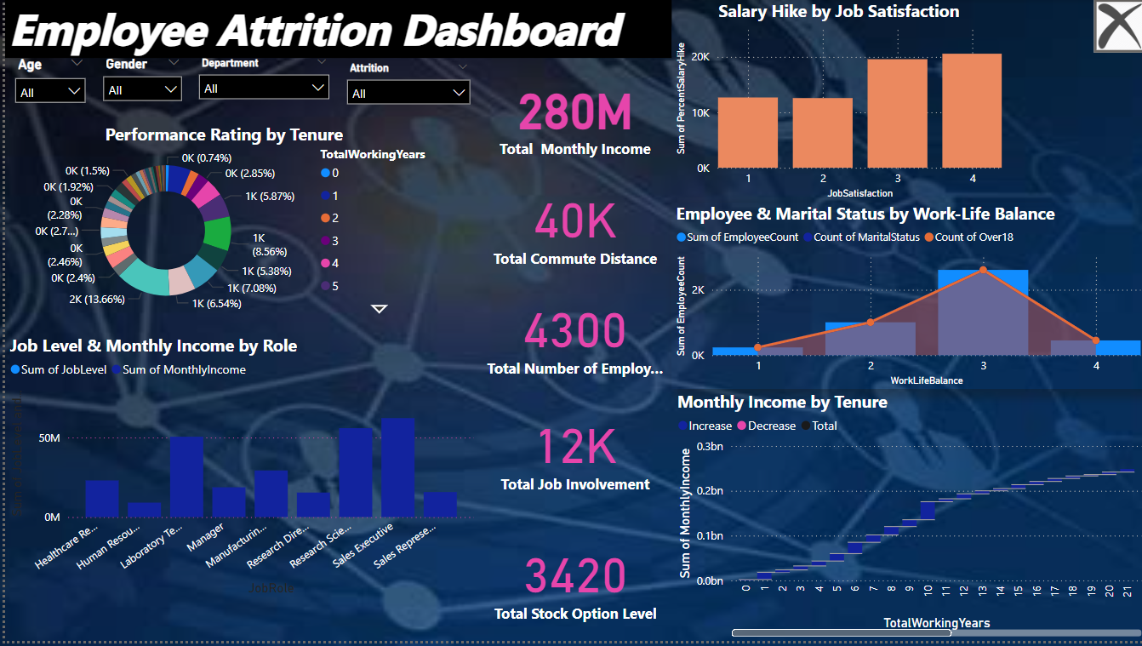

Slide 10
THANK YOU…

