Slide 1
Classification into high/low income categories
INSOFE Batch 39 CUTe No. 2
Group 5:
Revathi Gunasekaran
Yateesh Sugur
Kunal Ray

Slide 2
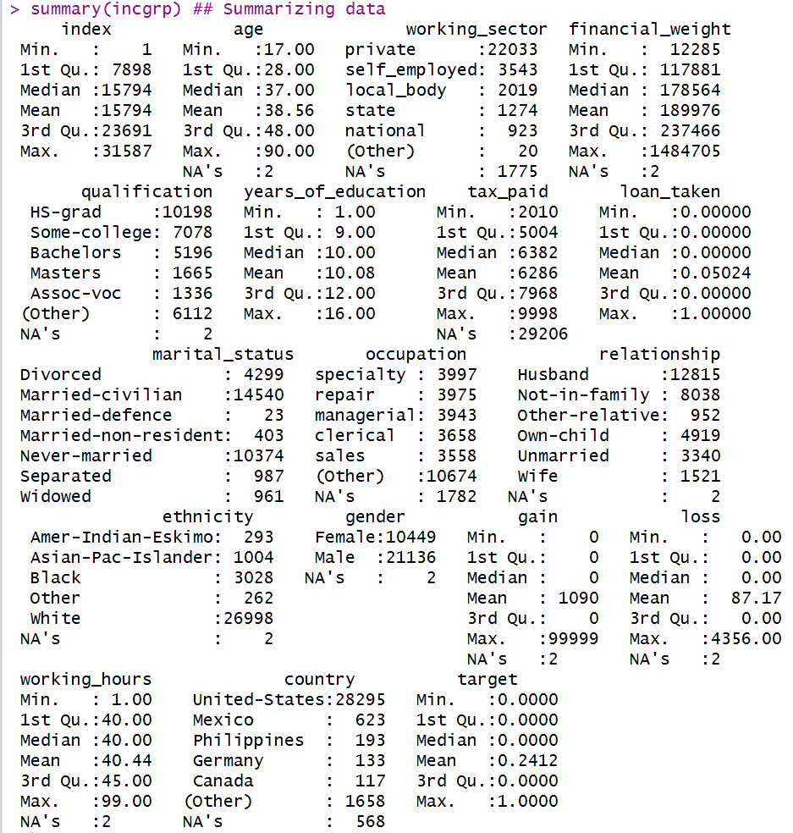
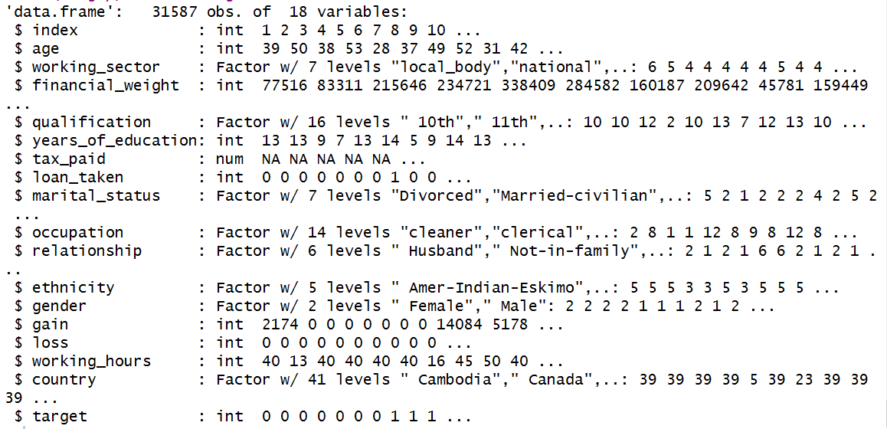
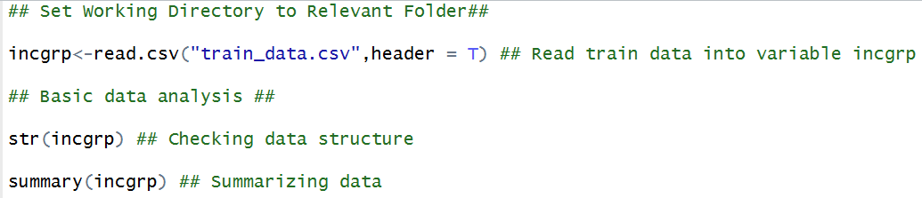
Data description
Data Provided
File No. 1 – train_data.csv: Model Training Data with 31587 Rows x 18 Columns
File No. 2 – test_data.csv: Holdout data with 976 Rows x 17 Columns (minus target variable)

Slide 3
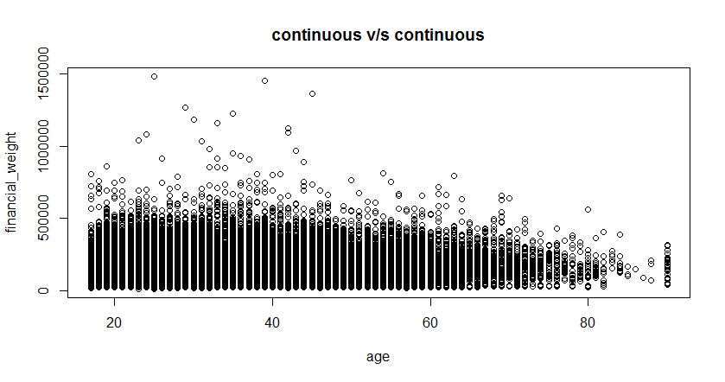
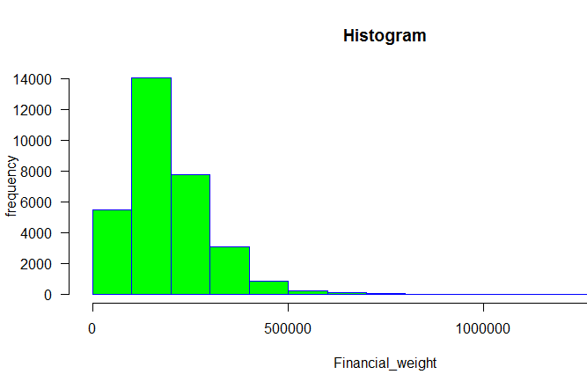
Data observations
Several cuts of base data were visualized.
It was attempted that learnings from these visualizations were incorporated during model building.

Slide 4
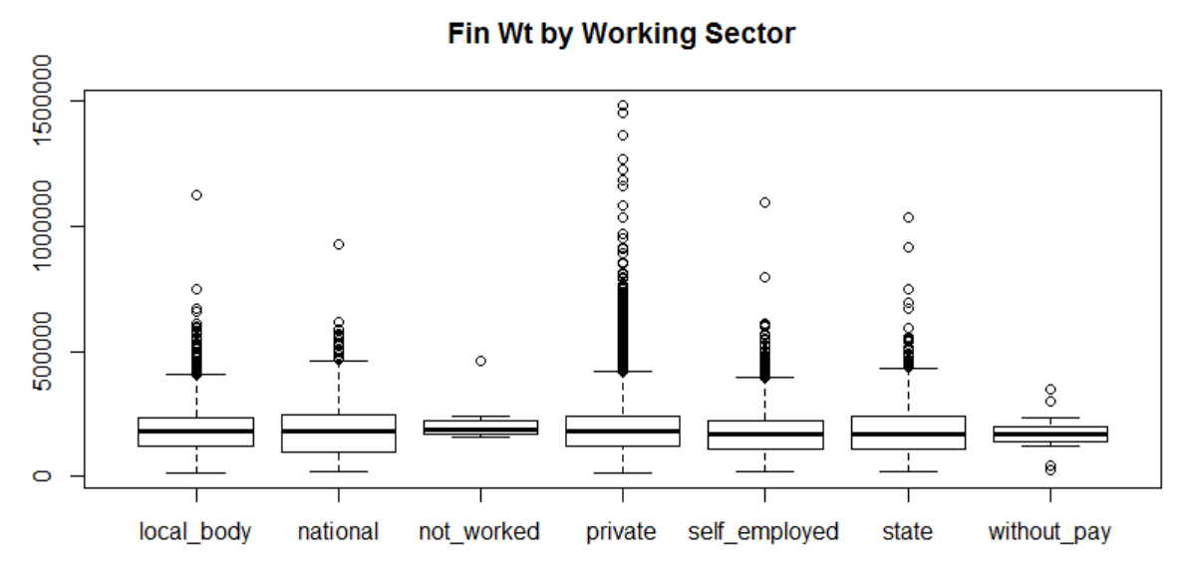
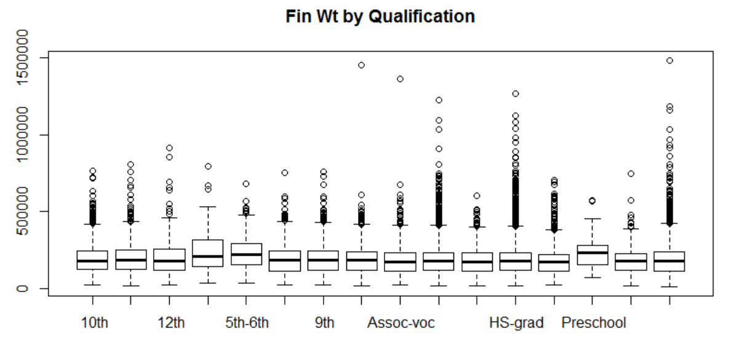
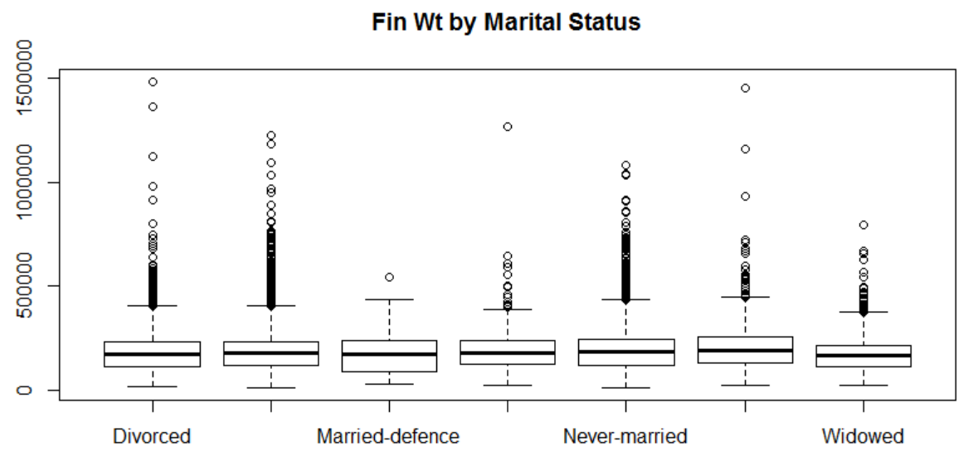
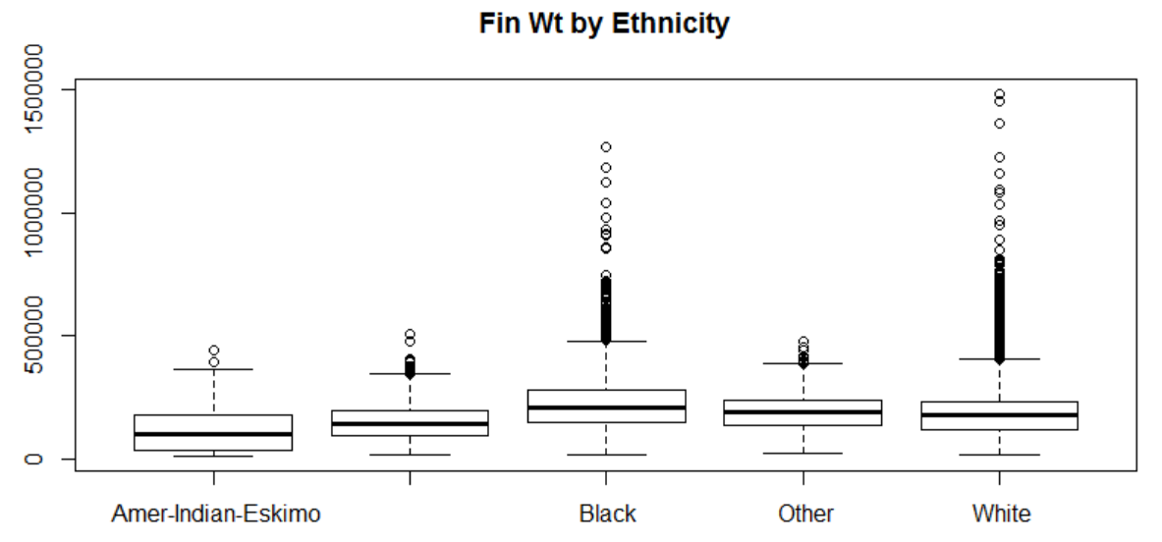
Data observations contd.

Slide 5
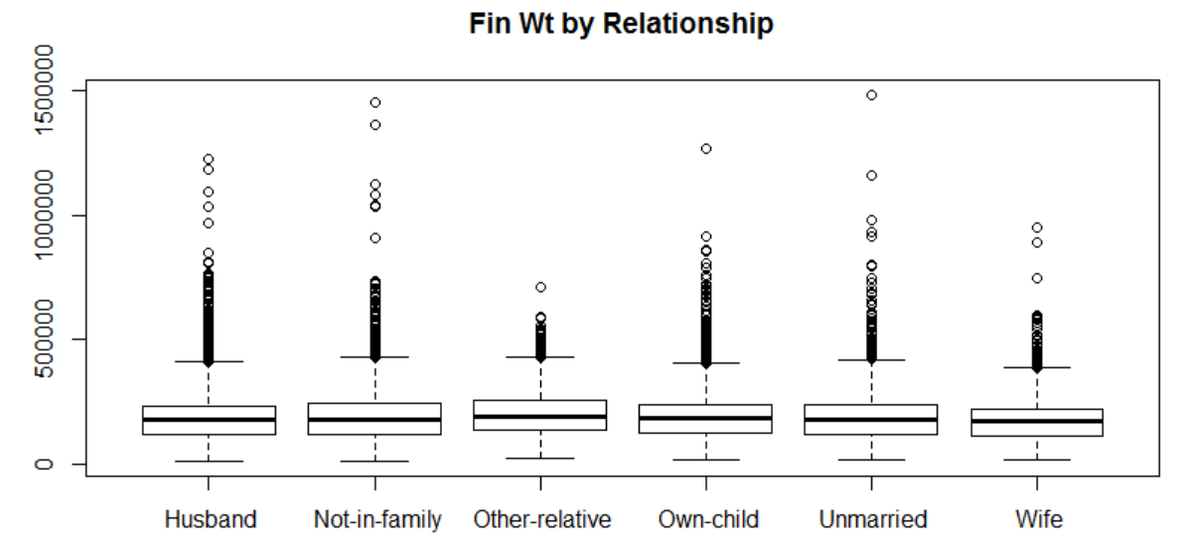
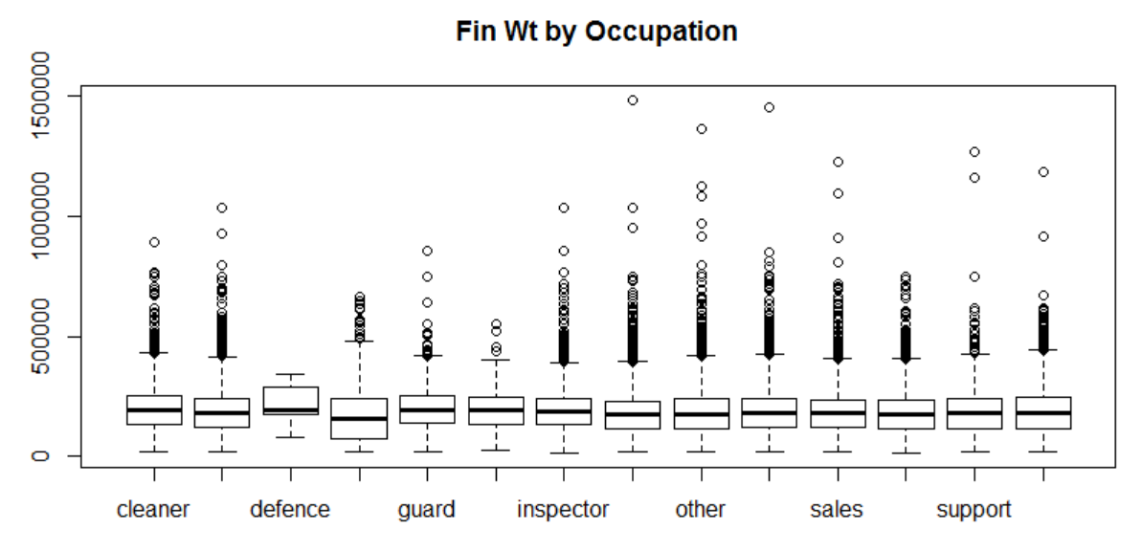
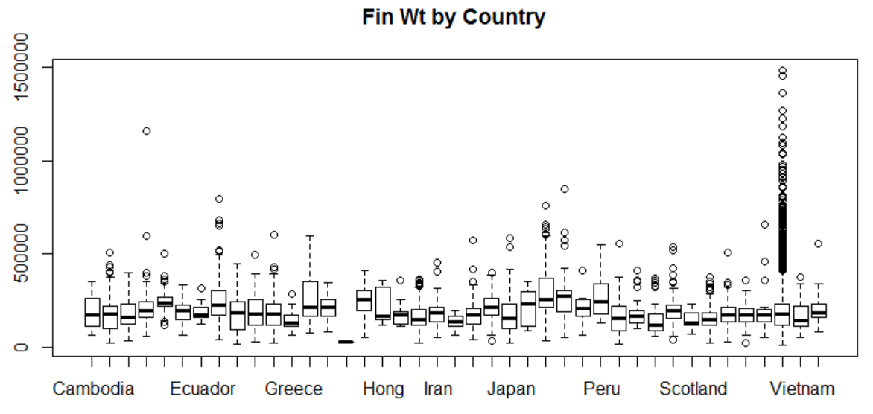
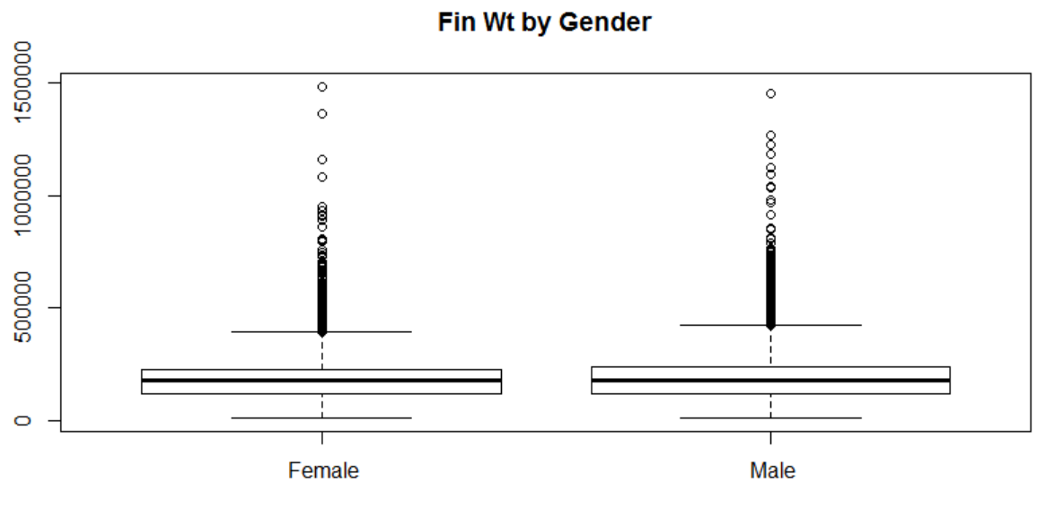
Data observations contd.

Slide 6
Pre – processing

Slide 7
Preliminary observations & changes
1. Attribute ‘loan_taken’ is considered an integer. Should be transformed into factor.
2. Attribute ‘tax_paid’ has 92.4% NA values. Can be removed.
3. Attribute ‘index’ is unique. Can be moved to ‘rownames’.
Remaining data on train has 31587 rows x 16 columns

Slide 8
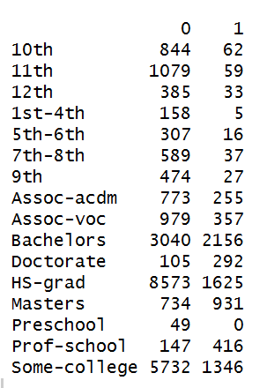
grouping levels – qualification
16 levels to be reduced to 8
Order of education level - Preschool < 1st-4th < 5th-6th < 7th-8th < 9th < 10th < 11th < 12th < HS-grad < Prof-school < Assoc-acdm < Assoc-voc < Some-college < Bachelors < Masters < Doctorate
Levels with similar proportion of target variable may be clubbed together.
LeftStudy – Preschool, 1st – 4th, 5th – 6th, 7th – 8th, 9th, 10th, 11th, 12th.
Associate – Assoc-acdm, Assoc-voc.

Slide 9
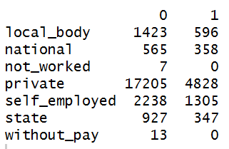
grouping levels – working sector
7 levels to be reduced to 6
Levels with similar proportion of target variable may be clubbed together.
‘without_pay’ can be merged into ‘not_worked’ since they show similar behavior.

Slide 10
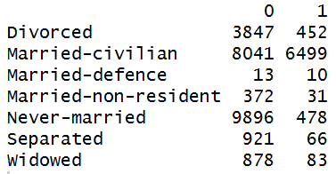
Grouping levels – marital status
7 levels to be reduced to 5
Levels with similar proportion of target variable may be clubbed together.
Married – Resident : Married-civilian, Married-defence.
‘Widowed’ may be combined with ‘Separated’.

Slide 11
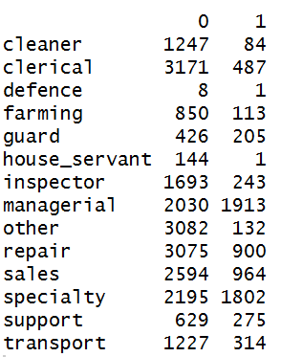
Grouping levels – occupation
14 levels to be reduced to 6
Levels with similar proportion of target variable may be clubbed together.
Lowest – cleaner, house-servant, other
Low – clerical, defence, farming, inspector
Lower mid – sales
Mid – repair, transport
Upper mid – guard, support
Upper – managerial, specialty

Slide 12
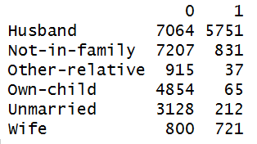
Grouping levels – relationship
6 levels to be reduced to 2
Levels with similar proportion of target variable may be clubbed together.
Spouse – Husband, Wife
Other – Not-in-family, Other-relative, Own-child, Unmarried

Slide 13
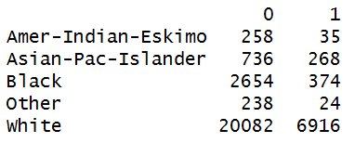
Grouping levels – ethnicity
5 levels to be reduced to 2
Levels with similar proportion of target variable may be clubbed together.
Bk – Amer-Indian-Eskimo, Black, Other
Wh – Asian-Pac-Islander, White

Slide 14
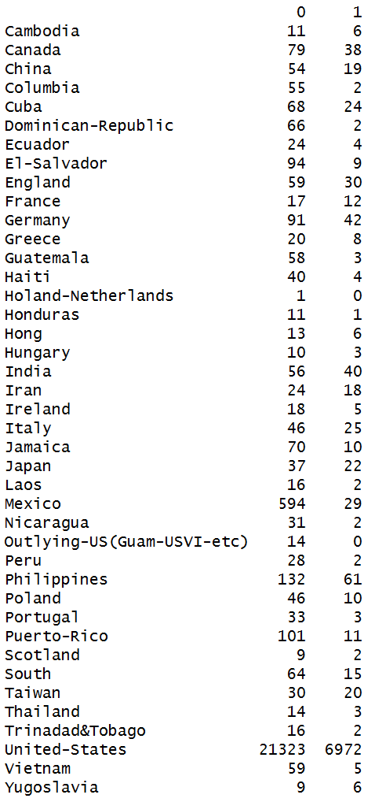
Grouping levels – country
41 levels to be reduced to 5
Levels with similar proportion of target variables may be clubbed together.
Very low – Columbia, Dominican-Republic, El-Salvador, Guatemala, Haiti, Holand-Netherlands, Honduras, Jamaica, Laos, Mexico, Nicaragua, Outlying-US-(Guam-USVI-etc), Peru, Portugal, Puerto-Rico, Trinidad&Tobago, Vietnam
Low – Ecuador, Hungary, Ireland, Poland, Scotland, South, Thailand
Medium – China, Cuba, Greece, United-States
High – Cambodia, Canada, England, Germany, Hong, Italy, Japan, Philippines
Very High – France, India, Iran, Taiwan, Yugoslavia

Slide 15
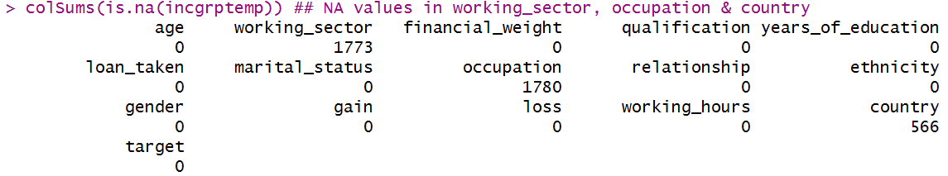
Missing value imputation
The Function ManyNAs returns 2 rows with high number of NA values across columns. These two rows may be removed.
Doing KNN imputation to remove missing values in working_sector, occupation & country.

Slide 16
Model Building

Slide 17
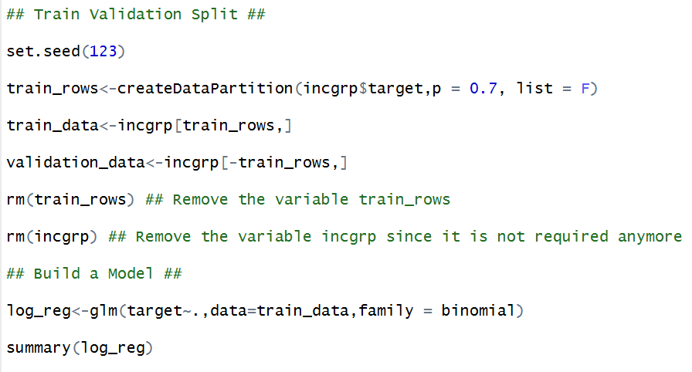
TRAIN Validation SPLIT & Model Building

Slide 18
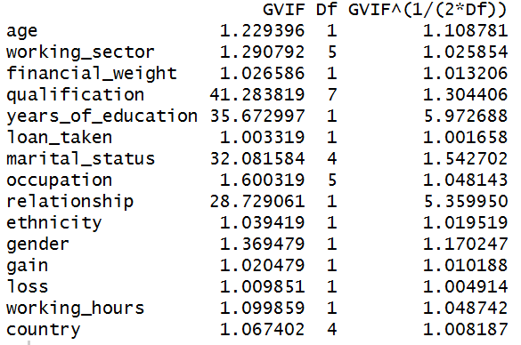
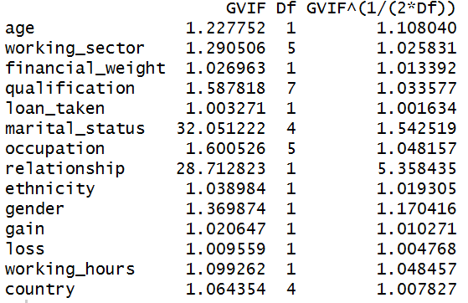
Collinearity & model iterations
1
2

Slide 19
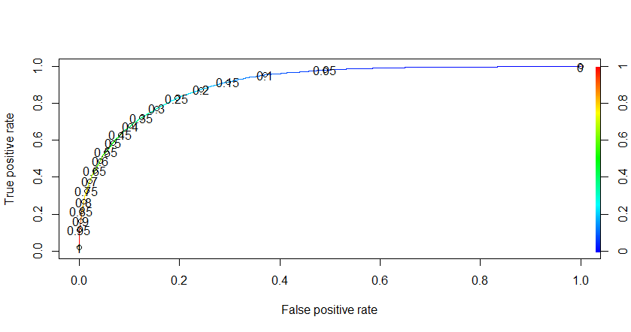
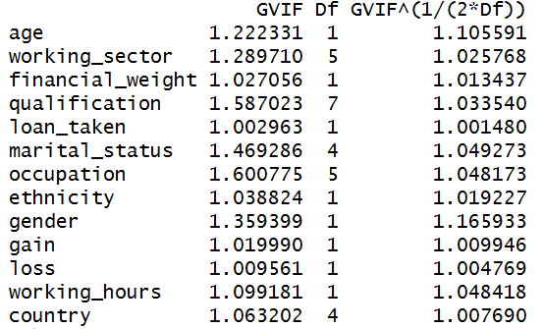
Final model & Performance
3
All adjusted GVIFs look good. AUC is calculated at 0.902

Slide 20
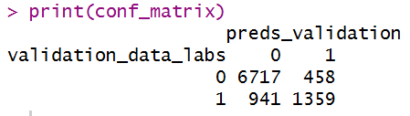
Model performance on validation
Choosing threshold value 0.5 gives maximum accuracy on validation
Sensitivity = TP/AP = 0.59
Specificity = TN/AN = 0.93
Accuracy = 0.8523 on Validation

Slide 21
Final testing

Slide 22
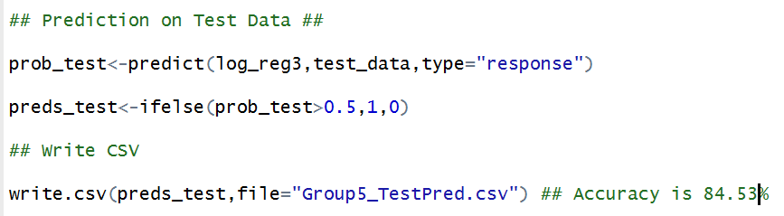
Model performance on holdout data
Complete all pre – processing steps on test data as performed on train & validation.
Final reported accuracy on test is 84.53%

