Slide 1




Presented by Jani Revathi
IPL Data
Analysis Using POWERBI
Data Analyst Internship
By Mentorness

Slide 2









Introduction
The goal of this Power BI project is to analyse IPL (Indian Premier League) cricket data to gain insights
into team and player performance, match outcomes, and various key metrics related to both batting
and bowling. The analysis will be carried out using data from multiple related tables, providing a
comprehensive view of the tournament's dynamics.

Slide 3
Datasets
Fact Bowling
▪ match_id: Unique identifier for the match.
▪ match: Description or name of the match.
▪ bowlingTeam: Name of the team that is bowling.
▪ bowlerName: Name of the bowler.
▪ overs: Number of overs bowled by the bowler.
▪ maiden: Number of maiden overs bowled.
▪ runs: Runs conceded by the bowler.
▪ wickets: Wickets taken by the bowler.
▪ economy: Economy rate of the bowler.
▪ 0s: Number of dot balls bowled.
▪ 4s: Number of fours conceded.
▪ 6s: Number of sixes conceded.
▪ wides: Number of wide balls bowled.
▪ noBalls: Number of no balls bowled.
Fact Batting Summary
▪ match_id: Unique identifier for the match.
▪ match: Description or name of the match.
▪ teamInnings: The team batting in the innings.
▪ battingPos: Batting position of the player.
▪ batsmanName: Name of the batsman.
▪ out/not_out: Whether the batsman was out or not out.
▪ runs: Runs scored by the batsman.
▪ balls: Balls faced by the batsman.
▪ 4s: Number of fours hit.
▪ 6s: Number of sixes hit.
▪ SR: Strike rate of the batsman.

Slide 4
Datasets
Dim Player
▪ name: Name of the player.
▪ team: Team the player belongs to.
▪ battingStyle: Batting style of the player
(e.g., Right-hand bat).
▪ bowlingStyle: Bowling style of the player
(e.g., Right-arm fast).
▪ playingRole: Role of the player
(e.g., Batsman, Bowler).
Dim Match Summary
▪ team1: Name of the first team.
▪ team2: Name of the second team.
▪ winner: Winner of the match.
▪ margin: Margin of victory.
▪ matchDate: Date of the match.
▪ match_id: Unique identifier for the match.

Slide 5


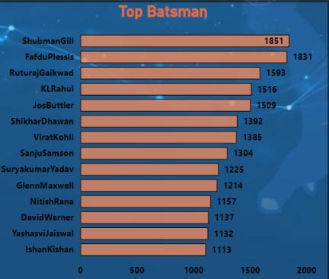

Top Batsman
The IPL Data Analysis dashboard highlights the exceptional performances of the top batsmen in the league, showcasing their impressive run-scoring abilities.
Leading the pack is Shubman Gill, who amassed a remarkable 1,851 runs, demonstrating his consistency and prowess at the crease.
Closely following him is Faf du Plessis, with an impressive 1831 runs, underscoring his vital role as a top-order batsman.

Slide 6

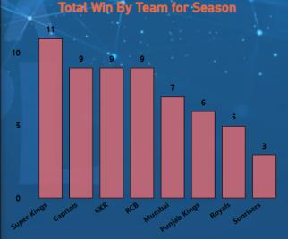
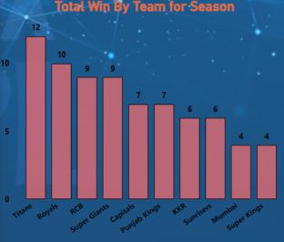
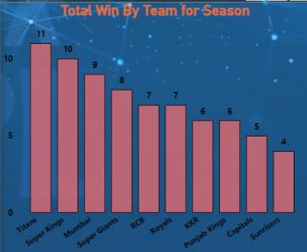
Total Wins Based Upon Year
2021
2022
2023
Leading the tally are the Royal Challengers Bangalore (RCB) and the Super Kings, each securing an impressive 25 wins.

Slide 7
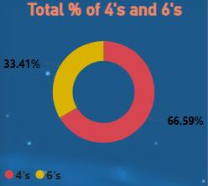
Matches Win by 4’s and 6’s
The distribution between 4's and 6's illustrates a balanced approach in the IPL, where batsmen have effectively combined safe boundary hitting with aggressive, power-packed shots. While the majority of scoring came from 4's, the substantial proportion of 6's reflects the importance of power hitting in the modern T20 game, enabling teams to capitalize on scoring opportunities and maintain a high run rate.

Slide 8
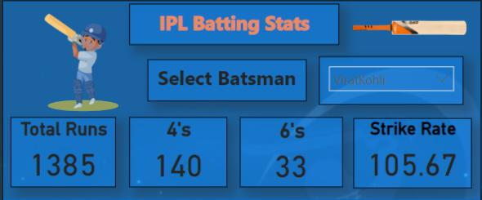
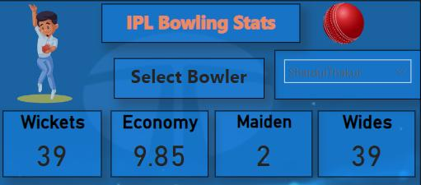
BEST BATSMAN
BEST
BOWLER

Slide 9
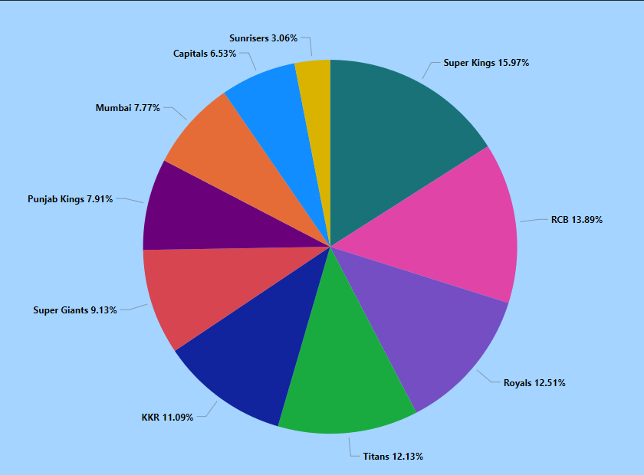
Winning Percentage by Team
Leading the chart are the Super Kings, with a commanding winning percentage of 15.97%. This statistic underscores their consistent excellence and strategic superiority, making them a formidable force in the league.
These winning percentages provide highlight the strengths and areas where each team has excelled, offering valuable insights for fans, analysts, and the teams themselves as they prepare for future competitions.

Slide 10
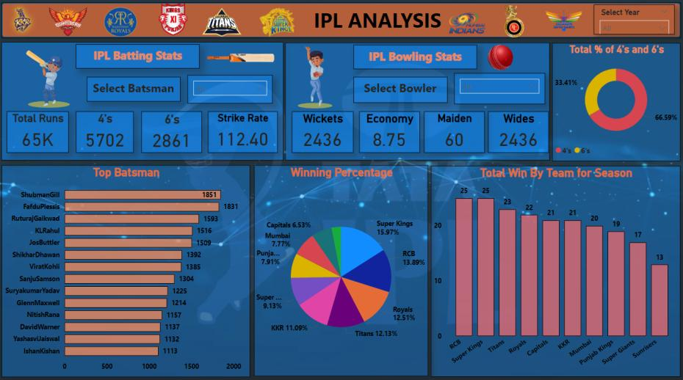
DASHBOARD

Slide 11
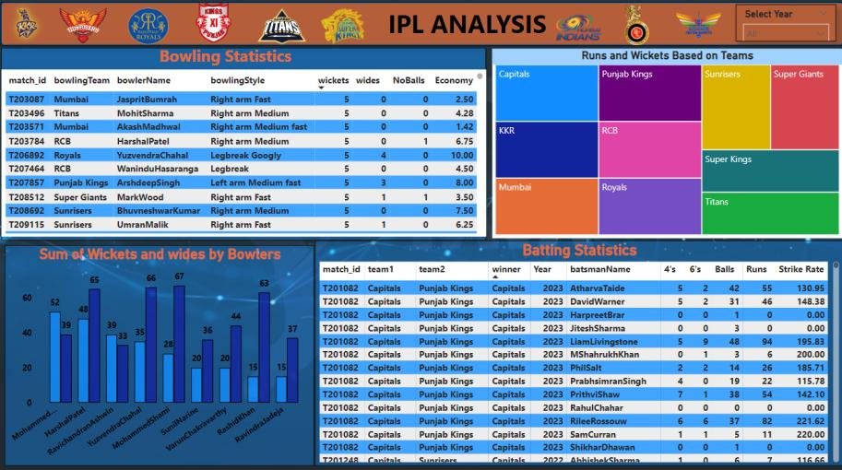
DASHBOARD

Slide 12
Thank
You

