Slide 1
Robust Image Classification
A Deep Learning Approach on the CIFAR-10 Dataset
TensorFlow 2.19 · Keras 3.13 · Google Colab T4 GPU · Python 3.12
Module : Applied Data Science 2
Student Name: Revathi Sivasankaran
Student ID : 4371ORRN
Lecturer : Kim Siong Wong
Github Link: https://github.com/revathisankar44-SAUI/CIFAR10-Deep-Learning
78.39%
79.01%
0.9785
2.5×
CNN Test Accuracy
CNN Best Val Accuracy
CNN Macro AUC
Imbalance Ratio

Slide 2
Project Objective
Objectives
Project Pipeline
01
Design & Train a CNN
Data Ingestion
1
Design, train, and evaluate a Convolutional Neural Network (CNN) for multi-class image classification on the CIFAR-10 benchmark dataset.
keras.datasets.cifar10
50,000 train · 10,000 test images
02
Fixed-Floor Sampling
2
Fixed-Floor Processing
Implement controlled inverse-accuracy sampling: 2,000 floor – 5,000 ceiling, ensuring stable gradient updates across all 10 target classes.
Inverse-accuracy sampling · 2k floor/5k ceiling
30,300 images · ratio 2.5×
03
Comparative Evaluation
3
CNN Training
Quantitatively compare CNN against a fully-connected baseline, demonstrating the advantage of spatial feature learning (76.29% vs 28.00%).
3-block CNN · BatchNorm · Dropout
class_weight · Adam · EarlyStopping
04
Full TensorFlow Workflow
4
Evaluation
Demonstrate a complete deep learning pipeline: EDA → imbalance design → preprocessing → augmentation → callbacks → evaluation — meeting assignment LOs.
Classification report · ROC/AUC
Confusion matrix · 76.29% test accuracy

Slide 3
CIFAR-10 Dataset Overview
The original CIFAR-10 datset contains 60,000 images with ten object classes.
The ten Classes are Airplane, Automobile, bird, cat, deer, dog, frog, horse, ship and truck.
Of the 60,000 images, 50,000 (5,000 for each class) is for training and 10,000 is for testing.
To identify the difference the images per class was deliberately changed as to each class is different training images.

Slide 4
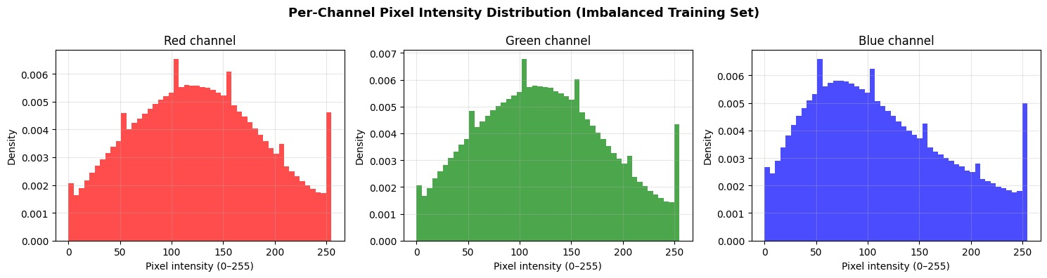
Pixel Statistics and Normalization
Raw statistics on R, G, B is X_train: mean = 125.64, 122.35, 112.24 and a standard deviation of 62.71, 61.75, 66.03 with pixel range.
Visualized using a histogram to verify there are no imbalance in pixel distribution.
Normalization is used to rescale images to a standard that can be used to train the model i.e all images in a particular uniform size and quality so that difference in the sample for each class does not affect the model learning.

Slide 5
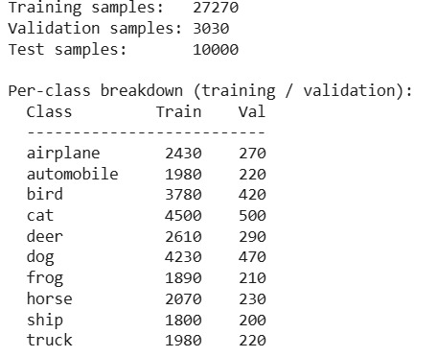
Train, Validation and Test Split
90% of the dataset is used forI training and 10% is used for validation of the initial 30,300 train dataset i.e 27,270 images for training the models and 3030 for validation .
The split is created in a way that this class does not affect the training models based on the classes
The test samples are kept as is i.e 10000 samples.

Slide 6
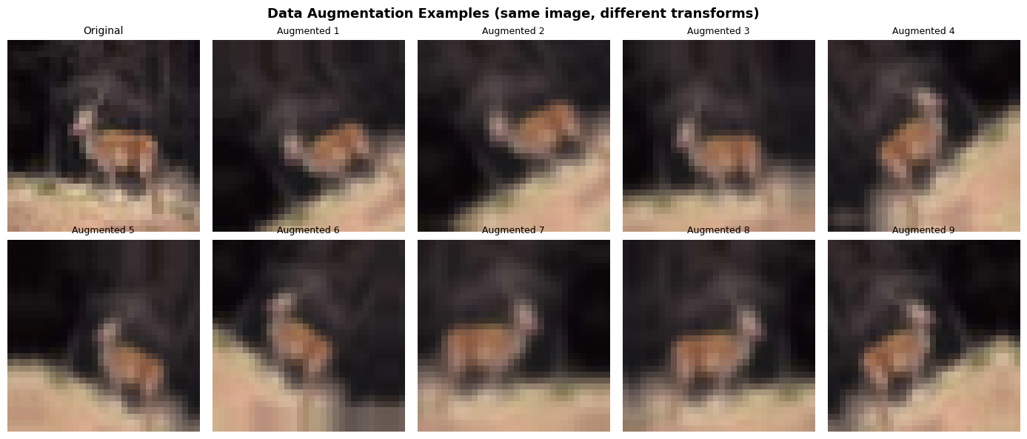
Data Augmentation:
Data Augmentation is utilized to generalize the dataset better and reduce overfitting thereby increasing the quality of the model and generalise better.
Augmentation is done using keras sequential layer and the types of Augmentation implemented are random horiazontal flip,rotation, zoom and translation.
This layer is directly integrated to CNN model graph so the model learns during the training.
Multiple examples of the augmented variants of the same image is shown in the image.

Slide 7
Baseline and CNN Architecture
Baseline dense model: Flatten → Dense 512 + Dropout 0.3 → Dense 256 + Dropout 0.3 → Dense 10 softmax, about 1.7M trainable parameters.
CNN model: three Conv–BatchNorm–Conv–BatchNorm–MaxPooling–Dropout blocks (32, 64, 128 filters) followed by GlobalAveragePooling2D → Dense 256 + Dropout 0.5 → Dense 10 softmax.
Despite having only ~325K parameters, the CNN exploits spatial inductive bias and in‑graph augmentation, unlike the fully connected baseline

Slide 8
Training Configurations & Callbacks
Both models uses adam (learning rate 0.001), sparse categorical cross-entropy and track accuracy as the main metrics.
EarlyStopping ,ModelCheckpoint, ReduceLROnPlateau and CSVLogger are configured for each model to ensure proper learning.
CNN learning time is longer to allow deeper architecture more time to learn using Augmentation.

Slide 9
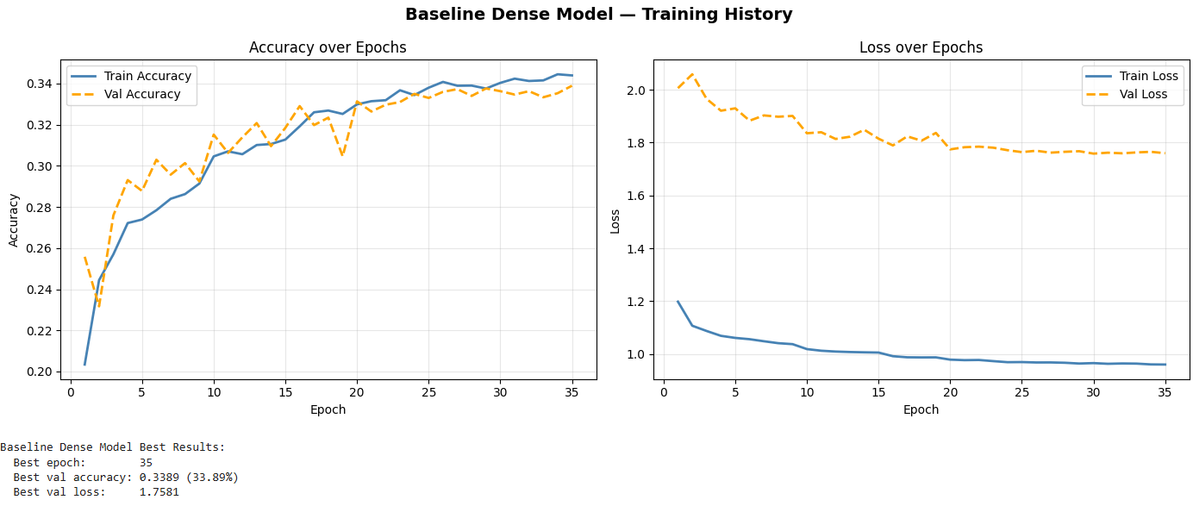
Training Outcomes : Baseline
Baseline trained for 35 epochs before Early Stopping stopped the training as the best results are from epochs 30.
Validation loss comes around 1.7581 with accuracy at 33.89% even while using imbalanced sampling and class weights.
This shows that purely dense baseline architecture is unable to use the 32*32 image structure efficienty.

Slide 10
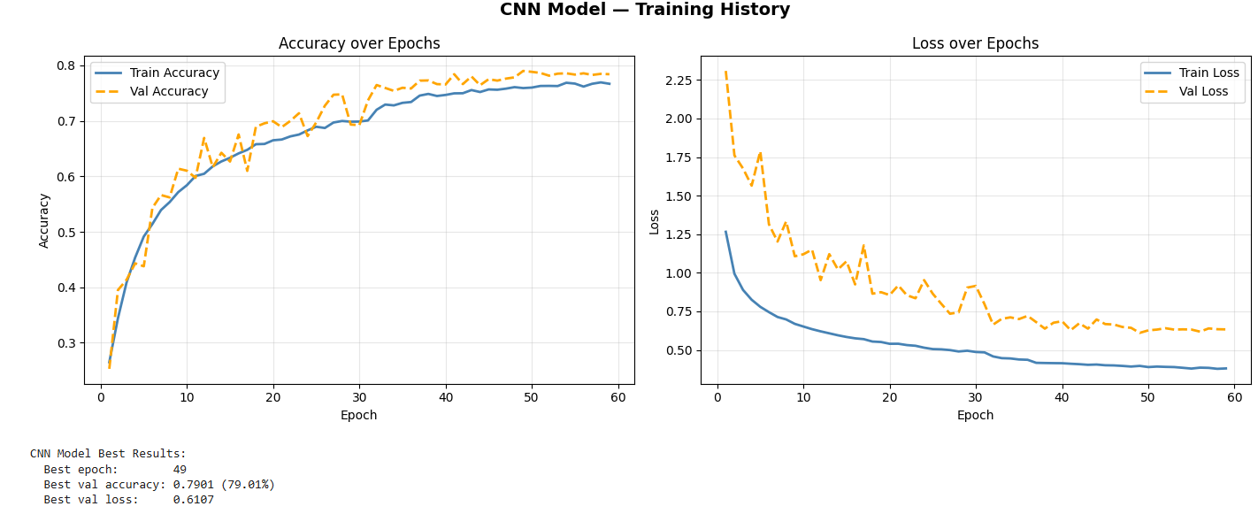
Training Outcomes : CNN
CNN trains around 59 epochs with ReduceLROnPlateau lowering learning rate as val_loss plateaus i.e loss stops getting lower.
The best validation loss is =0.6107 at epoch 49 and validation accuracy of 0.7901 i.e, 79.01%.
Reative to the dense baseline, the CNN achieves substantially higher accuracy and lower loss on the same imbalanced subset and weights.

Slide 11
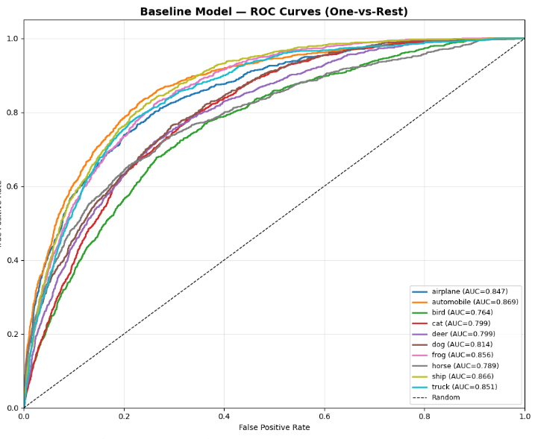
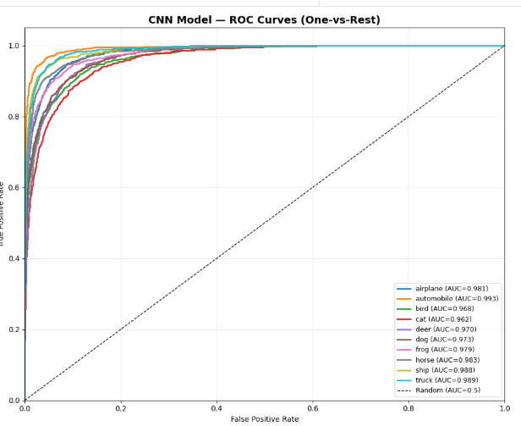
Comparison of ROC
The ROC comparison between Baseline and CNN shows the difference between a simple baseline dense model that struggles to identify differences between classes while the CNN model that demonstrates greater identification over classes proving its ability to learn and identify distinct features on the classes even with not exact amount of data on each class.

Slide 12
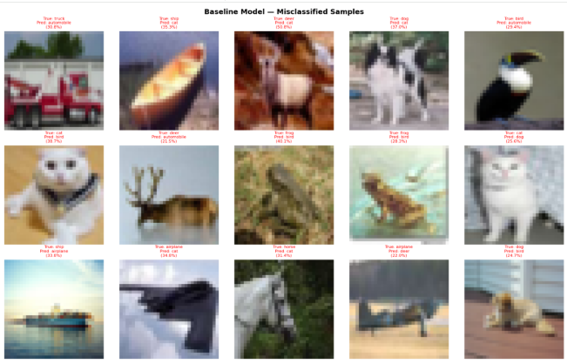
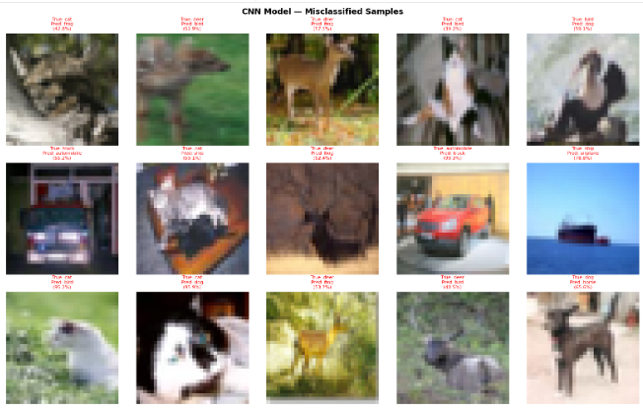
Misclassified Samples Comparison
Baseline model Misclassified:7162 / 10000 (71.62%).
CNN Model Misclassified: 2161 / 10000 (21.61%).
This comparison shows how the CNN model is better than the baseline dense model and the accuracy of the CNN model even with imbalanced training imagedatasets.

Slide 13
Conclusion:
The comparison between Baseline Dense model and CNN model are as clear as day and night as CNN clearly outperforms Baseline model on all fronts and classes.
Even with the same dataset, weights and limitations CNN outperforms baseline model with baseline model has a val_accuracy of 33.89% and CNN with val_accurcy of 79.01% which is a difference of 45.12%.
A validation accuracy of 33.89% is worse than random guessing, while 79.01% demonstrates strong performance. With a fully balanced training dataset, this CNN architecture can realistically reach above 85% accuracy."

