Slide 1

Amazon Product Reviews
Multi-Class Sentiment Analysis and Topic Modelling
Dataset Link : https://www.kaggle.com/datasets/cynthiarempel/amazon-us-customer-reviews-dataset
Presented by
Revathi Sivasankaran
4371ORRN

Slide 2
Project Overview
Background
Why It Matters
E-commerce platforms receive millions of customer reviews daily, making manual analysis impossible.
This project uses Machine Learning and NLP to:
• Classify review sentiment (1–5 stars)
• Extract dominant product topics
• Score review quality & helpfulness
• Detect low-quality or misleading reviews
Boost product quality
Turn millions of reviews into quality insights
Fix key issues
Identify delivery, pricing & usability problems
Detect fake reviews
Flag misleading or low-quality content
Drive decisions
Actionable insights for e-commerce teams

Slide 3
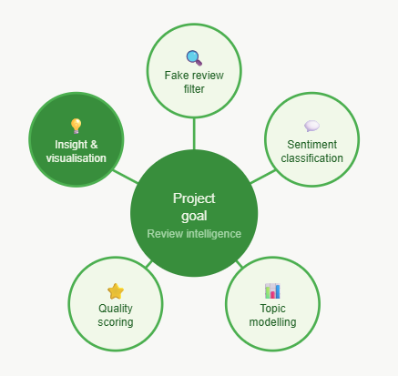
Research Question
How effectively can machine learning and NLP techniques extract customer sentiment, identify key discussion topics, and assess the quality and authenticity of Amazon product reviews to generate actionable insights for e-commerce decision-making?

Slide 4
Quality Scoring Quality Scoring
Project Objectives
Fake Review Filter
Sentiment Classification
Topic Modelling
Build a multi-signal filter using verified purchase status, sentiment-rating consistency, linguistic patterns.
Develop & compare LR, Random Forest, and DistilBERT classifiers targeting ≥85% accuracy for 1–5star ratings.
Identify 5–10 dominant topics using LDA & BERTopic: product quality, delivery, pricing, and usability.
Quality Scoring
Insight & Visualization
Build a composite quality score from review length, sentiment strength, and helpful votes to rank reviews.
Analyze and visualize relationships between sentiment, topics & review quality for e-commerce stakeholders.

Slide 5
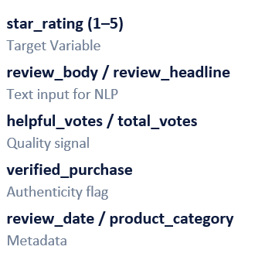
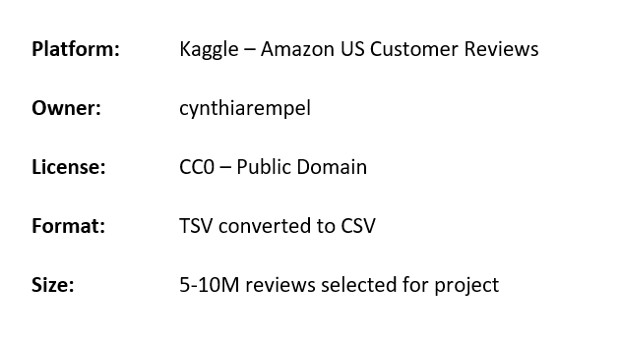
Overview Dataset
Overview
6.9M
Total Reviews
15
Columns
1-5
Star Ratings
3-5
Processed Size
Key Columns
Dataset Source

Slide 6
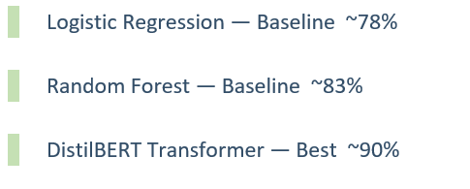
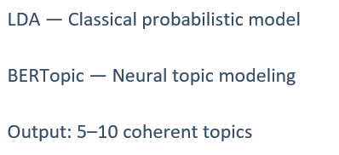
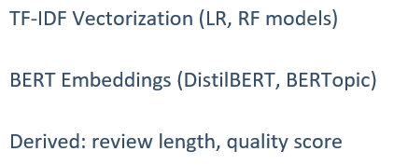
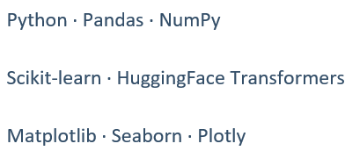
Methodology & Technology Stack
Sentiment Classification
Topic Modeling
Methodology & Technology Stack
Feature Engineering
Supporting Tools

Slide 7
Project Timeline
W1
May 25 – June 07
Literature Review
W2
Jun 01– Jun 14
Data Download & EDA
W4–5
W3
Jun 08– Jun 21
Data Preprocessing
W4
Jun 15– Jun 28
Feature Engineering
W5
Jun 22– Jul 05
Model Development
W6
Jun 29– Jul 09
Topic Modeling
W7
Jul 10
Analysis & Report

Slide 8
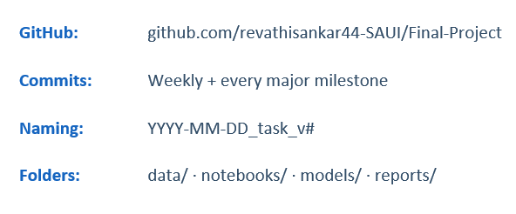
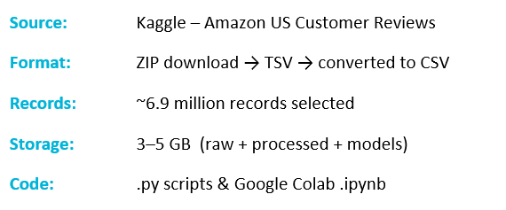
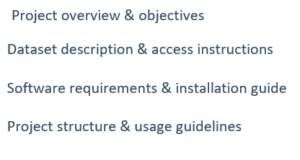
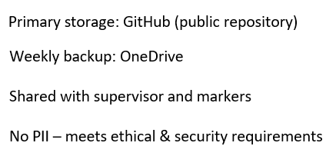
Data Management Plan
Version Control
Metadata
Version Control
Security & Storage

Slide 9
Ethics & Compliance
GDPR Compliance
The dataset contains no personally identifiable information (PII) such as names, addresses, email addresses or contact details. The project therefore poses minimal GDPR risk and does not involve the processing of personal data.
UH Ethical Policies
The project complies with University of Hertfordshire ethical guidelines for data science research. The study uses secondary, publicly available data and does not involve human participants, surveys, interviews or experiments.
Data Use Permission
The dataset is publicly available via Kaggle for research and educational purposes under CC0 (Public Domain) licensing. The project adheres to all licensing and usage terms of the dataset throughout its duration
Ethical Data Collection
Amazon collected reviews as part of its e-commerce platform to solicit customer feedback on products and services. The published dataset contains only anonymised review data — no sensitive or private user information — and shows no evidence of unethical collection.

Slide 10
References
2001
Breiman, L. Random Forests. Machine Learning, 45(1), 5–32. https://doi.org/10.1023/A:1010933404324
2019
Devlin, J., Chang, M. W., Lee, K., & Toutanova, K. BERT: Pre-training of deep bidirectional transformers for language understanding. In Proceedings of NAACL-HLT 2019 (pp. 4171–4186). https://arxiv.org/abs/1810.04805
2022
Grootendorst, M. BERTopic: Neural topic modeling with a class-based TF-IDF procedure. arXiv Preprint arXiv:2203.05794.
https://arxiv.org/abs/2203.05794
2022
Jain, P. K., Saravanan, V., & Pamula, R. Sentiment Analysis Based on Deep Learning: A Comparative Study. Electronics, 9(3), 483.
https://doi.org/10.3390/electronics9030483

Slide 11

Thank you

