Slide 1
VERIDEXA AI
From claimed skills to proven capability.
IIC 3.0 Hackathon · Manipal University Jaipur

Slide 2
THE PROBLEM WITH EVERY RESUME
Claim ≠ Evidence ≠ Performance
CLAIM
EVIDENCE
PERFORMANCE
“I know SQL.”
A GitHub repo
A live, graded challenge
What a resume or LinkedIn profile says. Unverifiable, and everyone writes the same words.
Code that exists. Better than a claim — but doesn’t prove they can solve a new problem today.
Built from the job, solved in real time, executed for real. This is the only one Veridexa ever trusts.
2

Slide 3
HOW IT WORKS
One continuous loop
1
2
3
4
Paste a job description
Claim skills + link GitHub
Solve a real challenge
Get graded — for real
Claude extracts required skills, ranked by importance.
Optional — evidence is nice to have, never required.
Generated from the job’s own top skills. Not a quiz bank.
SQL runs in a sandbox first. AI scores a rubric. Backend totals it.
5
6
7
See Job Readiness %
Improve My Readiness
Resubmit — readiness updates live
A backend formula. The AI never touches the final number.
A new challenge is written to target the #1 weak skill.
Not a re-test. Proof the specific gap actually closed.
The differentiator: step 6 isn’t a difficulty slider. It’s a new challenge, written specifically to target this candidate’s worst-scoring skill from step 4.
3

Slide 4
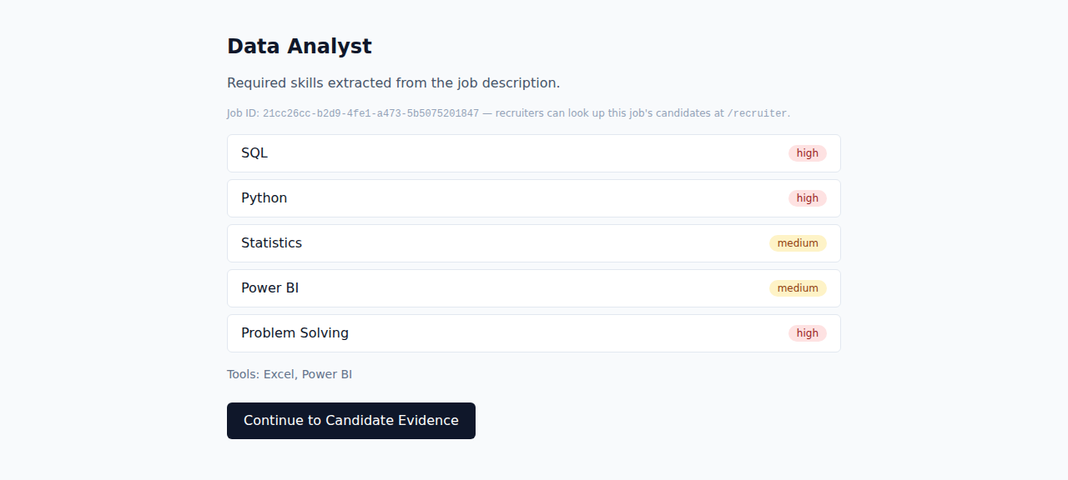
SEE IT LIVE — SCREEN 1
Paste a JD. Get real requirements.
Claude parses unstructured text into the exact taxonomy row we grade against — not a keyword match. Every job also gets an ID a recruiter can look up later.
4

Slide 5
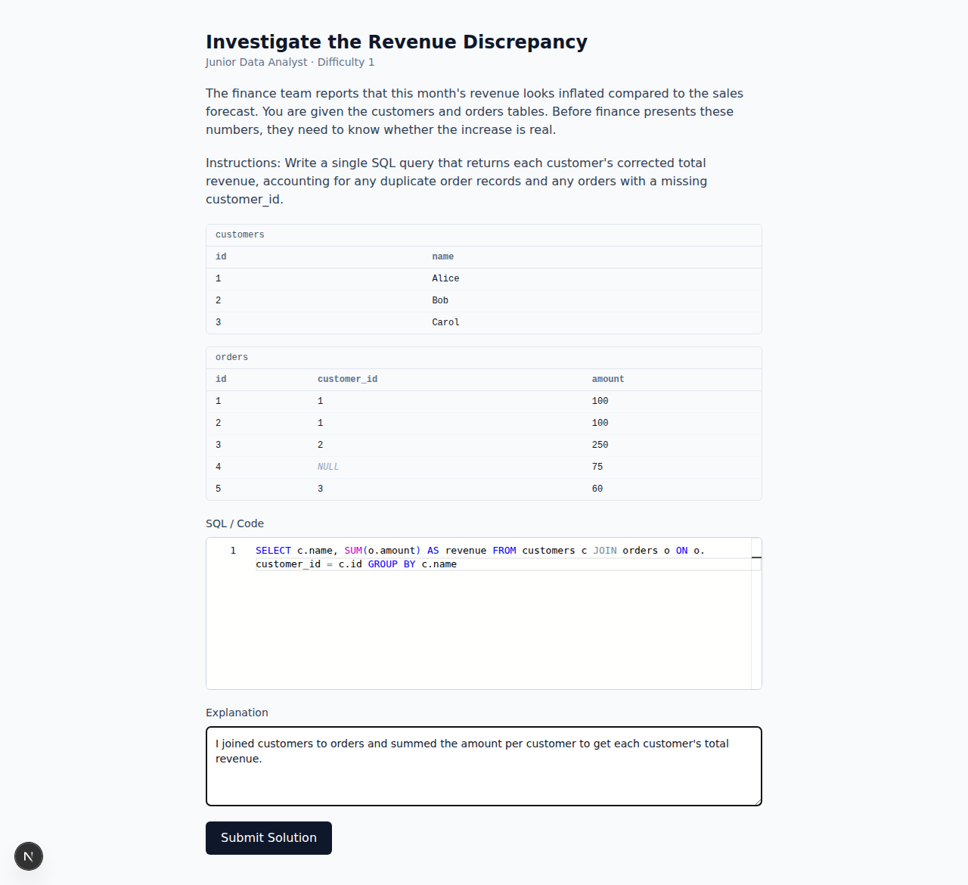
SEE IT LIVE — SCREEN 2
Not a quiz. A real dataset.
A SQL challenge generated from the job’s top skills, with a dataset that hides a real bug: a duplicated order row, and one order with a missing customer_id.
5

Slide 6
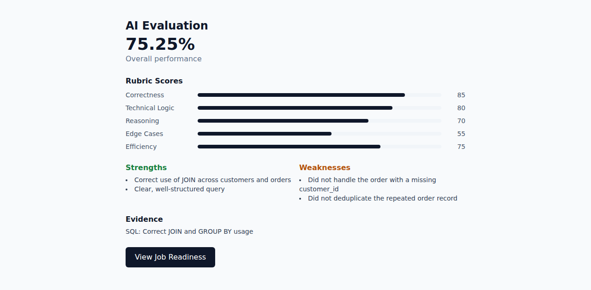
SEE IT LIVE — SCREEN 3
Graded honestly
The SQL sandbox runs the query for real, in-memory, before any AI reasoning happens. Claude scores the rubric — the backend computes the weighted total, always.
6

Slide 7
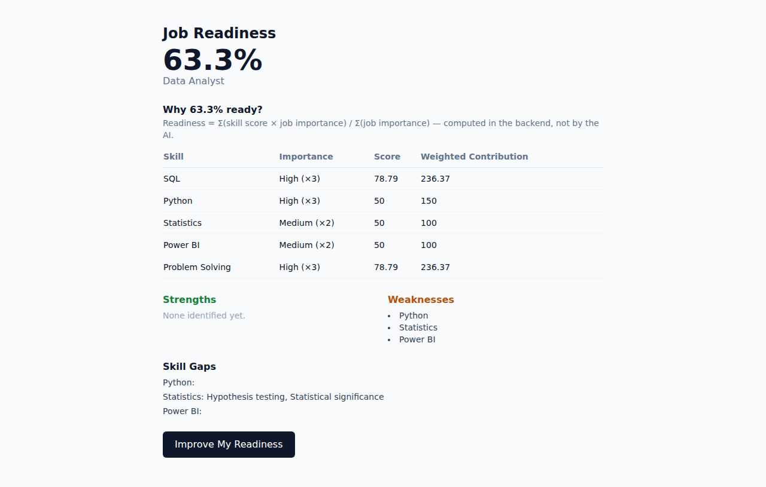
SEE IT LIVE — SCREEN 4
63.3% ready — and exactly why
Readiness = Σ(skill score × job importance) / Σ(job importance). A deterministic backend formula, shown on-screen — never a number the AI just decided.
7

Slide 8
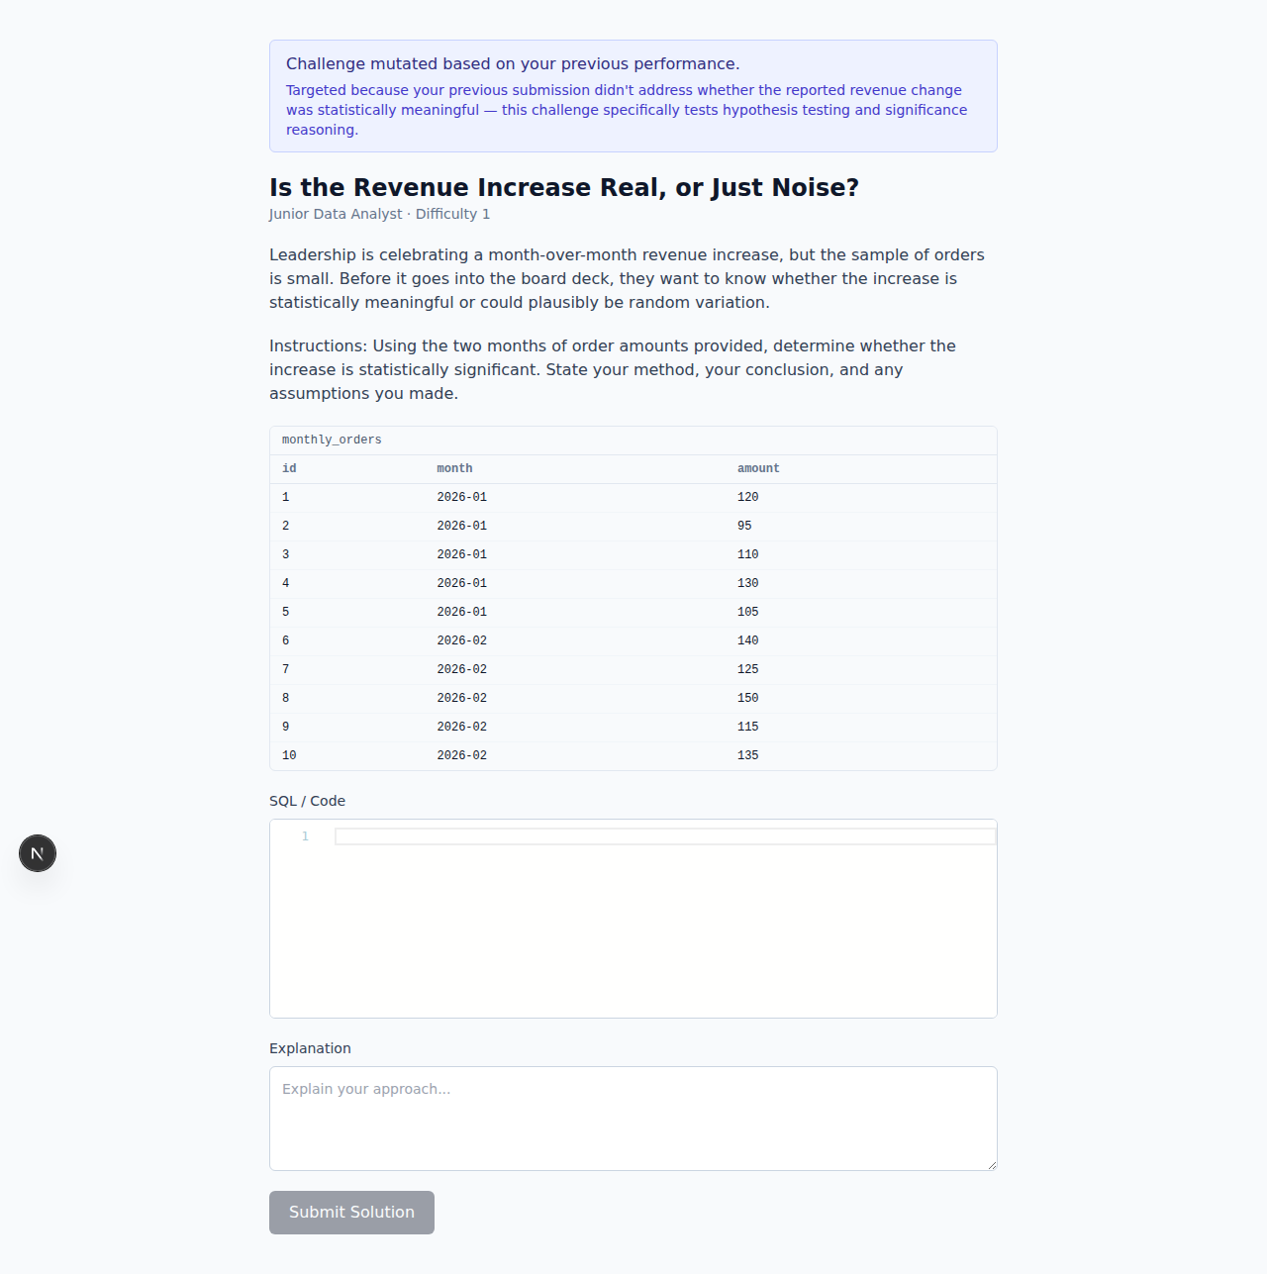
THE DIFFERENTIATOR
This challenge didn’t exist 5 seconds ago.
“Improve My Readiness” reads the previous evaluation’s #1 skill gap directly and writes a brand-new challenge that targets exactly that weakness. Never a difficulty slider — a reaction to what actually went wrong.
8

Slide 9
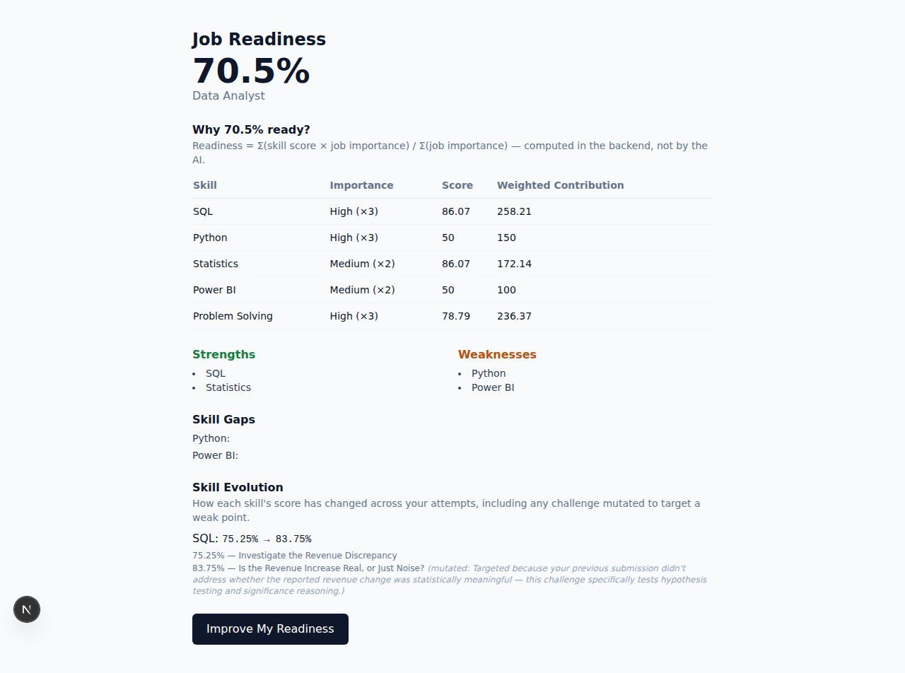
SEE IT LIVE — SCREEN 5 (FINAL)
Prove it again. Watch it move.
SQL
Readiness
Skill Evolution keeps the full history — not just a before/after — including the mutation reason for every attempt that targeted a gap.
75.25% → 83.75%
63.3% → 70.5%
9

Slide 10
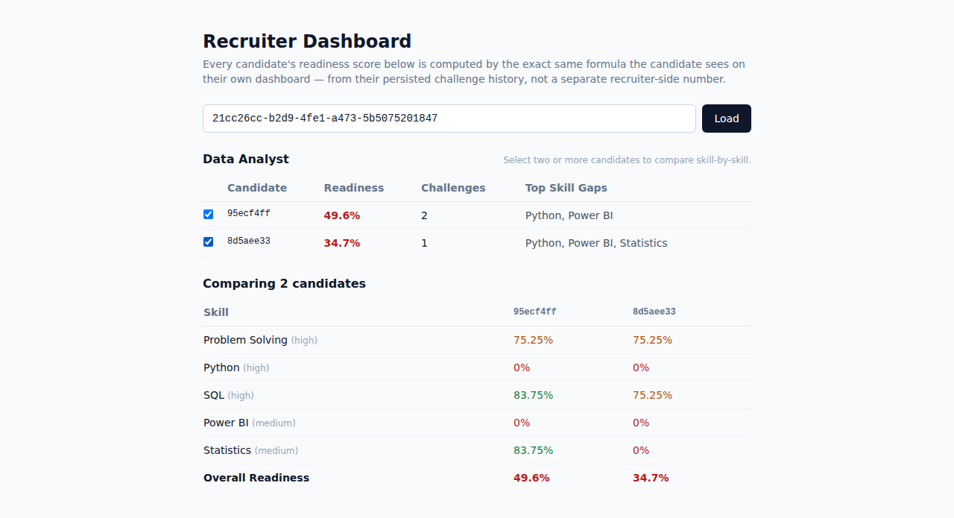
BEYOND THE MVP
Built for recruiters too.
Rank every candidate for a job by the exact same readiness formula — never a separate recruiter-side number — and compare candidates skill-by-skill.
10

Slide 11
BUILT FOR DEMO DAY
Works even when the Wi-Fi doesn’t.
1
2
3
Retry, then a hand-checked fallback
Isolated SQL sandbox
Rehearsed twice — network genuinely killed once
Every AI call retries once, then falls back to a fixture — flagged transparently on the response, never faked silently.
Candidate SQL runs against a fresh in-memory SQLite instance with a statement denylist, row caps, and a timeout.
Same in-flight session, network cut mid-run: identical readiness numbers, zero crashes, fallback engaged cleanly.
11

Slide 12
UNDER THE HOOD
Tech stack
Backend
Frontend
AI
FastAPI (Python 3.11)
Next.js 16 + TypeScript + Tailwind
Claude Sonnet 5 — structured outputs
Database
Editor
Sandbox
Postgres (Supabase)
Monaco (self-hosted)
In-memory SQLite, denylisted
Every score the candidate sees is a deterministic backend formula — Claude supplies reasoning and sub-scores, never the final number.
12

Slide 13
“Every number on this dashboard traces back to code that ran or a challenge that was graded.
Nothing here is something the candidate just said about themselves.”
VERIDEXA AI
From claimed skills to proven capability. · Thank you.

