Slide 1
Faculty
Information
System
Group Number :03
Mentor
Manish Rajhans
Notes:
Add instructor notes here.

Slide 2
Objectives
Project Understanding
Approach used
Modules
Project Execution
Learning
Best Practices
Opportunity for improvement
Q&A
Notes:
Add instructor notes here.

Slide 3
Project Understanding
This project is about Faculty Information System allows to store and retrieve all information regarding faculty, where we have considered three roles.
Admin
Faculty
Students
Admin can create/delete/update/view other users, department, courses, subjects etc.
Faculty can add personal information, work history, publish publication, courses etc.
Student can search faculty publication and view the information.
Notes:
Add instructor notes here.

Slide 4
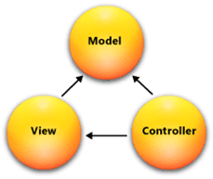
Approach used :
The approach we used in this project is Model view Controller architecture
Model: Model is a part of the application which implements the logic for the application's data domain. It is used to retrieve and store model state in a database like SQL Server database. It also use for business logic separation in the application.
View: View is a component that forms the application's user interface. It is used to create web pages for the application.
Controller: Controller is the component which handles user interaction. It works with the model and select view to render the web page. In MVC application, the view only displays information whereas the controller handles and responds to user input and requests.
Here we used database first entity framework.

Slide 5
Modules
This Project consists of 3 modules. They are :
Admin
  Authentication
  Create Users
  Add Department
  Add/Update/Delete Course & Subjects
  View Faculty Information and Publication
Faculty
  Authentication
  Add/Update Personal information , Job History, Publication
  View Information
Student
  Authentication
  Search and View Publication
Notes:
Add the notes here.
Add instructor notes here.

Slide 6
Module Diagrams
Faculty:
No
Is Valid
Add Personal Information
Login
Stop
Yes
Database

Slide 7
Admin:
1.Create User:
No
Is Valid
Yes
Create User
Login
Stop
Database

Slide 8
2. View Faculty Information:
3. Add Department/Course/Subject:
Database
View Faculty Information
Login
Database
Add Department/Course/Subject
Login

Slide 9
Student:
No
Is Valid
Yes
Home Page
Login
Stop
Database

Slide 10
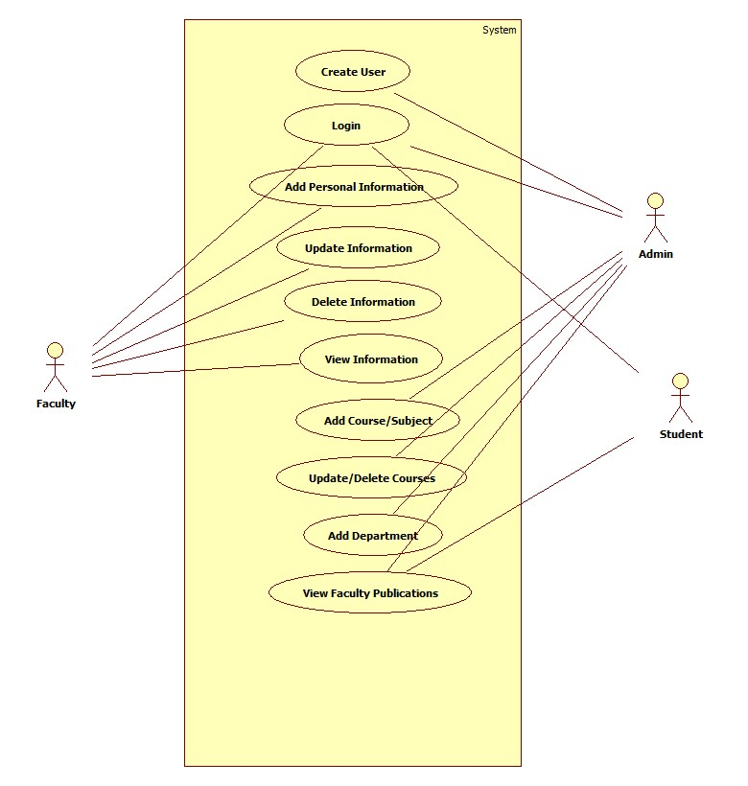
Project Execution
Use Case Diagram:

Slide 11
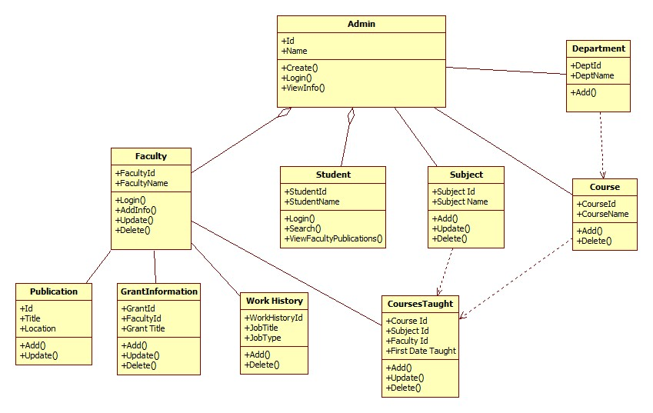
Class Diagram:

Slide 12
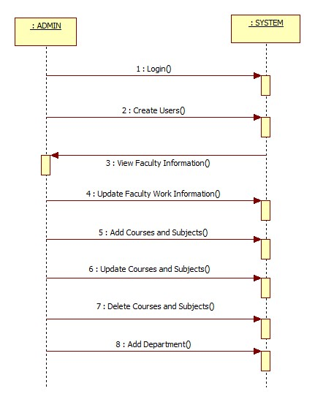
Sequence Diagram:

Slide 13
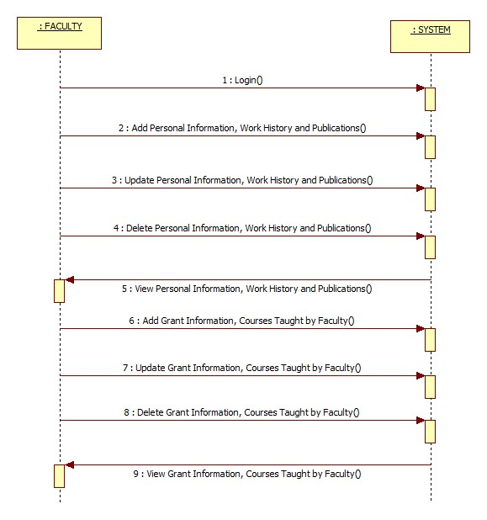
Sequence contd.
Notes:
Add the notes here.
Add instructor notes here.

Slide 14
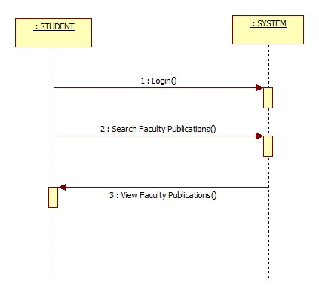
Sequence contd.

Slide 15
Learning
The current application, online Faculty Information system which is a .NET application is been developed using MVC, SQL Server 2012 in the C# programming language.
By implementing this project, we have gained a good learning experience with C#.NET programming language.
Earlier we work on SQL server management studio and in this we applied LINQ entity framework
Notes:
Add the notes here.
Add instructor notes here.

Slide 16
Best Practices
Define the Scope and Objectives
Define the Deliverables
Project Planning
Tracking and Reporting Project Progress
Follow Indentation, Naming Convention
Readability, Maintainability of a program
Type mismatch for parameters should be seen carefully
Perform unit testing for each module
Notes:
Add the notes here.
Add instructor notes here.

Slide 17
Opportunity for improvement
While this is technically a complete system, the opportunities for expanding are almost limitless. Here are a few additional features we recommend to be added in the next version.
We can use authentication and authorization filters
Currently, we have implemented this application in MVC, we can extend it to Web API for making it accessible over wide area of Network.
Notes:
Add the notes here.
Add instructor notes here.

Slide 18
Q & A
Notes:
Add the notes here.
Add instructor notes here.

Slide 19
Thank You.!

