Slide 1
Faculty
Information
System
Group Number :05
Mentor
Manish Rajhans
Notes:
Add instructor notes here.

Slide 2
Objectives
Project Understanding
Approach used
Modules
Project Execution
Learning
Best Practices
Opportunity for improvement
Q&A
Notes:
Add instructor notes here.

Slide 3
Project Understanding
This project is about Faculty Information System which considers three user roles.
Administrator
Faculty
Students
who can perform the following functionalities :
Admin can create/delete/update/view other users, designation, department, courses, subjects etc.
Faculty can add their personal information, work history, publish their publications, add their courses taught, accept grants etc.
Student can search for faculty publications and view it’s information.
Notes:
Add instructor notes here.

Slide 4
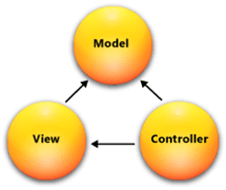
Approach Used
The approach we used in this project is Model view Controller architecture
Model: Model is a part of the application which implements the logic for the application's data domain. It is used to retrieve and store model state in a database like SQL Server database. It also use for business logic separation in the application.
View: View is a component that forms the application's user interface. It is used to create web pages for the application.
Controller: Controller is the component which handles user interaction. It works with the model and select view to render the web page. In MVC application, the view only displays information whereas the controller handles and responds to user input and requests.
Here we used database first entity framework.
Fig.1

Slide 5
Modules
This Project consists of 3 modules. They are :
Admin
  Authentication
  Create Users
  Add Department
  Add Designation
  Add/Update/Delete Course & Subjects
  View Faculty’s Personal Information and Edit Job History.
Faculty
  Authentication
  Add/Update Personal information , Job History, Publications, Courses Taught, Grants allocated.
  View it’s own Information
Student
  Authentication
  Search and View Publication
Notes:
Add the notes here.
Add instructor notes here.

Slide 6
Module Diagrams
Admin:
1.Create User:
No
Is Valid
Yes
Create User
Login
Stop
Database

Slide 7
2. View Faculty Information and Work History:
3. Add Department/Course/Subject/Designation:
Database
View Faculty Information/Work History
Login
Database
Add Department/Course/Subject/Designation
Login

Slide 8
Faculty:
No
Is Valid
Add Information
Login
Stop
Yes
Publication
Work History
Course Taught
Database
Grant

Slide 9
Student:
No
Is Valid
Yes
Home Page
Login
Stop
Search Information
Database

Slide 10
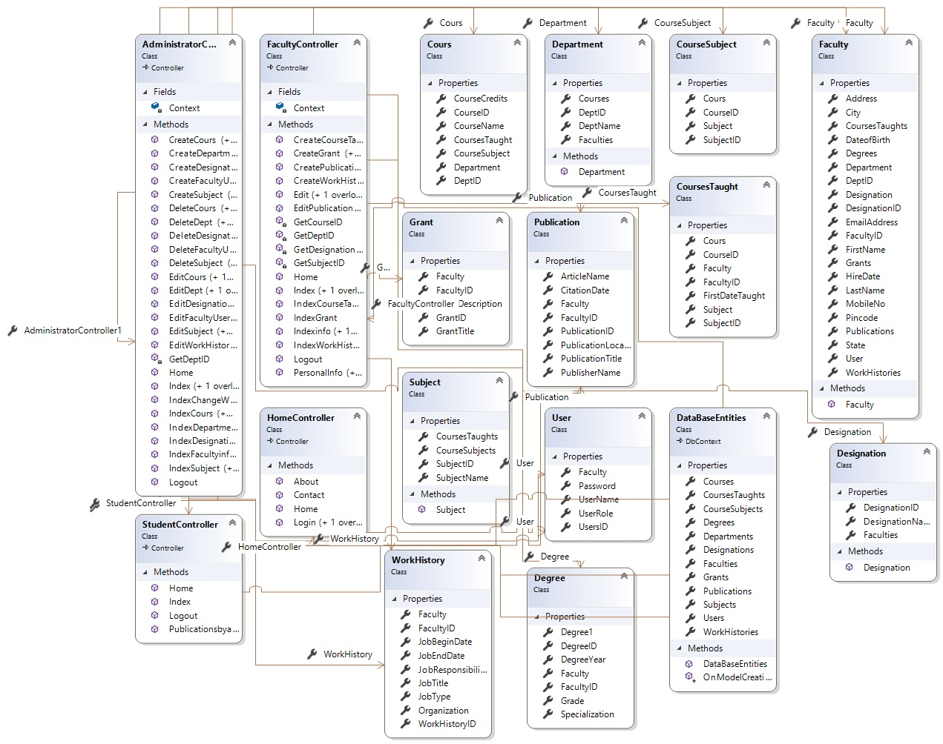
Class Diagram:

Slide 11
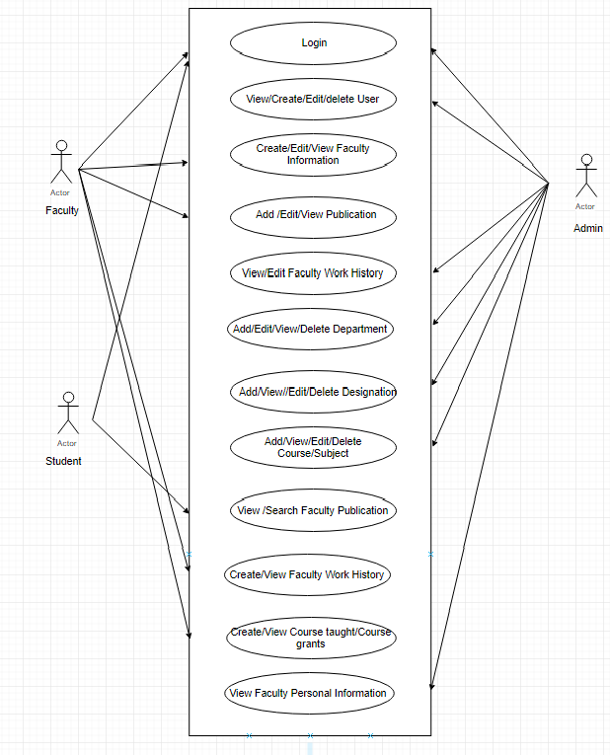
Project Execution
Use Case Diagram:

Slide 12
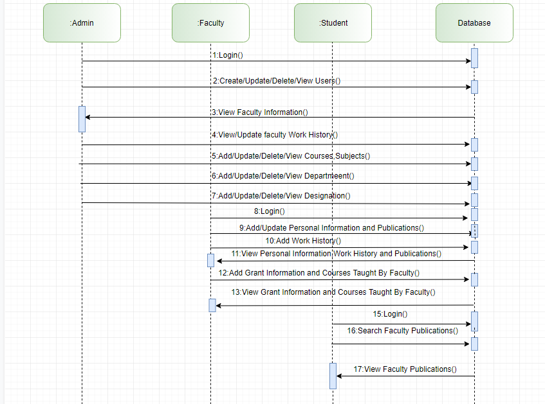
Sequence Diagram:

Slide 13
Learning
This application is a .NET Web Application which follows the MVC Architectural Pattern and has been developed with the help of SQL Server 2012 and C# programming language.
By implementing this project, we have gained a good learning experience by using the ASP .NET programming language.
Overall, ASP .NET is powerful Server-side programming Language and with it’s recent release of ASP .NET Core(Open Source), it’s going to be adapted by many companies in the near future.
Notes:
Add the notes here.
Add instructor notes here.

Slide 14
Best Practices
Define the Scope and Objectives
Define the Deliverables
Project Planning
Tracking and Reporting Project Progress
Follow Indentation, Naming Convention
Readability, Maintainability of a program
Type mismatch for parameters should be seen carefully
Perform unit testing for each module
Notes:
Add the notes here.
Add instructor notes here.

Slide 15
Opportunity for improvement
While this is technically a complete system, the opportunities for expanding are almost limitless. Here are a few additional features we recommend which could be added in the next version :
Currently, within the student module, the student can only view & search the publications added by the faculty. There could be a few more additional features added for the student module, for example, an upload download feature for publication etc.
Also, we have implemented this Monolithic application in MVC, instead of this, we can build it in a Microservices Architectural pattern and containerize them and orchestrate it with Kubernetes/Azure Service Fabric. By doing this, one can get a great opportunity to work like a complete Software Developer and can gain a high level understanding of how things are built.
Notes:
Add the notes here.
Add instructor notes here.

Slide 16
Q & A
Notes:
Add the notes here.
Add instructor notes here.

Slide 17
Thank You.!

