Slide 1
Uber Trips Data Analysis
By Revatish Anil Sur

Slide 2
Project Objective
To analyze Uber trip patterns using SQL and Python.
We aim to understand trip completion, cancellations, and car unavailability.

Slide 3
Data Overview
Dataset: Uber_Cleaned.xlsx
Key Columns: Status, Pickup point, Request time, Drop time
Status Types: Trip Completed, Cancelled, No Cars Available

Slide 4
Key Questions Explored
What is the overall distribution of trip statuses?
Which pickup point had the most successful trips?
Where were cancellations and unavailability highest?

Slide 5
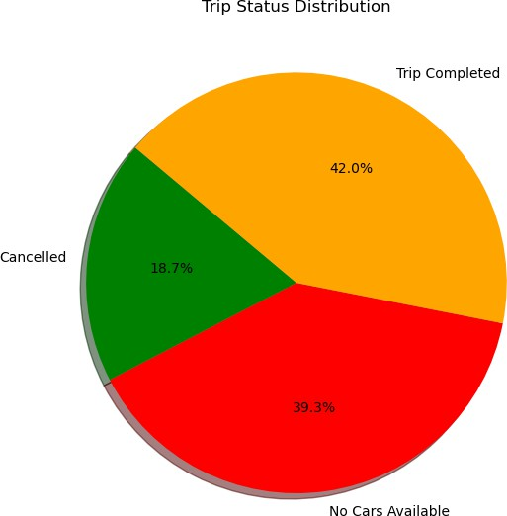
How Did Uber Trips End?

Slide 6
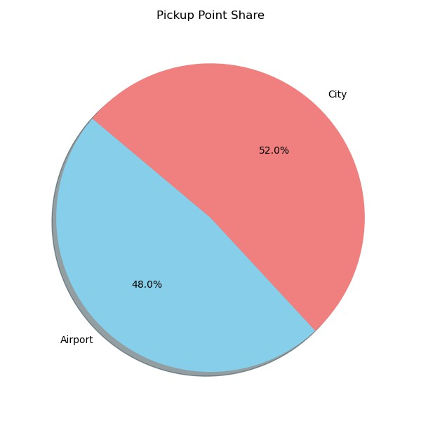
Where Were Trips Requested From?

Slide 7
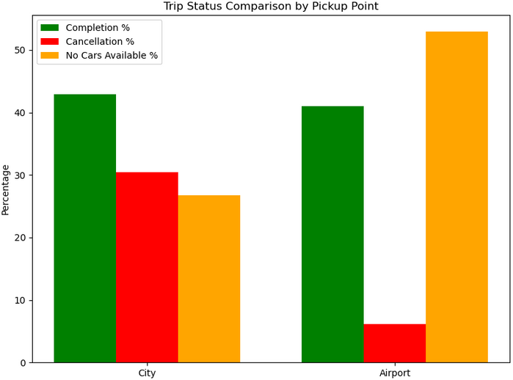
Success vs Failure by Location

Slide 8
Key Insights from the Analysis
Most trip requests came from the Airport, but many were not completed.
City trips had the highest completion rate and lowest cancellations.
No Cars Available was a major issue for Airport pickups.
Improving driver availability in the Airport could raise success rates.
This data suggests operational focus should shift to Airport requests.

Slide 9
Thank You!
Questions are welcome.

