Slide 1
Agile Project Management with Scrum

Slide 2
Resource links
http://www.agilealliance.org/
http://www.agilemanifesto.org/
http://www.scrum-master.com/

Slide 3
Manifesto for Agile Software Development
Individuals and interactions over processes and tools
Working software over comprehensive documentation
Customer collaboration over contract negotiation
Responding to change over following a plan
Notes:
No up front complete documentation which soon is outdated.

Slide 4
12 Principles behind the Agile Manifesto (1)
Our highest priority is to satisfy the customer through early and continuous delivery of valuable software.
Welcome changing requirements, even late in development. Agile processes harness change for the customer's competitive advantage.
Deliver working software frequently, from a couple of weeks to a couple of months, with a preference to the shorter timescale.
Business people and developers must work together daily throughout the project.

Slide 5
12 Principles behind the Agile Manifesto (2)
Build projects around motivated individuals. Give them the environment and support they need, and trust them to get the job done.
The most efficient and effective method of conveying information to and within a development team is face-to-face conversation.
Working software is the primary measure of progress.
Agile processes promote sustainable development.
The sponsors, developers, and users should be able
to maintain a constant pace indefinitely.

Slide 6
12 Principles behind the Agile Manifesto (3)
Continuous attention to technical excellence
and good design enhances agility.
Simplicity--the art of maximizing the amount
of work not done--is essential.
The best architectures, requirements, and designs emerge from self-organizing teams.
At regular intervals, the team reflects on how
to become more effective, then tunes and adjusts its behavior accordingly.

Slide 7
Introduction of Scrum
Scrum flow
Scrum roles
Scrum artifacts

Slide 8
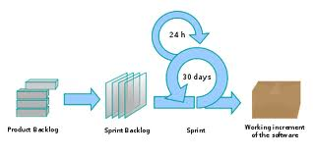
Scrum flow

Slide 9
Roles
Product owner
Scrum master
  Responsible for the scrum process
    Teaching
    Implementing
    Ensuring
Scrum team
Notes:
Chicks and pigs

Slide 10
Scrum Artifacts
Product backlog
Burndown chart
Sprint Backlog
Notes:
Burndown chart: X: date. Y Hours of work remaining

Slide 11
Product backlog
Ever changing
Prioritized list
Owned by product owner
Spread sheet example

Slide 12
Sprint Backlog
The sprint backlog defines the work, or tasks, that a team defines for turning the Product backlog it selects for that Spring into an increment of potentially shippable product functionality
Task should be 4-16 hours each
Highly visible, real-time picture of the work
Owned by the team
Maintained as spread sheet daily by a tracker or responsible individuals.

Slide 13
Burndown chart
Visualize the correlation between the amount of work remaining and the progress in reducing the work
    X: date
    Y: hours of work remaining
Updated according the Sprint backlog

Slide 14
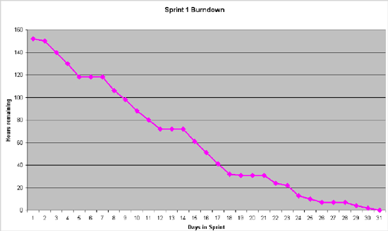
Burndown Chart Example

Slide 15
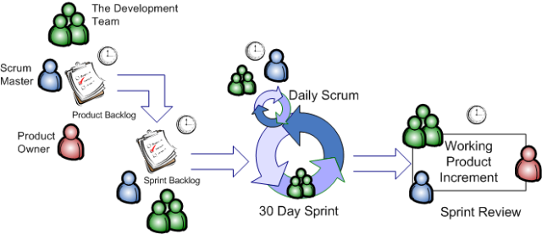
Scrum roles and artifacts

Slide 16
Scrum meetings
Sprint planning meeting
Daily standup meeting
Sprint review meeting

Slide 17
Sprint planning meeting
Stake-holders to refine and re-prioritize the Product Backlog and Release Backlog and to choose the goals for the next iteration, usually droved by the highest business value and risk
Scrum team and Product Owner meet to consider how to achieve the requests, and to create a sprint backlog of tasks to meet the goals

Slide 18
Daily Standup Meeting
Three things to talk in 5-10 minutes
  What did I accomplish yesterday?
  What will I do today?
  What obstacles are impeding my progress?
Why standup meeting?
    Promote individual’s commitment to the team
    Promote close working relationship
    Identify issues in timely fashion

Slide 19
Sprint Review Meeting
Demo time
  Informal
  Anybody can attend
Did the team achieved the sprint goal?

Slide 20
Sprint Retrospective Meeting
Find the ways to improve team’s performance
  Start doing
  Stop doing
  Continue doing
Who can attend?
  Team, product owner, scrum master

Slide 21
What will we do?
Assign the Role
  Product owner
    One from each team (pretending)
  Scrum Master
    Team coordinator
  Scrum team
    Everyone in your team
  Others stakeholders
    Instructor
    End users
Notes:
Instructor will act as user who may asking for features.

Slide 22
What will we do?
Artifacts
  Product Backlog
    Created and maintained by product owner
      Do not change it if you are not the product owner
    Available to the public to see
  Spring backlog
    Created and maintained by the team
    Updated daily ( 3 days a week MWF) by a tractor or individuals
    Available to the public
  Burndown chart
    Created every day and available to the public

Slide 23
What will we do?
Sprint Planning meeting
Sprint time
  2-3 weeks for each sprint to fit our schedule (not 30 days)
  3 sprints
Daily standup meeting
  What have you done since last meeting?
  What will you do before the next meeting?
  What is blocking you?
Demo at the end of each sprint
Sprint retrospective meeting

Slide 24
What will we do?
So what about requirement analysis and Design and deliverables/documentation?
  Before the first sprint, do high level requirement and design
  In each sprint, do detailed requirement and design for the features that are being implemented in that sprint
    It is likely we need to adjust previous design, source code in later sprint. Be prepared for that.
Notes:
Spend more time to do requirement analysis design in the first sprint, a little less in second one, and even maybe less in the third one.
At the end of each sprint, standardized documents should be created for requirement and design

Slide 25
What will we do?
  So you still do them, but incrementally
    Start from the big picture
      Requirement analysis
      architecture design
      high level class design
      storage design
      interface design
    Then focus on the requirements that will be implemented in each sprint
      Use case
      GUI design
      Detailed class design
      Collaboration Design (UML diagram)
    Then implementation the feature
      Write the code
      Test
      Write User documentation

Slide 26
Reminder
Do not forget the goal of this class
  This class is not just about writing a program
    You should know some programming language by now.
  By the end of the term, each student should be able to:
    To be able to work in a team on a large software project.
    To understand the basic steps of large software project development.
    To be able to effectively analyze a programming problem
    To be able to effectively formulate use cases and scenarios
    To be able to create class, object, use case, interface, and state machine diagrams in UML notation.
    To be able to effectively design a solution to a programming problem.
    To be able to assess risks of large software project.

Slide 27
Heads-up
You will get first hand experience about the complexity working a software project in a team
Hopefully You will be convinced that software engineering is critical to your professional development
You will enjoy the professional collaboration with your team mates
You may feel some documentation are not necessary for the project that you are working on.
  But it’s better that you and your team faithfully to take the time to do the exercises.

Slide 28
Important Dates
The first sprint timed-box (2 weeks)
  starts Week 7 Monday
  ends Week 8 Friday
Sprint Review
  Week 8 Friday

Slide 29
Resource and Tools
All team member: Read Scrum FAQ and read online resource that FAQ referenced
Scum Basics
The team coordinator is the scrum master
  Design the sprint backlog spread sheet, burn down chart
  Update the daily (every other day) burn down chart

Slide 30
Questions?
Do we have to standup for standup meeting?

