Slide 1

Agile Development
Using Scrum
Dan Retzlaff
Management Information Chief - Applications Development
Wisconsin Department of Public Instruction
26th Annual Management Information Systems [MIS] Conference
Thursday, February 14, 2013

Slide 2
Objectives
Review the Software Development Lifecycle and the problems it creates
Understand where Agile Methodology came from
Review the Agile Scrum Process and Roles
How Scrum has made an impact at the Wisconsin Department of Public Instruction
2

Slide 3
Traditional Thinking
Traditional project management used for software development = Waterfall Method
Requirements
Design
Implementation
Verification
Maintenance
3

Slide 4
Problems with Waterfall Method
Difficult to accommodate change once a process is underway
Phases must be completed in a sequential order
Difficult to respond to changing customer requirements
Few business systems have stable requirements
4

Slide 5
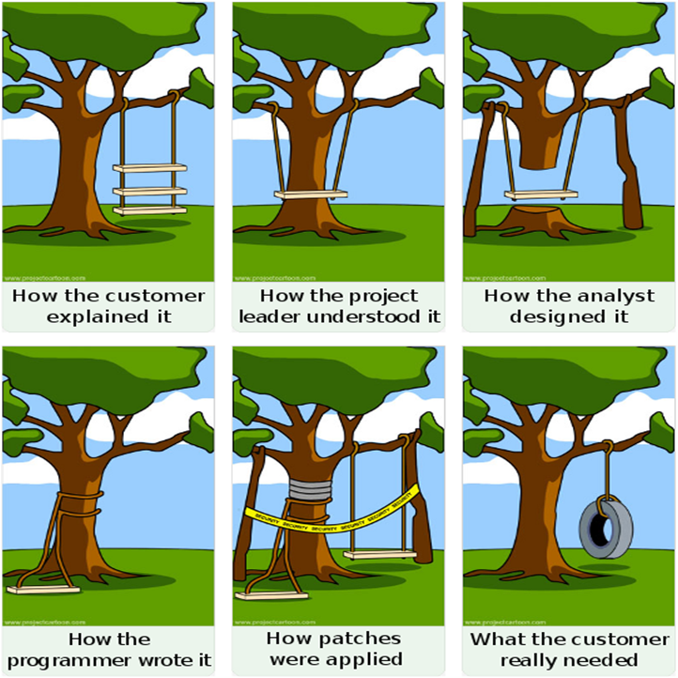
Photos are stock photos. Release for web use of all photos on file.
5

Slide 6
Agile Thinking
A group of software development methodologies based on iterative incremental development
Simply, a different way to manage IT projects, teams, or any work involving a complex process
6

Slide 7
Agile Manifesto
Individuals and interactions over process and tools
Working Software over comprehensive documentation
Customer collaboration over contract negotiation
Responding to change over following a plan
That is, while there is value in the items on the right, we value the items on the left more.
7

Slide 8
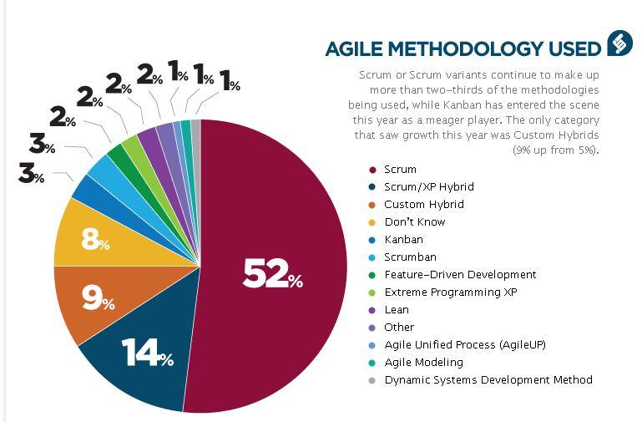
Scrum
Graph provided by VersionOne. http://www.versionone.com/state_of_agile_development_survey/11/
8

Slide 9
Key Scrum Beliefs
People
+
=
Product
Practices
Scrum requires a mental shift in the way people think
  A preference of People over Practices: understanding that solving complex problems requires brainpower, not recipes;
  An understanding that the best Products are developed by having a Focus on User's Needs rather than relying on a requirements document;
  The acceptance that Reality Trumps Expectations, so when reality and expectations don't match, it is the expectations that must change;
  The preference for Self-Organizing Teams over either lone-wolf-ism or tightly controlled management; and
  The realization that each of us is part of a Team developing Product and that we are not simply People doing Work.
9

Slide 10
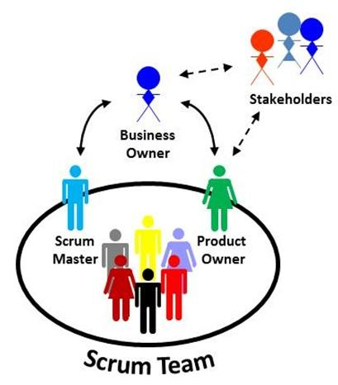
The Scrum Team
The Scrum Team is a small (ideally 5-9) group of people that provides useful Products and Results for Stakeholders.
Stakeholders
  The most important role involved in Scrum
  The reason a Team is developing a Product
Business Owner (BO)
  A special stakeholder, often the Team's sponsor or champion and controls the budget for the Team
Product Owner (PO)
  Most important person on the Scrum Team
  Works with Stakeholders to represent their interests to the Team
  Held accountable for the value of the Team's results
Scrum Team Members
  Do the work (analysis, design, code, test, document, data quality checks, or whatever work is required for a desired outcome)
Scrum Master (SM)
  Facilitator, moderator, and coach
  Manages relationship between the PO and the Scrum Team
  Focuses on team improvement
Graphic referenced from Agile Atlas: http://agileatlas.org/commentaries/scrum-in-a-nutshell
10

Slide 11
The Product Backlog
A Scrum Team's work is managed with a Product Backlog
  A collection of Product Backlog Items
  Items (User Stories) represent the stakeholders' needs and wants that add value to a product
Team does not do anything for any Stakeholder unless it's in the backlog
The Product Owner is responsible for prioritizing the Backlog
11

Slide 12
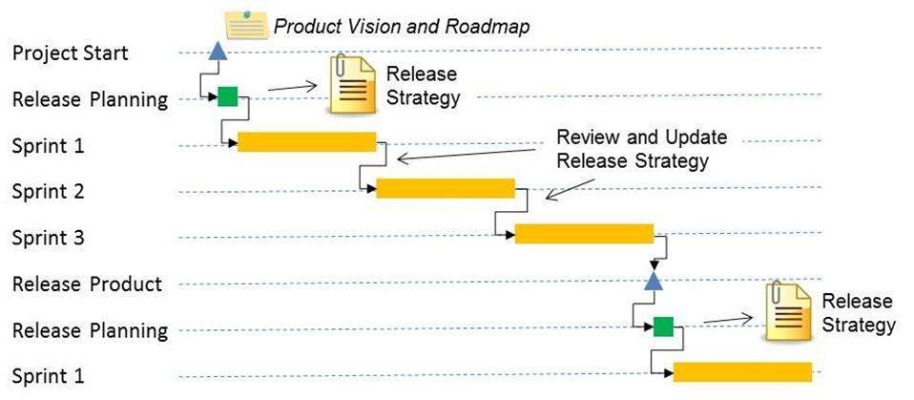
Release Planning
Visioning phase
  PO and Stakeholders produce a Product Vision and Product Roadmap
  Overall focus is on the Product
  Not a part of Scrum Itself
Stakeholders and Scrum Team negotiate what should be accomplished in a Release
Once the Team has a Backlog that supports Release Goals, the Team starts Sprinting
12
Graphic referenced from Agile Atlas: http://agileatlas.org/commentaries/scrum-in-a-nutshell

Slide 13
The Sprint
Fundamental process flow of Scrum
A short, fixed-length period of time
Goal is to produce Backlog Items into renewable products that Stakeholders can provide feedback on
Sprint Planning allows the PO to work with the Team to negotiate what Backlog Items the Team will work on in order to meet Release Goals
Scrum Master ensures Team agrees to realistic goals
13

Slide 14
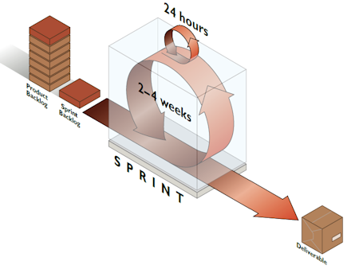
The Sprint
Sprint Planning
Daily Scrum
  Daily Standups
Sprint Review
Sprint Retrospective
Diagram of Scrum sprint, taken from Scrum in five minutes from Southhouse
14

Slide 15

Using Scrum at
Wisconsin Department of Public Instruction
Started small by building a Product Backlog for one business area (Special Education). Provided some overall training and started sprinting from there. Team is currently on Sprint 39.
The following Scrum teams have now been established:
  Special Education
  Title I
  General Data Collections
  Teacher Licensing
  Business Office
  Business Intelligence
15

Slide 16
Using Scrum at
Wisconsin Department of Public Instruction
Increased Productivity
Keeps Teams Focused on Delivering Value
Helps manage multiple projects with limited resources
Improved Communications through Transparency
Not as many individuals working in silos
Team members no longer have to worry about over commitments made by management and unrealistic deadlines
"As a manager, Agile has been very helpful in keeping me informed on a daily basis of a project’s status. It is a great communication tool that stores all information and communication regarding a project in a common location. It cuts down on ‘face-time,’ maximizes production, and helps to ensure we meet our deadlines.“
Anita Castro
Assistant Director, Special Education
16

Slide 17
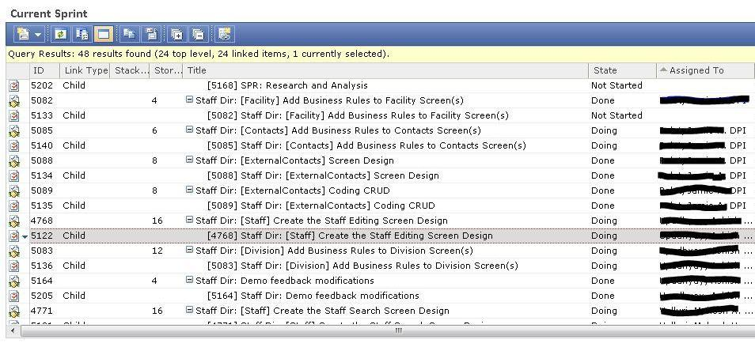
Scrum Storyboards at
Wisconsin Department of Public Instruction
Scrum Team Dashboards with Microsoft Team Foundation Server (TFS)
17

Slide 18
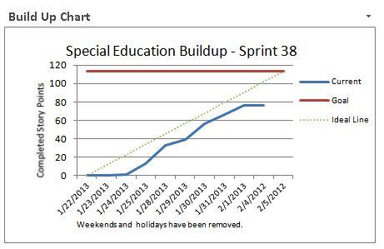
Scrum Buildup Charts at
Wisconsin Department of Public Instruction
Buildup charts are updated daily so that all Scrum Team members and Stakeholders are aware of the sprint's progress.
18

Slide 19
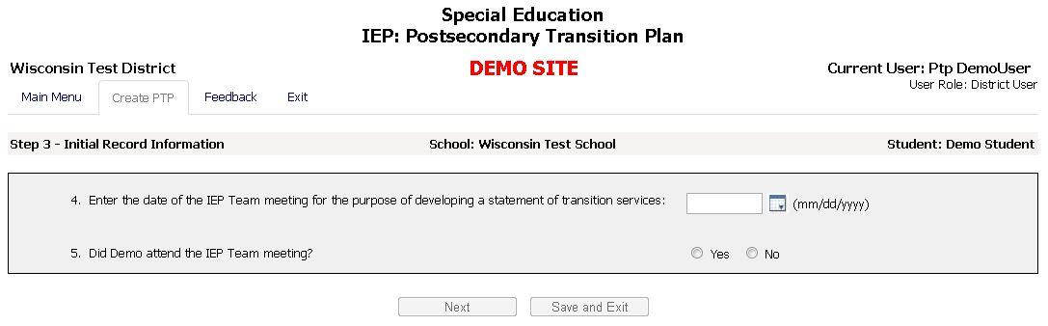
Products Released using Scrum (PTP)
Wisconsin Department of Public Instruction
WI State Performance Plan (SPP), Indicators #13
IEP: Postsecondary Transition Plan (PTP)
To learn more about the Wisconsin's Special Education IEP: PTP click the link below:
http://sped.dpi.wi.gov/sped_spp-transition
19

Slide 20
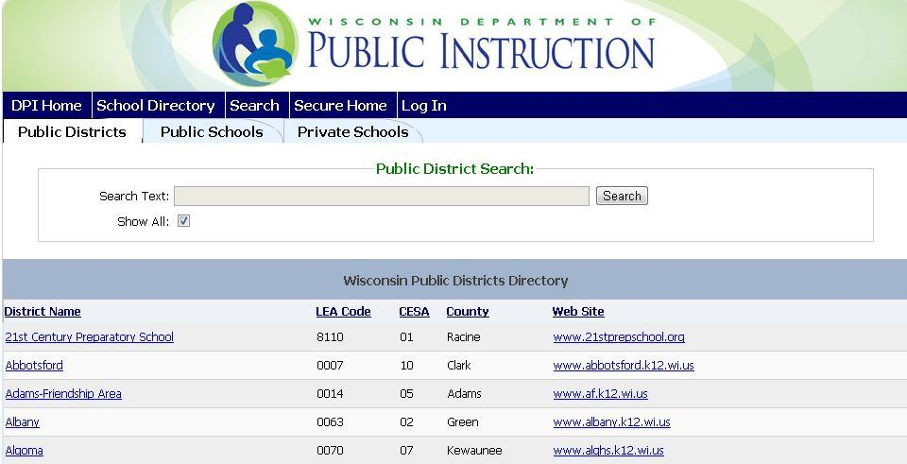
Products Released using Scrum (School Directory)
Wisconsin Department of Public Instruction
Wisconsin Public and Private School Directory
You can view this site by clicking on the following link: https://apps4.dpi.wi.gov/SchoolDirectory/
20

Slide 21
Advice for Implementing Scrum
Create a vision.
Start small - Scrum requires organizational culture change.
Scrum can be used with any Complex System. It is not strictly used for Software Development.
Create a maturity model.
Never give in to status quo! Scrum is Continuous Improvement.
Get an Agile Coach.
21

Slide 22



Scrum Resources
Book Recommendations
Exploring Scrum: The Fundamentals
Essential Scrum
Agile Software Development with Scrum
22

Slide 23
Scrum Resources
Online Recommendations
The Scrum Guide by Scrum.org. (Online Book)
  http://www.scrum.org/Portals/0/Documents/Scrum%20Guides/Scrum_Guide.pdf
Scrum Alliance
  http://www.scrumalliance.org
Jeff Sutherland
  http://scrum.jeffsutherland.com
Mountain Goat Software - Mike Cohn's Blog
  http://www.mountaingoatsoftware.com/blog
23

