Slide 1
ROP Programming/Coding
Ms. Nies
Mon & Wed 4:00 – 6:30 P.M.
LBHS Rm. 51

Slide 2
IDLE
IDLE stands for :
Integrated DeveLopment Environment
It has a Python shell window, which gives you access to the Python interactive mode.
It also has a file editor that lets you create and edit Python source files.

Slide 3
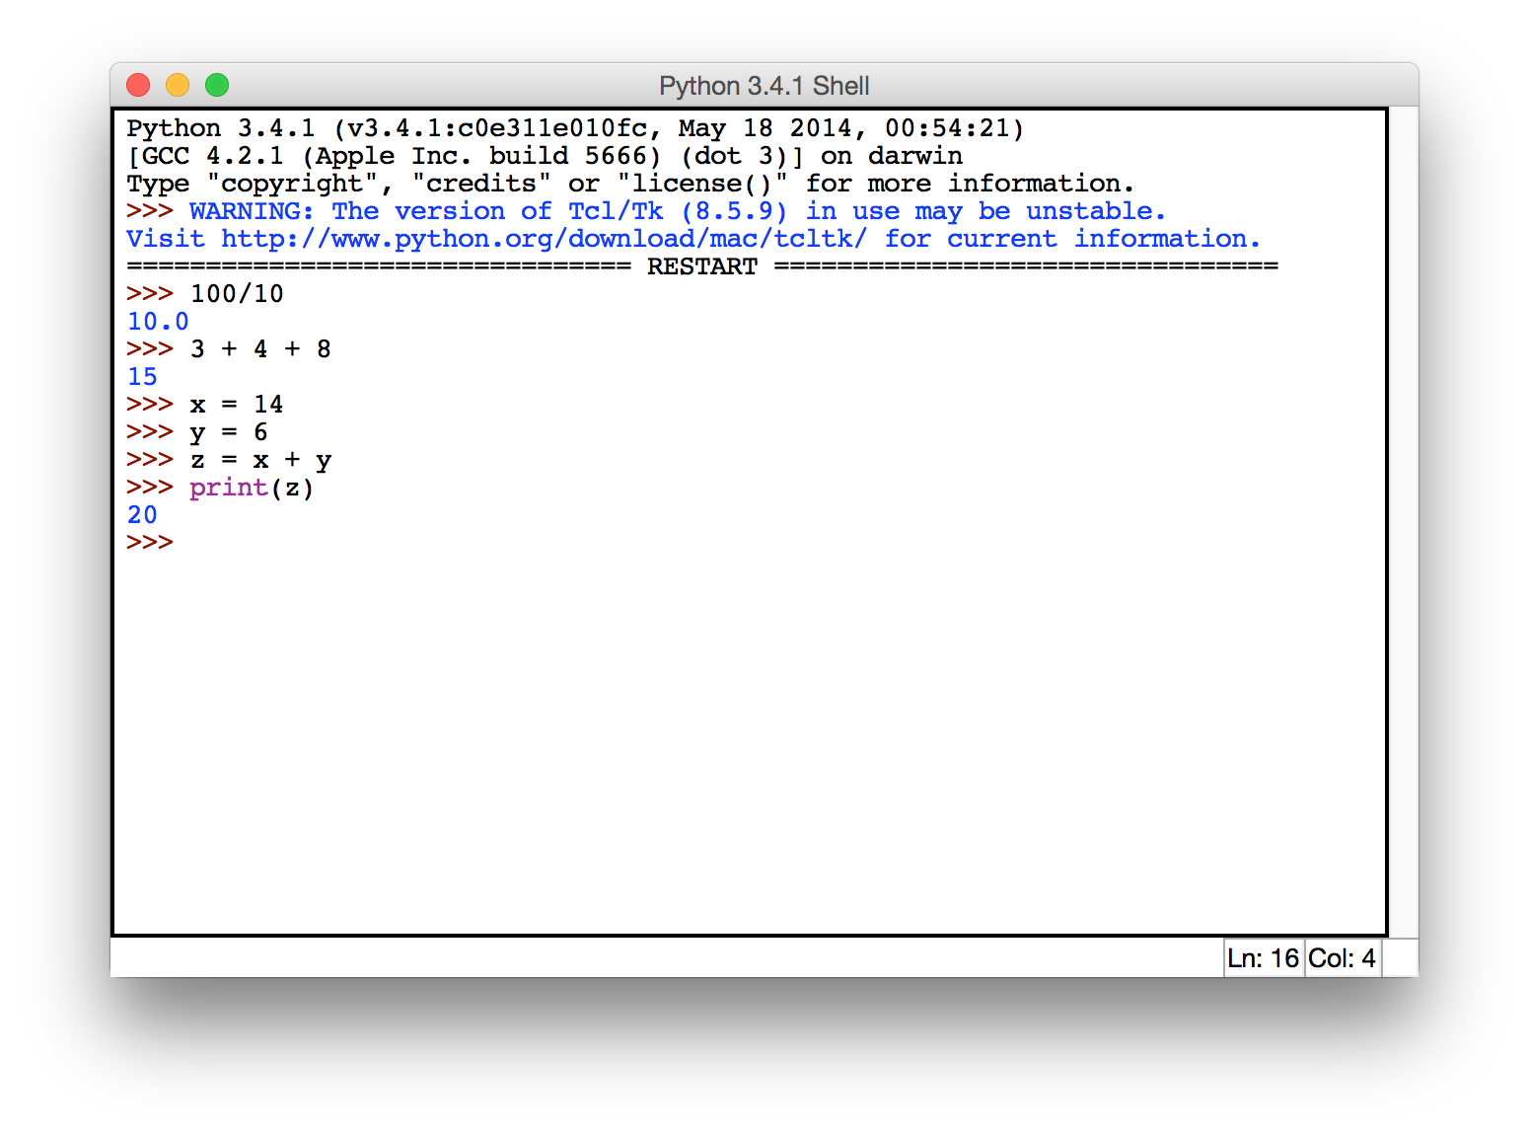
IDLE Shell
The shell allows you to type Python code directly into the console at the '>>>' prompt. Whenever you enter a complete code fragment, it will be executed.

Slide 4
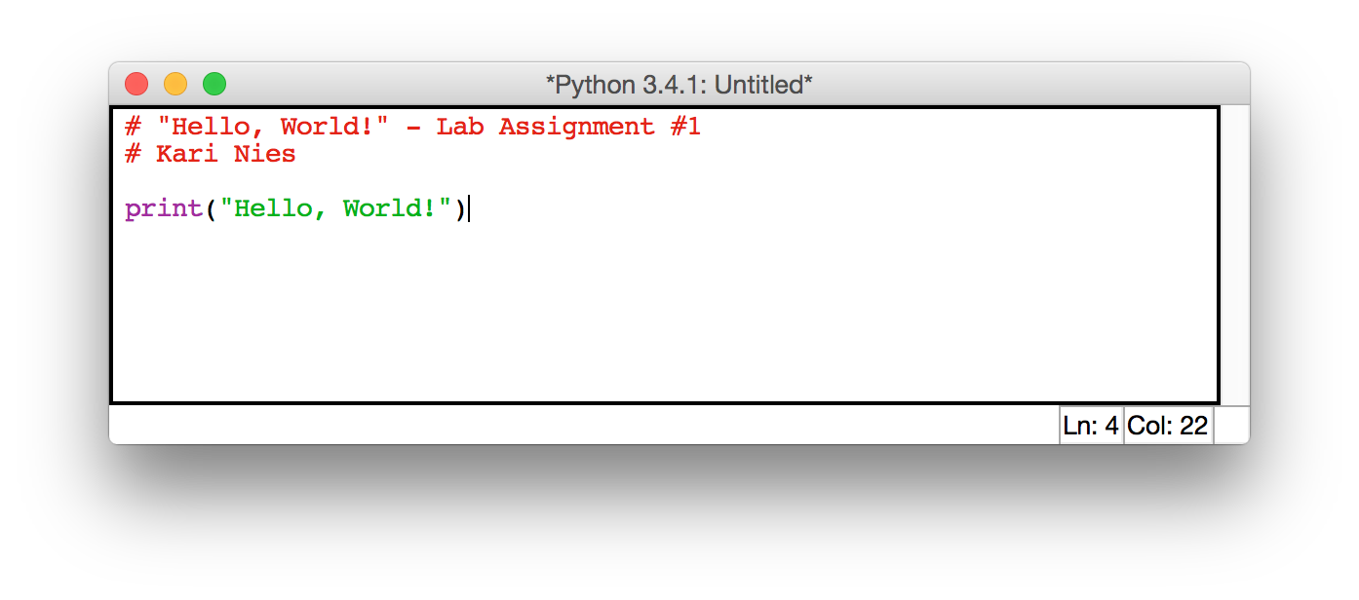
IDLE Editor
Create a new file or open an existing file, and save using the File menu.
To execute your code, select your edit window then use Run>Run module (or F5)
The interpreter will execute each line of your file from top to bottom
Your output will appear in the shell console window
Notes:
Students type some basic arithmetic and store results in a variable. Save and execute. Now show that the declarations in your code can be referenced in the shell.

Slide 5
Working files
Create a folder on the desktop for your working files i.e. “lab1”
Save all your Python files and data files to your working directory
Before you leave, drag your working folder into your google docs (mylbusd.org).
Turn in any due assignments to Haiku
AFTER copying your files to your google docs, delete your working directory from the desktop.

Slide 6
Variables
In computer programming, variables are used to store values that can be be referenced and used by programs.
Variables reference reserved memory locations that store values.
In Python, variables are created with an assignment statement.
A variable always evaluates to the value that it is currently holding.
Notes:
x = 10 creates a variable x that references the value 10
= Is not the mathematical equivalent of the equals sign.
10 = x is illegal.
The LHS must be a variable. (Or something to which a value may be assigned)
x = x + 1 does not make sense as a mathematical equations.
In programming, it increments the value references by X by 1.
x = 10
print(X)

Slide 7
Assignment Statement
An assignment statement assigns a value to a variable.
e.g. x = 10
creates a variable x that references the value 10
The LHS of an assignment statement is generally a variable
The RHS is an expression that evaluates to a value
= Is not the mathematical equivalent of the equality sign
(that is == in Python)
x = x + 1 does not make sense as a mathematical equations
In programming, it increments the value references by x by

Slide 8
Python Names
Names are given to variables, functions, modules, etc. are called identifiers.
Every identifier must begin with a letter or underscore (“_”), followed by any sequence of letters, digits, or underscores.
Names can not be Python keywords (shown in orange in your IDLE editor)
Identifiers are case sensitive.

Slide 9
Example identifiers
These are all different, valid names:
spam
spAm
Spam_and_Eggs
spam_and_eggs
_spam___and___eggs
spam_and_2eggs
These are invalid names:
1egg
Spam!

Slide 10
Variables and Types
Every variable has an implicit type, based on the the value that it references.
i.e.
x = 10 – x is an integer
x = “hello” – now x is a string
The type of a variable determines
how much memory is allocated
which operations can be performed on it

Slide 11
Python Basic Data Type
The values that can be computed by a programming language are grouped into various kinds, called types.
All programming languages support basic data types for
numbers
text
logic

Slide 12
Python Built-in Data Types
Integer : i.e. 10
Float: i.e. 10.0
String: i.e. “Hello, World!”
Boolean: True/False
e.g. x = 10
we say, x is an integer
10 is also an integer, an integer literal
Notes:
In many languages (C, Java) Data types constrain what values a variable can hold (not for Python)
Data types constrain what operations that can be performed on an variable/object.
x = 10
We say x is an integer. 10 is also an integer.
10 is an integer literal
“Hello” is a string literal

Slide 13
Type Checking
Try typing this into your Python shell:
>>>i = 10
>>>print(i)
>>>i = i + 1
>>>print(i)
>>>i = “Hello”
>>>print(i)
>>>i = i + 1 *** What happens here?
>>>i = i + “ Chucky”
>>>print(i)
Notes:
Explain dynamic type checking vs static type checking

Slide 14
Numeric Operators
Integer Float Operators
x + y | sum of x an y
x - y | difference of x and y
x * y | product of x and y
x / y | quotient of x and y
x // y | floored quotient of x and y
x % y | remainder of x and y
-x | x negated
+x | x unchanged
abs(x) | absolute value of x
int(x) | x converted to integer
float(x) | x converted o floating point
x ** y | x to the power y

Slide 15
Functions
A function is a block of organized, reusable code that is used to perform a single repeatable task.
Function calls
abs(x)
print(value)
<function name>(<argument>)
<function name>(<arg>, <arg>…)

Slide 16
Function calls (continued)
In Python we can create new types using classes. A class is an "object-oriented" construct. (we'll cover classes later….)
A class defines a new type including the functions/operations available on "objects" of that type. These special functions are called "methods". Methods are "attached" to objects and called using this format:
<obj>.<method_name>(<args>)
e.g. str.upper()
Notes:
For now, just remember….. strings are actually a built-in class in Python. Think of the methods as the functions that apply only to string objects (such as upper, and lower), functions apply to different types such as len() and str(). Len() is available for multiple types, such as lists. str() conversion is for any type.

Slide 17
Expressions
Python expressions are evaluated like mathematical expressions.
Operator precedence
1+10*3 evals to 31
Parenthesis
(1+10)*3 evals to 33
Functions/Nested Fucntions
abs(-2) evals to 2
abs(-2*10) evals to -20
abs(-2*int("10")) evals to -20

Slide 18
Strings
A string literal begins and ends in single or double quotes. Beginning and ending quotes must match.
e.g.
str1 = “This is a string.”
str2 = ‘This is also a string.’
pi_str = str(3.14159)
answer = input(“Give me a response: ”)

Slide 19
Strings (cont.)
Escape characters
‘This isn\’t the end of my string!’
“This isn’t the end of my string!”
“Monty said, \“Hello, there!\””
‘Monty said, “Hello, there!” ’

Slide 20
Strings (cont.)
newline/return characters
>>>print("ab")
ab
>>>print("a\nb")
a
b

Slide 21
String Operations
Concatenation:
name = “Monty”
fullname = (name + “ Python”)
String functions:
len(fullname) gives 12
fullname.lower() gives ’monty python’
fullname.upper() gives ’MONTY PYTHON’
Notes:
Discuss the different types of functions and methods at high level.
func_name(var)
e.g. len(s)
Function call
var.func_name()
e.g. s.lower()
Method call (special kind of function that is "attached" to and object

Slide 22
String indexing
str = “ABCDEF”
>>>str[0]
’A’
>>>str[len(str)-1]
’F’
str[2] = ‘X’ Illegal!!!!!
In Python strings are immutable
You cannot change a character within a string, you can only create a new string.
Notes:
Immutable, means that you can’t modify an existing string. You can only create a new one.
>>> str[2] = 'X'
Traceback (most recent call last):
File "<pyshell#4>", line 1, in <module>
str[2] = 'X'
TypeError: 'str' object does not support item assignment
>>>

Slide 23
String Operators
String Operators
s + s | concatenate two strings
s * x | concatenate string with itself x times
len(s) | return length of string
s.lower() | return string converted to upper case
s.upper() | return string converted to lower case
str(o) | convert any object to a string
s[i] | indexing, return the character at position i

Slide 24
More Boolean Expressions
Logical Expressions
Logical Operator | Description
and | True if both operands are True
or | True if either operand is True
not | Reverses the logical state of its operand
Examples:
x >= 1 and x <= 100
x != -1
not True
All evaluate to False
Notes:
WHEN IN CONTEXT OF CONDITIONALS
Note that:
[‘’’, 0, and None] all return False, [“<any non empty string>”, any int that is not 0] return TRUE
Explain that None is a variable whose values is unallocated, i.e. it has not pointer to a value.
Here is an example to illustrate the Also:
def test_str(s) :
if s:
print("it's a non-empty string")
else:
print("it's empty!")
main():
test_str("Here is a string")
test_str("")
main()

Slide 25
Boolean Expressions
A boolean expression is any expression that evaluates to True or False.
Comparators | Math Symbol | Python
Less than | < | <
Greater than | > | >
Less than or equal to | ≤ | <=
Greater than or equal to | ≥ | >=
Equal | = | ==
Not Equal | ≠ | !=

