Slide 1
GPP Exam: Zombie AI
Revekka Andronikidu | 2DAE09

Slide 2
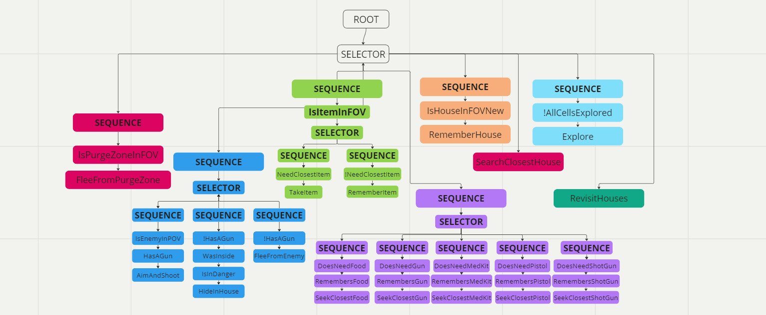
Decision Making

Slide 3
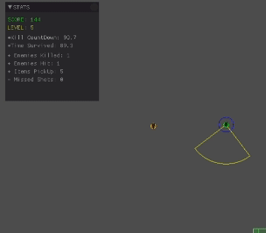
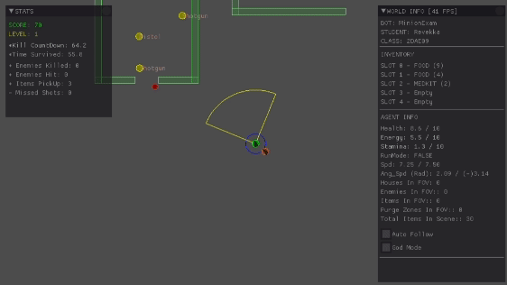
Enemy handling
Face enemy and shoot when orientation and desired direction difference < margin
Prefers shot gun for faster enemies, pistol for slower ones
No gun = hides in closest house or flees

Slide 4
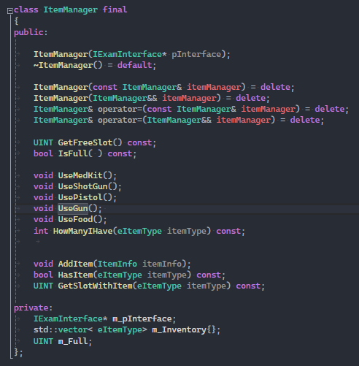
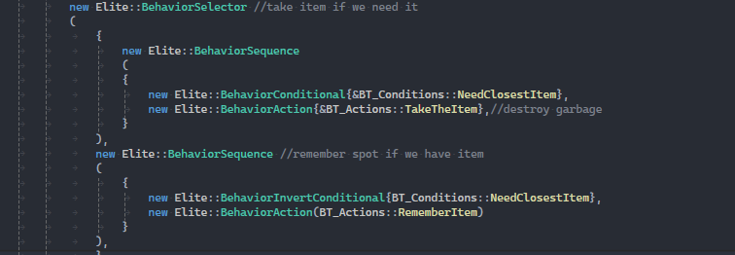
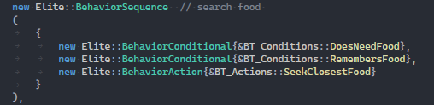
Inventory
Takes only item needed (destroys garbage)
Remembers location of the others
Seek closest remembered item when needed

Slide 5
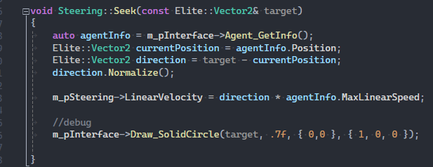
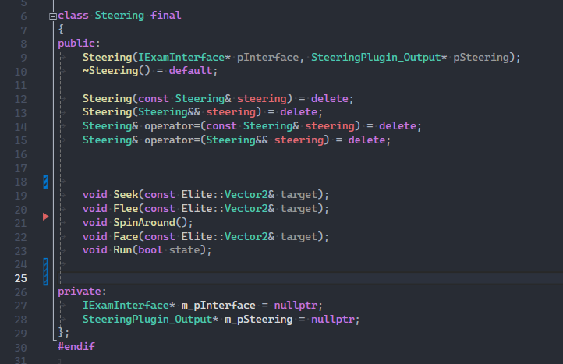
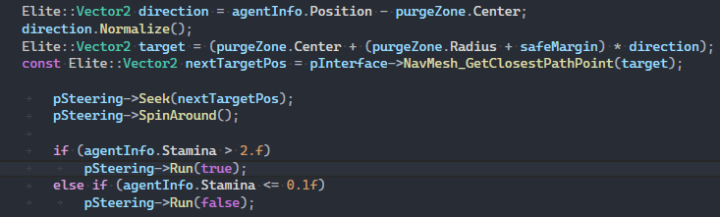
Movement - Steering

Slide 6
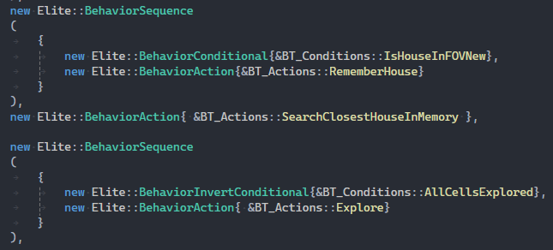
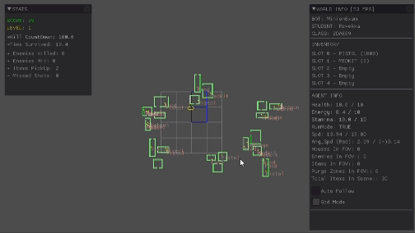
Movement - Exploration
Every house in FOV saved in memory
Agent visits closest house from memory that was not searched yet
When we have no more important tasks -> Explore
Gets small range of cells to explore, when everything is explored the range gets bigger

Slide 7
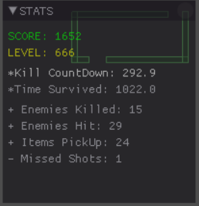
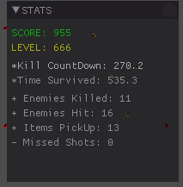
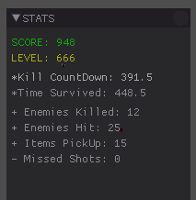
High Score

