Slide 1
形式语言与网络
计算环境构建
Notes:
1

Slide 2
网络计算环境的定义
网格就是下一代Internet；
网格计算就是在动态变化的、拥有多个
部门或者团体的复杂虚拟组织内，灵活、
安全的协同资源共享与问题求解；
3. 网格就是方便资源管理，有效支持广域
分布的、多领域的科学与工程问题解决的
中间件系统；
4. 网格是建造分布式科学计算环境的一种
一体化的集成方法，这一环境包括计算、
数据管理、科学仪器以及人类的协作；
5. 网格是一种无缝的、集成的计算与协作环境

Slide 3
网络计算环境：集成网络系统计算
资源，实现共享式协同完成计算
任务
Enabling the coordinated use of geographically
distributed resources — in the absence of central
control, omniscience, strong trust relationships
—— Ian Foster (Globus)
非专门定制网络，
非专门指定任务类型，
非专门设计运行软件
Notes:
2

Slide 4
CAKE Model
UGIand API
XML
SOAP and other protocols
TCP/IP
Notes:
3
Core Message: Modeling captures essential parts of the system
Key Point 1: Computer system basically automate business processes. However, it’s not easy to build software systems on time and within budget.
Key Point 2: Building a complex software system requires blueprint. You don’t construct a building without a blueprint. Visual modeling is the blueprint for software systems.
Conclusion: VM is a key to successful software development

Slide 5
计算的方便性（无处不在，作业盲提，服务透明）
计算的高效性（快速实时，大数据量）
Notes:
4
Core Message: VM captures business process
Key Point 1: Understanding business process is hard. If an architect and developers don’t understand the business process, which is the requirement for the system, you can’t build the proper system.
Key Point 2: Use case is a technique to capture business process from user’s perspective. Use case is easy to understand because business process is defined in textual format, not in computer lingo.
Example: Use the previous slide to describe use case. The system may handle order entry, inventory, and payroll processes. This particular use case only looks at order entry process.
Conclusion: VM captures business process

Slide 6
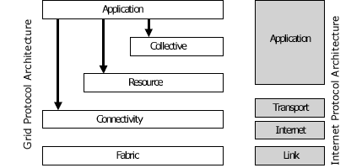
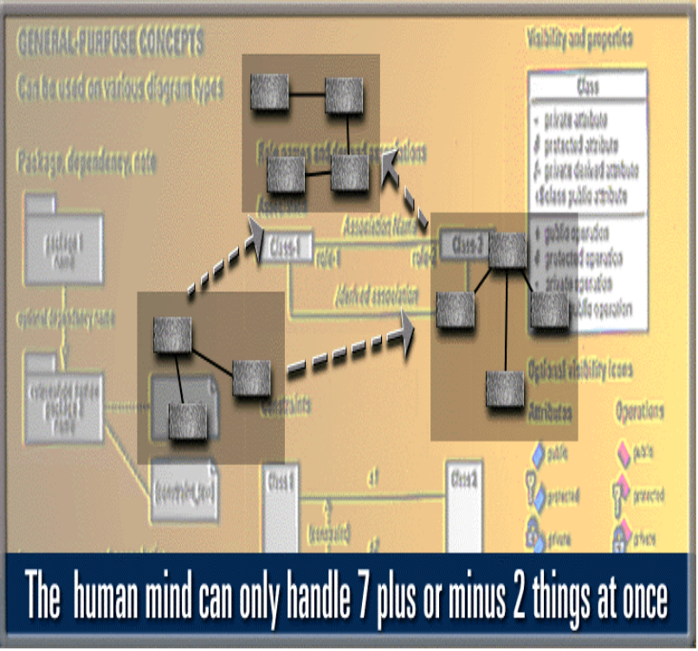
网络计算环境的构架：
从HOURGLASS到WEB SERVICE
Notes:
6
Core Message: VM manages complexity
Key Point 1: This is a model of typical system. Sale has information about purchase order, sales person, and customer. In a system, you may get hundreds or thousands of these things (or objects).
Key Point 2: Human mind can only handle 7 plus or minus things at once. VM allows you to raise your level of abstraction. There are constructs to group things into more manageable number of things.
Example: One new developer joins the group. How do you describe your software system?
Conclusion: VM manages complexity

Slide 7
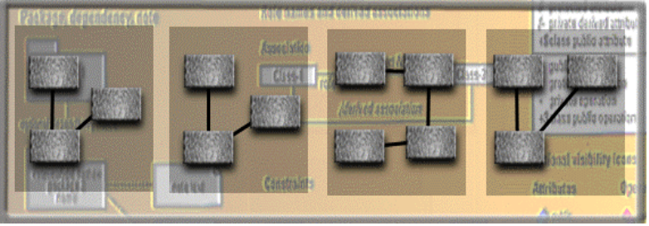
WEB SERVICE MANAGEMENT
users
Local server
网络环境
Notes:
8
Core Message: VM promotes reuse.
Key Point 1:On previous slide, we talked about reusing a model.
Key Point 2:There is a higher leverage of reuse. Reusing parts of the system or an application. For example, a component is an application in a binary format, whether the component is made of objects or not. VM can be used as a component browser and it can also be used to model component assembly.
Conclusion: VM promotes reuse.

Slide 8
异构平台
异构编程环境
异构操作系统
异构网络配置
异构语言
为解决以上问题，系统需要：
与具体系统无关的公共协议（通过接口规范映射为具体环境）
用户描述计算任务语言（通过语法解释和语义绑定，映射为具体执行语言）
通讯使用的文本（XML文本文件，使用SOAP，TCP/IP解决异构网络之间的通讯)
Notes:
9
Core message -- second bullet
UML can be used to communicate system and software design throughout the life cycle

Slide 9
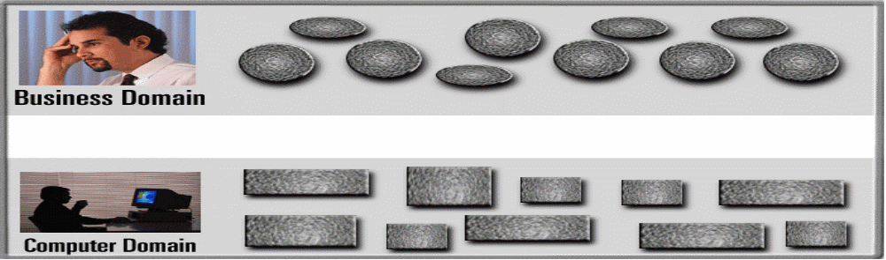
问题：采用什么样的语言模式作为系统的宿主语言
方便地描述计算任务
与具体的计算环境无关
很好地灵活性，适应规范和协议的变化
Notes:
5
Core Message: VM is a communication tool.
Key Point 1: Business analyst and domain experts define requirements. Software architects and developers build systems based on requirements. Typically, they have communication problems due to different use of terminology and different definition of concepts.
Key Point 2: Take a look at the Rose development team. The team is distributed in three cities around the world; Sweden, Milwaukee, and Philadelphia. There is a common language - visual modeling.
Key Point 3: With VM, there is a smooth transition between business domain and computer domain. Also, you can establish traceability from business domain to computer domain.
Conclusion: VM is a communication tool.

Slide 10
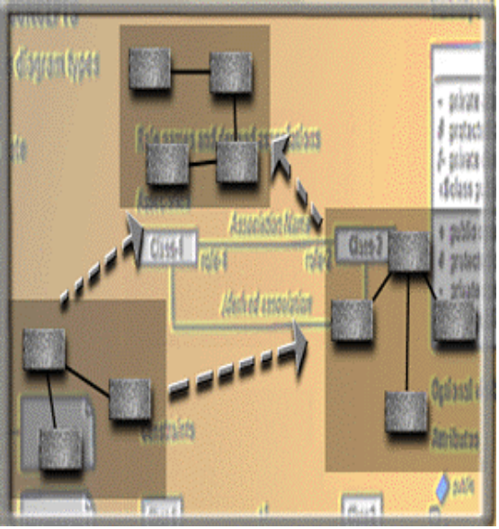
规范和标准：XML，XHTML，…
系统标准通讯文件
用户任务描述
网络服务应用界面
Notes:
12
The last set of slides briefly introduces most of the UML notations.
NOTE: Not all notations are covered due to time constraints

Slide 11
语言模型抽象：
标准协议文件（XML）：上下文无关文法，函数式语言模式（元素、属性）
数学计算任务描述：表达式，关系式。
编程语言：操作命令（operation）操作数据。
<apply>
<plus/>
<cn>2</cn>
<cn>5</cn>
</apply>
2+5>a , plus(2,5)
Setcolor(4)
b:=2; c:=5
A:=b + c
分类代数模型（sorted algebra）
类逻辑代数语言模式（LAL语言）
Notes:
13

Slide 12
抽象语言模型：
变量，函数符号，关系符号
逻辑连接符号（指令控制符号）
公式表达式（数学表达式），关系表达式
If gcd (f, g) =1 then getfactor( f + g )
没有具体的语法和语义定义！
语法和语义分离
语法语义和程序分离
Notes:
16

Slide 13
系统软件
任务描述文件
LAL语言书写
系统工作文件（XML格式）
语法获取
执行程序调用
语义获取
语法定义文件（元素名称字典，DTD）
应用软件接口规范（API）
Notes:
7
Core Message: VM defines software architecture
Key Point 1:Model of a system is essentially a software architecture. You can then map it to the physical architecture. For example, this is a three tier architecture - mapping logical to physical.
Key Point 2: Model your system independent of the implementation language. Technology change too much too fast. A few years ago, C++ was the language of the future but today it’s Java. How do you plan to change your system from PowerBuilder to Visual Basic? Reuse models.
Conclusion: VM defines software architecture

Slide 14
公共协议（大家必须遵守的规则）：
计算任务描述的书写格式规范
XML规范
应用软件接口规范
语法获取：语法字典（DTD，上下文无关语言），解析器（DOMxerces)，Chomsky范式与操作树（节点集合）
语义获取：指称语义（接口规范，绑定，服务发布UDDI）
Notes:
15

Slide 15
决定系统功能的核心不是软件，而是规范和文档
规范不变，系统软件无需改变
文件改变，则语法和语义解释随之变化
（体现了系统的柔性，适应性强）
动态更新，
透明升级，
自治维护，
功能定制。
面向规范的软件开发方法
Notes:
17

Slide 16
对宿主语言的要求：
很好的描述数学计算
很好的语法代数结构
很好的语义解释性能
很好的与其它计算语言的互翻译性
形式语言理论有助于宿主语言模式的设计和中间件开发 （LAL语言的性能）
Notes:
24

Slide 17

有没有更好的语言模式？
Notes:
63

Slide 18
Uses and Extends Use Case Relationships
As the use cases are documented, other use case relationships may be discovered
  A uses relationship shows behavior that is common to one or more use cases
  An extends relationship shows optional behavior
<<uses>>
Register for courses
<<uses>>
Logon validation
Maintain curriculum
Copyright © 1997 by Rational Software Corporation
Notes:
19

Slide 19
Actors
An actor is someone or some thing that must interact with the system under development
Registrar
Professor
Student
Billing System
Copyright © 1997 by Rational Software Corporation
Notes:
14

Slide 20
Use Case Diagram
Use case diagrams are created to visualize the relationships between actors and use cases
Request Course Roster
Student
Professor
Maintain Schedule
Billing System
Maintain Curriculum
Registrar
Copyright © 1997 by Rational Software Corporation
Notes:
18

Slide 21
Uses and Extends Use Case Relationships
As the use cases are documented, other use case relationships may be discovered
  A uses relationship shows behavior that is common to one or more use cases
  An extends relationship shows optional behavior
<<uses>>
Register for courses
<<uses>>
Logon validation
Maintain curriculum
Copyright © 1997 by Rational Software Corporation
Notes:
19

Slide 22
Sequence Diagram
A sequence diagram displays object interactions arranged in a time sequence
: Student
registration
registration
math 101
math 101
form
manager
section 1
1: fill in info
2: submit
3: add course(joe, math 01)
4: are you open?
5: are you open?
6: add (joe)
7: add (joe)
Copyright © 1997 by Rational Software Corporation
Notes:
21

Slide 23
Collaboration Diagram
A collaboration diagram displays object interactions organized around objects and their links to one another
course form :
1: set course info
CourseForm
2: process
: Registrar
3: add course
aCourse :
theManager :
Course
CurriculumManager
4: new course
Copyright © 1997 by Rational Software Corporation
Notes:
22

Slide 24
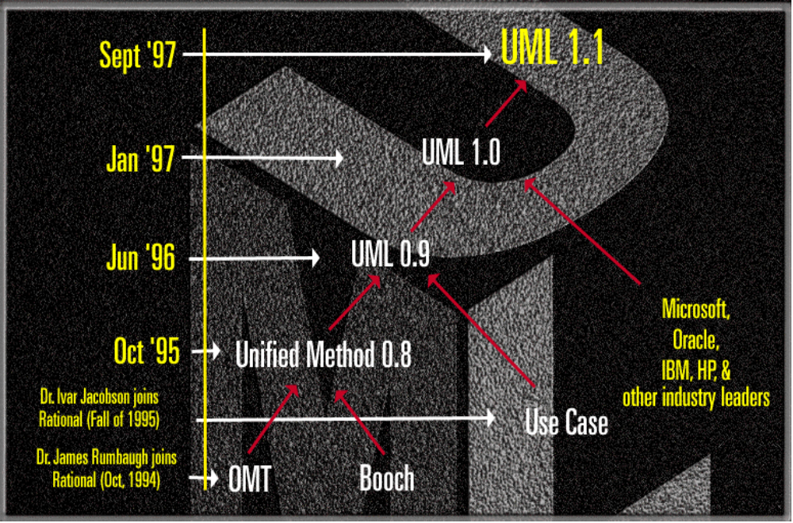
History of the UML
Nov ‘97
UML approved by the OMG
Copyright © 1997 by Rational Software Corporation
Notes:
10
Walk the audience through the timeline. Point out that the UML is the natural successor to the notations.
1. Late ‘80s and early ‘90 - there are many (50+) OO methodologies
2. Among the first generation methodologies, Booch and OMT stood out
3. Around 1993, second generation methodologies came out - Booch ‘93 and OMT-II. Methodologist borrowed good concepts from each others so many concepts were the same across the methodologies, but different notations.
4. Oct. 1994 - Dr. James Rumbaugh joined Rational to unify Booch & OMT.
5. At OOPSLA ‘95, Grady and Jim announced Unified Method 0.8.
6. Use Case technique developed by Dr. Ivar Jacobson was adapted by all
methodologies by then.
7. Rational acquires Objectory in fall of ‘95 - Dr. Ivar Jaconson joins Rational.
8. Jun of ‘96 - Rational submits UML 0.9 to OMG.
9. UML gains industry support from HP, Microsoft, Oracle + 16 others
10. UML is the defacto standard for OO and component technologies
11. The final submission goes in Sep. ‘97 - expect the announcement in Dec.

Slide 25
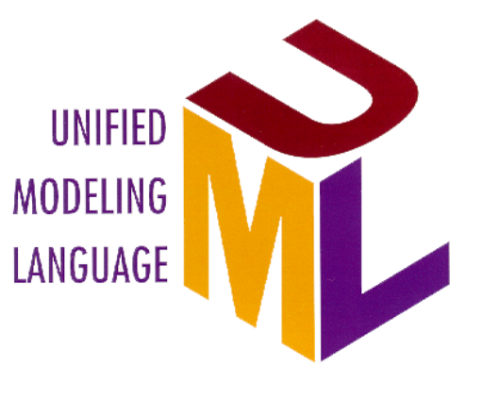
UML Supports
Application Development
Relationships
Objects
Business Objects
large scale system
ORDBMS
Oracle
Classes
application partitioning
Components
Microsoft
Scenarios
CORBA
OMG
Use Cases
ActiveX/COM
Microsoft
Business Process
Copyright © 1997 by Rational Software Corporation
Notes:
11
Transition: So! Who should use UML? Everybody who is doing software development.
Core Message: UML supports object and component-based technology.
Key Point 1: UML is an expressive language that can be used to describe pretty much everything about software application.
- object technology: objet, class, relationships, scenario, Use Case
- component-based development: component, ActiveX/COM, CORBA
- large scale system, application partitioning

Slide 26
Classes
RegistrationForm
ScheduleAlgorithm
RegistrationManager
Course
Student
Professor
CourseOffering
Copyright © 1997 by Rational Software Corporation
Notes:
25

Slide 27
Operations
The behavior of a class is represented by its operations
Operations may be found by examining interaction diagrams
registration
registration
form
manager
RegistrationManager
3: add course(joe, math 01)
addCourse(Student,Course)
Copyright © 1997 by Rational Software Corporation
Notes:
26

Slide 28
Attributes
The structure of a class is represented by its attributes
Attributes may be found by examining class definitions, the problem requirements, and by applying domain knowledge
Each course offering
has a number, location
and time
CourseOffering
number
location
time
Copyright © 1997 by Rational Software Corporation
Notes:
27

Slide 29
Classes
RegistrationForm
ScheduleAlgorithm
RegistrationManager
addStudent(Course, StudentInfo)
Course
name
numberCredits
Student
open()
name
addStudent(StudentInfo)
major
Professor
name
CourseOffering
tenureStatus
location
open()
addStudent(StudentInfo)
Copyright © 1997 by Rational Software Corporation
Notes:
28

Slide 30
Finding Relationships
Relationships are discovered by examining interaction diagrams
  If two objects must “talk” there must be a pathway for communication
RegistrationManager
Registration
Math 101:
Manager
Course
3: add student(joe)
Course
Copyright © 1997 by Rational Software Corporation
Notes:
31

Slide 31
Relationships
RegistrationForm
ScheduleAlgorithm
RegistrationManager
addStudent(Course, StudentInfo)
Course
name
numberCredits
Student
open()
name
addStudent(StudentInfo)
major
Professor
name
CourseOffering
tenureStatus
location
open()
addStudent(StudentInfo)
Copyright © 1997 by Rational Software Corporation
Notes:
32

Slide 32
Multiplicity and Navigation
RegistrationForm
ScheduleAlgorithm
0..*
1
RegistrationManager
addStudent(Course, StudentInfo)
Course
1
0..*
name
numberCredits
Student
open()
major
addStudent(StudentInfo)
1
3..10
Professor
1..*
4
CourseOffering
tenureStatus
1
location
0..4
open()
addStudent(StudentInfo)
Copyright © 1997 by Rational Software Corporation
Notes:
34

Slide 33
Inheritance
RegistrationForm
ScheduleAlgorithm
RegistrationManager
addStudent(Course, StudentInfo)
Course
RegistrationUser
name
numberCredits
name
Student
open()
major
addStudent(StudentInfo)
Professor
CourseOffering
tenureStatus
location
open()
addStudent(StudentInfo)
Copyright © 1997 by Rational Software Corporation
Notes:
36

Slide 34
State Transition Diagram
Add student[ count < 10 ]
Add Student /
Initialization
Set count = 0
Open
do: Initialize course
entry: Register student
exit: Increment count
Cancel
Cancel
[ count = 10 ]
Canceled
do: Notify registered students
Closed
Cancel
do: Finalize course
Copyright © 1997 by Rational Software Corporation
Notes:
38

Slide 35
Component Diagram
Billing.exe
Register.exe
Billing
System
People.dll
Course.dll
User
Course
Student
Professor
Course
Course
Offering
Copyright © 1997 by Rational Software Corporation
Notes:
40

Slide 36
Deploying the System
The deployment diagram shows the configuration of run-time processing elements and the software processes living on them
The deployment diagram visualizes the distribution of components across the enterprise.
Copyright © 1997 by Rational Software Corporation
Notes:
41

Slide 37
Deployment Diagram
Registration
Database
Main
Library
Building
Dorm
Copyright © 1997 by Rational Software Corporation
Notes:
42

Slide 38
What the Iterative Life Cycle Is Not
It is not hacking
It is not a playpen for developers
It is not unpredictable
It is not redesigning the same thing over and over until it is perfect
It is not an excuse for not planning and managing a project
It is not something that affects only the developers on a project
Copyright © 1997 by Rational Software Corporation
Notes:
44
Some managers have the perception that “iterative” really means “hacking” or not knowing what you’re doing or not planning anything. Nothing could be further from the truth.

Slide 39
What the Iterative Life Cycle Is
It is planned and managed
It is predictable
It accommodates changes to requirements with less disruption
It is based on evolving executable prototypes, not documentation
It involves the user/customer throughout the process
It is risk driven
Copyright © 1997 by Rational Software Corporation
Notes:
45
If anything, the iterative life cycle requires more planning and more thought all along the way. The difference is that instead of doing all of the detailed planning up front, it is done in a distributed fashion, a little at a time along the way, when enough information is available to make the planning worthwhile.

Slide 40
Risk Profile of an Iterative Development
Inception
Waterfall
Elaboration
Risk
Construction
Transition
Preliminary
Iteration
Architect.
Iteration
Architect.
Iteration
Devel.
Iteration
Devel.
Iteration
Devel.
Iteration
Transition
Iteration
Transition
Iteration
Post-
deployment
Time
Copyright © 1997 by Rational Software Corporation
Notes:
48
With a typical waterfall approach, no significant amounts of risk are removed until integration begins near the end of the life cycle. The highest (technical) risks are typically architectural: performance (speed, capacity, accuracy, etc.), system interface integrity, and system qualities (adaptability, portability, etc.). These cannot be verified until a significant portion of the system has been coded and integrated.
With an iterative approach, the highest risk items are addressed early in the life cycle, thereby making significant reductions in the risk profile. From a management perspective, the level of confidence in the project plan should correspondingly increase significantly from iteration to iteration.

Slide 41
Risk Reduction Drives Iterations
Define scenarios to address highest risks
Plan Iteration N
Cost
Schedule
Initial Project Risks
Initial Project Scope
Develop Iteration N
Collect cost and quality metrics
Iteration N
Assess Iteration N
Revise Overall
Project Plan
Cost
Schedule
Scope/Content
Revise Project Risks
Reprioritize
Risks Eliminated
Copyright © 1997 by Rational Software Corporation
Notes:
51

Slide 42
Use Cases Drive the Iteration Process
Inception
Elaboration
Construction
Transition
Iteration 1
Iteration 2
Iteration 3
“Mini-Waterfall” Process
Iteration Planning
Rqmts Capture
Analysis & Design
Implementation
Test
Prepare Release
Copyright © 1997 by Rational Software Corporation
Notes:
52
Each phase is divided into one or more iterations. Each iteration is defined in terms of the scenarios it implements. The classes needed to implement all selected scenarios are developed in a mini-waterfall development process.

Slide 43
The Iteration Life Cycle: A Mini-Waterfall
Selected scenarios
Results of previous iterations
Up-to-date risk assessment
Controlled libraries of models, code, and tests
Iteration Planning
Requirements Capture
Analysis & Design
Implementation
Test
Prepare Release
Release description
Updated risk assessment
Controlled libraries
Copyright © 1997 by Rational Software Corporation
Notes:
53
This is what one single iteration looks like.
As with any waterfall representation of a process, in the mini-waterfall, many of these activities are occurring concurrently. For example, analysis is not done all in one continuous lump. And it intermingles with design and code, etc.

Slide 44
Copyright © 1997 by Rational Software Corporation
Notes:
63

