Slide 1

Encoding Reversing Petri Nets in Answer Set Programming
Kyriaki Psara
Joint work with Yiannis Dimopoulos, Eleftheria Kouppari, and Anna Philippou

Slide 2
Our goal
To develop concise and efficient logical representation of reversible system behaviour
To implement a systematic way for the automatic analysis and reasoning about Reversing Petri Nets (RPNs)
To highlight how an Answer Set Programming (ASP) can be used to reason about the behaviour of RPN models

Slide 3
Answer Set Programming
A novel paradigm for applying declarative logic programming techniques
ASP is a set of rules of the form:
A₀ ← A₁,...A_{m},not A_{m+1},...not A_{n}
Models a system as well as a query about the system by devising a logic program
clingo (https://potassco.org/clingo/)
ASP has been used to model
1-safe Place/Transition nets, basic Petri Nets, Coloured Petri nets, Petri net extensions

Slide 4
Reversing Petri nets
A variation of Petri nets a reversible approach to Petri nets, which allows the transitions of a net to be reversed [Philippou & Psara 2018]
A Reversing Petri net is a tuple (P, T, A, B, F) where
P is a finite set of places
T is a finite set of transitions
A is a finite set of bases or tokens
is a set of bonds
is a set of directed arcs
x
a
y
a-b
c
a
b
t₂
z
b

Slide 5
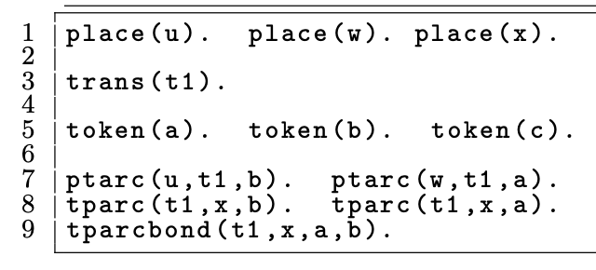
RPNs to ASP
The basic predicates that represent the input network are:
trans(T), token(Q), place(P), ptarc(P,T,Q), tparc(T,P,Q), ptarcbond(P,T,Q1,Q2), tparcbond(P,T,Q1,Q2)
u
b
b
c
x
b-a
t₁
w
a
a

Slide 6
Marking and States
Marking: A distribution of tokens/bonds on places:
History: assigns a memory to a transition
H: T → 2^{ℕ}
State: a pair of a marking and a history

Slide 7
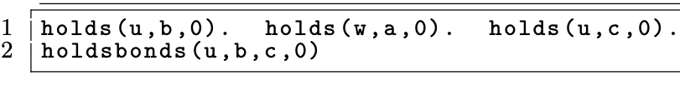
From RPNs to ASP
Marking: holds(P,Q1,TS),holdsbonds(P,Q1,Q2,TS)
History: TS is the step of the simulation
the simulation length is encoded by the last argument TS of the predicates of our model
u
b
b
c
x
b-a
t₁
w
a
a

Slide 8
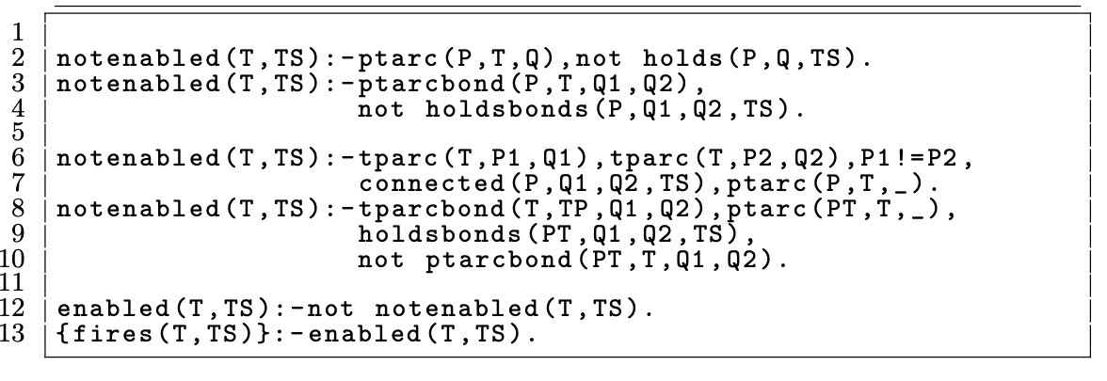
Forward enabledness
Definition: A transition t is forward enabled in an RPN state ⟨M,H⟩ if:
All tokens/bonds required for the transition are available on its incoming places
Tokens/bonds cannot be cloned
Bonds cannot be recreated

Slide 9
Forward Execution
a
a
a
t₁
a
a-b
b
t₃
b
b
b
t₂

Slide 10
Forward Execution
[1]
a
a
a
t₁
a
a-b
b
t₃
b
b
b
t₂

Slide 11
Forward Execution
[1]
a
a
a
t₁
a
a-b
b
t₃
[2]
b
b
t₂
b

Slide 12
Forward Execution
[1]
a
a
t₁
a
[3]
a-b
a-b
b
t₃
[2]
b
b
t₂

Slide 13
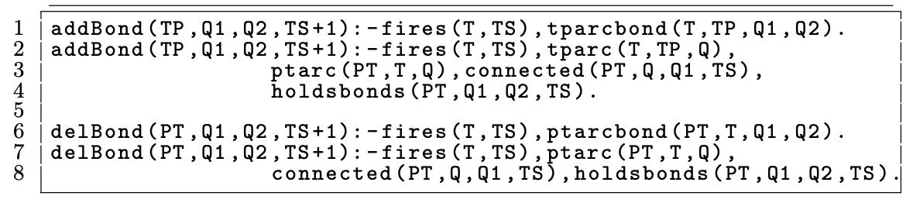
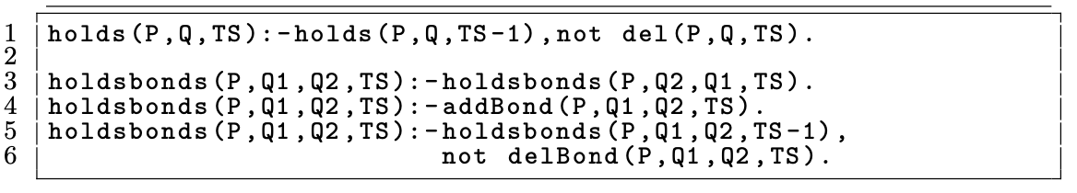
Forward Execution
Definition: If a transition t is forward enabled in an RPN then the marking is updated as follows:

Slide 14
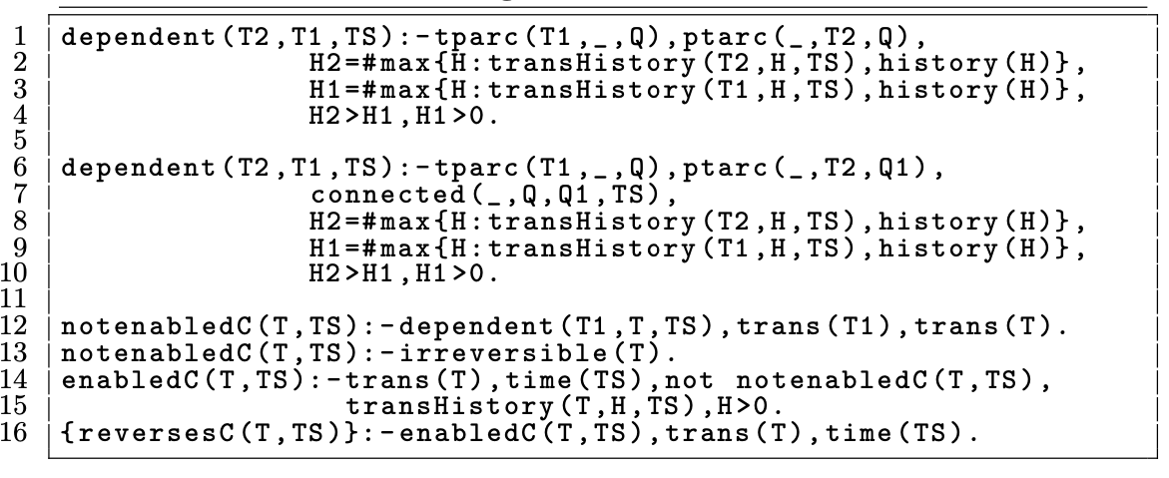
Causal order enabledness
Definition: A transition t is causally enabled in an RPN state ⟨M,H⟩ if:
There are no transitions causally dependent on t
Two transitions are causally dependent if they manipulate the same tokens
The transition has been executed

Slide 15
Causal Execution
[1]
a
a
t₁
a
[3]
a-b
a-b
b
t₃
[2]
b
b
t₂

Slide 16
Causal Execution
[1]
a
a
a
t₁
a
a-b
b
t₃
[2]
b
b
t₂
b

Slide 17
Causal Execution
a
a
a
t₁
a
a-b
b
t₃
[2]
b
b
t₂
b

Slide 18
Causal Execution
a
a
a
t₁
a
a-b
b
t₃
b
b
b
t₂

Slide 19
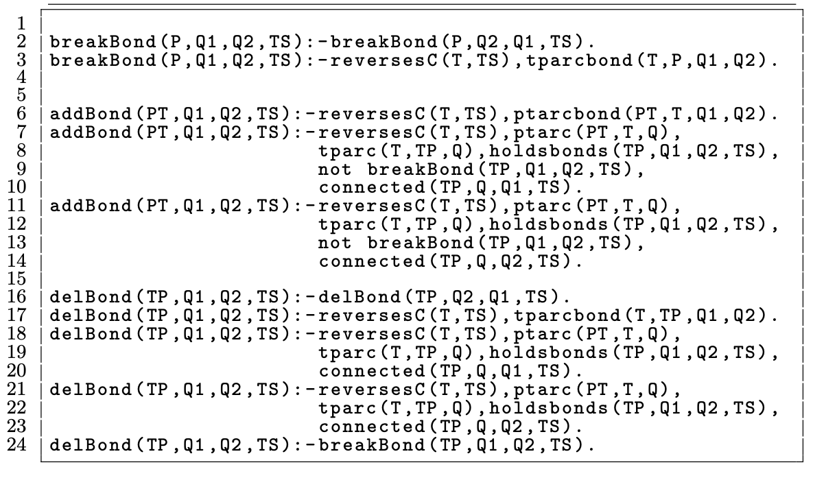
Causal Execution
Definition: If a transition t is causally reversible in an RPN then the marking is updated as follows

Slide 20
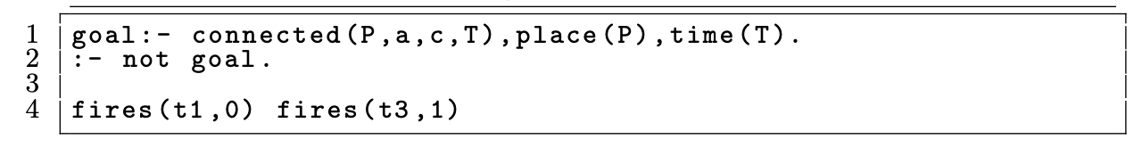
Queries
A reachable state where some place holds the bond a−c
t
b
x
b
r
d,a-b
t₂
d
[1]
u
d,a
d,a
s
t₁
d,a
[2]
y
a
d,a-c
d
a
t₃
c
v
c

Slide 21
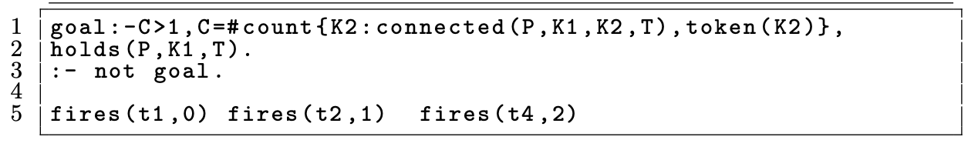
Queries
A reachable state where some place holds a bond with at least three tokens
d
t
b
[2]
x
[3]
z
r
d,a-b
d,a-b
a-b,
b-c
a
t₂
t₄
b
d
[1]
c
d
u
d,a
t₁
d,a
s
d,a
y
a
d,a-c
t₃
v
c
c

Slide 22
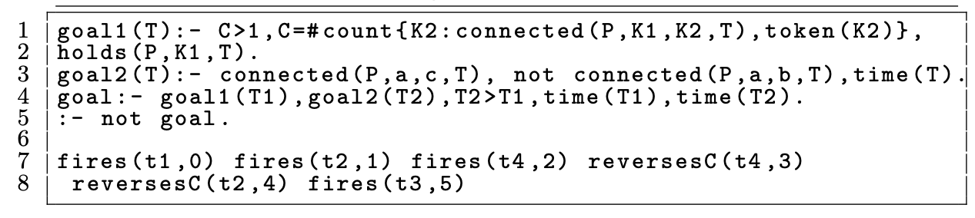
Queries
A reachable state that first creates a bond with at least three tokens, and a bond with a and c but without b
d
t
b
b
x
z
r
t₂
d,a-b
d,a-b
t₄
a-b,
b-c
d
[1]
u
d,a
t₁
d,a
s
d,a
[2]
y
a
t₃
d,a-c
d
a
v
c
c
c

Slide 23
Concluding Remarks
Presented a methodology for analysing reversible systems modelled as RPNs based on ASP
We argue that ASP:
allows an expressive and flexible methodology for defining models and their properties
can handle difficult queries on complex models efficiently

Slide 24
Current and Future Work
Extend our translation to out-of-causal reversibility
Capture a variety of RPN properties
Allow multiple tokens of the same base/type to occur in a model
Use the graphical interface of existing RPN tools to model ASP
Colored Petri Nets:
Customised RPN tool

Slide 25

Thank you for your attention!

Slide 26
References
[Heljanko and Niemela 2003] K. Heljanko and I. Niemela ̈. Bounded LTL model checking with stable models. TPLP, 3(4-5):519–550, 2003.
[Anward et al. 2013 ] S. Anwar, C. Baral, and K. Inoue. Encoding Petri nets in answer set programming for simulation based reasoning. TPLP, 13(4-5-Online-Supplement), 2013.
[Anward et al. 2013] S. Anwar, C. Baral, and K. Inoue. Encoding higher level extensions of Petri nets in answer set programming. In Proceedings of LPNMR 2013, LNCS 8148, pages 116–121. Springer, 2013.
[Anward et al. 2014] S. Anwar, C. Baral, and K. Inoue. Simulation-based reasoning about biological pathways using Petri nets and ASP. Logical Modeling of Biological Systems, pages 207–243, 2014.
[Philippou & Psara 2018] A. Philippou and K. Psara. Reversible computation in Petri nets. In Proceedings of RC 2018, LNCS 11106, pages 84–101. Springer, 2018.

