Slide 1

Title page option 2 with solid color background
A Proposed Research Platform for Fully Adiabatic, Reversible, and Superscalar (FARS) Microarchitectures
A Work In Progress Paper
Byron Gregg & Christof Teuscher

Slide 2
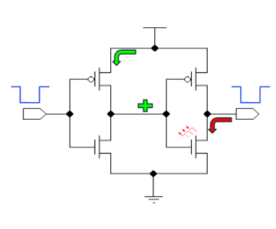

Section page with headline and two columns for copy
Introduction / Motivation
Motivation: Performance Meets the Energy Wall
IF | ID | EX | MEM | WB
 | IF | ID | EX | MEM | WB
 |  | IF | ID | EX | MEM | WB
 |  |  | IF | ID | Stalled |  |  |  | EX | MEM | WB
 |  |  |  | IF | Stalled |  |  |  | ID | EX | MEM | WB
Scalar
Power and energy constraints increasingly dominate HPC scaling [1][2]
OoO execution is essential for performance via Instruction-Level Parallelism [3]
Irreversible computation fundamentally dissipates energy [4]
Reversible logic enables energy recovery, but none exist in OoO applications
IF | ID | EX | MEM | WB
 | IF | ID | EX | MEM | WB
 |  | IF | ID | EX | MEM | WB
 |  |  | IF | ID | EX | MEM | WB
 |  |  |  | IF | ID | EX | MEM | WB
SuperScalar
$$E≥k_{B}T\ln{(2)}$$
[1] Kocot, Czarnul, & Proficz, “Energy-Aware Scheduling for High-Performance Computing Systems: A Survey” [2] Esmaeilzadeh et al., “Dark Silicon and the End of Multicore Scaling” [3] Hennessy & Patterson, “Computer Architecture: A Quantitative Approach” [4] Landauer, “Irreversibility and Heat Generation in the Computing Process”
2

Slide 3
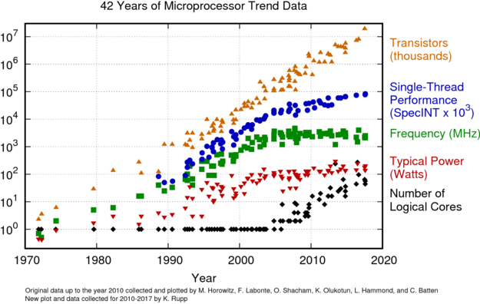
Section page with headline and two columns for copy
Introduction / Motivation
Why Energy Is the Bottleneck (Not Transistors)
Dennard scaling failure [1]
Energy per operation > latency in long-running workloads
HPC systems already operate within power envelopes [2]
A first-order problem; modern systems are power-limited before performance-limited.
[1] Bohr & Young, “CMOS Scaling Trends” (IEEE Micro) [2] D’Mello et al. “Aurora: Architecting Argonne’s First Exascale Supercomputer for Accelerated Scientific Discovery” [3] Rupp, “42 Years of Microprocessor Trend Data”
3

Slide 4
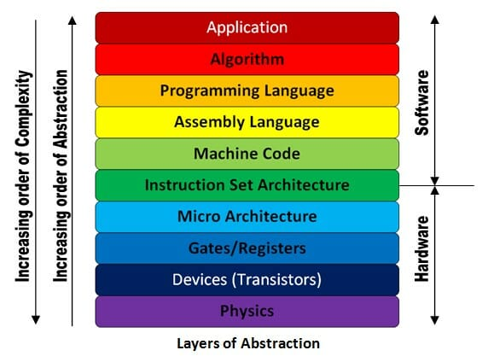
Section page with headline and two columns for copy
Introduction / Goals
Layers of Abstraction
Majority of Reversible Computing research done at higher language levels
Focus of this work and potential gains
Majority of Adiabatic and Reversible Hardware research done at the gate level and lower
Image from: https://ms.codes/blogs/computer-hardware/what-does-the-hardware-layer-in-computer-architecture-include
4

Slide 5
Section page with headline and two columns for copy
Core Research / Question
Research Questions
Can out-of-order microarchitectures be redesigned to be reversible and energy-recovering while retaining meaningful performance advantages?
Reversible speculation and rollback
Reversible renaming and scheduling
Can workloads executed on such microarchitectures present meaningful energy/information recovery?
Workload-dependent benefits
Explore the architectural feasibility tradeoffs
5

Slide 6
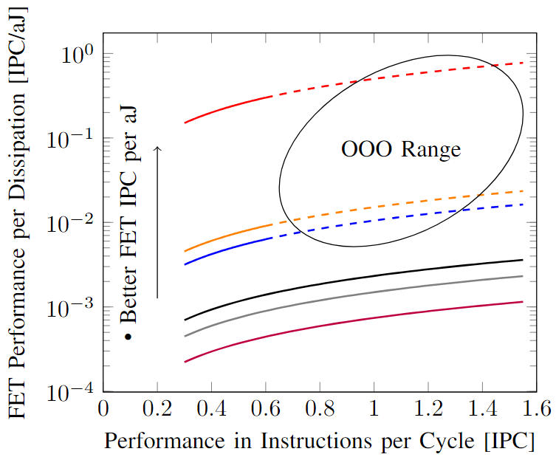
Section page with headline and two columns for copy
Core Research / State of the Art & Gap
What Exists And What Doesn’t
Reversible processors (w/ full ISA):
Vieri’s Pendulum [1,2]
High-performance processors:
Aggressively OoO
Fundamentally irreversible
Key gap:
No demonstrated reversible out-of-order microarchitecture
[1] Vieri, “Pendulum–A Reversible Computer Architecture.” [2] Vieri, “Reversible Computer Engineering and Architecture.” [3] Gregg and Teuscher, “General Principles for Implementing Branch Prediction inFully Adiabatic, Reversible, and SuperScalar (FARS) Processors.”
6

Slide 7
Section page with headline and two columns for copy
Core Research / Why HPC Workloads
FARS Architectural Framework
Reversible Execution Model
Instructions are bijective transformations over the architectural state.
E.g., if a loop is executed 5 times in the forward, it must be executed 5 times in reverse.
Requires enough information be retained to reconstruct prior states.
SuperScalar and Out-of-Order Coordination
Requires speculative execution but must also support inversion.
Rather than flushing speculative state on misprediction, execution history would have to be unwound through controlled reversal (could be done in parallel).
Memory Implications
Reversible memory interaction requires retaining sufficient state to enable inversion.
Cache replacement and hierarchy transfers must avoid destructive updates or encode overwritten state explicitly.
7

Slide 8

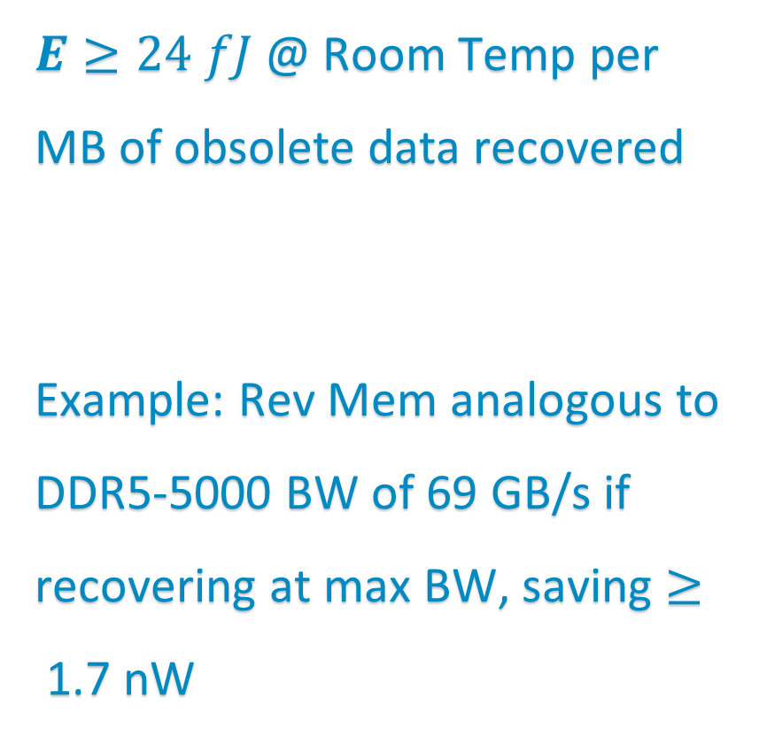

Section page with headline and two columns for copy
Core Research / Goals
Idealized System
Fully Adiabatic MIPS/RISC example
(pipelines not shown)
And Reversible
MEM
FWD
10001
11001
01001
10001
11101
REV
IF
ID
EX
FWD
FWD
FWD
REV
REV
REV
$$E≥k_{B}T\ln{(2)}$$
PC
00011001
01011001
00001001
01010001
00011101
01011011
$E≥24 fJ$@ Room Temp per MB of obsolete data recovered
Example: Rev Mem analogous to DDR5-5000 BW of 69 GB/s if recovering at max BW, saving $≥$1.7 nW
REV
FWD
DDR5-5000 data from: https://www.hpcwire.com/2024/01/18/hpc-memory-when-faster-might-be-slower/#:~:text=The%20tested%20DDR5%2D4800%20(63,the%20maximum%20one%20would%20expect.&text=Tuning%20to%20another%20application%20from,small%20increase%20of%20only%202%25.&text=Another%20test%20is%20the%20popular,the%20faster%20DDR5%2D5600%20memory.
8

Slide 9
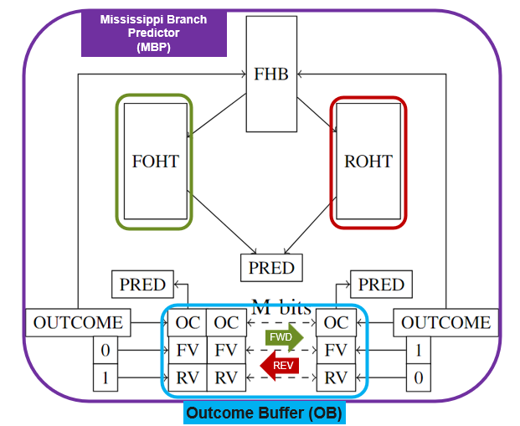
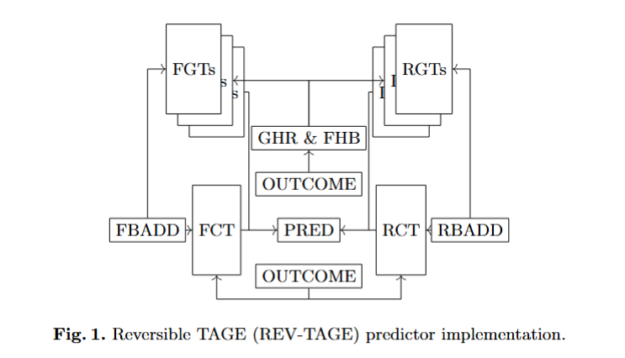
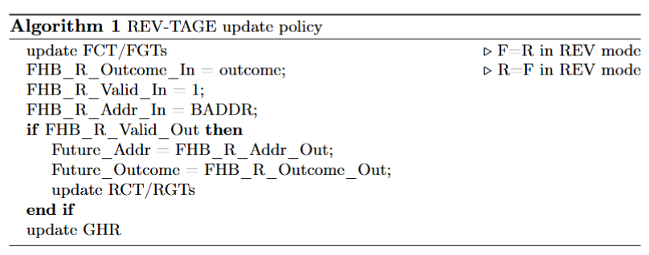
Section page with headline and two columns for copy
Prior Work / Credibility
Concrete Artifact
Reversible branch prediction mechanisms [1]
[1] Gregg and Teuscher, “Against the Current: Introducing Reversibility to SuperScalar Processors via Reversible Branch Predictors”
9

Slide 10
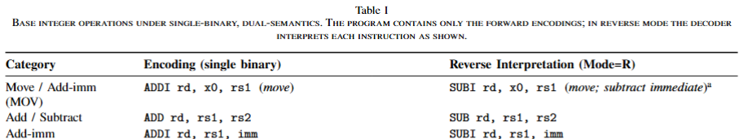
Section page with headline and two columns for copy
Prior Work / Credibility
Immanent Works
Reversible RISC-V ISA (REVive) [WIP]
Architectural energy modeling [WIP]
10

Slide 11
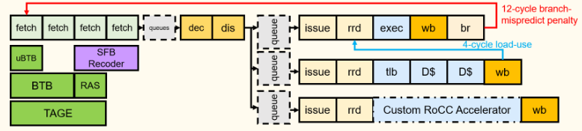
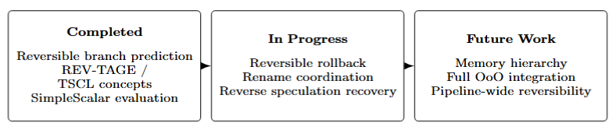
Section page with headline and two columns for copy
Planned Platform / BOOM V3 Reversified
Superscalar Integration Path
11
[1] Zhao, Korpan, Gonzalez, & Asanovic “SonicBOOM: The 3rd Genera-tion Berkeley Out-of-Order Machine.”

Slide 12
Section page with headline and two columns for copy
Planned Platform / Visualizing Reversible Information-Energy
Intended Culmination
Simulation Platform
Tests real HPC workloads on a reversible architecture.
Extends programs to meet REVive ISA requirements.
Models the minimum energy recovered/saved from running reversibly.
Models which architectural components yield the biggest savings per workload.
MEM
15%
TAGE
5%
BTB
10%
Fetch
Decode
Issue
Exec
MEM
uBTB
5%
PC
Other
5%
FPU
40%
Decode
20%
Parallel Speculation Unroll
Fetch
Decode
Issue
UnExec
12

Slide 13
Section page with headline and two columns for copy
End
Conclusion and Invitation
We intend to develop a platform that allows others to test real workloads using our architecture to identify those that could benefit most from reversibility.
We invite you once the platform is available to test it out and provide feedback; please email greggbyr@pdx.edu for collaboration requests.
13

Slide 14
Q&A
Thanks for listening!

