Slide 1
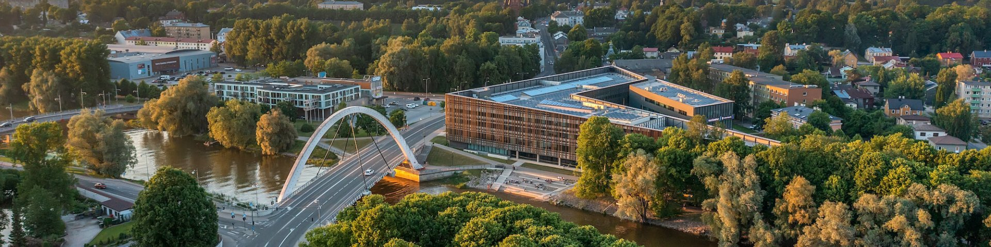



Reversible Deep Learning for ¹³C NMR in Chemoinformatics: On Structures and Spectra
Stefan Kuhn, Vandana Dwarka, Przemyslaw Grenda, and Eero Vainikko

Slide 2
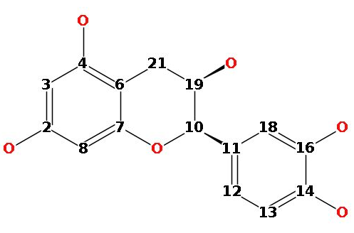
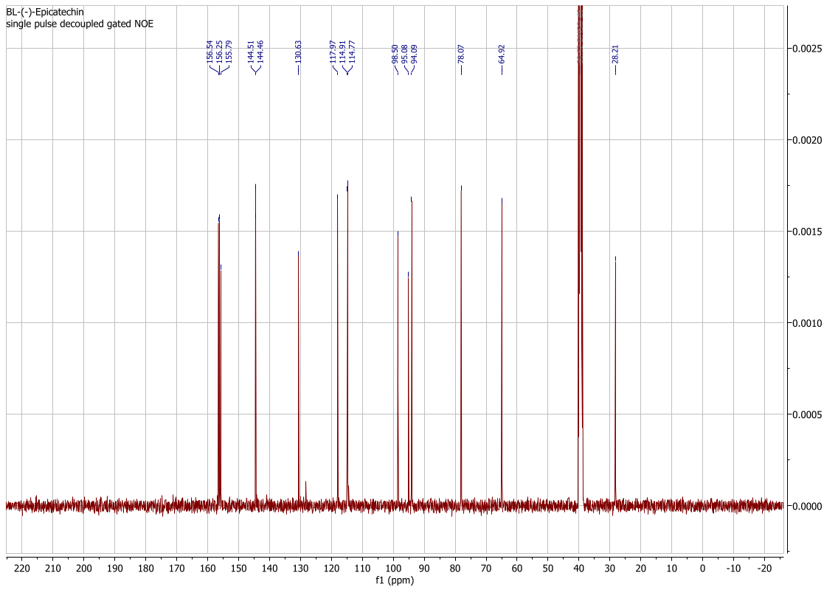
Background
Neural networks, in particular “deep learning” versions of them, have been a ubiquitous tool, used for all kinds of applications in computer science and practically any other area.
In chemoinformatics, one area is the prediction of properties from molecules (QSAR).
These properties include nuclear magnetic resonance spectra (NMR) spectra.

Slide 3
Background
The inverse problem has been tackled as well (referred to as “structure elucidation”).
This is not as well defined as spectrum prediction (there can be identical spectra for different molecules).
Still, neural networks have recently been trained to do it.

Slide 4
Background
Question: Would it be possible to have one solution for both problems?
Let’s defer the answer for now.
?

Slide 5
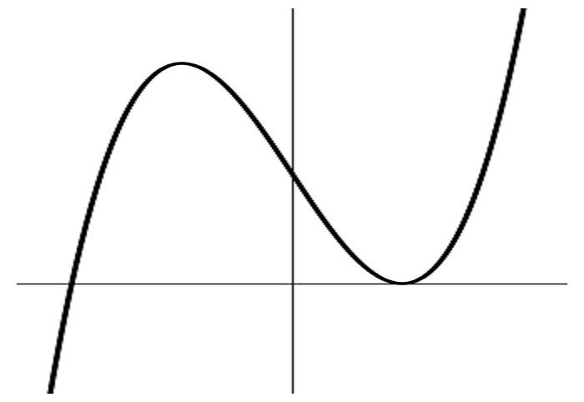
Neural Networks
Generally, an NN consists of a multitude of neurons.
It executes a (complicated) function.
A neuron, in principle looks like this:
Function parameters are initialized randomly initially
x₁=0.5
x₂=0.1
?
x₃=0.9

Slide 6

Neural Networks – Forward pass
Assume our function is
Assume the random initial values are a=0.4, b=0.9, c=0.2, d=-0.1
We then get an output of y=0.37 for our example inputs
$$y=a∗x1+b∗x2+c∗x3+d$$
x₁=0.5
error=0.33
x₂=0.1
Y=0.37 , but should be 0.7
x₃=0.9

Slide 7
Neural Networks – Learning
We notice that the result is wrong – it should be 0.7 according to our training examples
We then change (using mathematical operations) the parameters so that the result gets better.
After one round of learning, we get a=0.5, b=0.9, c=0.4, d=-0.1
x₁=0.5
error=0.1
x₂=0.1
Y=0.6, but should be 0.7
x₃=0.9

Slide 8
Neural Networks – Reversibility
Doing this with many examples and repeatedly makes the network converge to a stable state for all parameters (hopefully)
If we only had a=0.4, b=0.9, c=0.2, d=-0.1 and the neuron as below, could we perform learning?
In order to correct the parameters, we needed the inputs.
x₁=?
error=0.1
x₂=?
Y=0.6, but should be 0.7
x₃=?

Slide 9
Neural Networks – Reversibility
Learning needs to know the inputs, since the function is not reversible, i. e. we cannot conclude the inputs from the output alone.
If the functions in an NN are (partially) reversible, it is referred to as a (partially) reversible NN.
The main purpose of those is to save memory (if a modern NN has millions or even billions of parameters, there is some memory to save).
Ulidowski, I. (2023). Saving Memory Space in Deep Neural Networks by Recomputing: A Survey. In: Kutrib, M., Meyer, U. (eds) Reversible Computation. RC 2023. Lecture Notes in Computer Science, vol 13960. Springer, Cham. https://doi.org/10.1007/978-3-031-38100-3_7
Zingel, U., Kuhn, S., Vainikko, E. (2025). Implementing Reversible Neural Networks. In: Glück, R., Kaarsgaard, R. (eds) Reversible Computation. RC 2025. Lecture Notes in Computer Science, vol 15716. Springer, Cham. https://doi.org/10.1007/978-3-031-97063-4_12

Slide 10
Invertible Neural Networks
Thinking about it, I wondered if it would not be possible to make a fully reversible network and use it to solve a problem and its inverse by training only one network.
In particular, our structure-spectrum relationship seems a really nice example here.
We call such networks invertible NNs, just to have a clear terminology
invertible neural network

Slide 11
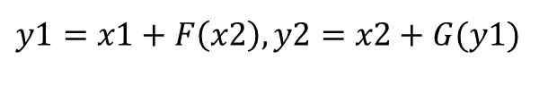
Invertible Neural Networks
There is some work on this, in particular i-RevNet, which are based on RevNets.
Both make convolutional operations reversible.
RevNet processes two (matrix) inputs into two matrix outputs in a fashion that the functions are reversible:
i-RevNet combines am invertible part with a classifier since it is used on the ImageNet classification task.
This could be called an “ML view of reversibility”
$$y1​​​=x1​+F\left(x2​\right), y2=x2​+G(y1​)​$$
Jörn-Henrik Jacobsen, Arnold Smeulders, Edouard Oyallon: i-RevNet: Deep Invertible Networks, ICLR 2018 - International Conference on Learning Representations, Apr 2018, Vancouver, Canada. 2018, https://iclr.cc/ Aidan N Gomez, Mengye Ren, Raquel Urtasun, and Roger B Grosse. The reversible residual network: Backpropagation without storing activations. arXiv preprint arXiv:1707.04585, 2017.

Slide 12
Our Invertible Neural Network
In contrast, we want to apply “real” reversibility, as used in the RC world.
This puts a restriction on what we can do – basically, we cannot lose information in the network.
We have decided to use
C_{x}H_{y} molecules where x<=17, encoded as 4 matrices encoding C-C bonds only.
¹³C NMR spectra binned into 1024 buckets.

Slide 13
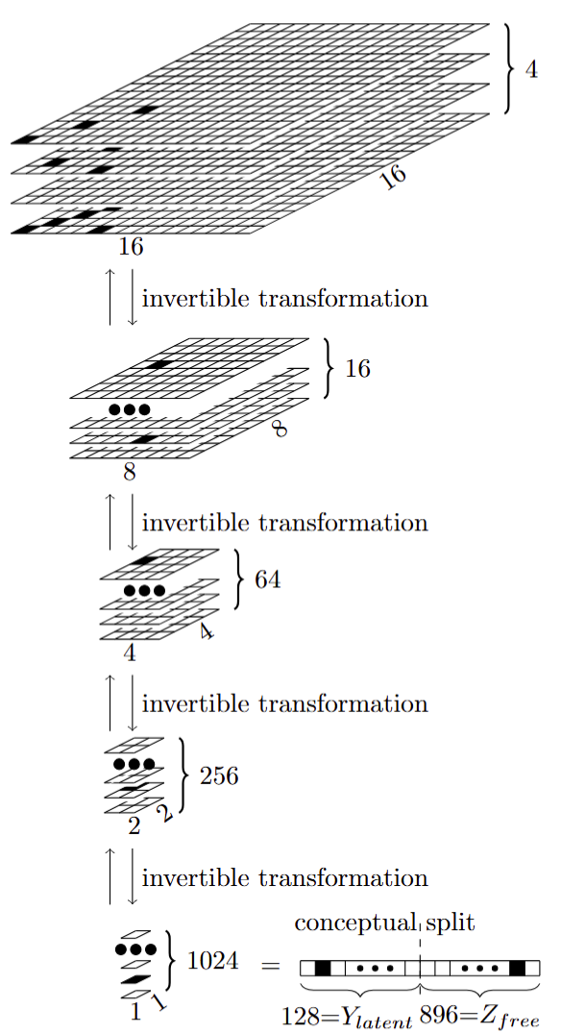
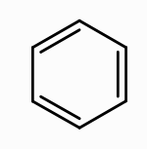
Our Invertible Neural Network
Encoded here
Information content stays the same (16*16*4==1024).
Problem: Only 128 bits “meaningful” information in our structures.
The “technical” information content is 1024 bits, but the “domain” information is 128 bits.

Slide 14
Our Invertible Neural Network
We divide the 1024 bits into 128 “useful” bits and define the rest as meaningless.
The loss function and the learning should ensure this.

Slide 15
Results - The network can predict spectra
10 runs with different, random train/validation splits gives F1 values between 0.1548 and 0.1839, with a mean of 0.1695.
For comparison, using the same bit representation and a state-of-the-art NN, the F1 value is 0.92.
A random predictor with the same probability of 1s and 0s achieves an expected F1 of about 0.0643
nmrshiftdb2 molecule ID | Real | Predicted
20181820 | 14, 20, 22, 78, 81 | 11, 13, 85, 127
20097935 | 13, 77, 79, 80, 86, 88 | 76, 77, 78, 79, 80, 82, 83, 84
60033845 | 9, 11, 13, 17, 18, 22, 23, 24, 33, 74, 84, 85, 92 | 10, 12, 13, 15, 17, 18, 19, 20, 21, 22, 23, 24, 27, 28, 75, 77, 83, 86, 88
10016372 | 3, 12 | 8, 14, 16, 20
60063671 | 8, 10, 13, 19, 47, 49, 67, 68, 80, 87, 89 | 8, 11, 40, 41, 46, 47, 49, 50,68, 80, 82, 86, 89
60033894 | 7, 8, 12, 14, 16, 18, 21, 22, 80, 82 | 7, 8, 12, 14, 17, 18, 19, 20, 21,23, 71, 80
10023267 | 8, 10, 27, 74, 76, 77, 78, 85, 86, 90, 93 | 12, 15, 23, 74, 77, 78, 80, 89, 90, 92
10005628 | 7, 8, 41, 53 | 46, 72, 127
10016436 | 10, 71, 80, 83, 86 | 11, 46, 72, 82, 83, 85, 127
10016490 | 14, 75, 81, 89, 93 | 85, 127
Some typical examples of real and predicted binned spectra.

Slide 16
Results - The network is invertible for trained values
From a known Y_{latent} and Z_{free}, we can reconstruct the input.
That is a minimum requirement.
There are small rounding errors between 0.00009 to 0.00015.

Slide 17
Results - Z_{free} primarily captures residual variation
Since all meaningful content on the output side of the network is in Y_{latent}, we want Z_{free} to be independent from Y_{latent} and to be well-behaved.
 | Over validation set
 | Real |  | Ideal
Metric per Sample | Mean | Std | Mean | Std
Z_{free} mean | 0.0858 | 0.0334 | 0 | small
Z_{free} std | 0.5861 | 0.0795 | 1 | small
Real and ideal values for Z_{free} statistics.

Slide 18
Results - The data manifold is well structured
How stable is the inverse mapping is when Z_{free} changes while Y_{latent} is fixed.
Z_{free} can be taken either from the forward pass of a real sample or from the learned prior.
We then add Gaussian noise to z_{free} and measure how much the reconstructed input changes.
Radius ϵ | CD_{local}(ϵ) | rCD_{local}(ϵ)
0.01 | 0.598314 | 0.140901
0.05 | 2.760628 | 0.635761
0.10 | 5.379945 | 1.106703
0.20 | 10.559302 | 1.083014
0.50 | 21.109917 | 0.578593
1.00 | 38.130421 | 0.59810
Conditional deviation under perturbations of Z_{free} at fixed Y_{latent}.

Slide 19
Results - Generated X values are meaningful
For unknown Y_{free}, there should be meaningful inputs.
The results can hardly be an exact result, since a very specific arrangement of only a few 1s in the matrices is required. This is not enforced during training.
We calculate the correlation coefficient between the number of 1s in the real inputs and the reconstructed ones. For ten rounds, the mean correlation coefficient was 0.1863, with a minimum of 0.0971 and a maximum of 0.2284.
We also calculate the correlation between the number of 1s in the fourth array of the input for each molecule (aromatic bonds). The correlation coefficient was 0.1775 (min=0.09563, max=0.2073) for ten runs.

Slide 20
Conclusion
Neural networks can be designed to be run in both directions.
This requires training in only one direction, but puts restrictions on the input and output spaces.
We used chemical structures and ¹³C NMR spectra as an example.
We have shown that this network produces meaningful results in both directions.
Currently, the results are inferior to specialized networks.
Invertible NNs have potential not only to solve problems, but also to help clarifying the information space of problems.

Slide 21

Questions?
We are planning a workshop at
The largest applied and industrial mathematics conference worldwide
Talk to us if you are interested
Stefan Kuhn, Vandana Dwarka, Przemyslaw Grenda, and Eero Vainikko

