Slide 1
Welcome to the 18th International Conference on Reversible Computation
Clément Aubert & Luca Roversi

Slide 2
`7 minutes’ introduction
Organization
Today’s program (overview)

Slide 3
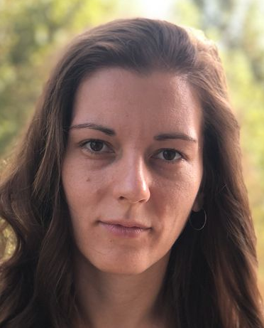
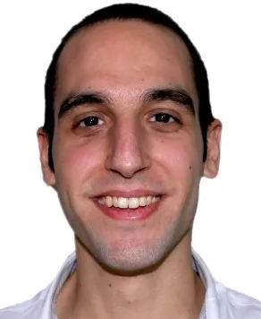
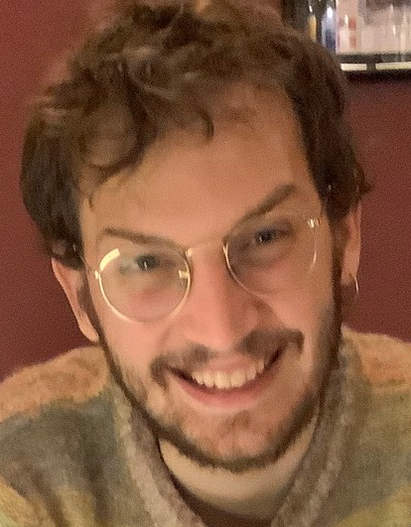
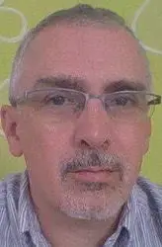
Organization: the locals
Doriana
Mario
Matteo
Luca

Slide 4
Organization
WIFI
If it works for you: Eduroam
If not, please, ask me
Power supply
On your left side
This is room “De Filippi”
Always open, with some local inside
Room “Aula B”
Work room, available for all
If locked, ask the keys to a local
Cofee-breaks/Lunches
1° floor (stairs/lift)
Follow a local or the indications

Slide 5
Today’s program (overview)
Sessions’ chairs wanted
Do you present today? Please, make a test before the talk
Hannah Earley’s talk is on-line
First talk of the first section (Christine Li, Lia Yeh)
Video recorded
All remaining talks are on-site
Last talk should terminate at about 17:30
Social dinner at 19:45
Restaurant «La Via del Sale» quite close to this department

Slide 6
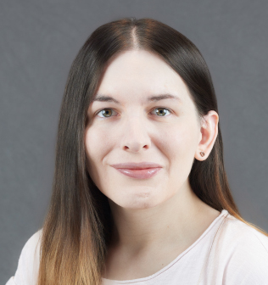
Hannah Earley, invited speaker
Essential Bio
Co-founder and Chief Technology Officer of Vaire Computing
At Vaire Computing, she leads the development of reversible computing architectures
PhD in Applied Mathematics and Theoretical Physics University of Cambridge, focused on:
mathematical foundations of computation
physics-informed models of logic

Slide 7
Enjoy the conference!

Slide 8
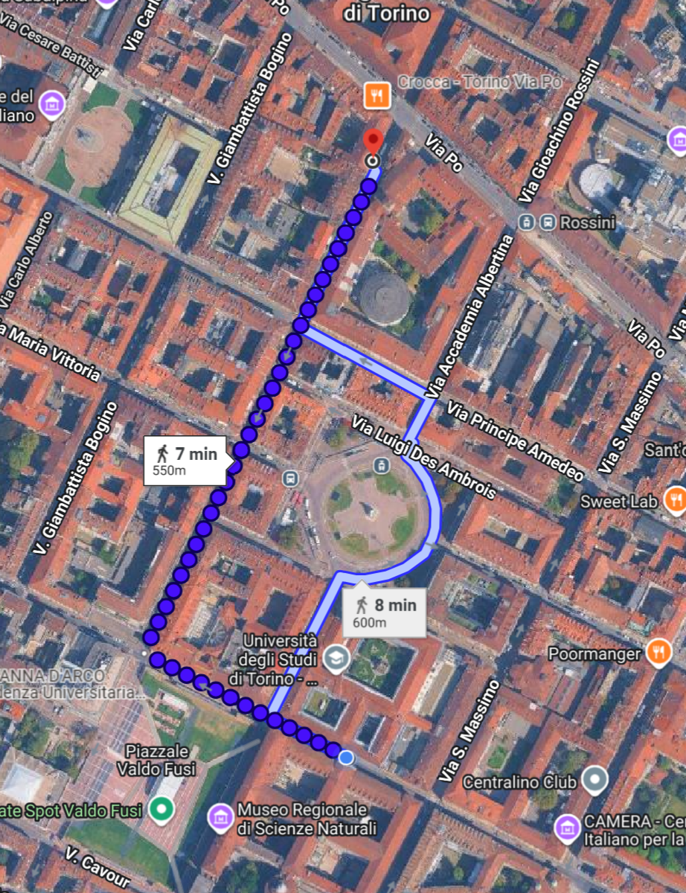
Restaurant at around 20:00
“La Via del Sale”
Via San Francesco da Paola, 2
(400m from here)

