Slide 1
18th International Conference on Reversible Computation Second Day
Clément Aubert & Luca Roversi

Slide 2
Today’s program (overview)
Do you present today? Please, make a test before the talk
Last talk should terminate at about 16:00
Then:
Closing
Presentation of the next edition
Social event at 17:00 after our last coffee-break
A walk of no more than two hours.
Expert guides will lead us through the city center.
We will listen to them using radio headsets.
Departure: entrance hall of this department
Please return the headsets
even if you decide to leave the walk before it ends.

Slide 3
The Proceedings are available
on the conference website

Slide 4
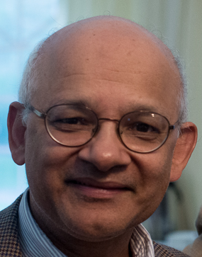
Prakash Panangaden, invited speaker
Essential Bio
Professor at:
Cornell University
Queen’s University
McGill University (Emeritus)
University of Edinburgh (Honorary)
Research across computer science, mathematics and physics:
quantum causality
quantum dynamics
programming languages
probabilistic systems
relativity
LICS Test of Time Award awarded twice (2017, 2022)

