Slide 1

Proposal Writing
Best practices
Do Better. Win More.™
Notes:
5 minutes for overview

Slide 2


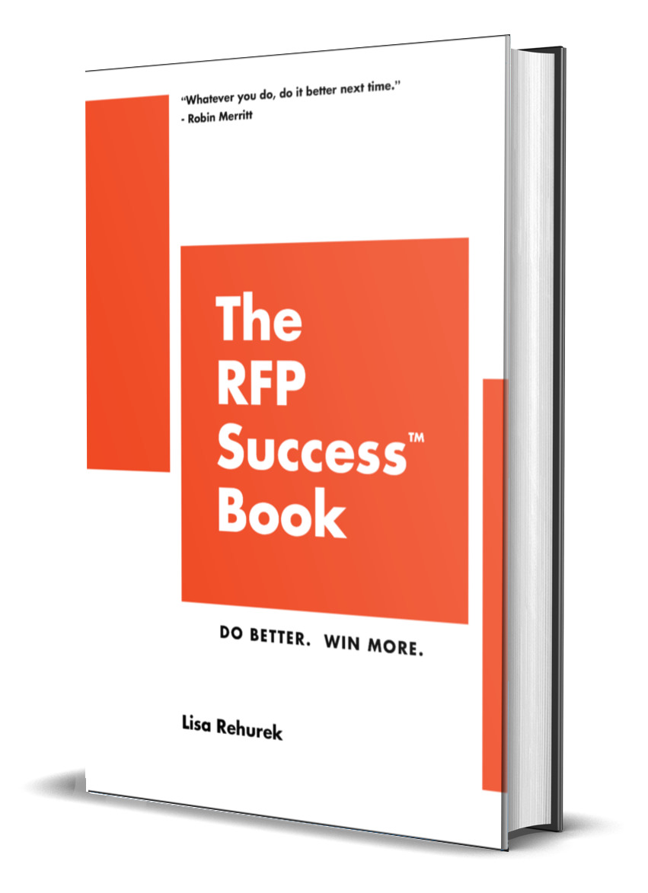
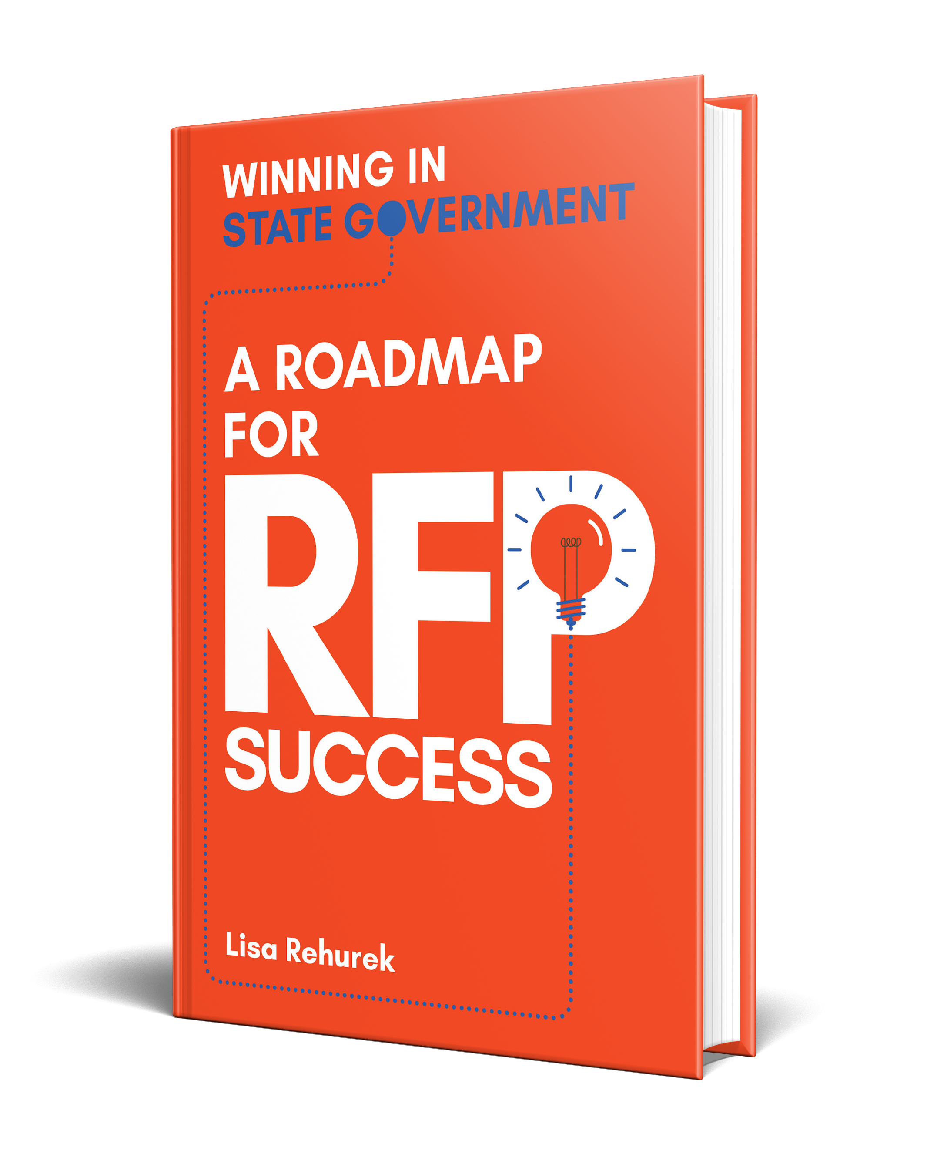



30+ Years of RFP experience on all sides
Founder & CEO
Author, Trainer, Advisor
Dog Lover, Fun Inspirer, Martini Lover

Slide 3

Today’s session
Biggest RFP Response Mistakes
Best Practices for each
Notes:
Questions along the way – drop them into the Chat and someone will help me keep my eye on them

Slide 4
Biggest mistakes
Notes:
Based on our experience with thousands of RFPs, plus we also talk to a lot of evaluators / procurement folks and these are aligned with what they tell us too

Slide 5
biggest mistakes
Not meeting requirements
Notes:
Mistake: Missing signatures, page limits, formatting requirements, or required documents can lead to immediate disqualification.
But the requirements and qualifications are just the beginning. That’s the baseline – it will NOT get you the win, but it’s a necessity to not get disqualified

Slide 6
biggest mistakes
Not meeting requirements
Not distinguishing yourself
Notes:
Mistake: Reusing a one-size-fits-all proposal without tailoring it to the specific agency’s needs and priorities.

Slide 7
biggest mistakes
Not meeting requirements
Not distinguishing yourself
Focusing too much on features instead of benefits
Notes:
Mistake: Listing services or product features without explaining how they solve the agency’s problems.

Slide 8
biggest mistakes
Not meeting requirements
Not distinguishing yourself
Focusing too much on features instead of benefits
Pricing too high or too low without justification or value prop
Notes:
Mistake: Overpricing makes you uncompetitive, while underpricing raises red flags about your ability to perform.

Slide 9
biggest mistakes
Not meeting requirements
Not distinguishing yourself
Focusing too much on features instead of benefits
Pricing too high or too low without justification or value prop
Not answering the questions appropriately
Notes:
Mistake: Not understanding who currently holds the contract or how competitors will position themselves.

Slide 10
biggest mistakes
Not meeting requirements
Not distinguishing yourself
Focusing too much on features instead of benefits
Pricing too high or too low without justification or value prop
Not answering the questions appropriately
Writing dull, technical, or hard-to-read content
Notes:
Mistake: Overloading responses with jargon, long paragraphs, or overly technical explanations that evaluators struggle to digest.

Slide 11
biggest mistakes
Not meeting requirements
Not distinguishing yourself
Focusing too much on features instead of benefits
Pricing too high or too low without justification or value prop
Not answering the questions appropriately
Writing dull, technical, or hard-to-read content
Waiting until the last minute
Notes:
Mistake: Rushing leads to errors, missed details, and poor-quality writing.

Slide 12
biggest mistakes
Not meeting requirements
Not distinguishing yourself
Focusing too much on features instead of benefits
Pricing too high or too low without justification or value prop
Not answering the questions appropriately
Writing dull, technical, or hard-to-read content
Waiting until the last minute
Failing to address evaluation criteria directly
Notes:
Mistake: Not aligning responses with the scoring criteria, making it harder for evaluators to award points.

Slide 13
biggest mistakes
Not meeting requirements
Not distinguishing yourself
Focusing too much on features instead of benefits
Pricing too high or too low without justification or value prop
Not answering the questions appropriately
Writing dull, technical, or hard-to-read content
Waiting until the last minute
Failing to address evaluation criteria directly
Overlooking the importance of references and past performance
Notes:
Mistake: Providing weak references, outdated project examples, or failing to highlight relevant past success.

Slide 14
biggest mistakes
Not meeting requirements
Not distinguishing yourself
Focusing too much on features instead of benefits
Pricing too high or too low without justification or value prop
Not answering the questions appropriately
Writing dull, technical, or hard-to-read content
Waiting until the last minute
Failing to address evaluation criteria directly
Overlooking the importance of references and past performance
Submitting without an objective final review
Notes:
Mistake: Typos, formatting errors, and missing sections undermine credibility and professionalism

Slide 15
Best practices

Slide 16
Best practices
Not meeting requirements
Use a compliance matrix
Notes:
Mistake: Missing signatures, page limits, formatting requirements, or required documents can lead to immediate disqualification.
Best Practice: Use a compliance matrix to track all requirements and conduct a final checklist review before submission.

Slide 17
Best practices
Notes:
Mistake: Missing signatures, page limits, formatting requirements, or required documents can lead to immediate disqualification.
Best Practice: Use a compliance matrix to track all requirements and conduct a final checklist review before submission.
Planning upfront is something people tend to dismiss, but it will help you so much as you move through the response

Slide 18
Best practices
Not distinguishing yourself
Know your differentiators
Notes:
Best Practice: Customize every proposal by incorporating the agency’s language, goals, and challenges into your response.

Slide 19

What Most Companies Do
Baseline
Respond to the Requirements
Notes:
I’m actually going to come out of the gate and give you an immediate “secret sauce” element.
There are two things you must do to meet the minimum baseline requirements.
First, you must respond to the requirements. Plain and simple. If you miss requirements, there’s a likelihood that you’ll get disqualified. We don’t want that for you!

Slide 20

What Most Companies Do
Baseline
Meet the qualifications
Respond to the Requirements
Notes:
Second, you’ve got to meet the qualifications. You can’t just meet 80% of the quals and think that’s ok. Because guess what? Your competitors will do these two things, and this is not where you want to lose points.
Now, this is where most companies stop. They focus solely on these two baseline elements. It actually feels like that’s what you’re supposed to do because of the format of the RFP.
However, the goal here is to win the RFP, not just answer the questions.
So these two things are simply the BASELINE. I want you to really grasp that, because just meeting these two things is not enough to win the bid. Unless you get lucky; and we don’t want to bet on luck.
Once you meet and respond to the baseline requirements, NOW you’re good enough to be taken seriously. NOW you move to the next step

Slide 21

The RFP Success® Way
Distinction
Baseline
Meet the qualifications
Respond to the Requirements
Notes:
And the next step – which is The RFP Success Way -- is Distinction.
Distinction is important because this is where you get the extra points. This is where you stand out from your competitors. Now is the time to show who you are, keep the evaluators engaged, provide value, and get the higher scores for the win.

Slide 22
Best Practices | Distinction
Highlight what you/your solution provides that no one else does
Notes:
Drop in the chat, what do you provide that no one else does

Slide 23

Best Practices | Distinction
Highlight what you/your solution provides that no one else does.
NOT an Expectation
Great customer service
On time deliverables

Slide 24

Best Practices | Distinction
Highlight what you/your solution provides that no one else does.
NOT an Expectation
Great customer service
On time deliverables
Customized for each proposal
Notes:
Why do you think one list of distinctions can’t carry over to ALL proposals?

Slide 25
Best Practices | Distinction
Highlight what you/your solution provides that no one else does.
NOT an Expectation
Great customer service
On time deliverables
Customized for each proposal
Some ideas:
Uniquely personalized service
Expert certifications
Market authority
Quantifiable evidence (99% customer satisfaction rating)
Exclusive partnerships
Proprietary processes / systems
Notes:
What else could you add to this list? A couple of minutes to brainstorm
That’s the D in the DARE Method. Let’s move on to the A.

Slide 26
Best practices
Focusing too much on features vs benefits
Use a problem-solution-impact approach
Notes:
Mistake: Listing services or product features without explaining how they solve the agency’s problems.
Best Practice: Use a “problem-solution-impact” approach to clearly demonstrate how your offering benefits the agency.

Slide 27
Best Practices | Problem/Solution
Problem:
The client, a mid-sized retail company, is experiencing significant inventory management issues. They face frequent stockouts and overstock situations, leading to lost sales opportunities and increased holding costs. The current manual inventory tracking system is inefficient and prone to errors, resulting in poor decision-making.
Notes:
This problem is something they will state in the RFP

Slide 28
Best Practices | Problem/Solution
Proposed Solution:
We propose implementing an automated inventory management system that integrates with the client’s existing ERP (Enterprise Resource Planning) software. Our solution includes:
Real-time Inventory Tracking: Utilizing RFID technology and IoT sensors to provide real-time data on stock levels.
Predictive Analytics: Implementing machine learning algorithms to forecast demand accurately, reducing stockouts and overstock.
User Training and Support: Offering comprehensive training for staff to ensure smooth adoption of the new system and ongoing support for troubleshooting.
Notes:
You want to come in as the thought leader; they’re looking to hire someone for a reason – either they don’t have the internal resources, or they don’t have the level of expertise needed.

Slide 29
Best Practices | Problem/Solution
Impact
By adopting our automated inventory management system, we anticipate the following impacts:
Increased Sales: A projected 20% increase in sales due to reduced stockouts, allowing customers to purchase desired products without delays.
Cost Savings: An estimated 15% reduction in holding costs by minimizing excess inventory and improving turnover rates.
Enhanced Decision-Making: Improved data accuracy and analytics will empower the client’s management team to make informed decisions regarding inventory purchases and stock levels.
Notes:
What else could you add to this list? A couple of minutes to brainstorm
That’s the D in the DARE Method. Let’s move on to the A.

Slide 30
Best practices
Pricing too high or too low without justification
Research, research, research
Know your value proposition
Notes:
Mistake: Overpricing makes you uncompetitive, while underpricing raises red flags about your ability to perform.
Best Practice: Research past awards and competitors to price strategically while emphasizing total value, not just cost.
FOIA request

Slide 31
Best Practices | Value Proposition
Key elements of a Value proposition
Target Audience: Identifies the specific group of customers that the product or service is designed for.
Problem Statement: Clearly defines the problem or need that the target audience faces.
Solution: Describes how the product or service addresses the identified problem and meets the customer's needs.
Benefits: Highlights the specific advantages or improvements that the customer will experience by using the product or service, such as increased efficiency, cost savings, enhanced quality, or improved experience.
Differentiation: Explains what makes the product or service unique compared to competitors, emphasizing features, quality, pricing, or other factors that set it apart.
Notes:
Mistake: Overpricing makes you uncompetitive, while underpricing raises red flags about your ability to perform.
Best Practice: Research past awards and competitors to price strategically while emphasizing total value, not just cost.

Slide 32
Best Practices | Value Proposition
Value proposition example:
Sweet Escape Ice Cream is not just about serving ice cream; we aim to create a memorable experience that adds joy to travel. By offering high-quality products, exceptional service, and a commitment to sustainability, we will enhance the airport's concession offerings and delight passengers with every scoop. Together, we can make travel sweeter!
Notes:
Mistake: Overpricing makes you uncompetitive, while underpricing raises red flags about your ability to perform.
Best Practice: Research past awards and competitors to price strategically while emphasizing total value, not just cost.

Slide 33
Best practices
Not answering the questions appropriately
Not answering the question as it was asked
Not answering all parts of the question
Focusing too much on you vs the solution you provide
Notes:
Mistake: Not understanding who currently holds the contract or how competitors will position themselves.
Best Practice: Analyze past contracts and competitor strengths/weaknesses to craft a compelling value proposition.

Slide 34

EXAMPLE:
ANSWER THE QUESTION
Does your firm have international capabilities? Describe.
Criminal background searches are available in all available international countries.

Slide 35
EXAMPLE:
ANSWER THE QUESTION
Does your firm have international capabilities? Describe.
Criminal background searches are available in all available international countries.
Q: If you were the evaluator, would you consider this question responsive or non-responsive?

Slide 36

EXAMPLE:
ANSWER THE QUESTION
Does your firm have international capabilities? Describe.
Yes, our firm has international capabilities.
The countries we serve are listed below:
Notes:
What you could do to get you the Exceeds
(Not only does our firm have international capabilities…..)

Slide 37
Example:
Answer the question
Describe your process for training new employees before they commence work
<Company> provides regular in-service training to our staff on best practices compliance in every aspect of the program. A training inventory is in place for all operations staff to include training on the following topics as applicable to the position:
Notes:
Same question – is this responsive? It’s hard for an evaluator to look at this and determine if they have a solid process.

Slide 38

Example:
Answer the question
Describe your process for training new employees before they commence work
STEP 1:
Each employee spends their first week of employment in training that is comprised of:
Session 1: Introduction to Compliance
Session 2: Compliance 201
Session 3: Standard Operating Procedures
Session 4: Client Experience Standards
The employee is then provided training applicable to their position.
STEP 2:
After training is complete, employee shadows their supervisor for several days for on-the-job training.
STEP 3:
Employees receive training quarterly and annually and are provided notice through our online tracking system.
Notes:
If they ask for a process, be very simplistic and give it to them in steps.
77% of readers are skimmers.

Slide 39
EXAMPLE:
ANSWER THE QUESTION
Q: Prior Experience.
Include experience in xyz consulting services. Experience shown should be work done by individuals who will be assigned to this project as well as that of your company. The Offeror must provide an overview of the proposing organization, the proposal, and the Offeror’s key strengths. The Offeror should demonstrate experience and familiarity with the program area in general. Studies or projects referred to must be identified and the name of the customer shown, including the name, address, and telephone number of the responsible official of the customer, company, or agency who may be contacted.
Notes:
We tend to see this in larger, state government, highly technical proposals
They are asking for a heck of a lot here, and you’ve got to unpack it and make sure that you address Every. Single. Thing.
How many questions are they actually asking here? (next slide)

Slide 40
EXAMPLE:
ANSWER THE QUESTION
Q: Prior Experience.
Include experience in xyz consulting services. Experience shown should be work done by individuals who will be assigned to this project as well as that of your company. The Offeror must provide an overview of the proposing organization, the proposal, and the Offeror’s key strengths. The Offeror should demonstrate experience and familiarity with the program area in general. Studies or projects referred to must be identified and the name of the customer shown, including the name, address, and telephone number of the responsible official of the customer, company, or agency who may be contacted.
Notes:
8 different questions here

Slide 41
EXAMPLE:
ANSWER THE QUESTION
Q: Prior Experience
Relevant Experience
Team Experience
Company Information
Company Experience
Overview of Our Company
Key Strengths
Overview of Our Proposal
Experience and familiarity with the program
Notes:
The better approach would be to list each of the three words and have one bullet for each one. (do this when you’re building the shell at the beginning so when things get rushed at the end when it’s easier to miss things, you’re not under pressure
Our eyes don’t love big blocks of text

Slide 42
Example:
Answer the question
Q: Describe your ability, capacity and skill to perform the contract.
Notes:
Here’s a bit of an easier example
Don’t assume that “ability, capacity, and skill” all mean the same thing. Break them out. That is NOT just one question, it’s three.
INPUT: How might you consider breaking this out?

Slide 43
Example:
Answer the question
Q: Describe your ability, capacity and skill to perform the contract.
A: TheBestCompany is the single best firm to perform this contract based on the following:
Ability and Skill:
Over 20 dedicated staff with the educational background, industry-specific experience, and proven client testimonials;
Over 30 years of firm experience with clients in 40 states;
Direct experience with all areas outlined in the Scope of Work
Capacity:
The team proposed has the capacity to fulfill this contract and provide an excellent level of service.
Notes:
The other approach would be to list each of the three words and have one bullet for each one.

Slide 44
Best Practices | Answering the Questions
3. Focusing too much on yourself instead of the solution
Notes:
Make no mistake, you are competing for attention span

Slide 45
Best Practices | Answering the Questions
IT IS NOT ABOUT YOU
IT IS NOT ABOUT YOU
IT IS NOT ABOUT YOU
HINT:
It isn’t about you
Notes:
WIIFM

Slide 46
Best Practices | Answering the Questions
It usually sounds something like this: “We help you….”
Speak TO them and their need/goal/objective, instead of about you
Notes:
We provide…
We have experience with…
Subtle but powerful nuance
WIIFM

Slide 47
Instead…
(Client) can improve/achieve/reduce (challenge)
by using our (solution)
which has already been proven on (relevant experience/program)
and resulted in (metric).
Notes:
Solution Statement
We are always more interested in WIIFM than in other people
Let me show you a specific example, and then we’re going to have you work on this.

Slide 48
Example
Final example:
XYZ company can achieve at least a 20% higher win rate by engaging with our team of experts which has already been proven on other healthcare businesses and resulted in up to an 80% increased win rate.
Notes:
We’re going to come back and have you do this exercise, but I want to show you a few more examples…

Slide 49
Best Practices | Answering the Questions
Example #2: Tell us about your team
BEFORE
The Customer has 24/7 access to the Security Operation Center via a telephone call, email, and the ticketing system. We also have engineers and project managers that will be dedicated to your project.
Notes:
This seems like a logical response. They asked about the team, this talks about the team. BUT it doesn’t address the WIIFT
That last line – we see that all the time in responses or when we’re reviewing library content.
Again, I want you to think about what they might be wanting when they ask this question. What are they looking for?
We go into it like, How can we answer this question, versus What do they really want/need to know
Q: What do you think they might care about when they are asking about the team?

Slide 50
Best Practices | Answering the Questions
Example #2: Tell us about your team
BEFORE
The Customer has 24/7 access to the Security Operation Center via a telephone call, email, and the ticketing system. We also have engineers and project managers that will be dedicated to your project.
AFTER
We know you need to go to market quickly, and we have the team – with the experience, capability, and expertise – to make that happen. With 24/7 access to the Security Operation Center and a dedicated team, you have what you need, when you need it.
This guarantees 99.9% uptime.
Notes:
Make it easy for them to understand right out of the gate. Make it easy for them to follow along. They don’t have the same level of expertise that you do. You’ve got to keep it simple and readable.
WHAT IS IMPORTANT TO YOUR CUSTOMERS? These are things you can make a list of upfront and then pull to customize for each proposal.

Slide 51
Best practices
Writing dull, technical, or hard-to-read content
Incorporate graphics appropriately
Lots of white space
Tell stories
Easy to follow
Clear & concise
Notes:
Mistake: Overloading responses with jargon, long paragraphs, or overly technical explanations that evaluators struggle to digest.
Best Practice: Write in clear, concise, and persuasive language with short paragraphs, bullet points, and visuals where possible.

Slide 52
Best Practices | Readability
Incorporate graphics
Tell an immediate story
Nothing overly complicated
Call-out boxes

Slide 53
Best Practices | Readability
White Space
Bullets
Shorter paragraphs

Slide 54
Best Practices | Readability
Tell stories
Keeps them engaged
More memorable
Relatability
Notes:
Break it up with subheaders, bullets, etc.
Use their language
Most of the evaluators had nothing to do with writing the RFP, so they don’t know it well themselves
Icons are the best! Key themes to follow along through the writing
It’s like a good realtor showing a house to a potential buyer – they guide them through, they emphasize the things they want them to focus on.

Slide 55
Best Practices | Readability
Make it Easy to Follow
Make it easy for the evaluators to clearly see & understand the answer to the specific question they have asked
Notes:
Break it up with subheaders, bullets, etc.
Use their language
Most of the evaluators had nothing to do with writing the RFP, so they don’t know it well themselves
Icons are the best! Key themes to follow along through the writing
It’s like a good realtor showing a house to a potential buyer – they guide them through, they emphasize the things they want them to focus on.

Slide 56
Easy to Follow Example
Q: Describe your ability, capacity and skill to perform the contract.
Answer:
TheBestCompany is the single best firm to perform this contract based on the following:
CAPACITY: Over 20 dedicated staff with the educational background, industry-specific experience, and proven client testimonials;
ABILITY: Over 30 years of firm experience with clients in 40 states;
SKILL: Direct experience with all areas outlined in the Scope of Work
CAPACITY
(more detail)
ABILITY
(more detail)
SKILL
(more detail)
Notes:
High level bullets to give those skimmers something, and then you can go into more details with each one.

Slide 57
Best Practices | Readability
Keep language simple and concise
Avoid a lot of multi-syllabic words, for example:
Instead of: | Use:
In the near future | Soon or Shortly
Facilitate | Help
Subsequently | Then
It is our intention to | We will or We intend to
Have to | Must
Take into consideration | Consider
In the event that | Provided
Notes:
How would you fill in the last three?
Must
Consider
Provided

Slide 58
Best Practices | Readability
8 words or less
14 words long
43 words long
Less than 10% Comprehension
90% Comprehension
100% Comprehension
Notes:
You also want to be succinct.
American Press Institute presented evidence there was a correlation between shorter sentences and reader comprehension. They found:
For sentences that were 8 words or less, readers understood (switch slides) 100% of the information.
For sentences that were 14 words long, readers understood 90%.
For sentences that were 43 words or longer, comprehension dropped to less than 10%.

Slide 59
Best Practices | Readability
8 words or less
14 words long
43 words long
Less than 10% Comprehension
90% Comprehension
100% Comprehension

Slide 60
Best Practices | Readability
8 words or less
14 words long
43 words long
Less than 10% Comprehension
90% Comprehension
100% Comprehension

Slide 61
Best Practices | Readability
8 words or less
14 words long
43 words long
Less than 10% Comprehension
90% Comprehension
100% Comprehension
Notes:
Be Succinct
Paragraphs should be no more than 4-5 sentences. Sentences should average 15-20 words per sentence.
Story of Misti telling me that no one would write sentences that were that long. Then hers were
It sneaks up on you

Slide 62
Best Practices | Readability
Which one rolls off the tongue better?
When our two companies are able to partner collaboratively together, we create successful experiences for our customers.
OR….
Notes:
Q: Which one do you feel reads better?

Slide 63
Best Practices | Readability
Which one rolls off the tongue better?
When our two companies are able to partner collaboratively together, we create successful experiences for our customers.
When we work together, we help our customers succeed.
Notes:
Q: Which one do you feel reads better?
The first one is understandable, but it’s not absorbable
It’s important to pay attention to the simplicity of writing to a lower grade level; let me tell you what I mean by that

Slide 64
Best Practices | Readability
15th Grade:
When our two companies are able to partner collaboratively together, we create successful experiences for our customers.
6th Grade:
When we work together, we help our customers succeed.
Grade
Level
Notes:
Most mainstream magazines focus on 6-8th grade level.
This is not about dumming it down because people can’t understand the first one. It’s about making it easier for the reader to absorb – with everything else that is swirling around us
We’ll be sending out a copy of this presentation that will include a Writing guide, and in that guide we have included information on how to access the Word readability feature
If extremely technical, it might be more like 8th or 9th grade; Avoid going over 10th grade even with highly technical

Slide 65
Best practices
Waiting until the last minute
Create a response calendar/timeline
Notes:
Mistake: Rushing leads to errors, missed details, and poor-quality writing.
Best Practice: Follow a structured proposal timeline, allowing time for drafts, reviews, and revisions before submission.

Slide 66
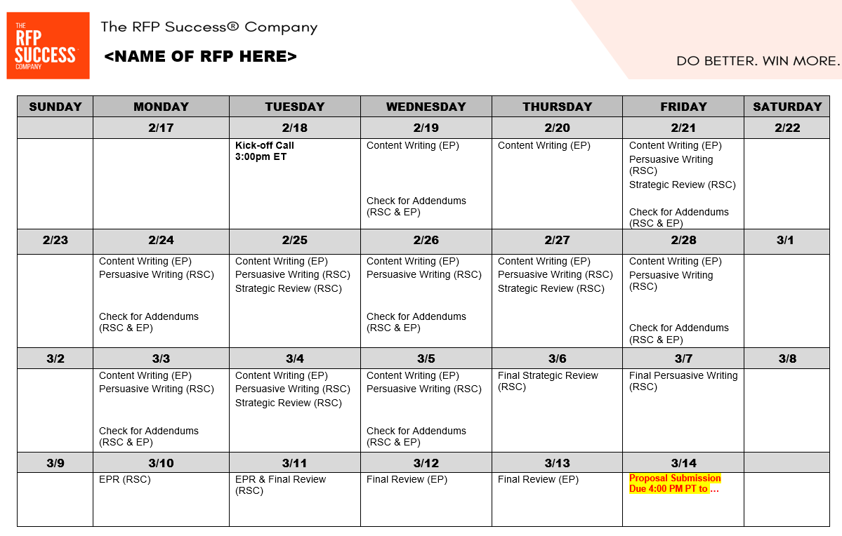
Best Practices | Calendar
Notes:
Most mainstream magazines focus on 6-8th grade level.
This is not about dumming it down because people can’t understand the first one. It’s about making it easier for the reader to absorb – with everything else that is swirling around us
We’ll be sending out a copy of this presentation that will include a Writing guide, and in that guide we have included information on how to access the Word readability feature
If extremely technical, it might be more like 8th or 9th grade; Avoid going over 10th grade even with highly technical

Slide 67
Best practices
Failing to address evaluation criteria
Map to the evaluation criteria
Notes:
Mistake: Not aligning responses with the scoring criteria, making it harder for evaluators to award points.
Best Practice: Structure your responses to match the evaluation criteria, making it easy for reviewers to find what they need.

Slide 68
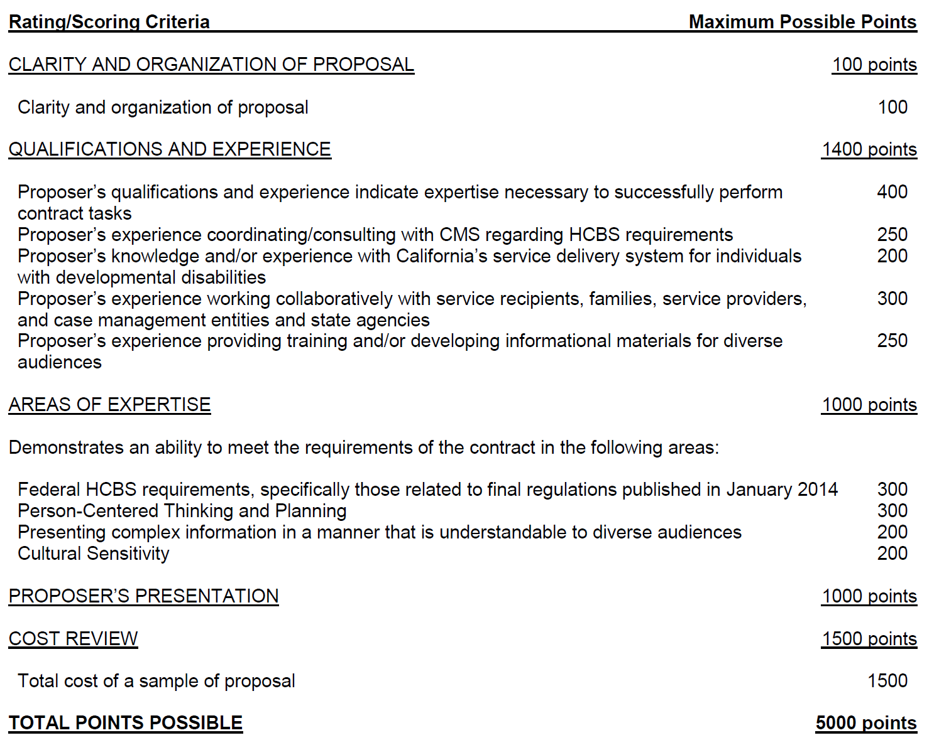
Best Practices | Eval Criteria
Example:
Notes:
More detailed, a nice outline, BUT….
The SOW was completely different from this; we had to structure our proposal in a way that correlated. And that’s not always easy. At the beginning of each answer, we had a little text box that correlated back to these criteria. Example to follow.

Slide 69
Best Practices | Eval Criteria
Example:
Notes:
My question here is “why” – be curious. Why do you think that this one area is the most points?
Remember those icons I showed you earlier? This would be a great use of those
Again, use the language in the evaluation criteria when you can
You can also sometimes find hints of hot buttons / where they’ve been burned before – a lot of times that’s where the higher scoring points comes in, especially if it doesn’t seem to make sense

Slide 70
Best Practices | Eval Criteria
Use this checklist when reviewing the evaluation criteria:
Examine the evaluation criteria within two days of RFP receipt
Craft clarifying questions for the Q&A if something is confusing or contradictory
Give your writers some pointers
Highlight key language from the evaluation criteria that should be used in their answers
Schedule your time/resources accordingly

Slide 71
Best practices
Overlooking the importance of references & past performance
Tailor appropriately
Notes:
Mistake: Providing weak references, outdated project examples, or failing to highlight relevant past success.
Best Practice: Select strong references and tailor past performance examples to closely align with the current RFP requirements.

Slide 72
Best practices
Not incorporating a final objective review
Editorial
Strategic
Notes:
Mistake: Typos, formatting errors, and missing sections undermine credibility and professionalism.
Best Practice: Have a separate reviewer (or team) conduct a final quality check before submission.

Slide 73
Questions?
Notes:
Based on our experience with thousands of RFPs, plus we also talk to a lot of evaluators / procurement folks and these are aligned with what they tell us too

Slide 74
Do Better. Win More.™

