Slide 1
Application | 1 | 2 | 3 | 4 | 5 | 6
Hard disk | 5 | 25 | 13 | 24 | 14 | 30
programs | [1,3] | [1,2] | [2,3] | [] | [3] | [2]
printer | 1 | 1 | 1 | 1 | 1 | 1
Node id | 1 | 2 | 3 | 4 | 5
Program id and size (MB) | -,- | 3,0.5 | 1,1 | 2,1.5 | 1,1
Sharable no. of programs | - | 2 | 3 | 4 | 1
Memory size (MB) | 16 | 4 | 64 | 32 | 8
Printer no. | 0 | 1 | 0 | 1 | 0
Disk space (MB) | 40 | 20 | 5 | 10 | 30
Band. Disk | 8 | 10 | 17 | 9 | 12
Band. Printer | 2 | 1 | 2 | 1 | 1

Slide 2
DISPATCHER

Slide 3
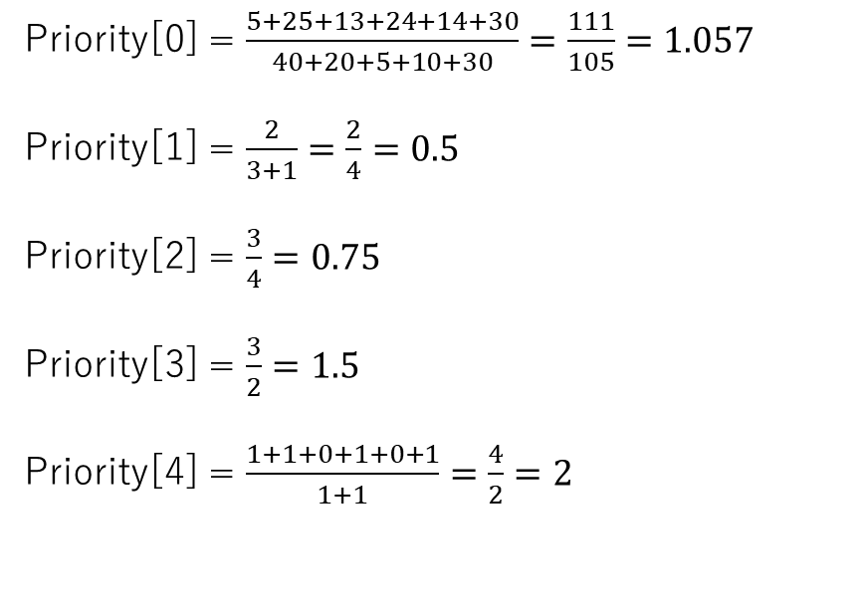
Applications: | App 1 | App 2 | App 3 | App 4 | App 5 | App 6
Priority | 0 | 0 | 0 | 0 | 0
Resource type | Hard disk | Program 1 | Program 2 | Program 3 | Printer
Application | 1 | 2 | 3 | 4 | 5 | 6
Hard disk | 5 | 25 | 13 | 24 | 14 | 30
programs | [1,3] | [1,2] | [2,3] | [] | [] | [2,3]
printer | 1 | 1 | 0 | 1 | 0 | 1
Priority[0] = $\frac{5+25+13+24+14+30}{40+20+5+10+30}=\frac{111}{105}=1.057$
Priority[1] = $\frac{2}{3+1}=\frac{2}{4}=0.5$
Priority[2] = $\frac{3}{4}=0.75$
Priority[3] = $\frac{3}{2}=1.5$
Priority[4] = $\frac{1+1+0+1+0+1}{1+1}=\frac{4}{2}=2$
Node id | 1 | 2 | 3 | 4 | 5
Program id and size (MB) | -,- | 3,0.5 | 1,1 | 2,1.5 | 1,1
Sharable no. of programs | - | 2 | 3 | 4 | 1
Memory size (MB) | 16 | 4 | 64 | 32 | 8
Printer no. | 0 | 1 | 0 | 1 | 0
Disk space (MB) | 40 | 20 | 5 | 10 | 30
Band. Disk | 8 | 10 | 17 | 9 | 12
Band. Printer | 2 | 1 | 2 | 1 | 1

Slide 4
Priority coefficients
Priority | $$1.057$$ | $$0.5$$ | $$0.75$$ | $$1.5$$ | $$2$$
Resource type | Hard disk | Program 1 | Program 2 | Program 3 | Printer
Sort priority by coefficients (Descending)
Priority | $$2$$ | $$1.5$$ | $$1.057$$ | $$0.75$$ | $$0.5$$
Resource type | Printer | Program 3 | Hard disk | Program 2 | Program 1

Slide 5
Request type | Apps
Printer | 1, 2, 4, 6
Program 3 | 3
Hard disk | 5
Program 2
Program 1
Apps are now dispatched to the Pool
Pool | Apps
0 | 1, 2, 4, 6
1 | 3
2 | 5
3
4

Slide 6
Objective Function

Slide 7
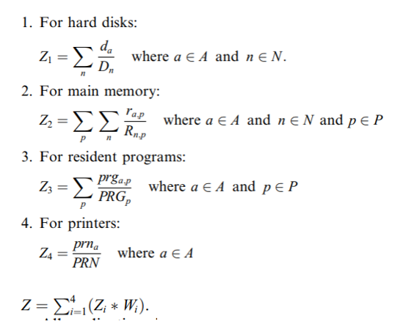
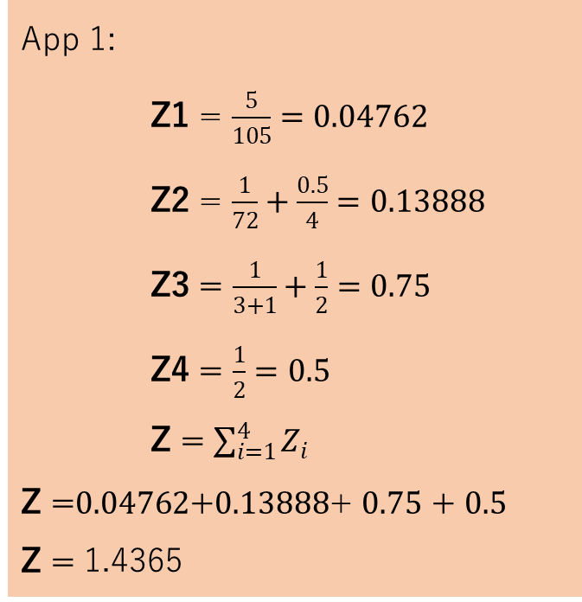
App 1:
Z1 = $\frac{5}{105}=0.04762$
Z2 = $\frac{1}{72}+\frac{0.5}{4}=0.13888$
Z3 = $\frac{1}{3+1}+\frac{1}{2}=0.75$
Z4 = $\frac{1}{2}=0.5$
Z = $\sum_{i=1}^{4}{Z_{i}}$
Z =$0.04762$+$0.13888$+ $0.75$ + $0.5$
Z = 1.4365
Application | 1 | 2 | 3 | 4 | 5 | 6
Hard disk | 5 | 25 | 13 | 24 | 14 | 30
programs | [1,3] | [1,2] | [2,3] | [] | [] | [2,3]
printer | 1 | 1 | 0 | 1 | 0 | 1
Node id | 1 | 2 | 3 | 4 | 5
Program id and size (MB) | -,- | 3,0.5 | 1,1 | 2,1.5 | 1,1
Sharable no. of programs | - | 2 | 3 | 4 | 1
Memory size (MB) | 16 | 4 | 64 | 32 | 8
Printer no. | 0 | 1 | 0 | 1 | 0
Disk space (MB) | 40 | 20 | 5 | 10 | 30
Band. Disk | 8 | 10 | 17 | 9 | 12
Band. Printer | 2 | 1 | 2 | 1 | 1
App 2:
Z = 1.299
App 3:
Z = 1.046
App 4:
Z = 0.729
App 5:
Z = 0.133
App 6:
Z = 1.708

Slide 8
Sorted by Objective Function:
Pool | Apps
0 | 1, 2, 4, 6
1 | 3
2 | 5
3
4
Pool | Apps
0 | 4, 2, 1, 6
1 | 3
2 | 5
3
4

Slide 9
Graph of Node Bandwidths

Slide 10
V₀
8
V₁
10
V₅
13
11
7
16
V₂
6
17
V₄
16
5
V₃

Slide 11
Resource Allocation

Slide 12
Current Pool | Apps
0 | 4, 2, 1, 6
1 | 3
2 | 5
3
4
Allocate apps by order of priority.
This means that application 4 from the current Pool 0 should be the first allocated.
Application | 4
Hard disk | 24
programs | []
printer | 1
CHECKING OF BANDWIDTH USING VARIANT DIJKSTRA’S ALGORITHM
NODE SELECTION FOR EACH REQUESTED RESOURCES

Slide 13
Node Selection

Slide 14
Node id | 1 | 2 | 3 | 4 | 5
Program id and size (MB) | -,- | 3,0.5 | 1,1 | 2,1.5 | 1,1
Sharable no. of programs | - | 2 | 3 | 4 | 1
Memory size (MB) | 16 | 4 | 64 | 32 | 8
Printer no. | 0 | 1 | 0 | 1 | 0
Disk space (MB) | 40 | 20 | 5 | 10 | 30
Band. Disk | 8 | 10 | 17 | 9 | 12
Band. Printer | 2 | 1 | 2 | 1 | 1
Application | 4
Hard disk | 24
programs | []
printer | 1
Node id | 1 | 2 | 3 | 4 | 5
Program id and size (MB) | -,- | 3,0.5 | 1,1 | 2,1.5 | 1,1
Sharable no. of programs | - | 2 | 3 | 4 | 1
Memory size (MB) | 16 | 4 | 64 | 32 | 8
Printer no. | 0 | 0 | 0 | 1 | 0
Disk space (MB) | 16 | 20 | 5 | 10 | 30
Band. Disk | 8 | 10 | 17 | 9 | 12
Band. Printer | 2 | 1 | 2 | 1 | 1
Application | 4 | Node
Hard disk | 24 | 1
programs | [] | None
printer | 1 | 2

Slide 15
Variant Dijkstra’s Algorithm

Slide 16
Current Graph:
Variant Dijkstra’s Algorithm
This algorithm finds a maximum bandwidth path with minimum hops.
The path always starts at V_{0.}
V₀
8
V₁
10
V₅
13
11
7
16
V₂
6
17
V₄
16
5
V₃

Slide 17
V₀
8
V₁
10
V₅
13
11
7
16
V₂
6
17
V₄
16
5
V₃
i | V₁ | V₂ | V₃ | V₄ | V₅ | curr | S
 | (0, -) | (0, -) | (0, -) | (0, -) | (0, -) | V₀ | {V₁, V₂, V₃, V₄, V₅}
0 | (0, -) | (13, V₀) | (0, -) | (16, V₀) | (8, V₀) | V₄ | {V₁, V₂, V₃, V₅}
1 | (0, -) | (13, V₀) | (5, V₄) |  | (8, V₀) | V₂ | {V₁, V₂, V₅}
2 | (0, -) |  | (13, V₂) |  | (11, V₂) | V₃ | {V₁, V₅}
3 | (6, V₃) |  |  |  | (13, V₃) | V₅ | {V₁}
4 | (10, V₅) |  |  |  |  | V₁ | {}

Slide 18
Finding the paths
During the process of VDA, a storage for the predecessor nodes are stored. We use it to determine the path.
Pre: | V₅ | V₀ | V₂ | V₀ | V₃
Maximum bandwidth paths with minimum hops:
Path (V₁) | V₀ | V₂ | V₃ | V₅ | V₁
Path (V₂) | V₀ | V₂
Path (V₃) | V₀ | V₂ | V₃
Path (V₄) | V₀ | V₄
Path (V₅) | V₀ | V₂ | V₃ | V₅

Slide 19
Path (V₁) | V₀ | V₂ | V₃ | V₅ | V₁
Path (V₂) | V₀ | V₂
Application | 4 | Node
Hard disk | 24 | 1
programs | [] | None
printer | 1 | 2
Node id | 1 | 2 | 3 | 4 | 5
Band. Disk | 8 | 10 | 17 | 9 | 12
Band. Printer | 2 | 1 | 2 | 1 | 1
V₀
V₀
8
8
V₁
2
V₅
V₁
2
V₅
13
12
11
7
11
7
16
16
V₂
6
17
V₄
V₂
6
17
V₄
16
5
16
5
V₃
V₃

Slide 20
Resource Allocation...
Since all conditions have been satisfied resource allocation will occur, resulting in the deduction of resources from the resource table.
Application | 4 | Node
Hard disk | 24 | 1
programs | [] | None
printer | 1 | 2
Node id | 1 | 2 | 3 | 4 | 5
Program id and size (MB) | -,- | 3,0.5 | 1,1 | 2,1.5 | 1,1
Sharable no. of programs | - | 2 | 3 | 4 | 1
Memory size (MB) | 16 | 4 | 64 | 32 | 8
Printer no. | 0 | 1 | 0 | 1 | 0
Disk space (MB) | 40 | 20 | 5 | 10 | 30
Band. Disk | 8 | 10 | 17 | 9 | 12
Band. Printer | 2 | 1 | 2 | 1 | 1
Node id | 1 | 2 | 3 | 4 | 5
Program id and size (MB) | -,- | 3,0.5 | 1,1 | 2,1.5 | 1,1
Sharable no. of programs | - | 2 | 3 | 4 | 1
Memory size (MB) | 16 | 4 | 64 | 32 | 8
Printer no. | 0 | 0 | 0 | 1 | 0
Disk space (MB) | 16 | 20 | 5 | 10 | 30
Band. Disk | 8 | 10 | 17 | 9 | 12
Band. Printer | 2 | 1 | 2 | 1 | 1

Slide 21
Currently the only allocated application is App 4.
Allocated | App 4
Current Pool | Apps
0 | 2, 1, 6
1 | 3
2 | 5
3
4
Application | 2
Hard disk | 25
programs | [1,2]
printer | 1
CHECKING OF BANDWIDTH USING VARIANT DIJKSTRA’S ALGORITHM
NODE SELECTION FOR EACH REQUESTED RESOURCES

Slide 22
Node id | 1 | 2 | 3 | 4 | 5
Program id and size (MB) | -,- | 3,0.5 | 1,1 | 2,1.5 | 1,1
Sharable no. of programs | - | 2 | 3 | 4 | 1
Memory size (MB) | 16 | 4 | 64 | 32 | 8
Printer no. | 0 | 0 | 0 | 1 | 0
Disk space (MB) | 16 | 20 | 5 | 10 | 30
Band. Disk | 8 | 10 | 17 | 9 | 12
Band. Printer | 2 | 1 | 2 | 1 | 1
Application | 2
Hard disk | 25
programs | [1,2]
printer | 1
Node id | 1 | 2 | 3 | 4 | 5
Program id and size (MB) | -,- | 3,0.5 | 1,1 | 2,1.5 | 1,1
Sharable no. of programs | - | 2 | 2 | 3 | 1
Memory size (MB) | 16 | 4 | 63 | 30.5 | 8
Printer no. | 0 | 0 | 0 | 0 | 0
Disk space (MB) | 16 | 20 | 5 | 10 | 5
Band. Disk | 8 | 10 | 17 | 9 | 12
Band. Printer | 2 | 1 | 2 | 1 | 1
Application | 2 | Node
Hard disk | 25 | 5
programs | [1,2] | 3, 4
printer | 1 | 4

Slide 23
V₀
8
V₁
2
V₅
12
11
7
16
V₂
6
17
V₄
16
5
V₃
Pre: | V₃ | V₀ | V₂ | V₀ | V₃

Slide 24
Path (V₄) | V₀ | V₄
Path (V₅) | V₀ | V₂ | V₃ | V₅
Application | 2 | Node
Hard disk | 25 | 5
programs | [1,2] | 3, 4
printer | 1 | 4
Node id | 1 | 2 | 3 | 4 | 5
Band. Disk | 8 | 10 | 17 | 9 | 12
Band. Printer | 2 | 1 | 2 | 1 | 1
V₀
V₀
8
V₁
V₅
8
2
V₁
V₅
2
12
11
7
12
16
11
7
V₂
6
5
V₄
15
V₂
6
5
V₄
16
5
16
5
V₃
V₃

Slide 25
After resource allocation:
Node id | 1 | 2 | 3 | 4 | 5
Program id and size (MB) | -,- | 3,0.5 | 1,1 | 2,1.5 | 1,1
Sharable no. of programs | - | 2 | 2 | 3 | 1
Memory size (MB) | 16 | 4 | 63 | 30.5 | 8
Printer no. | 0 | 0 | 0 | 0 | 0
Disk space (MB) | 16 | 20 | 5 | 10 | 5
Band. Disk | 8 | 10 | 17 | 9 | 12
Band. Printer | 2 | 1 | 2 | 1 | 1

Slide 26
Allocated | App 4 | App 2
Current Pool | Apps
0 | 1, 6
1 | 3
2 | 5
3
4
Application | 1
Hard disk | 5
programs | [1,3]
printer | 1
CHECKING OF BANDWIDTH USING VARIANT DIJKSTRA’S ALGORITHM
NODE SELECTION FOR EACH REQUESTED RESOURCES

Slide 27
Node id | 1 | 2 | 3 | 4 | 5
Program id and size (MB) | -,- | 3,0.5 | 1,1 | 2,1.5 | 1,1
Sharable no. of programs | - | 2 | 2 | 3 | 1
Memory size (MB) | 16 | 4 | 63 | 30.5 | 8
Printer no. | 0 | 0 | 0 | 0 | 0
Disk space (MB) | 16 | 20 | 5 | 10 | 5
Band. Disk | 8 | 10 | 17 | 9 | 12
Band. Printer | 2 | 1 | 2 | 1 | 1
Application | 1
Hard disk | 5
programs | [1,3]
printer | 1
Node id | 1 | 2 | 3 | 4 | 5
Program id and size (MB) | -,- | 3,0.5 | 1,1 | 2,1.5 | 1,1
Sharable no. of programs | - | 1 | 1 | 3 | 1
Memory size (MB) | 16 | 3.5 | 62 | 30.5 | 8
Printer no. | 0 | 0 | 0 | 0 | 0
Disk space (MB) | 16 | 20 | 0 | 10 | 5
Band. Disk | 8 | 10 | 17 | 9 | 12
Band. Printer | 2 | 1 | 2 | 1 | 1
Application | 1 | Node
Hard disk | 5 | 3
programs | [1,3] | 3, 2
printer | 1 | None

Slide 28
Application | 1 | Node
Hard disk | 5 | 3
programs | [1,3] | 3, 2
printer | 1 | None
Since at least one requested resource type could not be accommodated by any node the application will be deallocated and will be placed in the unallocated queue.
Note: The variant Dijkstra’s algorithm will not be called.
Node id | 1 | 2 | 3 | 4 | 5
Program id and size (MB) | -,- | 3,0.5 | 1,1 | 2,1.5 | 1,1
Sharable no. of programs | - | 1 | 1 | 3 | 1
Memory size (MB) | 16 | 3.5 | 62 | 30.5 | 8
Printer no. | 0 | 0 | 0 | 0 | 0
Disk space (MB) | 16 | 20 | 0 | 10 | 5
Band. Disk | 8 | 10 | 17 | 9 | 12
Band. Printer | 2 | 1 | 2 | 1 | 1
Node id | 1 | 2 | 3 | 4 | 5
Program id and size (MB) | -,- | 3,0.5 | 1,1 | 2,1.5 | 1,1
Sharable no. of programs | - | 2 | 2 | 3 | 1
Memory size (MB) | 16 | 4 | 63 | 30.5 | 8
Printer no. | 0 | 0 | 0 | 0 | 0
Disk space (MB) | 16 | 20 | 5 | 10 | 5
Band. Disk | 8 | 10 | 17 | 9 | 12
Band. Printer | 2 | 1 | 2 | 1 | 1

Slide 29
Allocated | App 4 | App 2
Unallocated | App 1
Current Pool | Apps
0 | 6
1 | 3
2 | 5
3
4
The next is App 6, but since it also requires printer, we are sure that it will also be in the unallocated queue.
Application | 6
Hard disk | 30
programs | [2]
printer | 1
CHECKING OF BANDWIDTH USING VARIANT DIJKSTRA’S ALGORITHM
NODE SELECTION FOR EACH REQUESTED RESOURCES

Slide 30
Allocated | App 4 | App 2
Unallocated | App 1 | App 6
Current Pool | Apps
0
1 | 3
2 | 5
3
4
All application in Pool 0 are dequeued, so we’ll proceed to the next Pool 1.
Application | 3
Hard disk | 13
programs | [2,3]
printer | 1
CHECKING OF BANDWIDTH USING VARIANT DIJKSTRA’S ALGORITHM
NODE SELECTION FOR EACH REQUESTED RESOURCES

