Slide 1

A PRIORITY-BASED RESOURCE ALLOCATION STRATEGY IN DISTRUBED COMPUTING NETWORKS

Slide 2
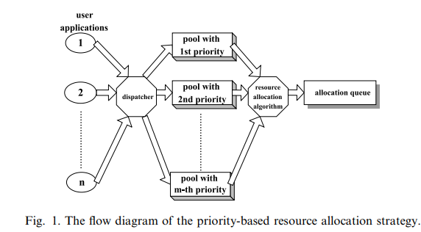

Slide 3
Application | 1 | 2 | 3 | 4 | 5 | 6
Hard disk | 5 | 25 | 13 | 24 | 14 | 30
programs | [1,3] | [1,2] | [2,3] | [] | [] | [2,3]
printer | 1 | 1 | 0 | 1 | 0 | 1
Node id | 1 | 2 | 3 | 4 | 5
Program id and size (MB) | -,- | 3,0.5 | 1,1 | 2,1.5 | 1,1
Sharable no. of programs | - | 2 | 3 | 4 | 1
Memory size (MB) | 16 | 4 | 64 | 32 | 8
Printer no. | 0 | 1 | 0 | 1 | 0
Disk space (MB) | 40 | 20 | 5 | 10 | 30
Band. Disk | 8 | 10 | 17 | 9 | 12
Band. Printer | 2 | 1 | 2 | 1 | 1

Slide 4

DISPATCHER

Slide 5
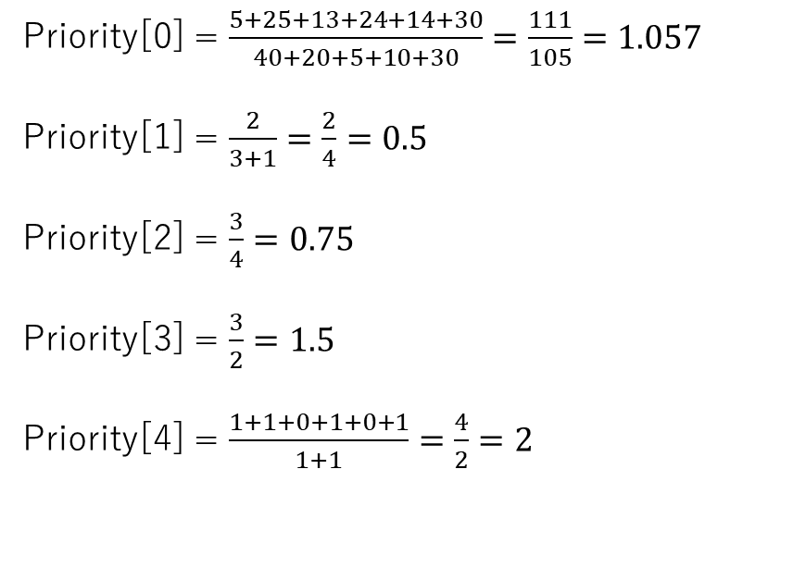
Applications: | App 1 | App 2 | App 3 | App 4 | App 5 | App 6
Priority | 0 | 0 | 0 | 0 | 0
Resource type | Hard disk | Program 1 | Program 2 | Program 3 | Printer
Application | 1 | 2 | 3 | 4 | 5 | 6
Hard disk | 5 | 25 | 13 | 24 | 14 | 30
programs | [1,3] | [1,2] | [2,3] | [] | [] | [2,3]
printer | 1 | 1 | 0 | 1 | 0 | 1
Priority[0] = $\frac{5+25+13+24+14+30}{40+20+5+10+30}=\frac{111}{105}=1.057$
Priority[1] = $\frac{2}{3+1}=\frac{2}{4}=0.5$
Priority[2] = $\frac{3}{4}=0.75$
Priority[3] = $\frac{3}{2}=1.5$
Priority[4] = $\frac{1+1+0+1+0+1}{1+1}=\frac{4}{2}=2$
Node id | 1 | 2 | 3 | 4 | 5
Program id and size (MB) | -,- | 3,0.5 | 1,1 | 2,1.5 | 1,1
Sharable no. of programs | - | 2 | 3 | 4 | 1
Memory size (MB) | 16 | 4 | 64 | 32 | 8
Printer no. | 0 | 1 | 0 | 1 | 0
Disk space (MB) | 40 | 20 | 5 | 10 | 30
Band. Disk | 8 | 10 | 17 | 9 | 12
Band. Printer | 2 | 1 | 2 | 1 | 1

Slide 6
Priority coefficients
Priority | $$1.057$$ | $$0.5$$ | $$0.75$$ | $$1.5$$ | $$2$$
Resource type | Hard disk | Program 1 | Program 2 | Program 3 | Printer
Sort priority by coefficients (Descending)
Priority | $$2$$ | $$1.5$$ | $$1.057$$ | $$0.75$$ | $$0.5$$
Resource type | Printer | Program 3 | Hard disk | Program 2 | Program 1

Slide 7
Request type | Apps
Printer | 1, 2, 4, 6
Program 3 | 3
Hard disk | 5
Program 2
Program 1
Apps are now dispatched to the Pool
Pool | Apps
0 | 1, 2, 4, 6
1 | 3
2 | 5
3
4

Slide 8
Objective Function

Slide 9
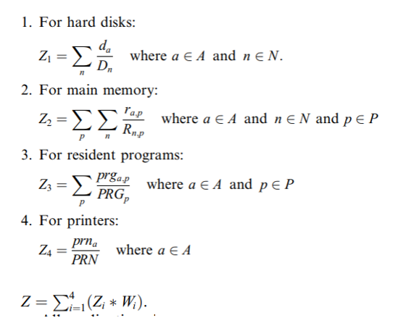
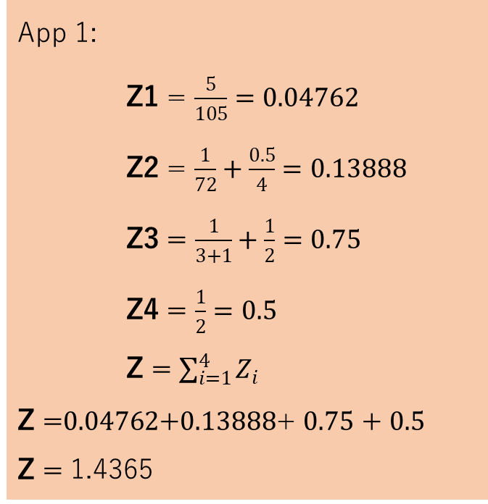
App 1:
Z1 = $\frac{5}{105}=0.04762$
Z2 = $\frac{1}{72}+\frac{0.5}{4}=0.13888$
Z3 = $\frac{1}{3+1}+\frac{1}{2}=0.75$
Z4 = $\frac{1}{2}=0.5$
Z = $\sum_{i=1}^{4}{Z_{i}}$
Z =$0.04762$+$0.13888$+ $0.75$ + $0.5$
Z = 1.4365
Application | 1 | 2 | 3 | 4 | 5 | 6
Hard disk | 5 | 25 | 13 | 24 | 14 | 30
programs | [1,3] | [1,2] | [2,3] | [] | [] | [2,3]
printer | 1 | 1 | 0 | 1 | 0 | 1
Node id | 1 | 2 | 3 | 4 | 5
Program id and size (MB) | -,- | 3,0.5 | 1,1 | 2,1.5 | 1,1
Sharable no. of programs | - | 2 | 3 | 4 | 1
Memory size (MB) | 16 | 4 | 64 | 32 | 8
Printer no. | 0 | 1 | 0 | 1 | 0
Disk space (MB) | 40 | 20 | 5 | 10 | 30
Band. Disk | 8 | 10 | 17 | 9 | 12
Band. Printer | 2 | 1 | 2 | 1 | 1
App 2:
Z = 1.299
App 3:
Z = 1.046
App 4:
Z = 0.729
App 5:
Z = 0.133
App 6:
Z = 1.708

Slide 10
Sorted by Objective Function:
Pool | Apps
0 | 1, 2, 4, 6
1 | 3
2 | 5
3
4
Pool | Apps
0 | 4, 2, 1, 6
1 | 3
2 | 5
3
4

Slide 11
Graph of Node Bandwidths

Slide 12
V₀
8
V₁
10
V₅
13
11
7
16
V₂
6
17
V₄
16
5
V₃

Slide 13
Resource Allocation

Slide 14
Current Pool | Apps
0 | 4, 2, 1, 6
1 | 3
2 | 5
3
4
Allocate apps by order of priority.
This means that application 4 from the current Pool 0 should be the first allocated.
Application | 4
Hard disk | 24
programs | []
printer | 1
CHECKING OF BANDWIDTH USING VARIANT DIJKSTRA’S ALGORITHM
NODE SELECTION FOR EACH REQUESTED RESOURCES

Slide 15
Node Selection

Slide 16
Node id | 1 | 2 | 3 | 4 | 5
Program id and size (MB) | -,- | 3,0.5 | 1,1 | 2,1.5 | 1,1
Sharable no. of programs | - | 2 | 3 | 4 | 1
Memory size (MB) | 16 | 4 | 64 | 32 | 8
Printer no. | 0 | 1 | 0 | 1 | 0
Disk space (MB) | 40 | 20 | 5 | 10 | 30
Band. Disk | 8 | 10 | 17 | 9 | 12
Band. Printer | 2 | 1 | 2 | 1 | 1
Application | 4
Hard disk | 24
programs | []
printer | 1
Node id | 1 | 2 | 3 | 4 | 5
Program id and size (MB) | -,- | 3,0.5 | 1,1 | 2,1.5 | 1,1
Sharable no. of programs | - | 2 | 3 | 4 | 1
Memory size (MB) | 16 | 4 | 64 | 32 | 8
Printer no. | 0 | 0 | 0 | 1 | 0
Disk space (MB) | 16 | 20 | 5 | 10 | 30
Band. Disk | 8 | 10 | 17 | 9 | 12
Band. Printer | 2 | 1 | 2 | 1 | 1
Application | 4 | Node
Hard disk | 24 | 1
programs | [] | None
printer | 1 | 2

Slide 17
Variant Dijkstra’s Algorithm

Slide 18
Current Graph:
Variant Dijkstra’s Algorithm
This algorithm finds a maximum bandwidth path with minimum hops.
The path always starts at V_{0.}
V₀
8
V₁
10
V₅
13
11
7
16
V₂
6
17
V₄
16
5
V₃

Slide 19
V₀
8
V₁
10
V₅
13
11
7
16
V₂
6
17
V₄
16
5
V₃
i | V₁ | V₂ | V₃ | V₄ | V₅ | curr | S
 | (0, -) | (0, -) | (0, -) | (0, -) | (0, -) | V₀ | {V₁, V₂, V₃, V₄, V₅}
0 | (0, -) | (13, V₀) | (0, -) | (16, V₀) | (8, V₀) | V₄ | {V₁, V₂, V₃, V₅}
1 | (0, -) | (13, V₀) | (5, V₄) |  | (8, V₀) | V₂ | {V₁, V₃, V₅}
2 | (0, -) |  | (13, V₂) |  | (11, V₂) | V₃ | {V₁, V₅}
3 | (6, V₃) |  |  |  | (13, V₃) | V₅ | {V₁}
4 | (10, V₅) |  |  |  |  | V₁ | {}

Slide 20
Finding the paths
During the process of VDA, a storage for the predecessor nodes are stored. We use it to determine the path.
Pre: | V₅ | V₀ | V₂ | V₀ | V₃
Maximum bandwidth paths with minimum hops:
Path (V₁) | V₀ | V₂ | V₃ | V₅ | V₁
Path (V₂) | V₀ | V₂
Path (V₃) | V₀ | V₂ | V₃
Path (V₄) | V₀ | V₄
Path (V₅) | V₀ | V₂ | V₃ | V₅

Slide 21
Path (V₁) | V₀ | V₂ | V₃ | V₅ | V₁
Path (V₂) | V₀ | V₂
Application | 4 | Node
Hard disk | 24 | 1
programs | [] | None
printer | 1 | 2
Node id | 1 | 2 | 3 | 4 | 5
Band. Disk | 8 | 10 | 17 | 9 | 12
Band. Printer | 2 | 1 | 2 | 1 | 1
V₀
V₀
8
8
V₁
2
V₅
V₁
2
V₅
13
12
11
7
11
7
16
16
V₂
6
17
V₄
V₂
6
17
V₄
16
5
16
5
V₃
V₃

Slide 22
Resource Allocation...
Since all conditions have been satisfied resource allocation will occur, resulting in the deduction of resources from the resource table.
Application | 4 | Node
Hard disk | 24 | 1
programs | [] | None
printer | 1 | 2
Node id | 1 | 2 | 3 | 4 | 5
Program id and size (MB) | -,- | 3,0.5 | 1,1 | 2,1.5 | 1,1
Sharable no. of programs | - | 2 | 3 | 4 | 1
Memory size (MB) | 16 | 4 | 64 | 32 | 8
Printer no. | 0 | 1 | 0 | 1 | 0
Disk space (MB) | 40 | 20 | 5 | 10 | 30
Band. Disk | 8 | 10 | 17 | 9 | 12
Band. Printer | 2 | 1 | 2 | 1 | 1
Node id | 1 | 2 | 3 | 4 | 5
Program id and size (MB) | -,- | 3,0.5 | 1,1 | 2,1.5 | 1,1
Sharable no. of programs | - | 2 | 3 | 4 | 1
Memory size (MB) | 16 | 4 | 64 | 32 | 8
Printer no. | 0 | 0 | 0 | 1 | 0
Disk space (MB) | 16 | 20 | 5 | 10 | 30
Band. Disk | 8 | 10 | 17 | 9 | 12
Band. Printer | 2 | 1 | 2 | 1 | 1

Slide 23
Currently the only allocated application is App 4.
Allocated | App 4
Current Pool | Apps
0 | 2, 1, 6
1 | 3
2 | 5
3
4
Application | 2
Hard disk | 25
programs | [1,2]
printer | 1
CHECKING OF BANDWIDTH USING VARIANT DIJKSTRA’S ALGORITHM
NODE SELECTION FOR EACH REQUESTED RESOURCES

Slide 24
Node id | 1 | 2 | 3 | 4 | 5
Program id and size (MB) | -,- | 3,0.5 | 1,1 | 2,1.5 | 1,1
Sharable no. of programs | - | 2 | 3 | 4 | 1
Memory size (MB) | 16 | 4 | 64 | 32 | 8
Printer no. | 0 | 0 | 0 | 1 | 0
Disk space (MB) | 16 | 20 | 5 | 10 | 30
Band. Disk | 8 | 10 | 17 | 9 | 12
Band. Printer | 2 | 1 | 2 | 1 | 1
Application | 2
Hard disk | 25
programs | [1,2]
printer | 1
Node id | 1 | 2 | 3 | 4 | 5
Program id and size (MB) | -,- | 3,0.5 | 1,1 | 2,1.5 | 1,1
Sharable no. of programs | - | 2 | 2 | 3 | 1
Memory size (MB) | 16 | 4 | 63 | 30.5 | 8
Printer no. | 0 | 0 | 0 | 0 | 0
Disk space (MB) | 16 | 20 | 5 | 10 | 5
Band. Disk | 8 | 10 | 17 | 9 | 12
Band. Printer | 2 | 1 | 2 | 1 | 1
Application | 2 | Node
Hard disk | 25 | 5
programs | [1,2] | 3, 4
printer | 1 | 4

Slide 25
V₀
8
V₁
2
V₅
12
11
7
16
V₂
6
17
V₄
16
5
V₃
Pre: | V₃ | V₀ | V₂ | V₀ | V₃

Slide 26
Path (V₄) | V₀ | V₄
Path (V₅) | V₀ | V₂ | V₃ | V₅
Application | 2 | Node
Hard disk | 25 | 5
programs | [1,2] | 3, 4
printer | 1 | 4
Node id | 1 | 2 | 3 | 4 | 5
Band. Disk | 8 | 10 | 17 | 9 | 12
Band. Printer | 2 | 1 | 2 | 1 | 1
V₀
V₀
8
V₁
V₅
8
2
V₁
V₅
2
12
11
7
12
16
11
7
V₂
6
5
V₄
15
V₂
6
5
V₄
16
5
16
5
V₃
V₃

Slide 27
After resource allocation:
Node id | 1 | 2 | 3 | 4 | 5
Program id and size (MB) | -,- | 3,0.5 | 1,1 | 2,1.5 | 1,1
Sharable no. of programs | - | 2 | 2 | 3 | 1
Memory size (MB) | 16 | 4 | 63 | 30.5 | 8
Printer no. | 0 | 0 | 0 | 0 | 0
Disk space (MB) | 16 | 20 | 5 | 10 | 5
Band. Disk | 8 | 10 | 17 | 9 | 12
Band. Printer | 2 | 1 | 2 | 1 | 1

Slide 28
Allocated | App 4 | App 2
Current Pool | Apps
0 | 1, 6
1 | 3
2 | 5
3
4
Application | 1
Hard disk | 5
programs | [1,3]
printer | 1
CHECKING OF BANDWIDTH USING VARIANT DIJKSTRA’S ALGORITHM
NODE SELECTION FOR EACH REQUESTED RESOURCES

Slide 29
Node id | 1 | 2 | 3 | 4 | 5
Program id and size (MB) | -,- | 3,0.5 | 1,1 | 2,1.5 | 1,1
Sharable no. of programs | - | 2 | 2 | 3 | 1
Memory size (MB) | 16 | 4 | 63 | 30.5 | 8
Printer no. | 0 | 0 | 0 | 0 | 0
Disk space (MB) | 16 | 20 | 5 | 10 | 5
Band. Disk | 8 | 10 | 17 | 9 | 12
Band. Printer | 2 | 1 | 2 | 1 | 1
Application | 1
Hard disk | 5
programs | [1,3]
printer | 1
Node id | 1 | 2 | 3 | 4 | 5
Program id and size (MB) | -,- | 3,0.5 | 1,1 | 2,1.5 | 1,1
Sharable no. of programs | - | 1 | 1 | 3 | 1
Memory size (MB) | 16 | 3.5 | 62 | 30.5 | 8
Printer no. | 0 | 0 | 0 | 0 | 0
Disk space (MB) | 16 | 20 | 0 | 10 | 5
Band. Disk | 8 | 10 | 17 | 9 | 12
Band. Printer | 2 | 1 | 2 | 1 | 1
Application | 1 | Node
Hard disk | 5 | 3
programs | [1,3] | 3, 2
printer | 1 | None

Slide 30
Application | 1 | Node
Hard disk | 5 | 3
programs | [1,3] | 3, 2
printer | 1 | None
Since at least one requested resource type could not be accommodated by any node the application will be deallocated and will be placed in the unallocated queue.
Note: The variant Dijkstra’s algorithm will not be called.
Node id | 1 | 2 | 3 | 4 | 5
Program id and size (MB) | -,- | 3,0.5 | 1,1 | 2,1.5 | 1,1
Sharable no. of programs | - | 1 | 1 | 3 | 1
Memory size (MB) | 16 | 3.5 | 62 | 30.5 | 8
Printer no. | 0 | 0 | 0 | 0 | 0
Disk space (MB) | 16 | 20 | 0 | 10 | 5
Band. Disk | 8 | 10 | 17 | 9 | 12
Band. Printer | 2 | 1 | 2 | 1 | 1
Node id | 1 | 2 | 3 | 4 | 5
Program id and size (MB) | -,- | 3,0.5 | 1,1 | 2,1.5 | 1,1
Sharable no. of programs | - | 2 | 2 | 3 | 1
Memory size (MB) | 16 | 4 | 63 | 30.5 | 8
Printer no. | 0 | 0 | 0 | 0 | 0
Disk space (MB) | 16 | 20 | 5 | 10 | 5
Band. Disk | 8 | 10 | 17 | 9 | 12
Band. Printer | 2 | 1 | 2 | 1 | 1

Slide 31
Allocated | App 4 | App 2
Unallocated | App 1
Current Pool | Apps
0 | 6
1 | 3
2 | 5
3
4
The next is App 6, but since it also requires printer, we are sure that it will also be in the unallocated queue.
Application | 6
Hard disk | 30
programs | [2, 3]
printer | 1
CHECKING OF BANDWIDTH USING VARIANT DIJKSTRA’S ALGORITHM
NODE SELECTION FOR EACH REQUESTED RESOURCES

Slide 32
Allocated | App 4 | App 2
Unallocated | App 1 | App 6
Current Pool | Apps
0
1 | 3
2 | 5
3
4
All applications in Pool 0 are dequeued, proceed to the next Pool 1.
Application | 3
Hard disk | 13
programs | [2,3]
printer | 1
CHECKING OF BANDWIDTH USING VARIANT DIJKSTRA’S ALGORITHM
NODE SELECTION FOR EACH REQUESTED RESOURCES

Slide 33
Node id | 1 | 2 | 3 | 4 | 5
Program id and size (MB) | -,- | 3,0.5 | 1,1 | 2,1.5 | 1,1
Sharable no. of programs | - | 2 | 2 | 3 | 1
Memory size (MB) | 16 | 4 | 63 | 30.5 | 8
Printer no. | 0 | 0 | 0 | 0 | 0
Disk space (MB) | 16 | 20 | 5 | 10 | 5
Band. Disk | 8 | 10 | 17 | 9 | 12
Band. Printer | 2 | 1 | 2 | 1 | 1
Application | 3
Hard disk | 13
programs | [2,3]
printer | 0
Node id | 1 | 2 | 3 | 4 | 5
Program id and size (MB) | -,- | 3,0.5 | 1,1 | 2,1.5 | 1,1
Sharable no. of programs | - | 1 | 2 | 2 | 1
Memory size (MB) | 16 | 3.5 | 63 | 29 | 8
Printer no. | 0 | 0 | 0 | 0 | 0
Disk space (MB) | 16 | 7 | 5 | 10 | 5
Band. Disk | 8 | 10 | 17 | 9 | 12
Band. Printer | 2 | 1 | 2 | 1 | 1
Application | 3 | Node
Hard disk | 13 | 2
programs | [2,3] | 4, 2
printer | 0

Slide 34
V₀
8
V₁
2
V₅
12
11
7
15
V₂
6
5
V₄
16
5
V₃
Pre: | V₃ | V₀ | V₂ | V₀ | V₂

Slide 35
Path (V₂) | V₀ | V₂
Application | 3 | Node
Hard disk | 13 | 2
programs | [2,3] | 4, 2
printer | 0
Node id | 1 | 2 | 3 | 4 | 5
Band. Disk | 8 | 10 | 17 | 9 | 12
Band. Printer | 2 | 1 | 2 | 1 | 1
V₀
8
V₁
2
V₅
2
11
7
16
V₂
6
5
V₄
16
5
V₃

Slide 36
Allocated | App 4 | App 2 | App 3
Unallocated | App 1 | App 6
Current Pool | Apps
0
1
2 | 5
3
4
All applications in Pool 0 are dequeued, proceed to the next Pool 2.
Application | 5
Hard disk | 14
programs | [3]
printer | 0
CHECKING OF BANDWIDTH USING VARIANT DIJKSTRA’S ALGORITHM
NODE SELECTION FOR EACH REQUESTED RESOURCES

Slide 37
Node id | 1 | 2 | 3 | 4 | 5
Program id and size (MB) | -,- | 3,0.5 | 1,1 | 2,1.5 | 1,1
Sharable no. of programs | - | 1 | 2 | 2 | 1
Memory size (MB) | 16 | 3.5 | 63 | 29 | 8
Printer no. | 0 | 0 | 0 | 0 | 0
Disk space (MB) | 16 | 7 | 5 | 10 | 5
Band. Disk | 8 | 10 | 17 | 9 | 12
Band. Printer | 2 | 1 | 2 | 1 | 1
Application | 5
Hard disk | 14
programs | [3]
printer | 0
Node id | 1 | 2 | 3 | 4 | 5
Program id and size (MB) | -,- | 3,0.5 | 1,1 | 2,1.5 | 1,1
Sharable no. of programs | - | 1 | 2 | 2 | 1
Memory size (MB) | 16 | 3.5 | 63 | 29 | 8
Printer no. | 0 | 0 | 0 | 0 | 0
Disk space (MB) | 2 | 7 | 5 | 10 | 5
Band. Disk | 8 | 10 | 17 | 9 | 12
Band. Printer | 2 | 1 | 2 | 1 | 1
Application | 5 | Node
Hard disk | 14 | 1
programs | []
printer | 0

Slide 38
V₀
8
V₁
2
V₅
2
11
7
15
V₂
6
5
V₄
16
5
V₃
Pre: | V₃ | V₅ | V₂ | V₀ | V₀

Slide 39
Path (V₁) | V₀ | V₅ | V₂ | V₃ | V₁
Node id | 1 | 2 | 3 | 4 | 5
Band. Disk | 8 | 10 | 17 | 9 | 12
Band. Printer | 2 | 1 | 2 | 1 | 1
Application | 5 | Node
Hard disk | 14 | 1
programs | []
printer | 0
While the edge numbers indicate the bandwidth each channel can accommodate, the allocation algorithm can still sometimes choose to attempt to allocate an application even if it requires a bandwidth higher than the channel can handle while sacrificing "quality of service“, but the allocation algorithm will not attempt to allocate an application that requires bandwidth lower than the specified threshold for quality of service (50% in our example).
V₀
V₀
8
8
V₁
2
V₅
V₁
2
V₅
2
2
11
7
11
7
15
15
V₂
6
5
V₄
V₂
0
5
V₄
16
5
16
5
V₃
V₃

Slide 40
Allocated | App 4 | App 2 | App 3 | App 5
Unallocated | App 1 | App 6
Current Pool | Apps
0
1
2
3
4
All applications in the Pools are now dequeued.

Slide 41

SECOND ITERATION

Slide 42
Allocated | App 4 | App 2 | App 3 | App 5
Unallocated | App 1 | App 6
All unallocated applications will be reintroduced to their respective pools.
Current Pool | Apps
0 | 1, 6
1
2
3
4

Slide 43
Allocated | App 4 | App 2 | App 3 | App 5
Allocated | App 2 | App 3 | App 5
Node id | 1 | 2 | 3 | 4 | 5
Program id and size (MB) | -,- | 3,0.5 | 1,1 | 2,1.5 | 1,1
Sharable no. of programs | - | 1 | 2 | 2 | 1
Memory size (MB) | 16 | 3.5 | 63 | 29 | 8
Printer no. | 0 | 0 | 0 | 0 | 0
Disk space (MB) | 2 | 7 | 5 | 10 | 5
The applications will be popped from the "allocated" queue and have their resources released, ready for use by the next applications. We can reasonably guarantee that each popped application is the application with the shortest approximate execution time from earlier sorting steps.
Application | 4 | Node
Hard disk | 24 | 1
programs | [] | None
printer | 1 | 2
Node id | 1 | 2 | 3 | 4 | 5
Program id and size (MB) | -,- | 3,0.5 | 1,1 | 2,1.5 | 1,1
Sharable no. of programs | - | 1 | 2 | 2 | 1
Memory size (MB) | 16 | 3.5 | 63 | 29 | 8
Printer no. | 0 | 1 | 0 | 0 | 0
Disk space (MB) | 26 | 7 | 5 | 10 | 5

Slide 44
V₀
V₀
8
8
V₁
2
V₅
V₁
V₅
10
2
3
11
7
11
7
15
15
V₂
0
5
V₄
0
5
V₂
V₄
16
5
16
5
V₃
V₃
Node id | 1 | 2 | 3 | 4 | 5
Band. Disk | 8 | 10 | 17 | 9 | 12
Band. Printer | 2 | 1 | 2 | 1 | 1

Slide 45
Allocated | App 2 | App 3 | App 5
Current Pool | Apps
0 | 1,6
1
2
3
4
Application | 1
Hard disk | 5
programs | [1,3]
printer | 1
CHECKING OF BANDWIDTH USING VARIANT DIJKSTRA’S ALGORITHM
NODE SELECTION FOR EACH REQUESTED RESOURCES

Slide 46
Node id | 1 | 2 | 3 | 4 | 5
Program id and size (MB) | -,- | 3,0.5 | 1,1 | 2,1.5 | 1,1
Sharable no. of programs | - | 1 | 2 | 2 | 1
Memory size (MB) | 16 | 3.5 | 63 | 29 | 8
Printer no. | 0 | 1 | 0 | 0 | 0
Disk space (MB) | 26 | 7 | 5 | 10 | 5
Band. Disk | 8 | 10 | 17 | 9 | 12
Band. Printer | 2 | 1 | 2 | 1 | 1
Application | 1
Hard disk | 5
programs | [1,3]
printer | 1
Node id | 1 | 2 | 3 | 4 | 5
Program id and size (MB) | -,- | 3,0.5 | 1,1 | 2,1.5 | 1,1
Sharable no. of programs | - | 0 | 1 | 2 | 1
Memory size (MB) | 16 | 3 | 62 | 29 | 8
Printer no. | 0 | 0 | 0 | 0 | 0
Disk space (MB) | 26 | 7 | 0 | 10 | 5
Band. Disk | 8 | 10 | 17 | 9 | 12
Band. Printer | 2 | 1 | 2 | 1 | 1
Application | 1 | Node
Hard disk | 5 | 3
programs | [1,3] | 3, 2
printer | 1 | 2

Slide 47
V₀
8
V₁
10
V₅
3
11
7
15
V₂
0
5
V₄
16
5
V₃
Pre: | V₅ | V₅ | V₂ | V₀ | V₀

Slide 48
Path (V₃) | V₀ | V₅ | V₂ | V₃
Path (V₂) | V₀ | V₅ | V₂
Application | 1 | Node
Hard disk | 5 | 3
programs | [1,3] | 3, 2
printer | 1 | 2
Node id | 1 | 2 | 3 | 4 | 5
Band. Disk | 8 | 10 | 17 | 9 | 12
Band. Printer | 2 | 1 | 2 | 1 | 1
V₀
The assigned "bandwidth" value for a path is taken from the edge in the path with the smallest bandwidth value, i.e., the "weakest link" of the path.
8
V₁
2
V₅
3
11
7
15
The application cannot be allocated since the bandwidth value of the path is less than the threshold for the quality of service, which is 50% (Band[Path] = 8 < 8.5 = 17 * 0.5).
V₂
0
5
V₄
16
5
V₃

Slide 49
Node id | 1 | 2 | 3 | 4 | 5
Program id and size (MB) | -,- | 3,0.5 | 1,1 | 2,1.5 | 1,1
Sharable no. of programs | - | 0 | 1 | 2 | 1
Memory size (MB) | 16 | 3 | 62 | 29 | 8
Printer no. | 0 | 0 | 0 | 0 | 0
Disk space (MB) | 26 | 7 | 0 | 10 | 5
Band. Disk | 8 | 10 | 17 | 9 | 12
Band. Printer | 2 | 1 | 2 | 1 | 1
Node id | 1 | 2 | 3 | 4 | 5
Program id and size (MB) | -,- | 3,0.5 | 1,1 | 2,1.5 | 1,1
Sharable no. of programs | - | 1 | 2 | 2 | 1
Memory size (MB) | 16 | 3.5 | 63 | 29 | 8
Printer no. | 0 | 1 | 0 | 0 | 0
Disk space (MB) | 26 | 7 | 5 | 10 | 5
Band. Disk | 8 | 10 | 17 | 9 | 12
Band. Printer | 2 | 1 | 2 | 1 | 1

Slide 50
Allocated | App 2 | App 3 | App 5
Unallocated | App 1
Current Pool | Apps
0 | 6
1
2
3
4
Application 6 will be allocated in a similar manner. The available bandwidth is also less than the minimum bandwidth required by application 6, so it is also left un-allocated until resources from the other applications are released.
Application | 6
Hard disk | 30
programs | [2,3]
printer | 1
CHECKING OF BANDWIDTH USING VARIANT DIJKSTRA’S ALGORITHM
NODE SELECTION FOR EACH REQUESTED RESOURCES

Slide 51
Allocated | App 2 | App 3 | App 5
Unallocated | App 1 | App 6
All unallocated applications will be reintroduced to their respective pools.
Current Pool | Apps
0 | 1, 6
1
2
3
4

Slide 52
Allocated | App 2 | App 3 | App 5
Allocated | App 3 | App 5
Node id | 1 | 2 | 3 | 4 | 5
Program id and size (MB) | -,- | 3,0.5 | 1,1 | 2,1.5 | 1,1
Sharable no. of programs | - | 1 | 2 | 2 | 1
Memory size (MB) | 16 | 3.5 | 63 | 29 | 8
Printer no. | 0 | 1 | 0 | 0 | 0
Disk space (MB) | 26 | 7 | 5 | 10 | 5
Application | 2 | Node
Hard disk | 25 | 5
programs | [1,2] | 3, 4
printer | 1 | 4
Node id | 1 | 2 | 3 | 4 | 5
Program id and size (MB) | -,- | 3,0.5 | 1,1 | 2,1.5 | 1,1
Sharable no. of programs | - | 1 | 3 | 3 | 1
Memory size (MB) | 16 | 3.5 | 64 | 30.5 | 8
Printer no. | 0 | 1 | 0 | 1 | 0
Disk space (MB) | 26 | 7 | 5 | 10 | 30

Slide 53
V₀
V₀
8
8
V₁
V₅
10
V₁
10
V₅
3
3
11
7
11
7
16
15
V₂
0
17
V₄
V₂
0
5
V₄
16
5
16
5
V₃
V₃
Node id | 1 | 2 | 3 | 4 | 5
Band. Disk | 8 | 10 | 17 | 9 | 12
Band. Printer | 2 | 1 | 2 | 1 | 1

Slide 54
THIRD ITERATION

Slide 55
Allocated | App 3 | App 5
Current Pool | Apps
0 | 1, 6
1
2
3
4
Application | 1
Hard disk | 5
programs | [1,3]
printer | 1
CHECKING OF BANDWIDTH USING VARIANT DIJKSTRA’S ALGORITHM
NODE SELECTION FOR EACH REQUESTED RESOURCES

Slide 56
Node id | 1 | 2 | 3 | 4 | 5
Program id and size (MB) | -,- | 3,0.5 | 1,1 | 2,1.5 | 1,1
Sharable no. of programs | - | 1 | 3 | 3 | 1
Memory size (MB) | 16 | 3.5 | 64 | 30.5 | 8
Printer no. | 0 | 1 | 0 | 1 | 0
Disk space (MB) | 26 | 7 | 5 | 10 | 30
Band. Disk | 8 | 10 | 17 | 9 | 12
Band. Printer | 2 | 1 | 2 | 1 | 1
Application | 1
Hard disk | 5
programs | [1,3]
printer | 1
Node id | 1 | 2 | 3 | 4 | 5
Program id and size (MB) | -,- | 3,0.5 | 1,1 | 2,1.5 | 1,1
Sharable no. of programs | - | 0 | 2 | 3 | 1
Memory size (MB) | 16 | 3 | 63 | 30.5 | 8
Printer no. | 0 | 0 | 0 | 1 | 0
Disk space (MB) | 26 | 7 | 0 | 10 | 30
Band. Disk | 8 | 10 | 17 | 9 | 12
Band. Printer | 2 | 1 | 2 | 1 | 1
Application | 1 | Node
Hard disk | 5 | 3
programs | [1,3] | 3, 2
printer | 1 | 2

Slide 57
V₀
8
V₁
10
V₅
3
11
7
16
V₂
0
17
V₄
16
5
V₃
Pre: | V₅ | V₀ | V₂ | V₀ | V₃

Slide 58
Pre: | V₅ | V₀ | V₂ | V₀ | V₃
Path (V₃) | V₀ | V₂ | V₃
Path (V₂) | V₀ | V₂
Application | 1 | Node
Hard disk | 5 | 3
programs | [1,3] | 3, 2
printer | 1 | 2
Node id | 1 | 2 | 3 | 4 | 5
Band. Disk | 8 | 10 | 17 | 9 | 12
Band. Printer | 2 | 1 | 2 | 1 | 1
V₀
8
V₁
2
V₅
Bandwidth is still too low.
So, we will not proceed to the allocation.
3
11
7
15
V₂
0
5
V₄
16
5
V₃

Slide 59
Path (V₅) | V₀ | V₂ | V₃ | V₅
Path (V₂) | V₀ | V₂
Application | 6 | Node
Hard disk | 30 | 5
programs | [2,3] | 4, 2
printer | 1 | 2
Node id | 1 | 2 | 3 | 4 | 5
Band. Disk | 8 | 10 | 17 | 9 | 12
Band. Printer | 2 | 1 | 2 | 1 | 1
V₀
8
V₁
10
V₅
3
11
7
16
V₂
0
17
V₄
16
5
V₃

Slide 60
Allocated | App 3 | App 5
Unallocated | App 1 | App 6
Current Pool | Apps
0
1
2
3
4
All applications in the Pools are now dequeued.
Same steps will be done. The resources for App 3 will be released and the unallocated apps will be reintroduced to the pool.

Slide 61
FOURTH ITERATION

Slide 62
Allocated | App 5
Current Pool | Apps
0 | 1, 6
1
2
3
4
Application | 1
Hard disk | 5
programs | [1,3]
printer | 1
CHECKING OF BANDWIDTH USING VARIANT DIJKSTRA’S ALGORITHM
NODE SELECTION FOR EACH REQUESTED RESOURCES

Slide 63
V₀
8
V₁
10
V₅
13
11
7
16
V₂
0
17
V₄
16
5
V₃
Pre: | V₅ | V₅ | V₅ | V₀ | V₀

Slide 64
Pre: | V₅ | V₅ | V₅ | V₀ | V₀
Path (V₃) | V₀ | V₅ | V₃
Path (V₂) | V₀ | V₅ | V₂
Application | 1 | Node
Hard disk | 5 | 3
programs | [1,3] | 3, 2
printer | 1 | 2
Node id | 1 | 2 | 3 | 4 | 5
Band. Disk | 8 | 10 | 17 | 9 | 12
Band. Printer | 2 | 1 | 2 | 1 | 1
V₀
8
V₁
2
V₅
Bandwidth is still too low.
So, we will not proceed to the allocation.
13
11
7
15
V₂
0
5
V₄
16
5
V₃

Slide 65
Pre: | V₅ | V₅ | V₅ | V₀ | V₀
Path (V₅) | V₀ | V₅
Path (V₂) | V₀ | V₅ | V₂
Application | 6 | Node
Hard disk | 30 | 5
programs | [2,3] | 4, 2
printer | 1 | 2
Node id | 1 | 2 | 3 | 4 | 5
Band. Disk | 8 | 10 | 17 | 9 | 12
Band. Printer | 2 | 1 | 2 | 1 | 1
V₀
V₀
8
0
V₁
V₅
V₁
V₅
2
2
13
13
10
7
11
7
15
15
V₂
0
5
V₄
V₂
0
5
V₄
16
5
16
5
V₃
V₃

Slide 66
Allocated | App 5 | App 6
Unallocated | App 1
Current Pool | Apps
0
1
2
3
4
All applications in the Pools are now dequeued.

Slide 67
FIFTH ITERATION

Slide 68
Allocated | App 6
Current Pool | Apps
0 | 1
1
2
3
4
Application | 1
Hard disk | 5
programs | [1,3]
printer | 1
CHECKING OF BANDWIDTH USING VARIANT DIJKSTRA’S ALGORITHM
NODE SELECTION FOR EACH REQUESTED RESOURCES

Slide 69
V₀
8
V₁
10
V₅
13
11
7
16
V₂
6
17
V₄
16
5
V₃
Pre: | V₅ | V₀ | V₂ | V₀ | V₃

Slide 70
Path (V₃) | V₀ | V₂ | V₃
Path (V₃) | V₀ | V₂
Application | 1 | Node
Hard disk | 5 | 3
programs | [1,3] | 3, 2
printer | 1 | 2
Node id | 1 | 2 | 3 | 4 | 5
Band. Disk | 8 | 10 | 17 | 9 | 12
Band. Printer | 2 | 1 | 2 | 1 | 1
V₀
V₀
0
0
V₁
V₅
V₁
V₅
2
2
1
13
10
7
11
7
15
15
V₂
6
5
V₄
V₂
6
5
V₄
16
5
0
5
V₃
V₃

Slide 71
All applications are already accommodated.
Therefore, the allocation queue is:
App 4 | App 2 | App 3 | App 5 | App 6 | App 1
- END -
https://github.com/revhea2/priority-based-resource-allocation.git

Slide 72
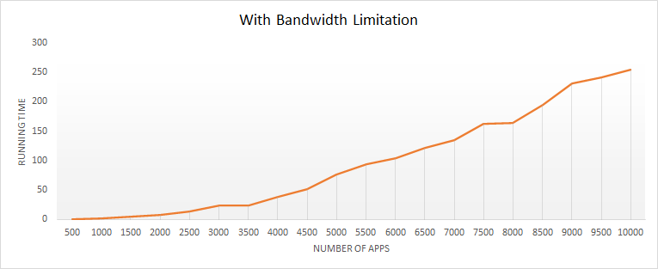
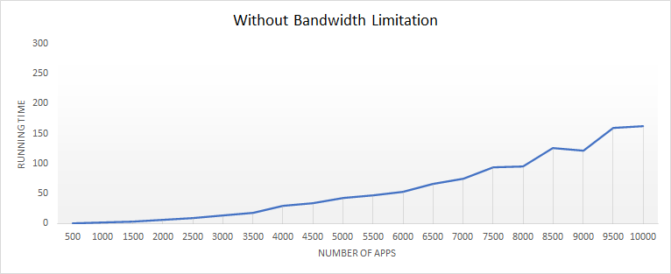
ANALYSIS

Slide 73
