Slide 1
Fitbit Data Analysis
Apr 10, 2023

Slide 2
Overview
Understand the trends from the given Fitbit users dataset and provide insights on different features to the Bellabeat marketing team.
Limitations
The data available corresponds to daily activity of only 33 users and even lower for few categories like sleep and weight.(weight not analyzed - 8 users)
The data is biased as it doesn’t show details about the gender, age group, locations.
Notes:
For effective analysis - wait for few more months to get a sample of atleast 100 or so based on the study.

Slide 3
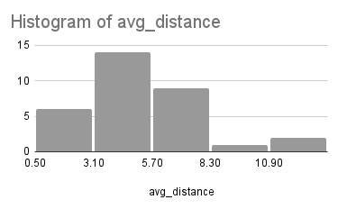
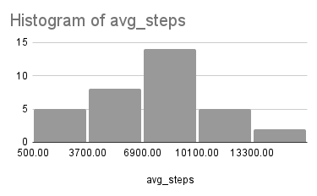
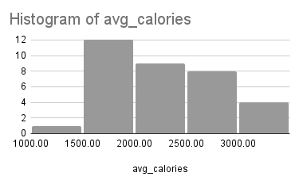
Understanding the trend
Average Distance
Average Steps
Average calories

Slide 4
Weekday vs Weekend:

Slide 5
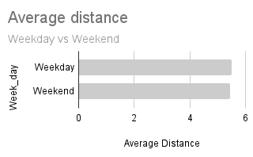
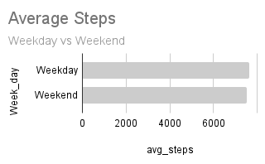
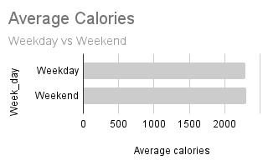
Comparison: Weekday vs Weekend
Average Distance
Average Steps
Average calories
Notes:
Members work hard in weekends compared to weekdays.

Slide 6
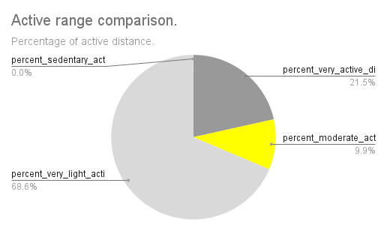
Active range
Notes:
Only 10% are moderately active whereas 68% very lightly active.

Slide 7
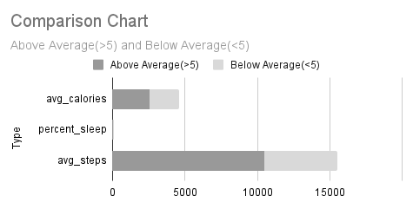
Above and Below average distance
Notes:
Members who cover more than the average distance(5miles) burn more calories, fall asleep faster and have more steps comparitively.

Slide 8
Insights and recommendations:
Weekend vs Weekday
Members are more active in the weekends.
Challenges/rewards for weekday activity.
Active range
More distance covered as very light activity.
Promote more moderate activity as challenges.
Above and below average distance
More the distance, more calories burned and more steps walked.
Notification when above average distance.met.
Sleep rate
Members who walk more fall asleep faster.
More sleep tracking features and rewards.

Slide 9
Thank you.

