Slide 1
How To Start Writing Compilers
Without a Ph.D.
revival/fnuque
Notes:
Hello everyone
Happy to see so many of you
For the next hour we're going to talk about compilers. We have a lot of ground to cover, so I'll try to keep the energy up.

Slide 2
Approach
Low-level & practical
Looking at source
Specific implementation
Notes:
Narrow, not a wide talk
Not a lot of theory
Geting up and leaving is up

Slide 3
http://github.com/revivalizer/compilertalk
Notes:
On that note – if you feel like something wasn't explained properly, or glossed over, or too imprecise! Look at the source!
Look for 'revivalizer' on github

Slide 4
Outline
Preliminaries
Lesson 1: Addition
Lesson 2: Complex expressions
Lesson 3: Fixing associativity
Lesson 4: Function calls
Lesson 5: Variables
Lesson 6: Control flow
Questions?
Notes:
Going from a very simple language to something that can do actual meaningful stuff
Step 1 is by far the hardest!

Slide 5
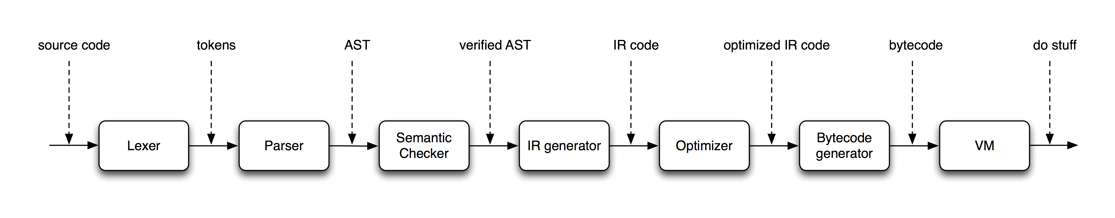
Compiler structure
Notes:
So what's our secret sauce? How can we do this in an hour?
KISS!
Strike 1: We won't do very much semantic checking – we'll make a simple language instead! No type systems, only allow one argument to functions and one return value :-)\
Strike 2: Optimization – not neccesary!
Okay – that's the stuff we cut out. Now, next two parts are important.
WORK SMART NOT HARD
Strike 3: DON'T DO YOUR PARSING AND LEXING MANUALLY. Other tools: Lexx/yacc, flex/bison, ANTLR. Still too tedious - use PEGs as a newbie!
Strike 4: Don't use C++ for tree structures, it's not a good fit! Use an dynamically typed language with easy hashtables.

Slide 6
Lesson 1: Addition

Slide 7
“1+2+3”
Notes:
First step: Write a compiler which supports programs of this type. Integers, arbitrary additions, arbitrary whitespace
The compiler will generate a program the computes the result of the expressive
Hopefully you have an intuitive sense that we can't solve this in this space (textual representation) – we need another representation

Slide 8
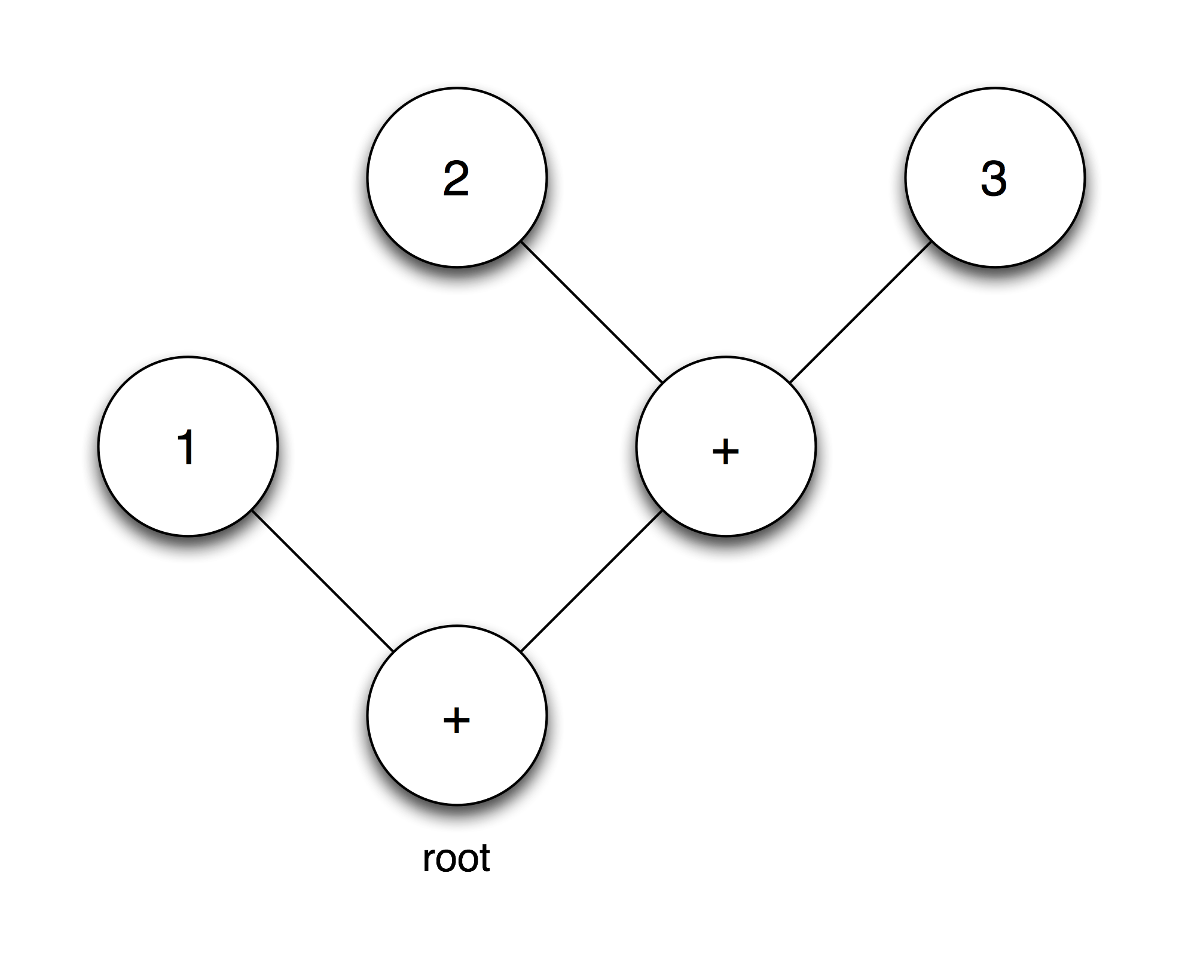
Lesson 1: Addition
“1+2+3”
Notes:
Here's another representation of our program
Tree structure
Node with a number of child nodes
Root node
AST – parse tree
Result of parsing
Tree structure that represents the computation you're trying to perform
In this case – two types: numeric constants, plus operator (binary)
Can we perform the calculation now?
I hope you can sense, yes we can! Probably find an algorithm that can compute this, no matter what the tree looks like. NOT SHOWING IT!

Slide 9
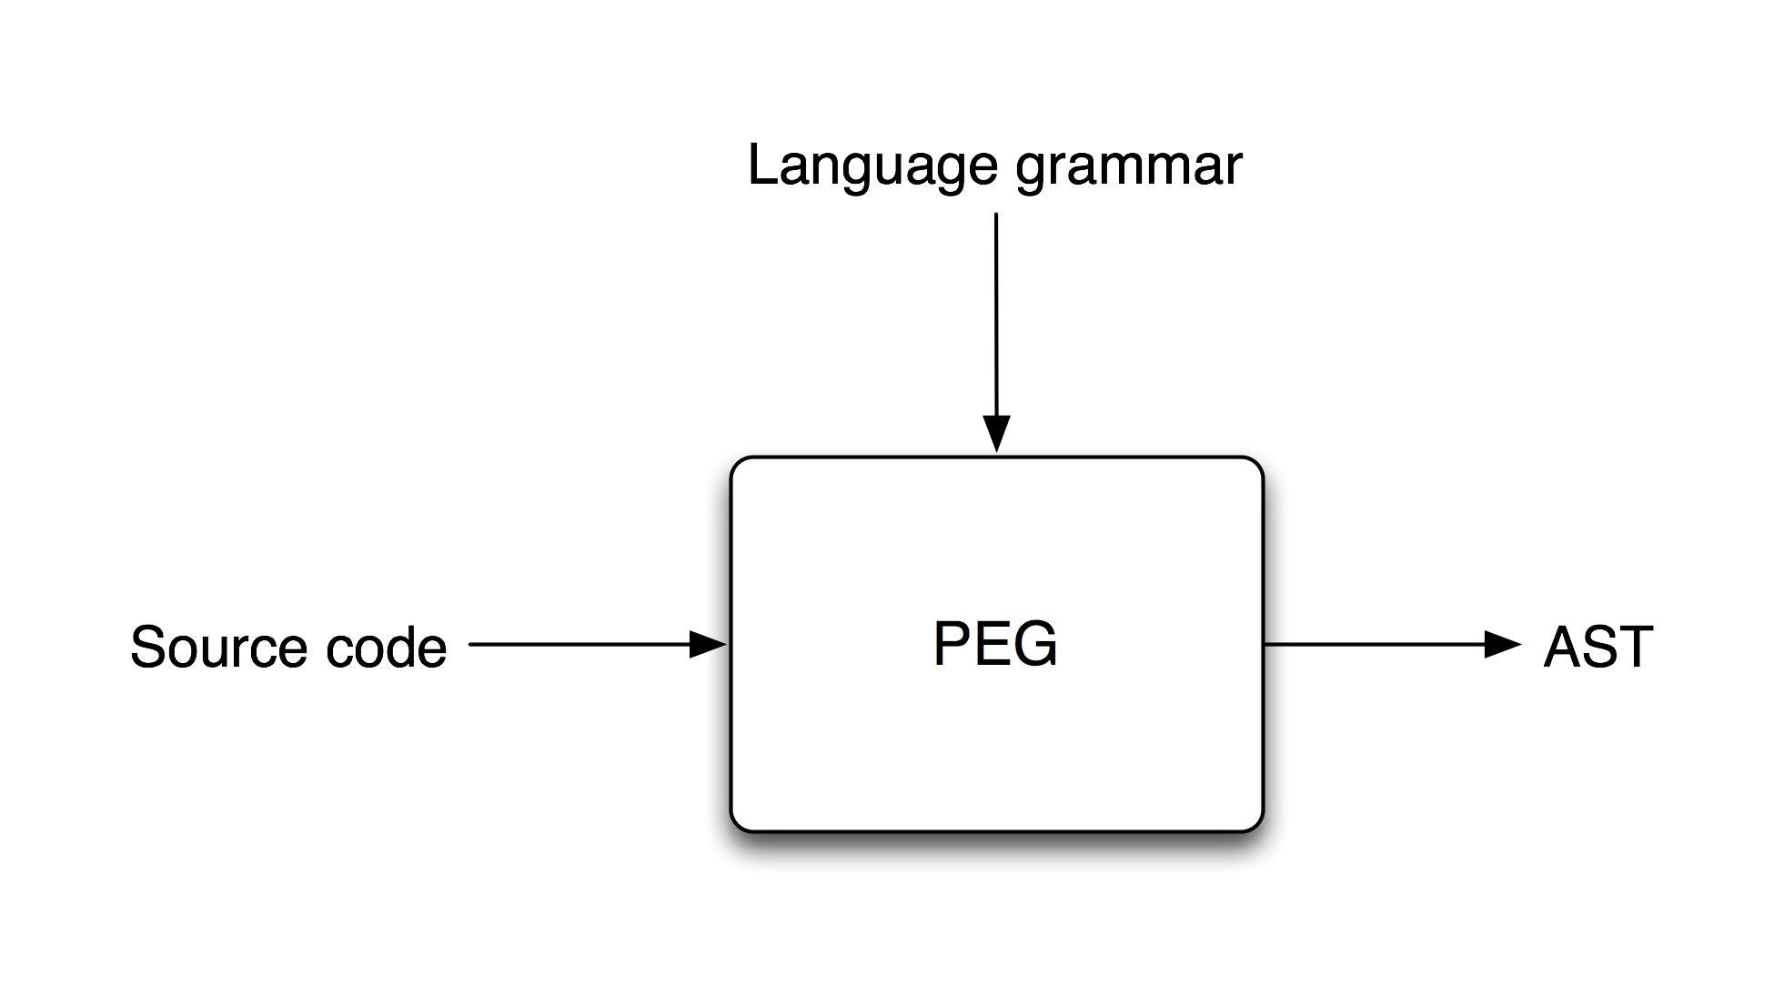
PEGs
Notes:
Great – but how did we get there?
Tool: PEG
Two inputs – grammar, source code
Gives you AST out!
What's grammar? Rules defining a language?
Set of rules that define valid ways to communicate ideas, or formulate thoughts, in that language

Slide 10
Grammar
Rules
Integers
Plus operator
Whitespace
“1+2+3”

Slide 11
PEGs
Define rule: r₁ ← e
String match: 'string' / [a-z]
Rule reference: r
Sequence: e₁ e₂
Zero-or-more: e*
One-or-more: e+
Optional: e?
Ordered choice: e₁ / e₂
Notes:
How do we define rules using PEG?
Regular expressions with super powers!
Textual Matching
Ordered choice a bit different!
Define rules – expression, or other rule recursively, or self-referential recursive (NOT LEFT RECURSIVE)
String matching varies between implementations

Slide 12
Formal rules
ws ← %s+
integer ← '-'? [0-9]+ ws?
plus_operator ← '+' ws?
plus_expr <- integer plus_operator integer
“1+2+3”

Slide 13
Formal rules
ws ← %s+
integer ← '-'? [0-9]+ ws?
plus_operator ← '+' ws?
plus_expr <- integer plus_operator plus_expr
“1+2+3”

Slide 14
Formal rules
ws ← %s+
integer ← '-'? [0-9]+ ws?
plus_operator ← '+' ws?
plus_expr <- integer plus_operator plus_expr
/ integer
“1+2+3”

Slide 15
Captures (1)
root ← ws? plus_expr
plus_expr ← integer
plus_operator
plus_expr
/ integer
plus_operator ← '+' ws?
integer ← '-'? [0-9]+ ws?
ws ← %s+
Notes:
Start with our rules

Slide 16
Captures (2)
root ← ws? (plus_expr) → {}
plus_expr ← (integer
plus_operator
plus_expr) → {}
/ integer
plus_operator ← ('+' ws?) → {}
integer ← ('-'? [0-9]+ ws?) → {}
ws ← %s+
Notes:
First step – telling the PEG which rules we want to capture. There are different ways of capturing, we're interested in capturing tables.

Slide 17
Captures (3)
Root ← ws? ({:root: plus_expr:}) → {}
plus_expr ← ({:operand1: integer:}
{:operator: plus_operator:}
{:operand2: plus_expr:}) → {}
/ integer
plus_operator ← ({:type: '+':} ws?) → {}
integer ← ({:value: '-'? [0-9]+:} ws?) → {}
ws ← %s+
Notes:
Naming the captures

Slide 18
Captures (4)
root ← ws? ({:root: plus_expr:}) → {}
plus_expr ← ({:tag: ''->'binary_op':}
{:operand1: integer:}
{:operator: plus_operator:}
{:operand2: plus_expr:}) → {}
/ integer
plus_operator ← ({:type: '+':} ws?) → {}
integer ← ({:tag: '' -> 'literal_int':} {:value: '-'? [0-9]+:} ws?) → {}
ws ← %s+
Notes:
Adding tags, so tables aren't anonymous

Slide 19
Resulting AST
root = {
  operand2 = {
    operand2 = {
      value = "3",
      tag = "literal_int"},
    operator = {
      type = "+"},
    operand1 = {
      value = "2",
      tag = "literal_int"},
    tag = "binary_op"},
  operator = {
    type = "+"},
  operand1 = {
    value = "1",
    tag = "literal_int"},
  tag = "binary_op"},
“1+2+3”

Slide 20
Evaluation
function eval(node)
  if (node.tag=="binary_op") then
    if (node.operator.type=="+") then
      return eval(node.operand1) + eval(node.operand2)
    end
  elseif (node.tag=="literal_int") then
    return tonumber(node.value)
  end
end

Slide 21
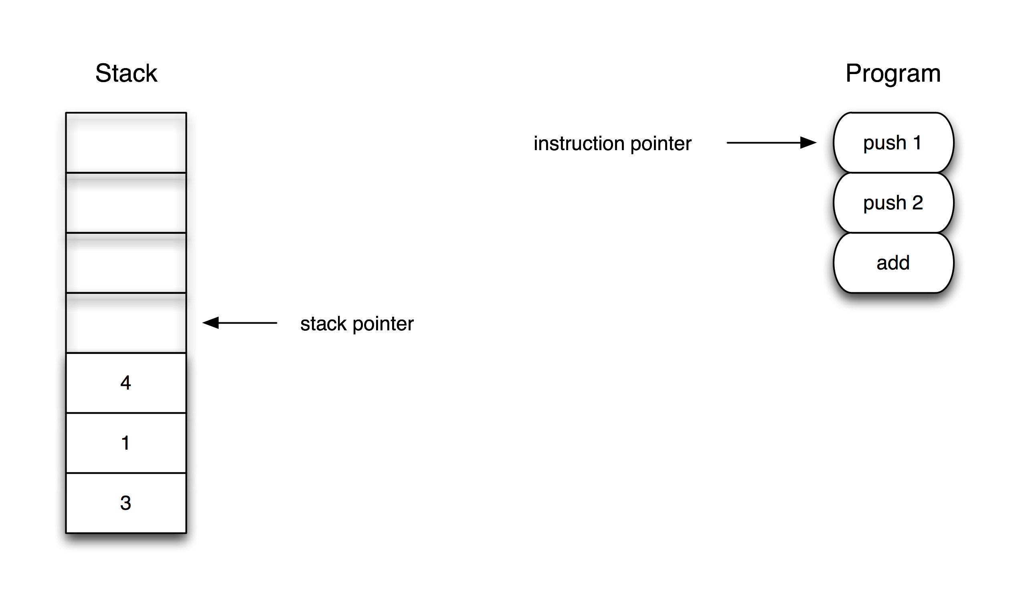
Stackbased VM (1)
Notes:
As mentioned, we're not going to target x86 machine code, although nice and fast, we can do a little simpler by writing a VM that runs our code.
What's a VM?
A emulated CPU running in software on the hardware CPU.
So we can design a little CPU ourselves, which is targeted to the language we're writing. Simple!
What are the components?
ILLUSTRATION: OPODE STREAM, with IP
ILLUSTRATION: STACK BASED
From the point of view of the programmar, or compiler: No access to raw memory. No registers. We can only work with a stack.
Push/pop
E.g. Add: Pop two numbers, do the add, push result.

Slide 22
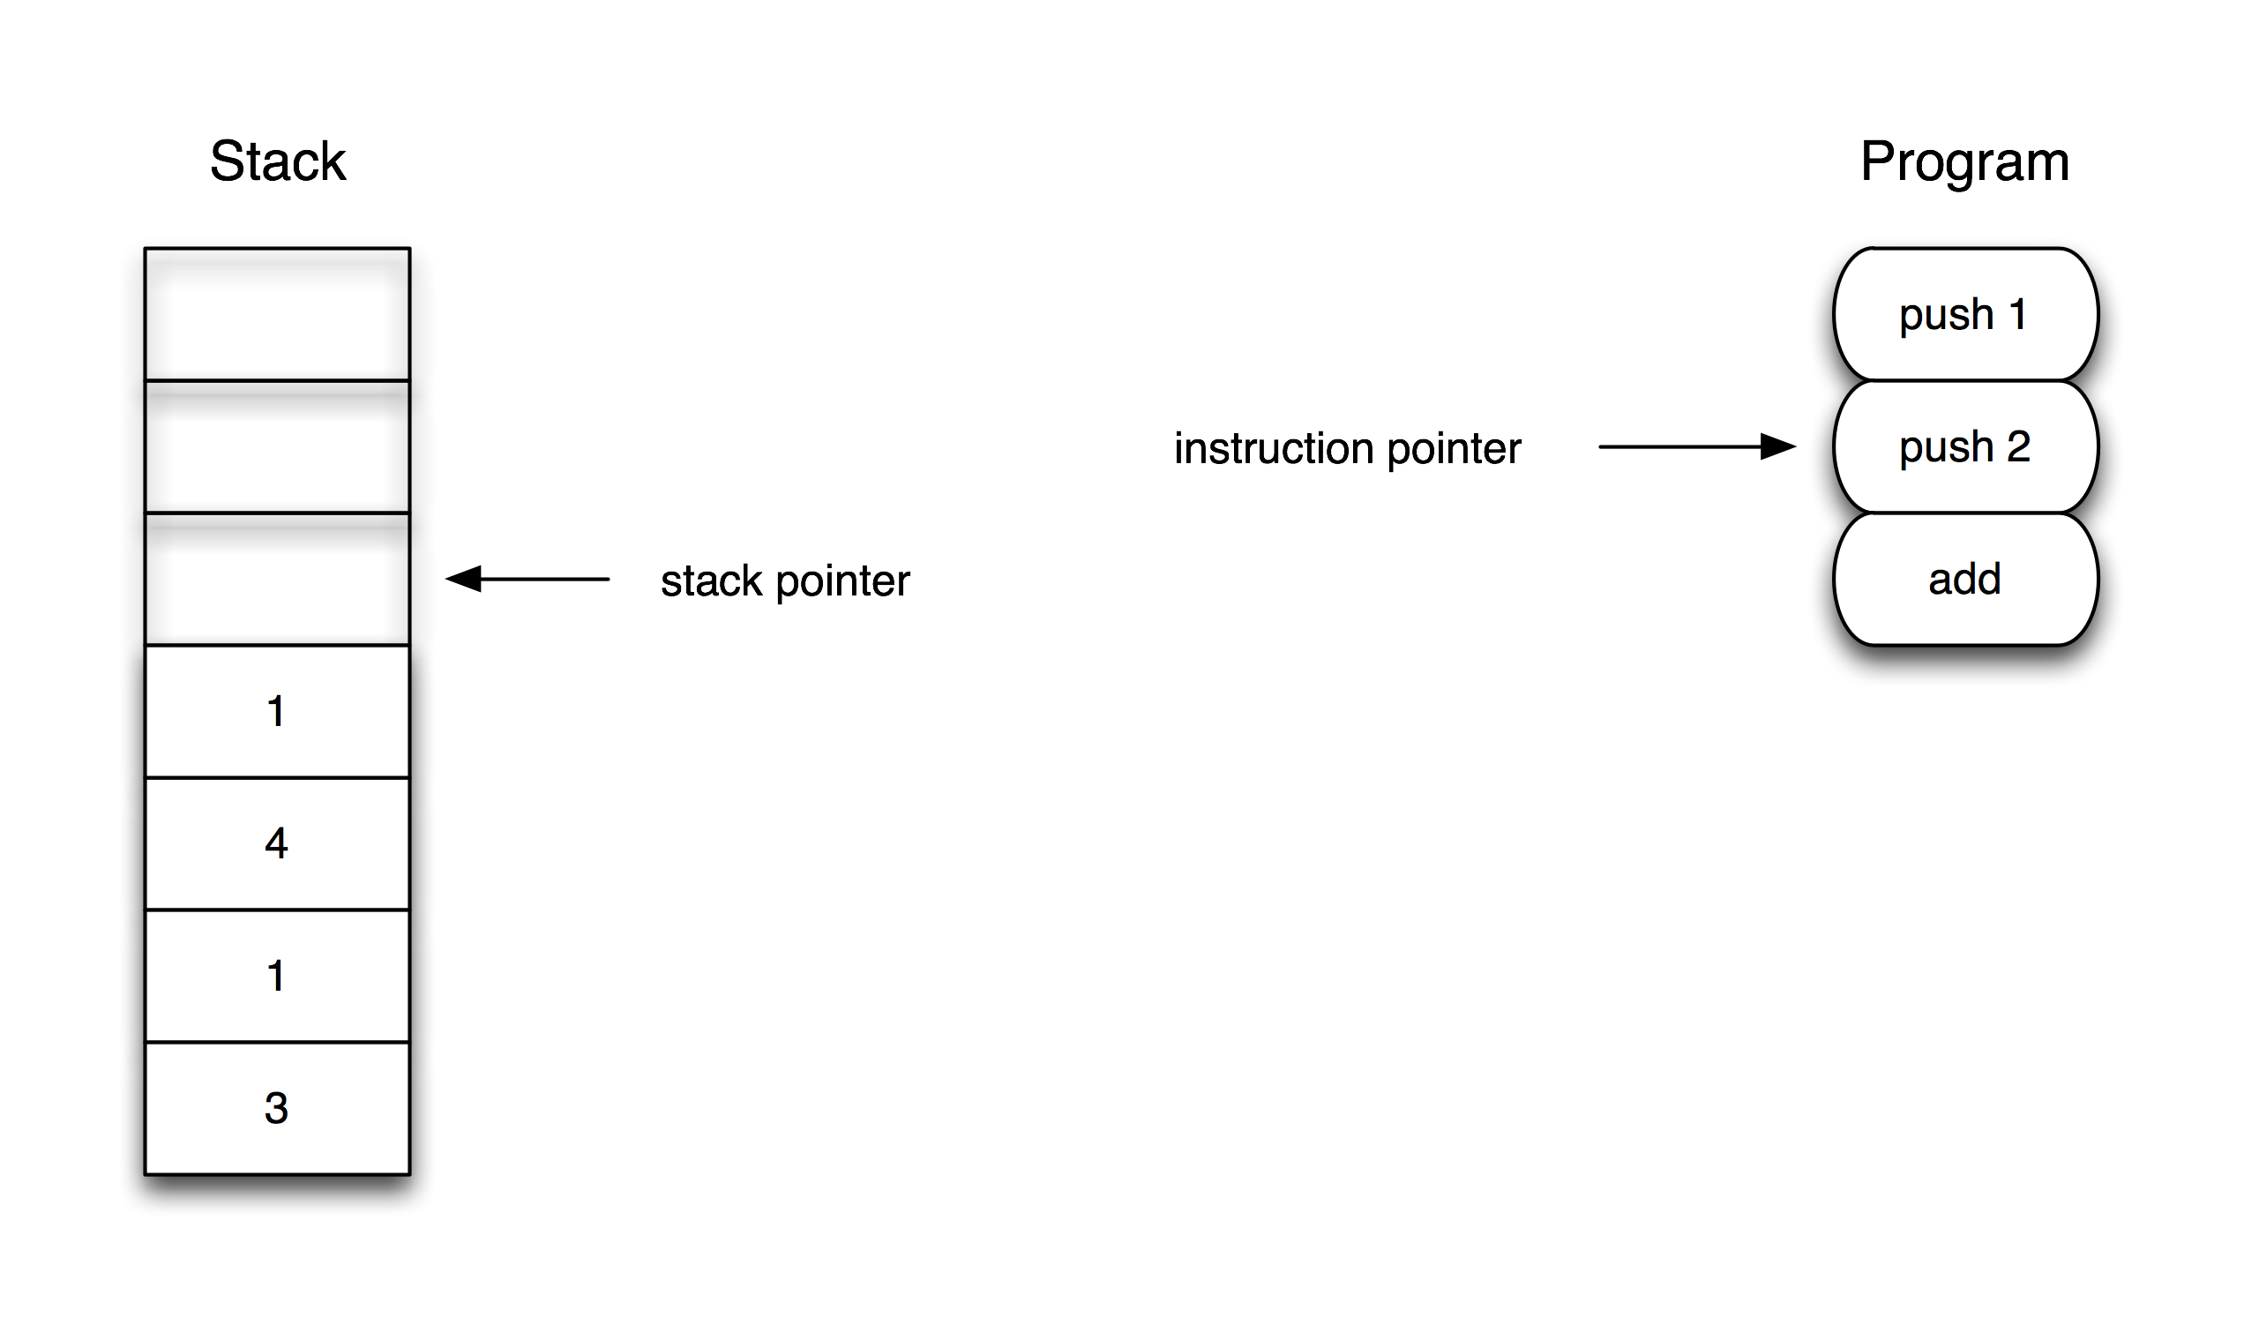
Stackbased VM (2)

Slide 23
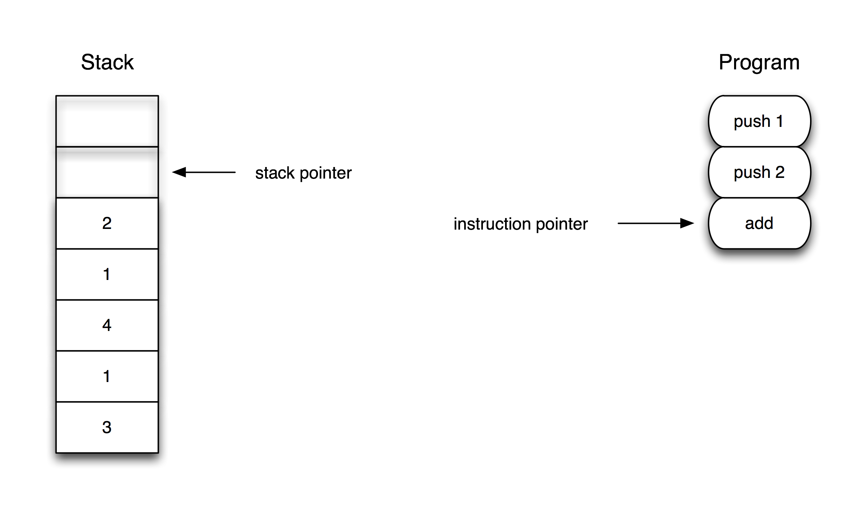
Stackbased VM (3)

Slide 24
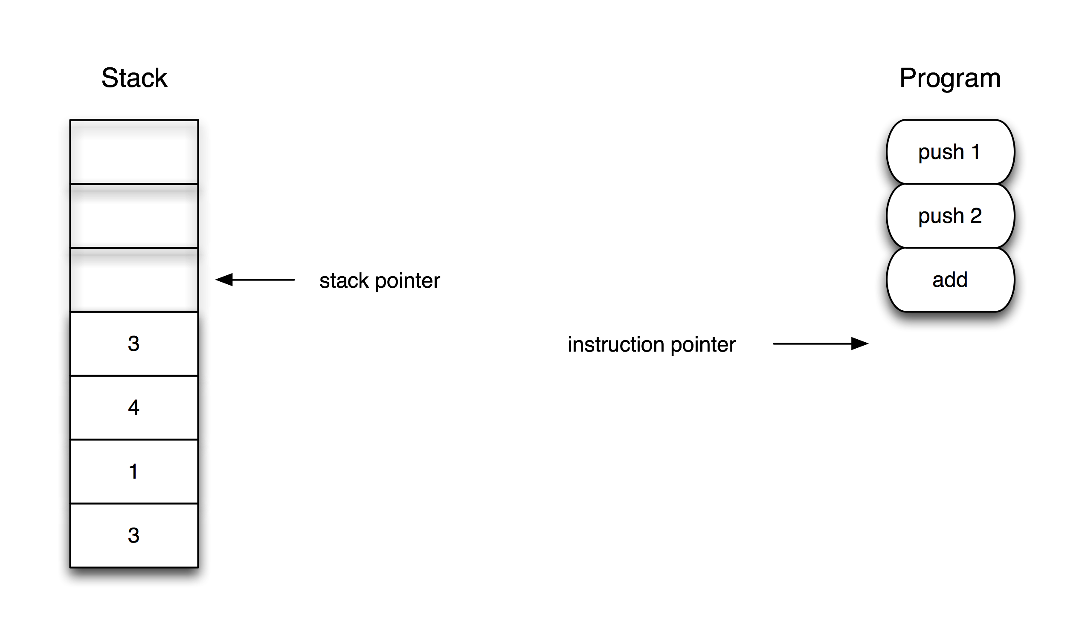
Stackbased VM (4)

Slide 25
VM instructions
typedef unsigned short opcode_t;
typedef unsigned short argument_t;
kOpReturn = 0x00,
kOpPush = 0x10,
kOpAdd = 0x20,

Slide 26
VM context
typedef struct
{
  opcode_t* bytecode;
  constant_t* constants;
} vm_program;
float vm_stack[1000];

Slide 27
VM
void vm_run(vm_program* program, opcode_t ip, constant_t* stack)
{
while (1) {
opcode_t op = program->bytecode[ip];
argument_t op_arg = program->bytecode[ip+1];
switch (op) {
case kOpReturn:
return;
case kOpPush:
stack[0] = program->constants[op_arg];
stack++; ip+=2;
break;
case kOpAdd:
stack[-2] = stack[-2] + stack[-1];
stack--; ip+=1;
break;
}
}
}

Slide 28
Bytecode generation
function generate_bytecode(node, program)
-- Generate bytecode for this node
if (node.tag=="literal_int") then
node.constant_index = program.constants:get_id(tonumber(node.value))
program.bytecode:insert(kOpPush)
program.bytecode:insert(node.constant_index-1)
elseif (node.tag=="binary_op" and node.operator.type=='+') then
generate_bytecode(node.operand1, program)
generate_bytecode(node.operand2, program)
program.bytecode:insert(kOpAdd)
end
end

Slide 29
Summary
Determined language features
Wrote PEG grammar
Defined instructions/opcodes
Wrote bytecode generator
Wrote simple VM

Slide 30
Status
kOpPush, kOpAdd
literal_int, binary_op (+)
“1+2+3”
“1 + 2”
“4 + 567 + 9 + 1”

Slide 31
Lesson 2: Complex expressions
Notes:
Phew!
Let's try for a more useful expression evaluator – i.e. number crunching.

Slide 32
Operators
Arithmetic : + - * / %
Relational : == != < <= > >=
Logical : && ||
Unary : ! + -

Slide 33
Precedence
1+2*3 = ?
1+(2*3) = 7

Slide 34
Precedence in C
Precedence | Operator | Description
3 | + - ! | Unary plus and minus Logical unary not
5 | * / % | Mul, div, modulo
6 | + - | Add, subtract
8 | < <= > >= | Relational operators
9 | == != | Equality operators
13 | && | Logical and
14 | || | Logical or

Slide 35
Operators
not_operator <- '!' ws?
plus_operator <- '+' ws?
minus_operator <- '-' ws?
multiplication_operator <- '*' ws?
division_operator <- '/' ws?
modulo_operator <- '%' ws?
addition_operator <- '+' ws?
subtraction_operator <- '-' ws?
less_than_or_equal_operator <- '<=' ws?
greater_than_or_equal_operator <- '>=' ws?
less_than_operator <- '<' ws?
greater_than_operator <- '>' ws?
equality_operator <- '==' ws?
inequality_operator <- '!=' ws?
logical_and_operator <- '&&' ws?
logical_or_operator <- '||' ws?

Slide 36
Operators
additive_operators <- addition_operator / subtraction_operator
multitive_operators <- multiplication_operator /
division_operator /
modulo_operator
equality_operators <- equality_operator / inequality_operator
relational_operators <- less_than_or_equal_operator /
greater_than_or_equal_operator /
less_than_operator /
greater_than_operator
unary_operators <- not_operator / plus_operator / minus_operator
Notes:
Let's group operators according to precedence level

Slide 37
Expression matching chain
Previously
plus_expr <- integer plus_operator plus_expr / integer
expression <- additive
additive <- multitive additive_operators additive / multitive
multitive <- primary multitive_operators multitive / primary
primary <- integer / open_parens expression close_parens
1*2+3*4

Slide 38
Expression matching chain
expression <- logical_or
logical_or <- logical_and logical_or_operator logical_or / logical_and
logical_and <- equality logical_and_operator logical_and / equality
equality <- relational equality_operators equality / relational
relational <- additive relational_operators relational / additive
additive <- multitive additive_operators additive / multitive
multitive <- unary multitive_operators multitive / unary
unary <- unary_operators unary / primary
primary <- integer / open_parens expression close_parens

Slide 39
Compiler and VM changes
if (node.tag=="literal_int") then
  program.bytecode:insert(kOpPush)
  bytecode:insert(node.constant_index-1)
elseif (node.tag=="binary_op") then
  generate_bytecode(node.operand1)
  generate_bytecode(node.operand2)
  program.bytecode:insert(binary_opcodes[node.operator.type])
elseif (node.tag=="unary_op") then
  generate_bytecode(node.operand)
  program.bytecode:insert(unary_opcodes[node.operator.type])
end
Notes:
VM changes: well.... just a bunch of opcodes!
Defined a table of operator bytecodes based on node.operator.type

Slide 40
Status
kOpPush, kOpAdd, kOpAdd, kOpSubtract, kOpMultiply, kOpDivide, kOpModulo, kOpEqual, kOpNotEqual, kOpLessThan, kOpLessThanOrEqual, kOpGreaterThan, kOpGreaterThanOrEqual, kOpLogicalAnd, kOpLogicalOr, kOpNot, kOpPlus, kOpMinus
literal_int, binary_op, unary_op
“1*2/3-4%5”
“1<2 || 56/19>=3”
“!((3+4>3%(56))”

Slide 41
Lesson 3: Fixing associativity
Notes:
First step: Write a compiler which supports programs of this type. Integers, arbitrary additions, arbitrary whitespace
The compiler will generate a program the computes the result of the expressive
Hopefully you have an intuitive sense that we can't solve this in this space (textual representation) – we need another representation

Slide 42
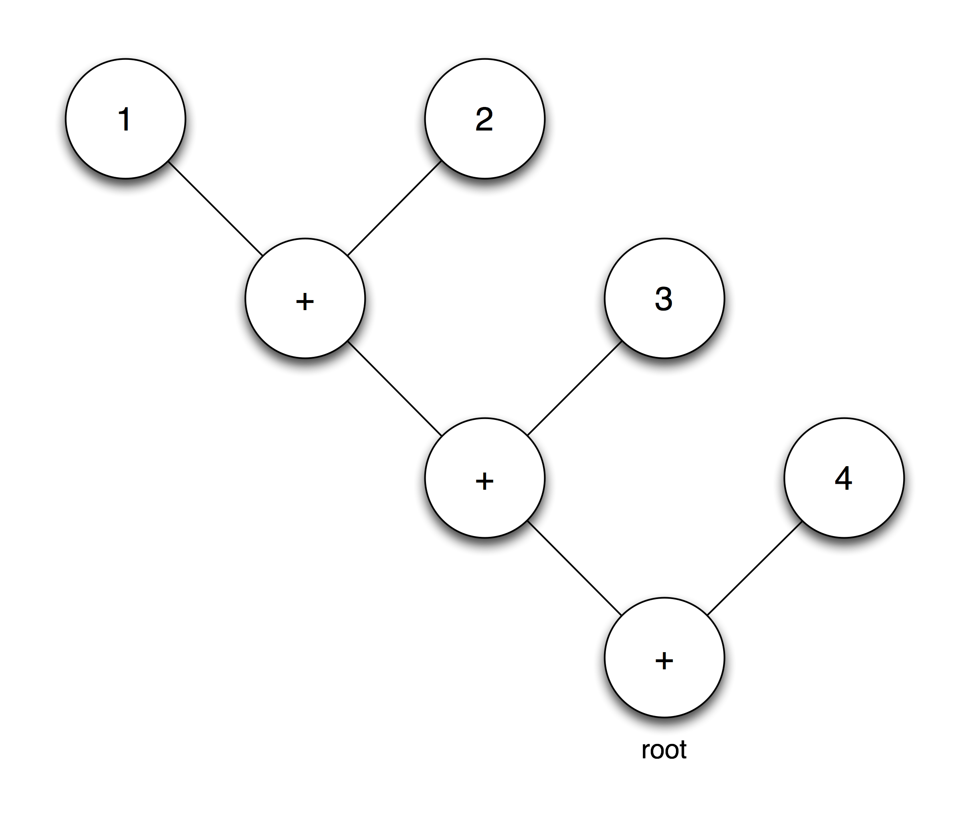
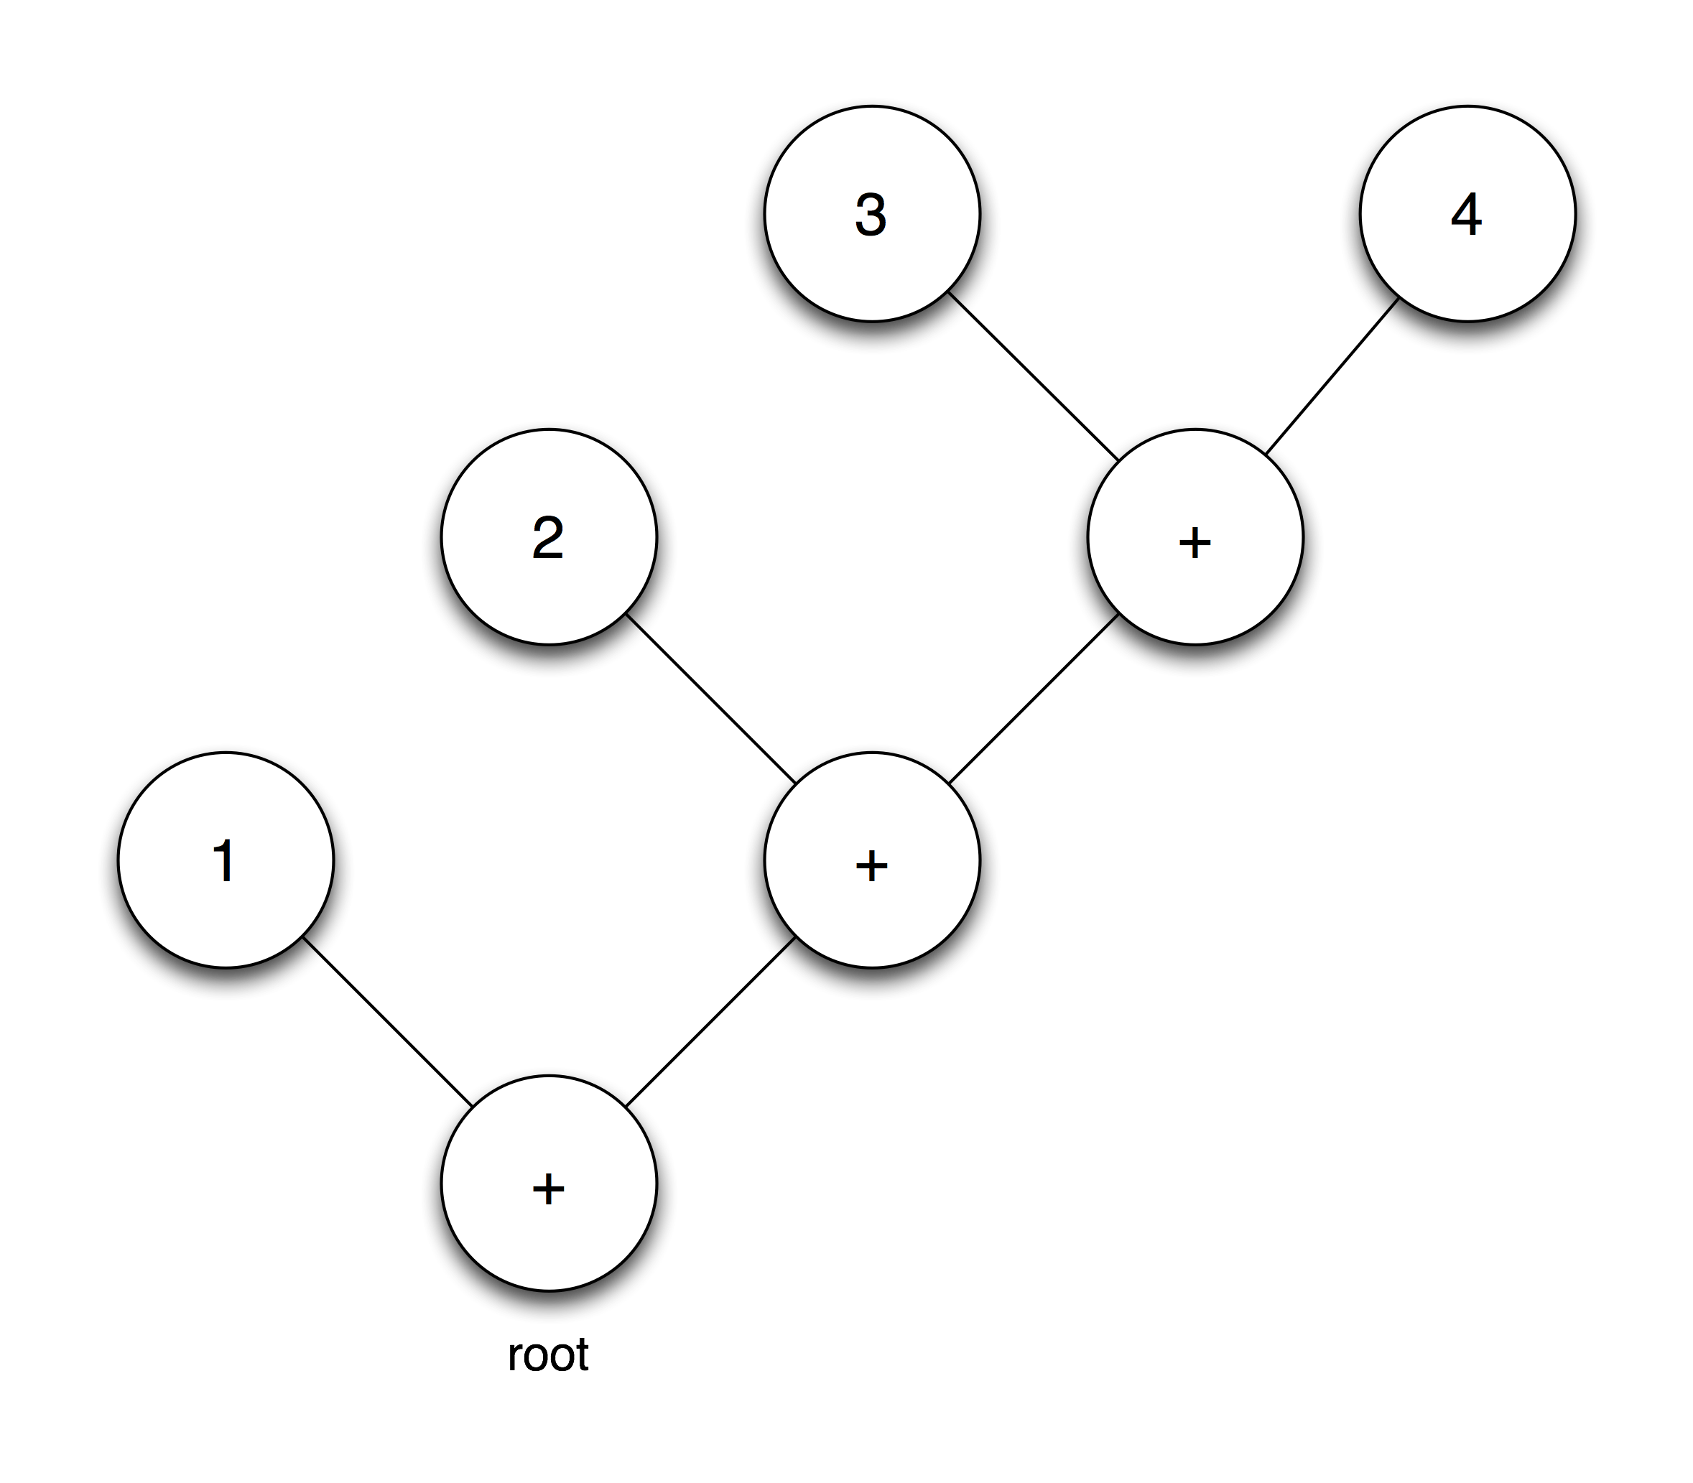
Associativity
1+2+3+4
6-3-2-1 = 0
6-(3-(2-1)) = 4
whoops
Left associative : ((1+2)+3)+4
Right associative: 1+(2+(3+4))
Notes:
We talked about precedence.
The other part of that is associativity – if you have a chain of operators of the same precedence level, in what order are they evaluated?
Our PEG match operator chain leads to right associative matching!
Unfortunately, not all operators are naturally right associative!

Slide 43
Capture precedence!
addition_operator <- ({:precedence: '' -> '6':}
{:assoc: '' -> 'left':}
{:type: '+':} ws?) -> {}

Slide 44

Associativity fix (1)

Slide 45
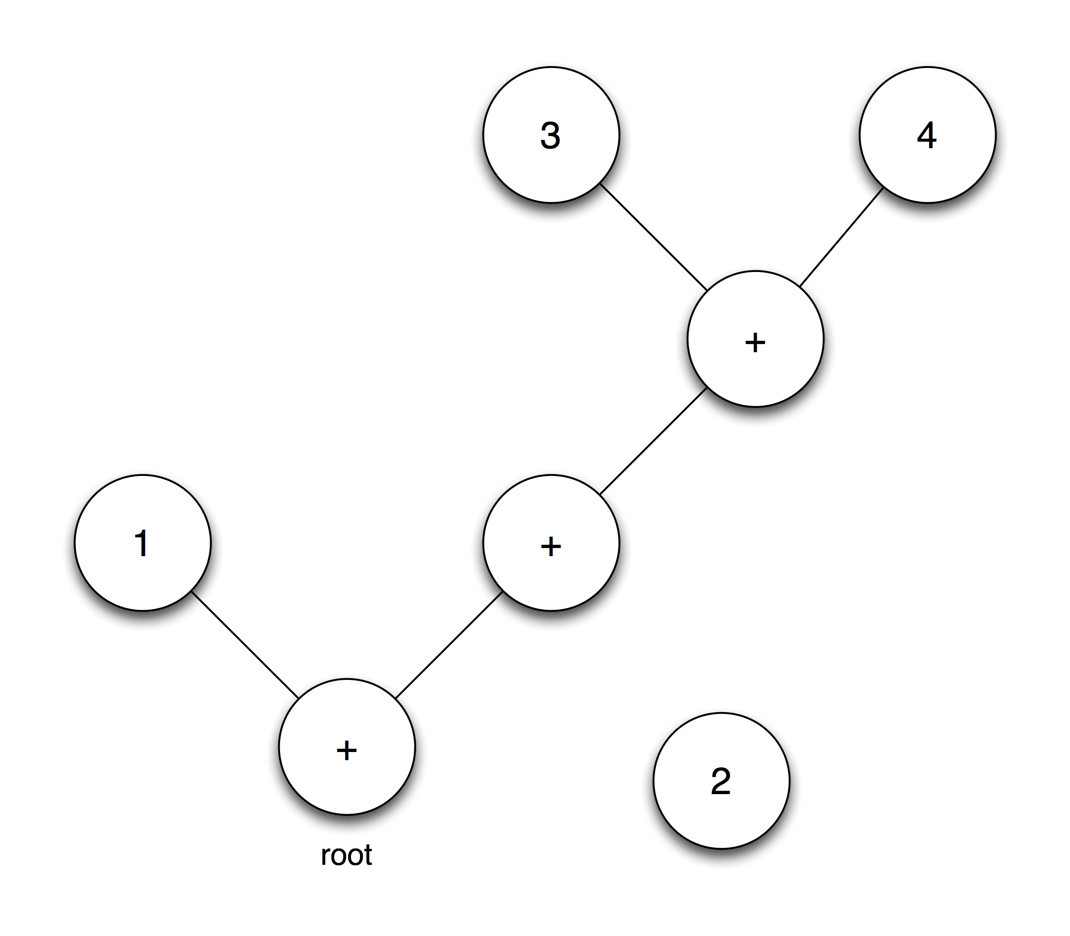
Associativity fix (2)

Slide 46
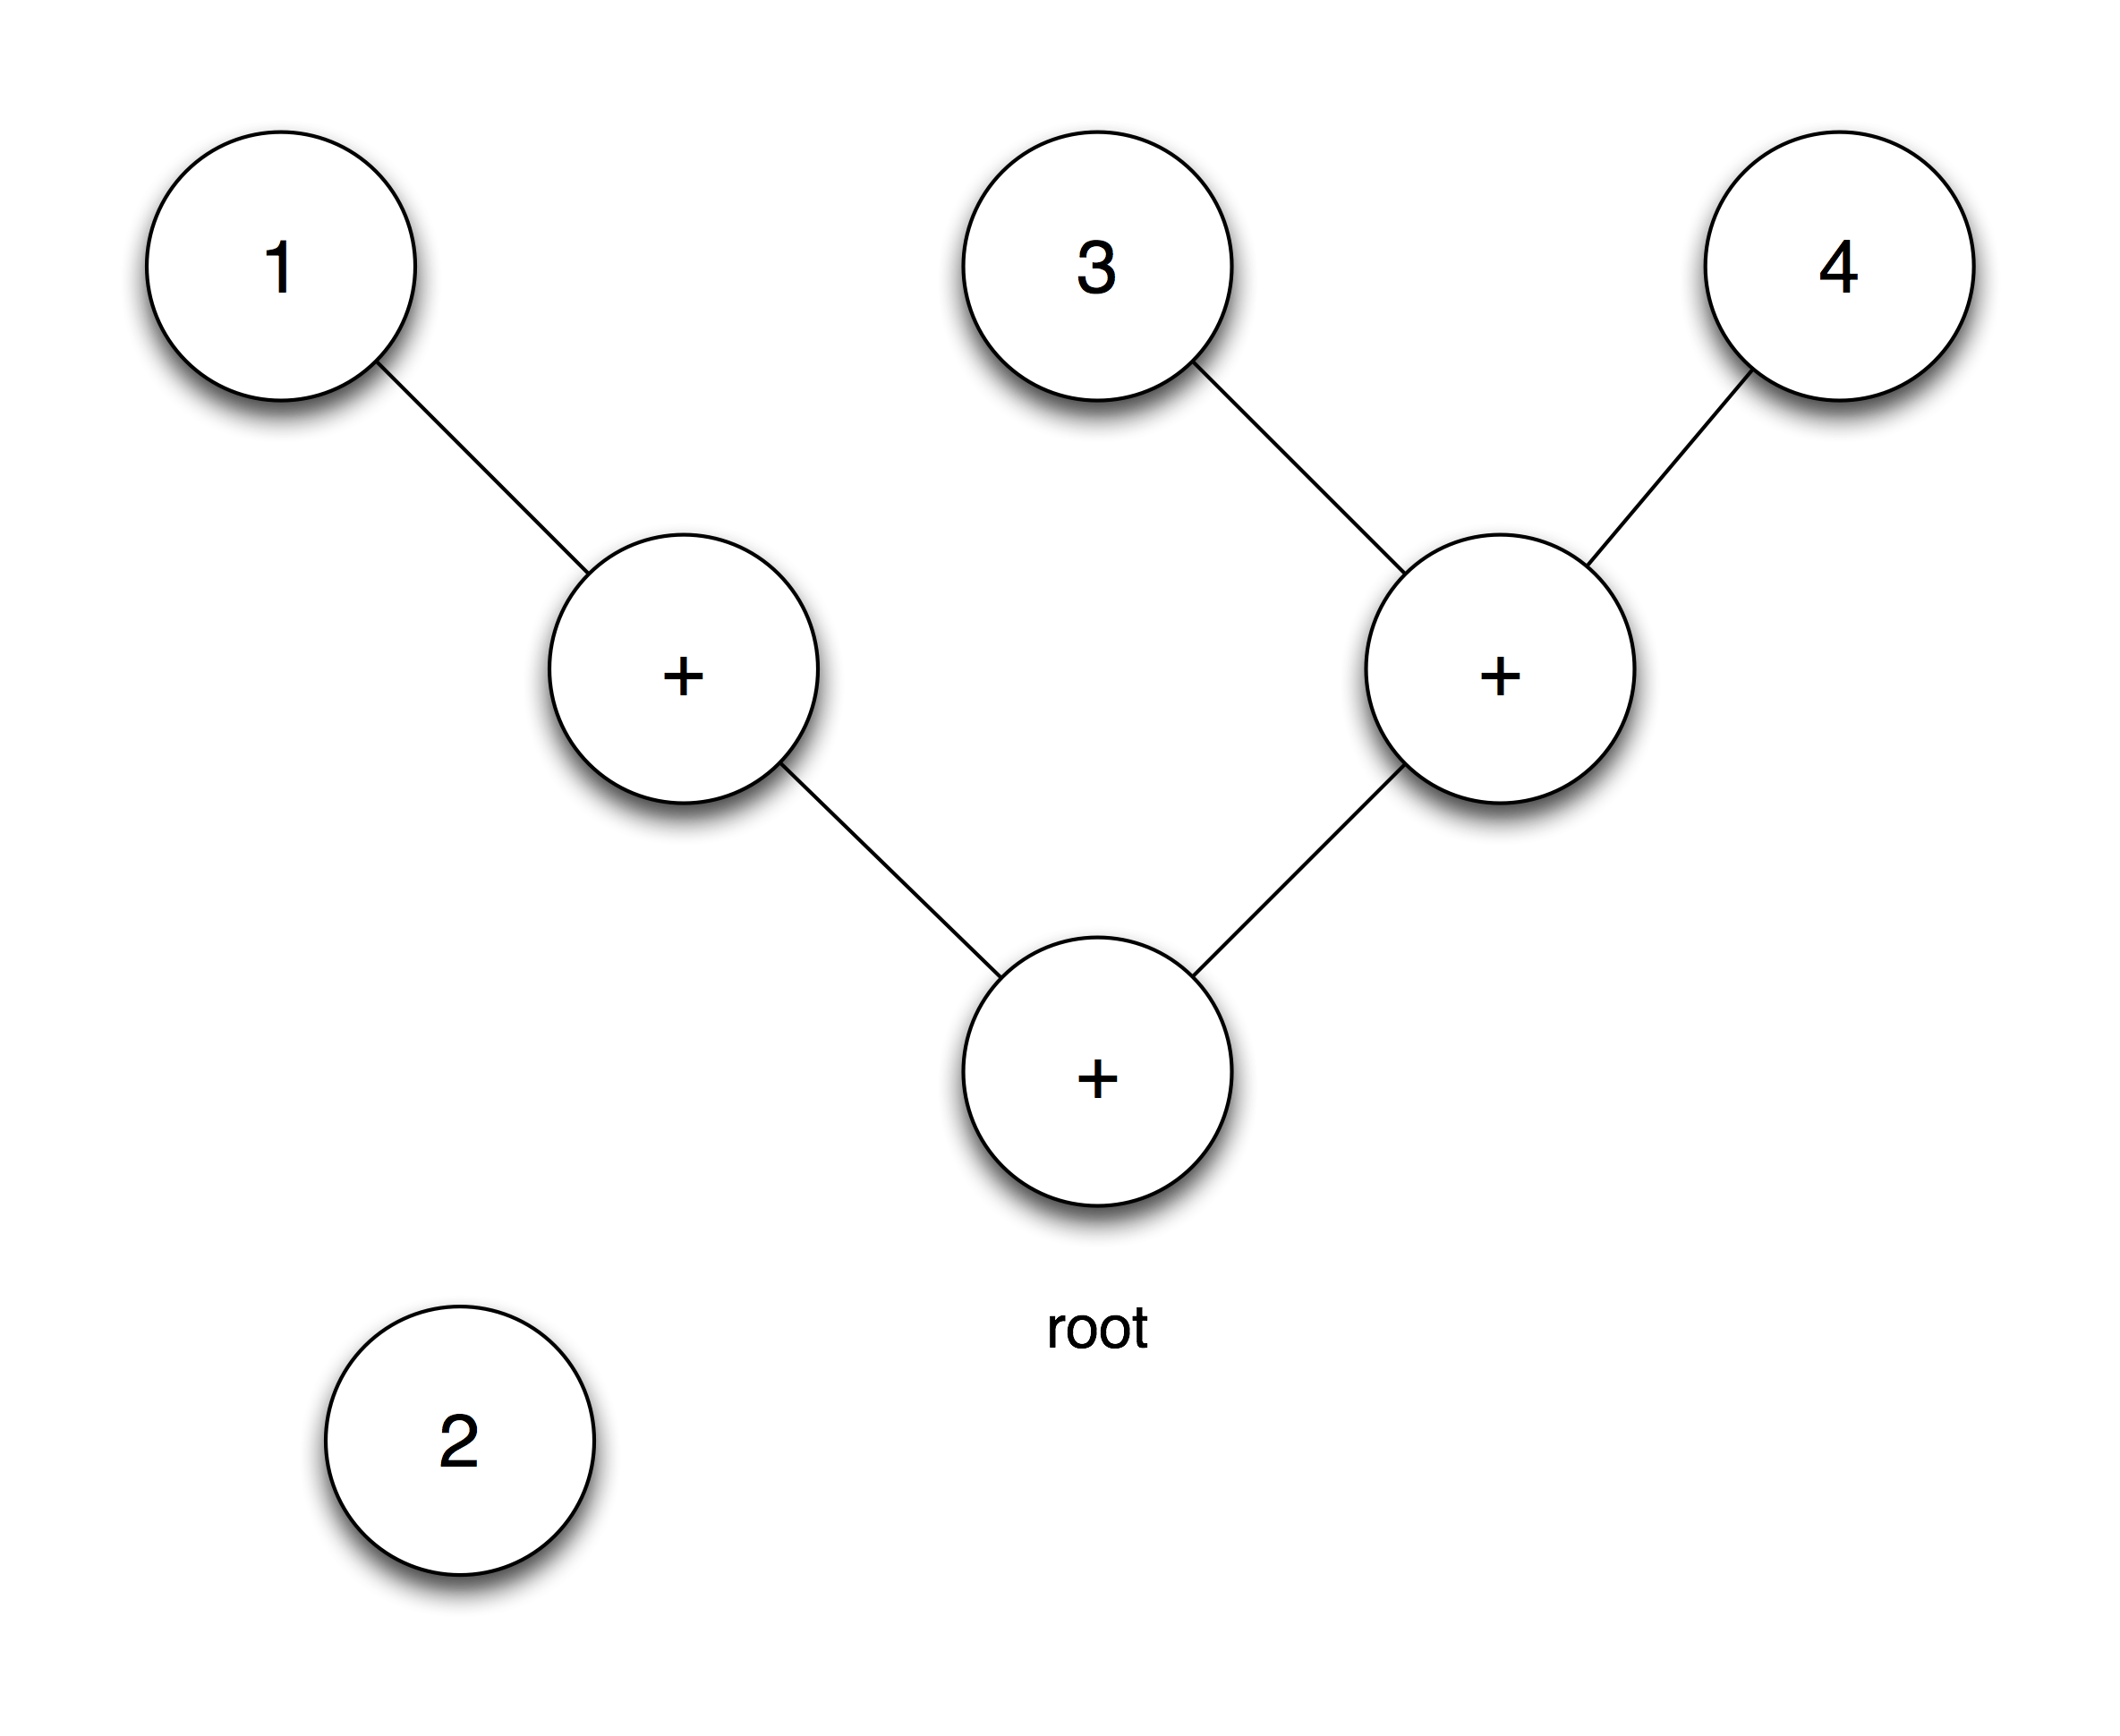
Associativity fix (3)

Slide 47
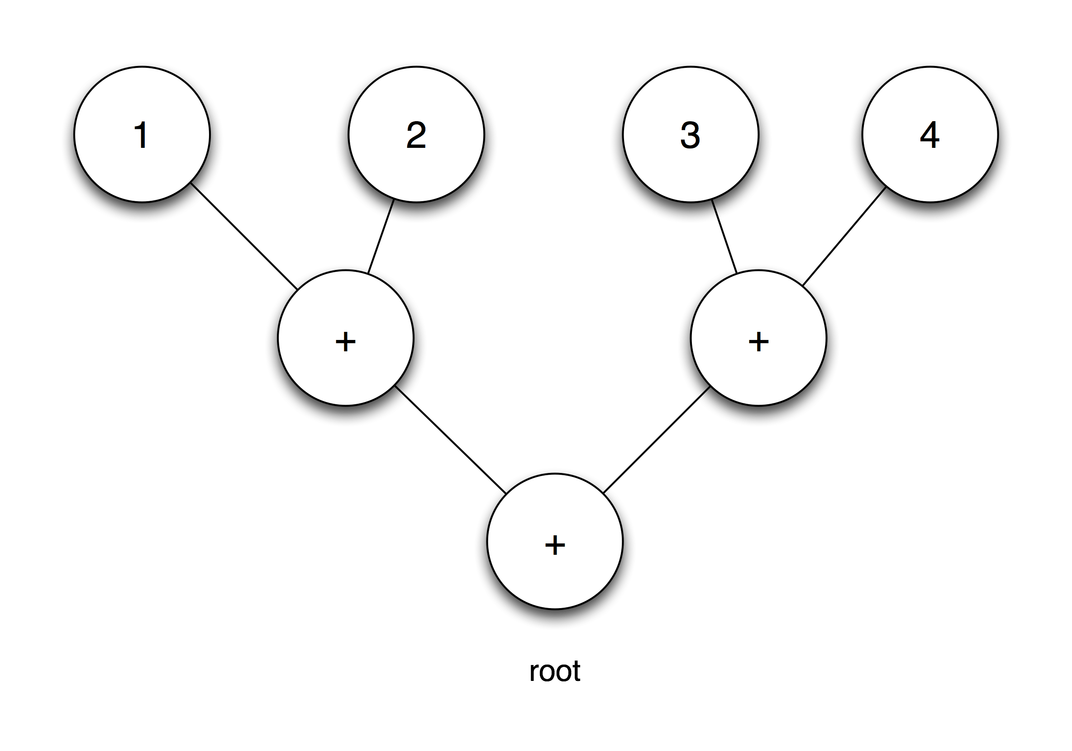
Associativity fix (4)

Slide 48
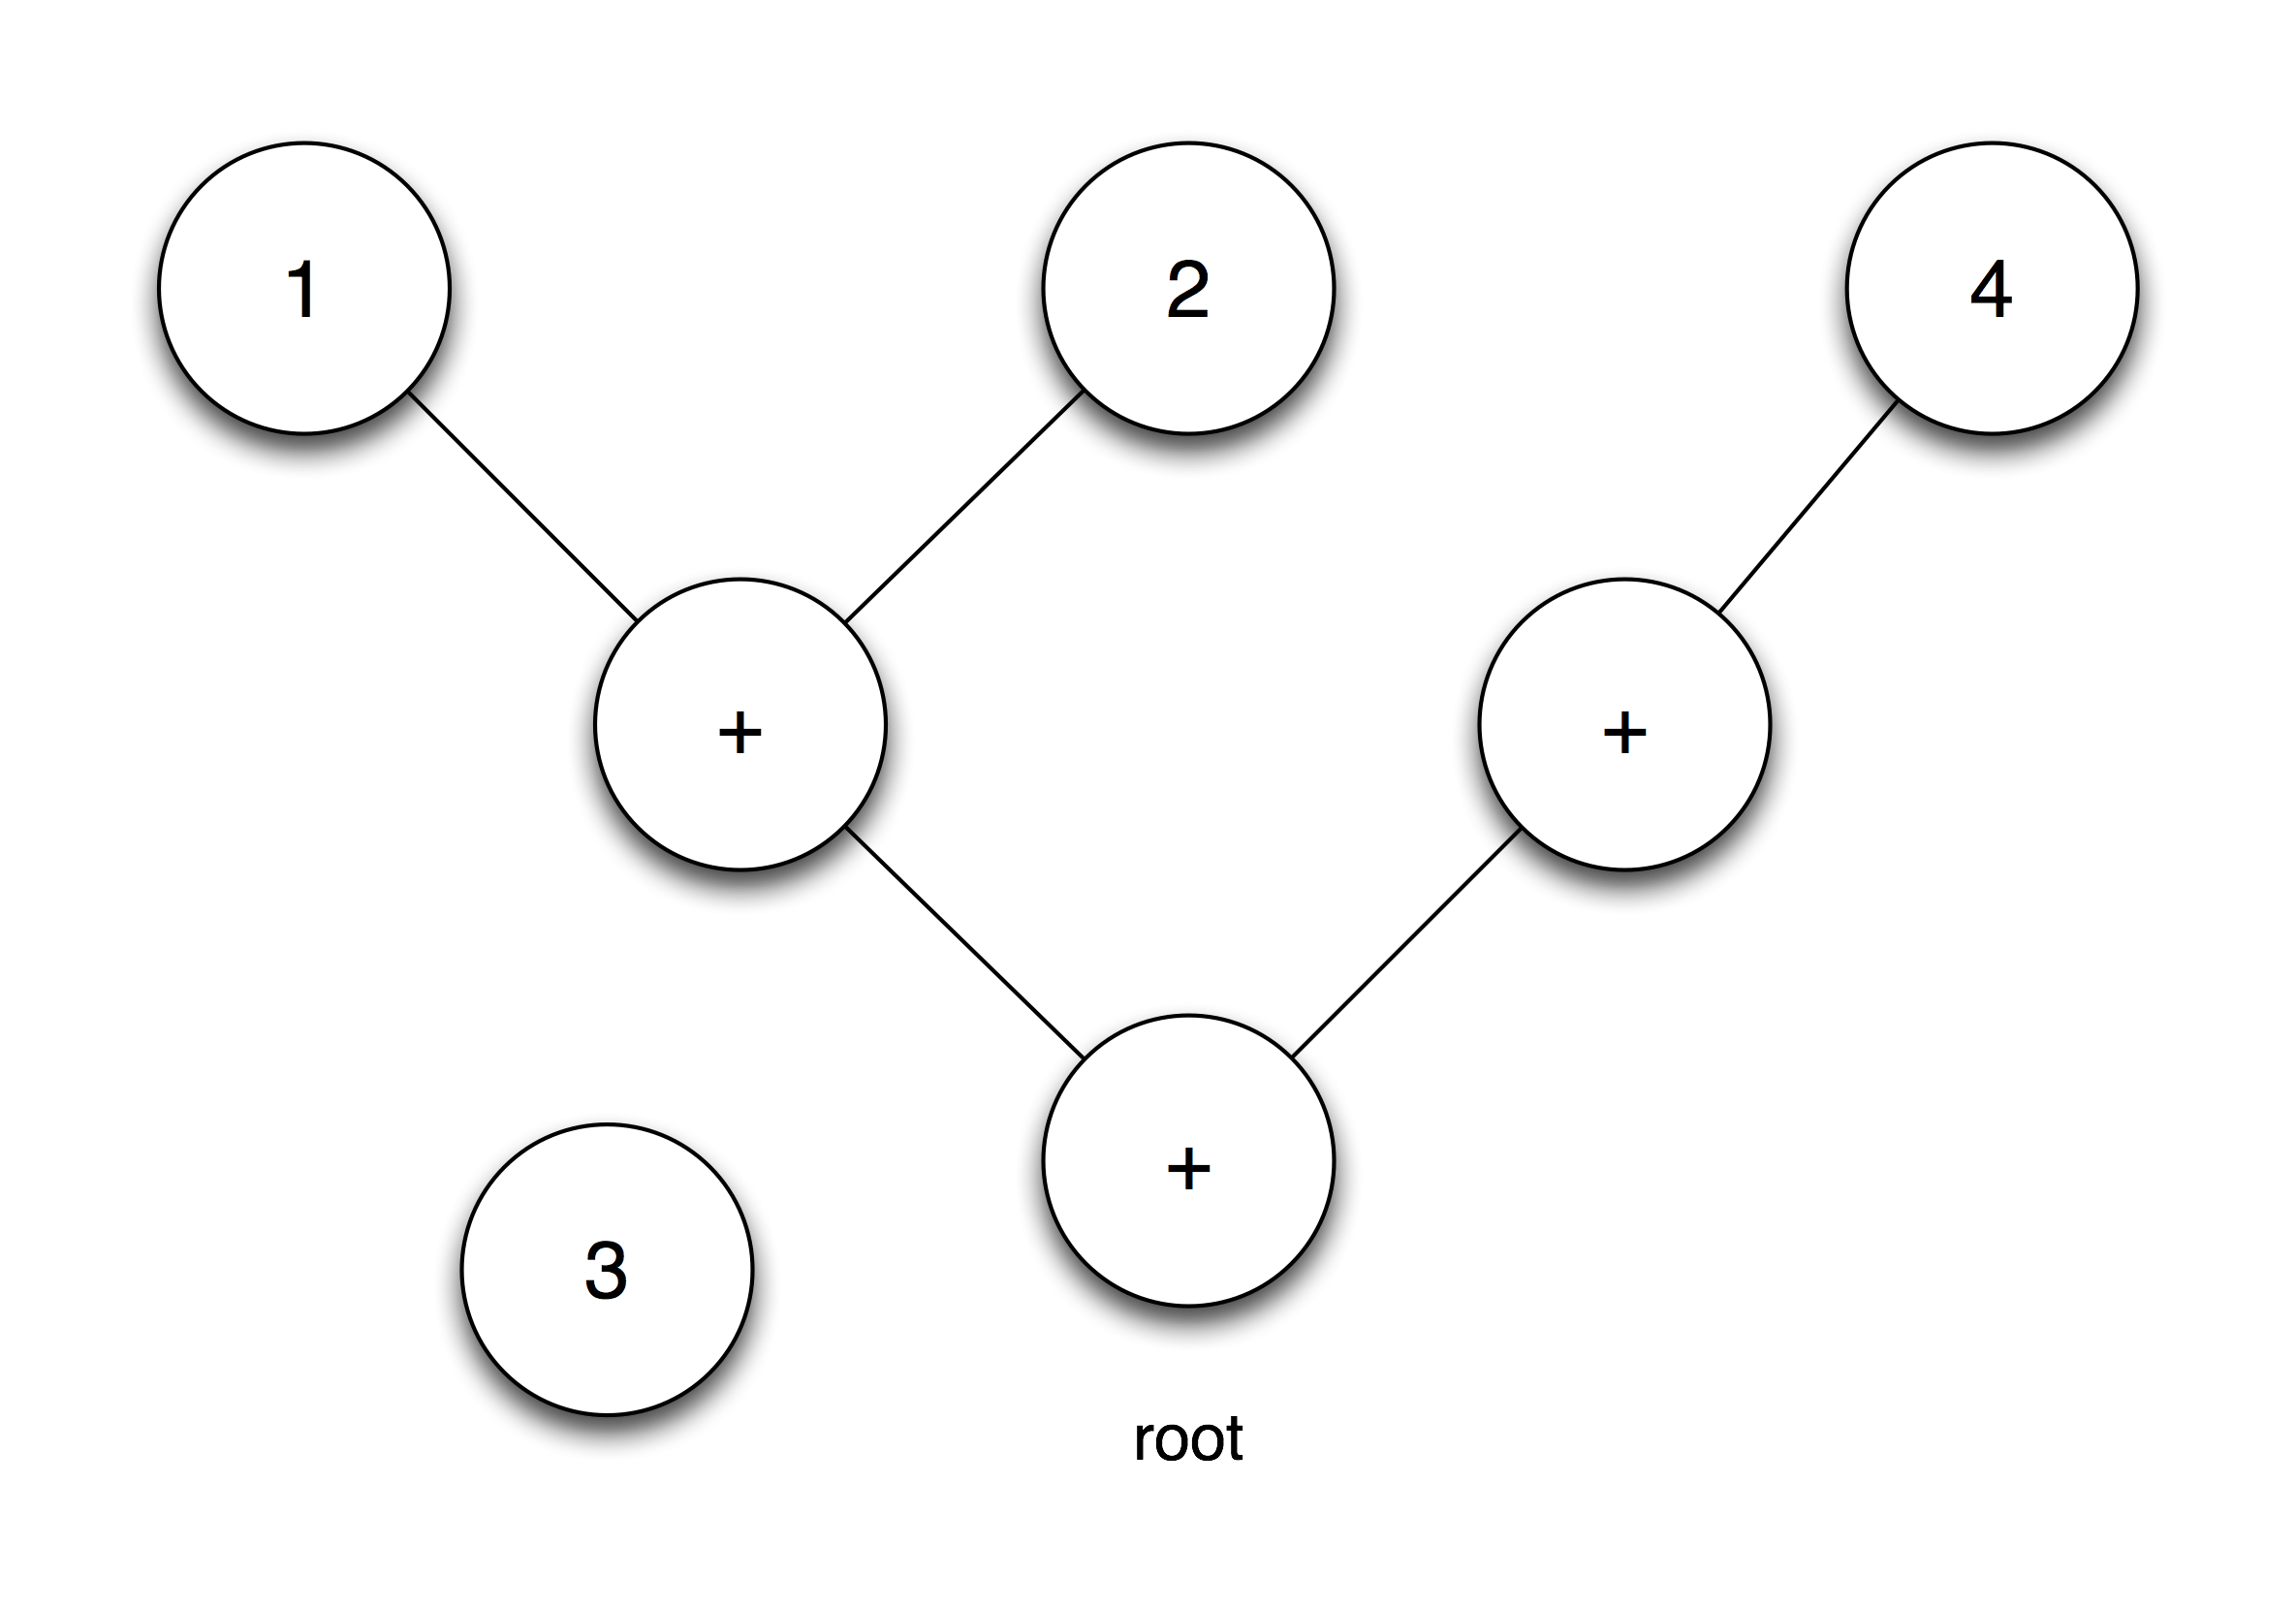
Associativity fix (5)

Slide 49
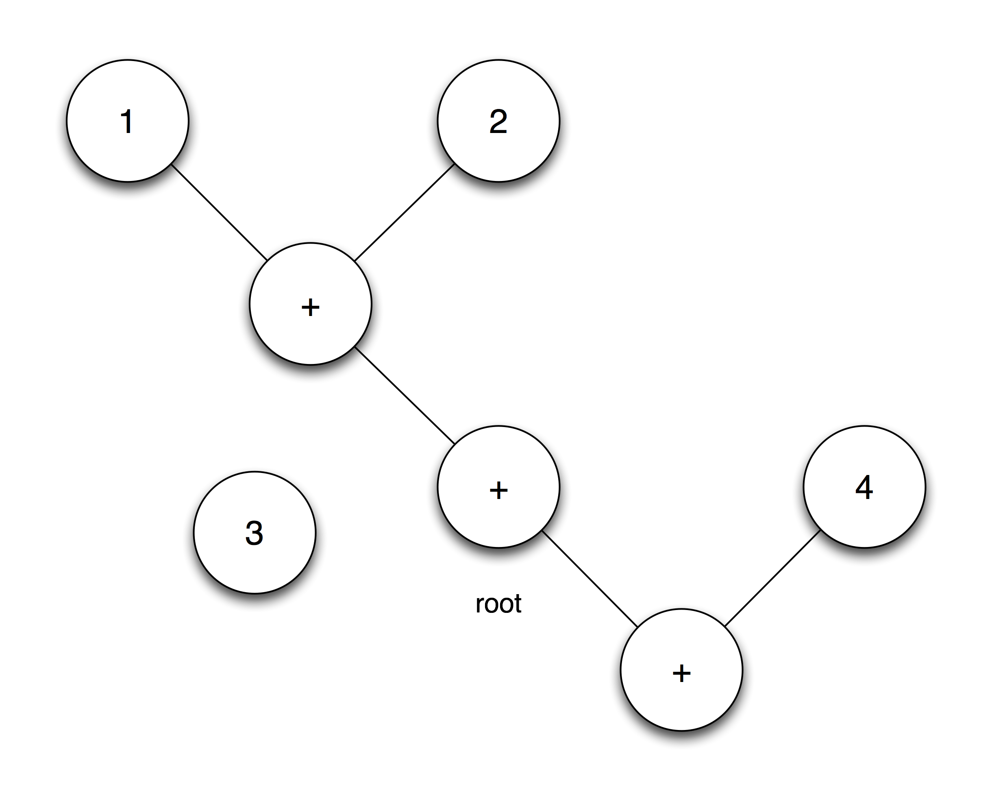
Associativity fix (6)

Slide 50
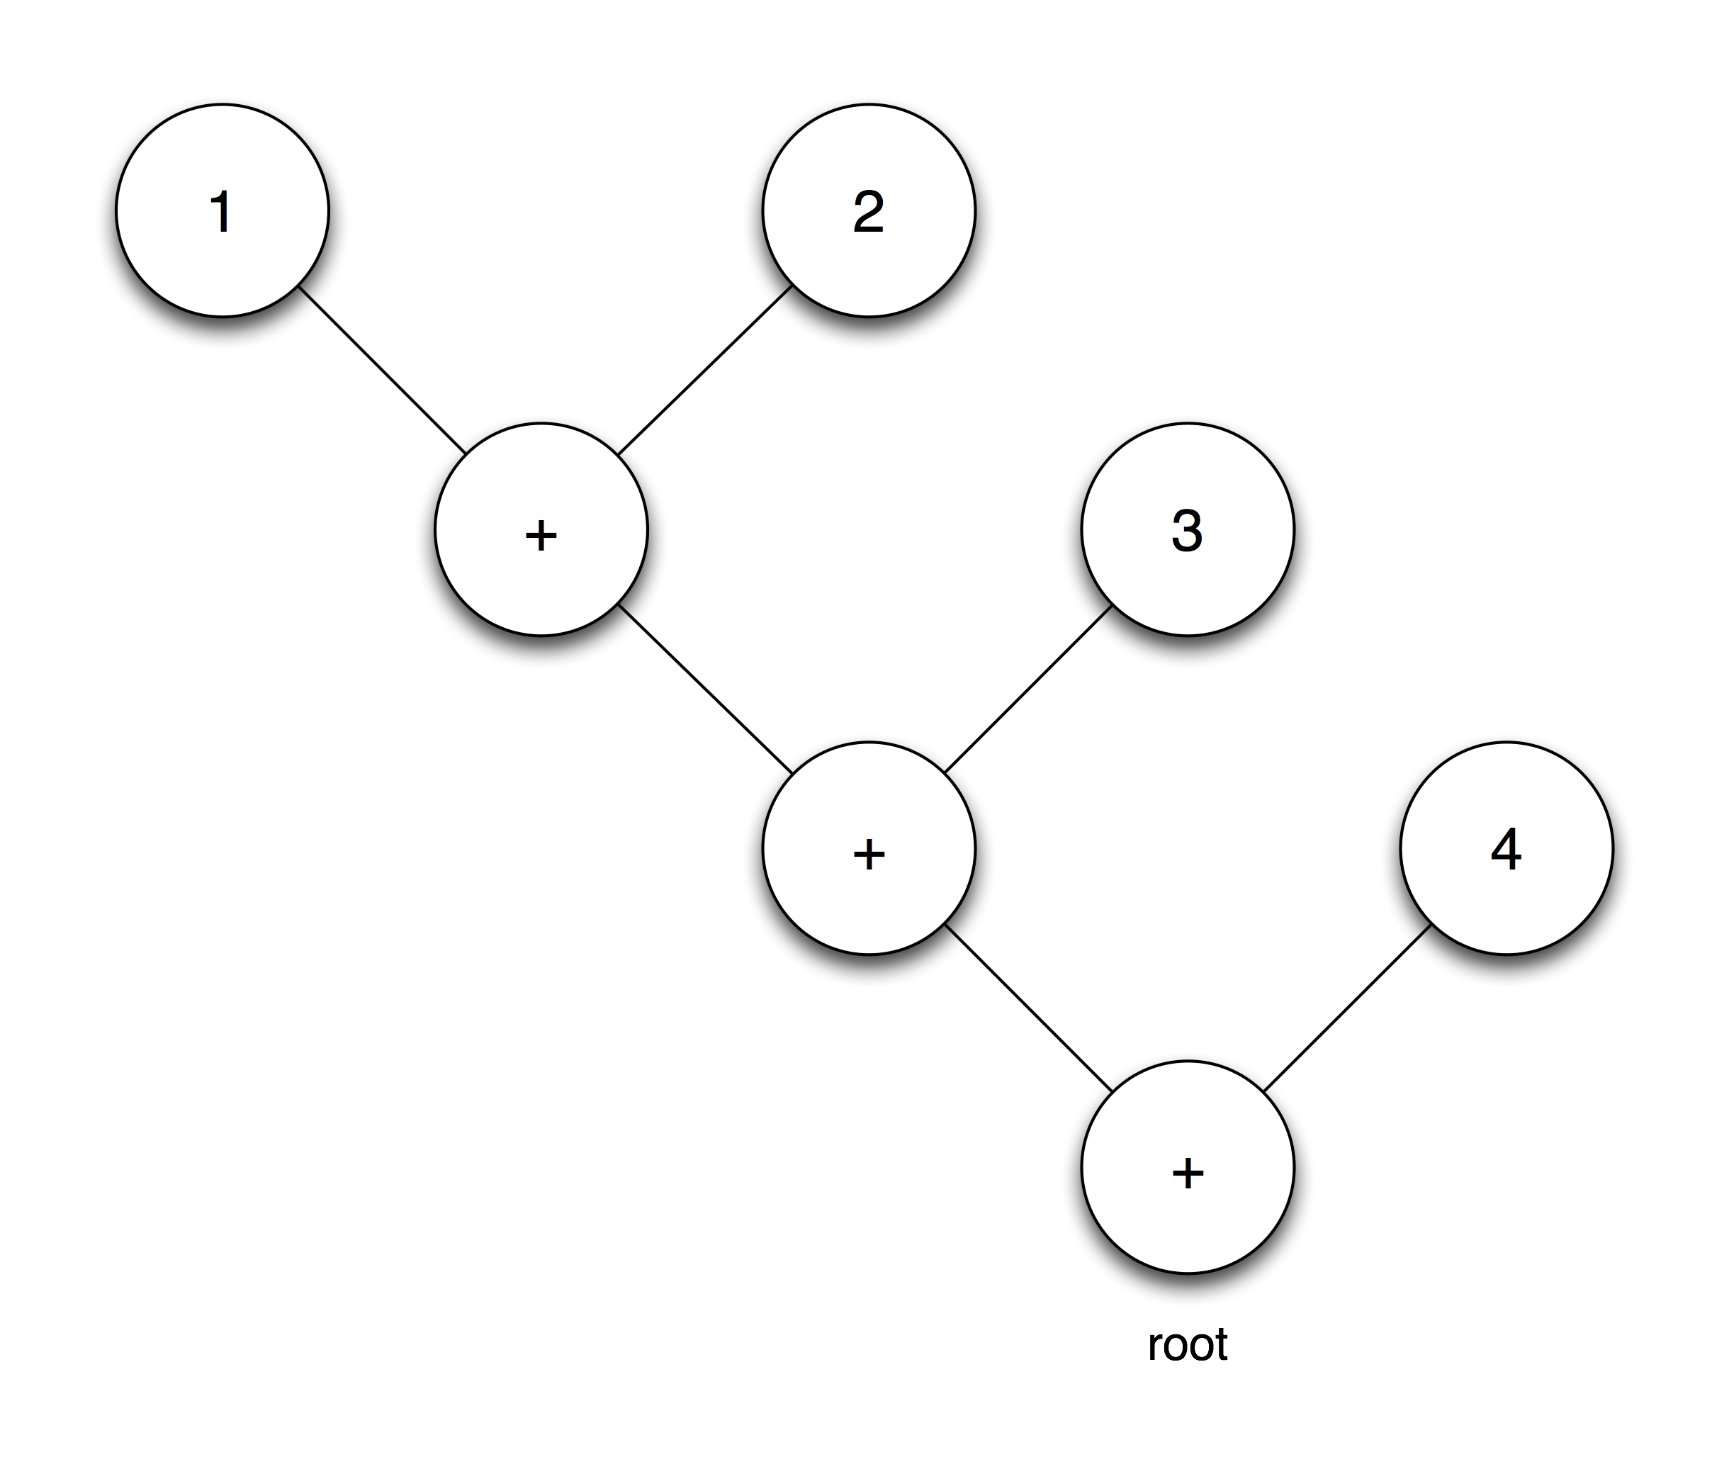
Associativity fix (7)

Slide 51
Associativity fix (7)

Slide 52
Lesson 4: Function calls
Notes:
Functions – the meat of what you can do! Interacting with the OS!
How can you influence the world?
Draw stuff in OpenGL, generate music, or generate 3D geometry.
Not going to get bogged down by that :-)

Slide 53
Function prototypes (1)
void print(number);
number sin(number);
number cos(number);

Slide 54
Function prototypes (2)
functions = {
["print"] = {
["id"] = 0,
["arguments"] = {[1] = {["type"] = "number"}},
["result"] = "void"},
["sin"] = {
["id"] = 1,
["arguments"] = {[1] = {["type"] = "number"}},
["result"] = "number"},
["cos"] = {
["id"] = 2,
["arguments"] = {[1] = {["type"] = "number"}},
["result"] = "number"}},
Notes:
What we see
Could also specify functions in parser, with individual opcodes, but that is silly.
Also means semantic checking!
Function name check
Argument num check
Context check – return value
The only semantic checking we'll be doing. Simple language + robust parser! :-)

Slide 55
Statements
start <- ws? statement_list
statement_list <- statement*
statement <- function_call_statement
function_call_statement <- function_call semicolon
Notes:
That's the functions we can call, how does our grammar change?
Let's back up for minute!
Print is not a function – it's a statement!
Root: Expression → Root: Statement list!

Slide 56
Function calls
function_call <- identifier open_parens function_call_arguments? close_parens
function_call_arguments <- expression (',' ws? expression)*
identifier <- [a-zA-Z] [a-zA-Z0-9_]* ws?
primary <- integer / function_call / open_parens expression close_parens
Notes:
That's the functions we can call, how does our grammar change?
Let's back up for minute!
Print is not a function – it's a statement!
Root: Expression → Root: Statement list!

Slide 57
Statements bytecode generation
function generate_bytecode
[…]
elseif (node.tag=="statement_list") then
for i,statement in ipairs(node) do
generate_bytecode(statement, program)
end
elseif (node.tag=="function_call") then
for i,arg in ipairs(node.arguments) do
generate_bytecode(arg, program)
end
program.bytecode:insert(kOpCallFunc)
program.bytecode:insert(functions[node.identifier].id)
elseif (node.tag=="function_call_statement") then
generate_bytecode(node.function_call, program)
if (functions[node.function_call.identifier].result=="number") then
program.bytecode:insert(kOpPop)
end
end
end
Notes:
That's the functions we can call, how does our grammar change?
Let's back up for minute!
Print is not a function – it's a statement!
Root: Expression → Root: Statement list!

Slide 58
VM changes
case kOpCallFunc:
{
switch (op_arg)
{
case kFuncPrint:
printf("%f\n", stack[-1]);
stack--;
break;
case kFuncSin:
stack[-1] = sinf(stack[-1]);
break;
case kFuncCos:
stack[-1] = cosf(stack[-1]);
break;
}
ip+=2;
break;
}
case kOpPop:
{
stack--;
ip+=1;
break;
}
Notes:
That's the functions we can call, how does our grammar change?
Let's back up for minute!
Print is not a function – it's a statement!
Root: Expression → Root: Statement list!

Slide 59
Status
kOpPush, kOpAdd, kOpAdd, kOpSubtract, kOpMultiply, kOpDivide, kOpModulo, kOpEqual, kOpNotEqual, kOpLessThan, kOpLessThanOrEqual, kOpGreaterThan, kOpGreaterThanOrEqual, kOpLogicalAnd, kOpLogicalOr, kOpNot, kOpPlus, kOpMinus, kOpFuncCall, kOpPop
literal_int, binary_op, unary_op, statement_list, function_call_statement, function_call
“print(1+2);
print(cos(31415/10000));
print(sin(2)*cos(3)<0);”

Slide 60
Lesson 5: Variables
Notes:
Two use cases: in an expression, or an assign statement

Slide 61
VM implications
Only global variables
VM context: bytecode, stack, set of constants
+ variables
Notes:
Variables work a lot like constants, except we can write to them using assign_statement

Slide 62
New opcodes
case kOpPushVar:
stack[0] = variables[op_arg];
stack++;
ip+=2;
break;
case kOpPopVar:
variables[op_arg] = stack[-1];
stack--;
ip+=2;
break;
Notes:
That's the functions we can call, how does our grammar change?
Let's back up for minute!
Print is not a function – it's a statement!
Root: Expression → Root: Statement list!

Slide 63
Variable parsing
statement <- function_call_statement / assign_statement
assign_statement <- identifier '=' ws? expression semicolon
primary <- integer /
function_call /
variable /
open_parens expression close_parens
variable <- identifier
Notes:
That's the functions we can call, how does our grammar change?
Let's back up for minute!
Print is not a function – it's a statement!
Root: Expression → Root: Statement list!

Slide 64
Variable compilation
function generate_bytecode(node, program)
[...]
elseif (node.tag=="variable") then
node.variable_index = program.variables:get_id(node.identifier)
program.bytecode:insert(kOpPushVar)
program.bytecode:insert(node.variable_index-1)
elseif (node.tag=="assign_statement") then
generate_bytecode(node.expression, program)
node.variable_index = program.variables:get_id(node.identifier)
program.bytecode:insert(kOpPopVar)
program.bytecode:insert(node.variable_index-1)
[...]
Notes:
That's the functions we can call, how does our grammar change?
Let's back up for minute!
Print is not a function – it's a statement!
Root: Expression → Root: Statement list!

Slide 65
Status
kOpPush, kOpAdd, kOpAdd, kOpSubtract, kOpMultiply, kOpDivide, kOpModulo, kOpEqual, kOpNotEqual, kOpLessThan, kOpLessThanOrEqual, kOpGreaterThan, kOpGreaterThanOrEqual, kOpLogicalAnd, kOpLogicalOr, kOpNot, kOpPlus, kOpMinus, kOpFuncCall, kOpPop, kOpPushVar, kOpPopVar
literal_int, binary_op, unary_op, statement_list, function_call_statement, function_call, assign_statement, variable
a = cos(19*b);
print(a*100);
y = sin(angle)*radius;

Slide 66
Lesson 6: Conditionals and loops
Notes:
First step: Write a compiler which supports programs of this type. Integers, arbitrary additions, arbitrary whitespace
The compiler will generate a program the computes the result of the expressive
Hopefully you have an intuitive sense that we can't solve this in this space (textual representation) – we need another representation

Slide 67
Control flow statements
if
if else
while

Slide 68
Control flow parsing
statement_list <- statement*
statement <- if_else_statement / if_statement / while_statement /
function_call_statement / assign_statement
block <- open_brace statement_list close_brace / statement
if_statement <- 'if' ws? open_parens expression close_parens block
if_else_statement <- 'if' ws? open_parens expression close_parens block
'else' ws? block
while_statement <- 'while' ws? open_parens expression close_parens block
Notes:
That's the functions we can call, how does our grammar change?
Let's back up for minute!
Print is not a function – it's a statement!
Root: Expression → Root: Statement list!

Slide 69
Labels
Jump destinations
program.labels → label soup
Clean up later
create_label(program)
program.bytecode:insert(create_label_ref(label))
Layer of indirection in bytecode: {tag="label_ref", id=label.id}
Passes after bytecode generation
  Generate sorted, distinct label list
  Replace label references in bytecode with fixed up label ids
Notes:
We don't always know the label address when we create and refer to it. That's going to be especially true as we expand our compiler. Thats the reason for the indirection.
Address can be set later.

Slide 70
Label list
Label list exported with bytecode, along with constants
List of bytecode adresses
VM context
  bytecode
  constants
  labels
  stack
  variables

Slide 71
Control flow VM changes
case kOpJump:
ip = program->labels[op_arg];
break;
case kOpJumpEqual:
if (stack[-1]==0.f)
ip = program->labels[op_arg];
else
ip += 2;
stack--;
break;
Notes:
That's the functions we can call, how does our grammar change?
Let's back up for minute!
Print is not a function – it's a statement!
Root: Expression → Root: Statement list!

Slide 72
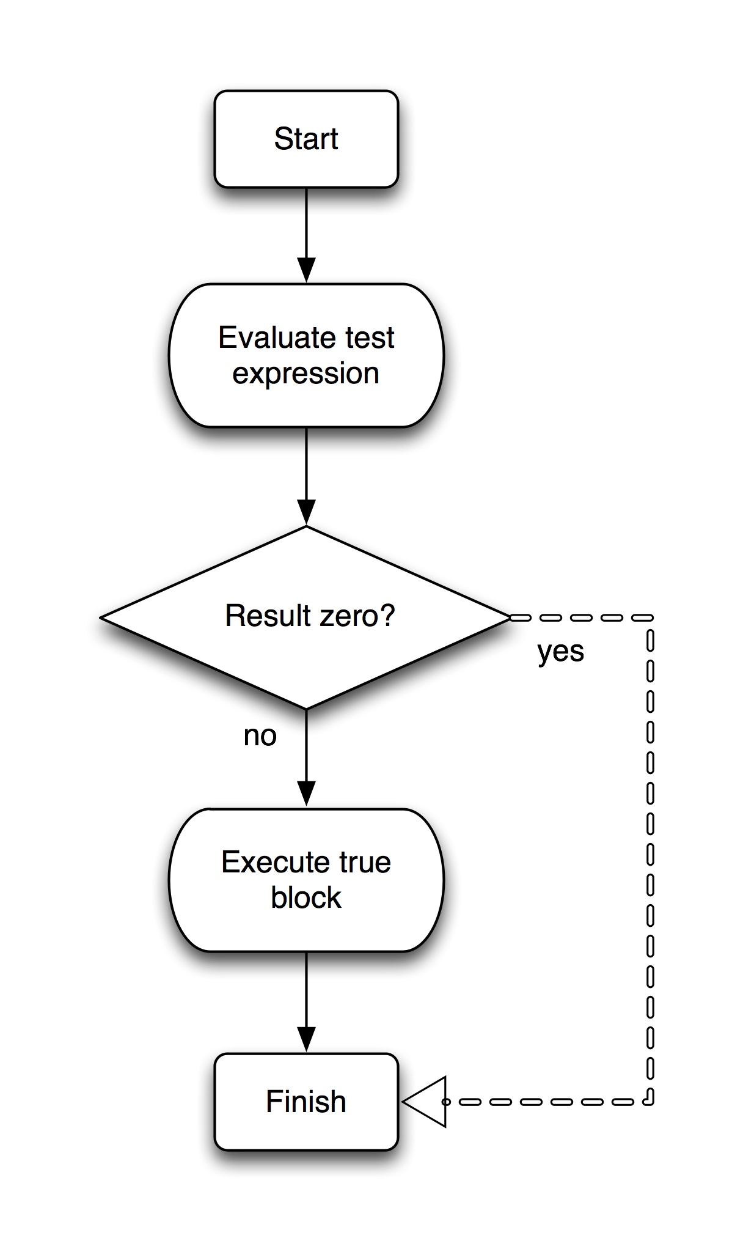
If compilation
function generate_bytecode(node, program)
[...]
elseif (node.tag=="if_statement") then
node.label_finish = create_label(program)
generate_bytecode(node.expression, program)
program.bytecode:insert(kOpJumpEqual)
program.bytecode:insert(
create_label_ref(node.label_finish))
generate_bytecode(node.block, program)
node.label_finish.address = #program.bytecode
[...]
Notes:
Tried to show the jump occuring with the big arrow

Slide 73
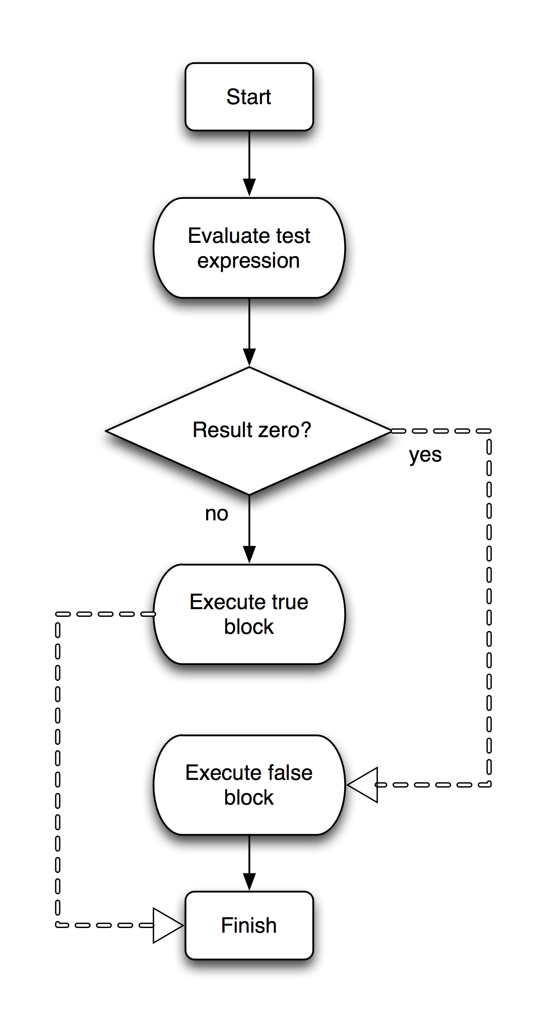
If-Else compilation
function generate_bytecode(node, program)
[...]
node.label_else = create_label(program)
node.label_finish = create_label(program)
generate_bytecode(node.expression, program)
program.bytecode:insert(kOpJumpEqual)
program.bytecode:insert(create_label_ref(node.label_else))
generate_bytecode(node.if_block, program)
program.bytecode:insert(kOpJump)
program.bytecode:insert(create_label_ref(node.label_finish))
node.label_else.address = #program.bytecode
generate_bytecode(node.else_block, program)
node.label_finish.address = #program.bytecode
[...]
Notes:
That's the functions we can call, how does our grammar change?
Let's back up for minute!
Print is not a function – it's a statement!
Root: Expression → Root: Statement list!

Slide 74
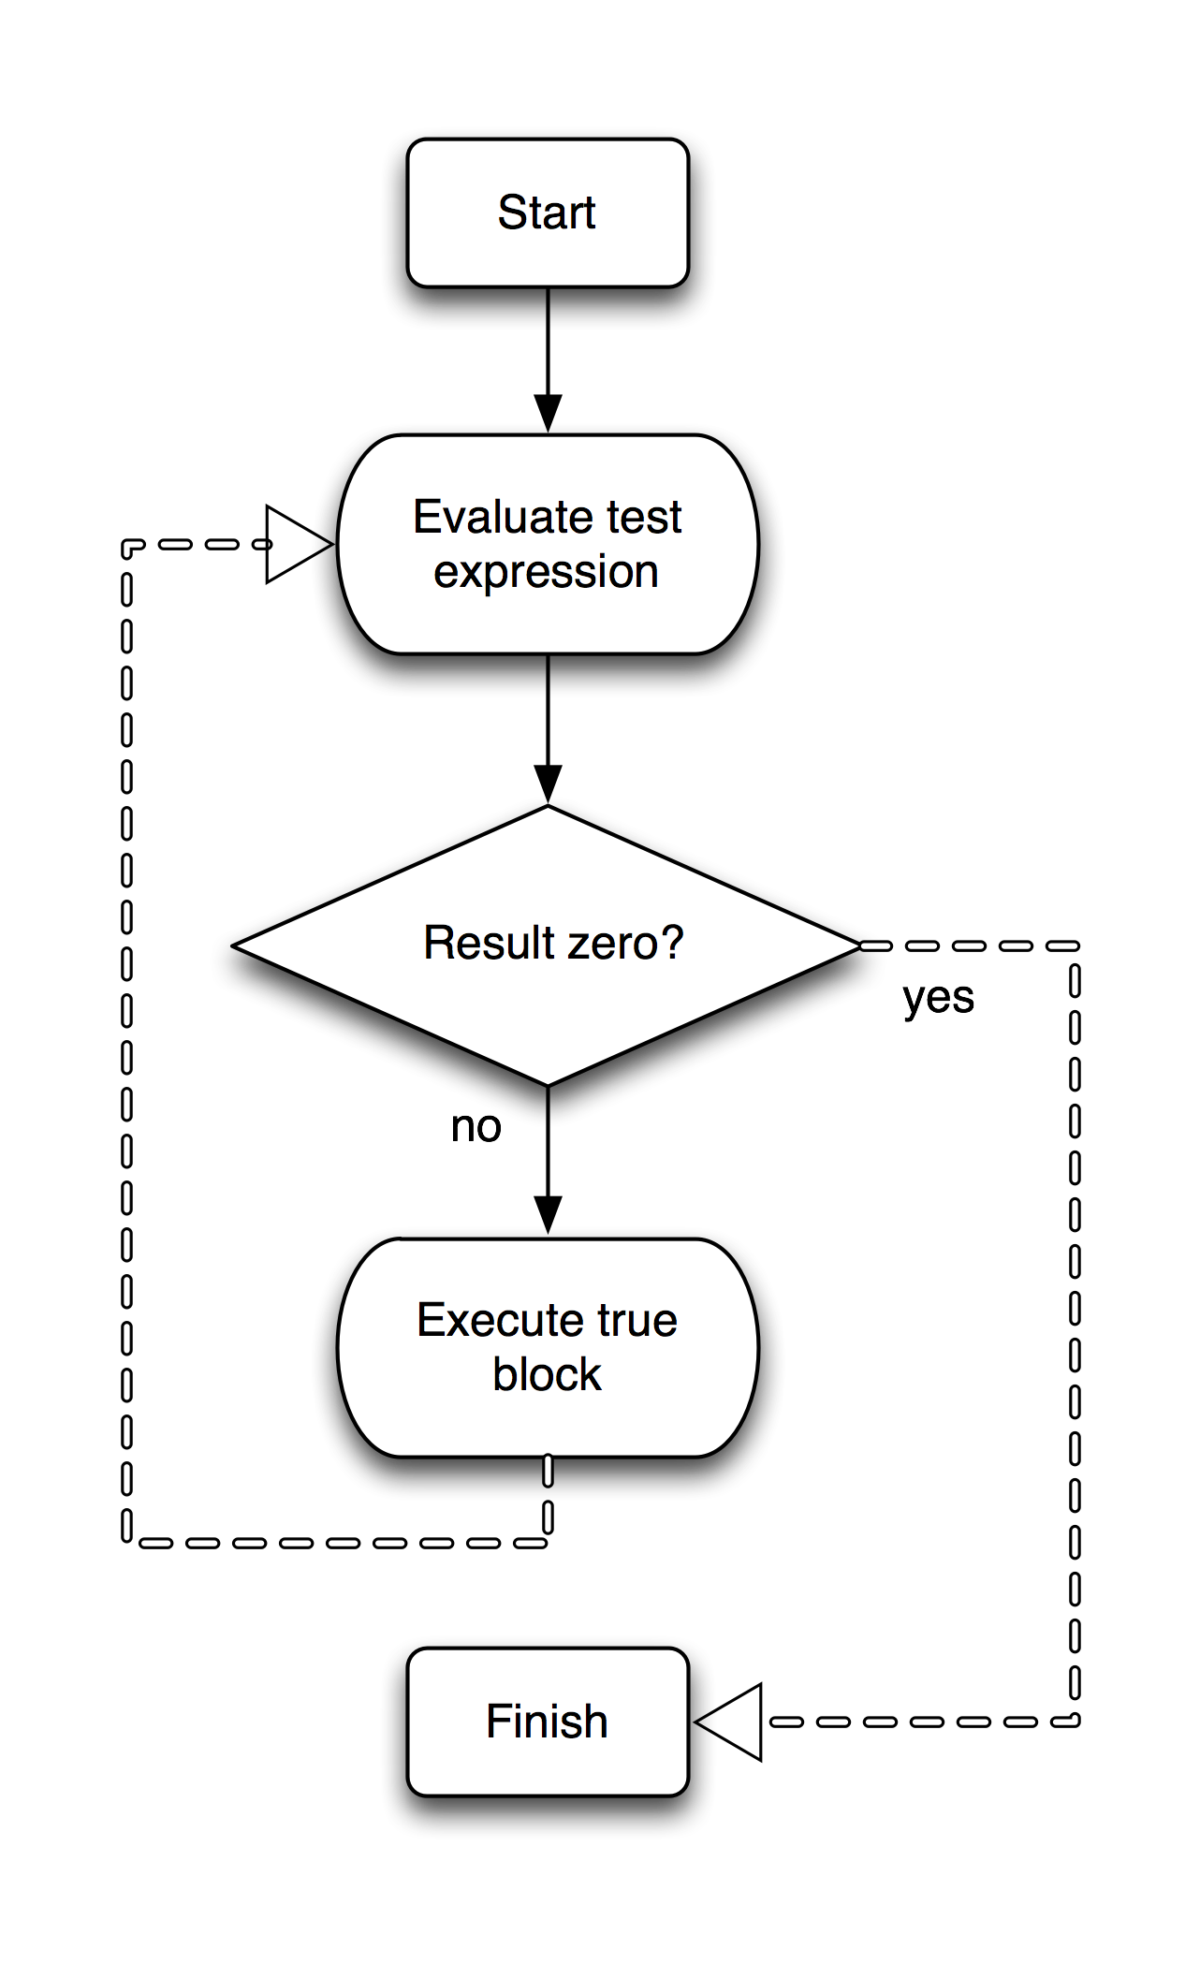
While compilation
function generate_bytecode(node, program)
[...]
node.label_test = create_label(program)
node.label_finish = create_label(program)
node.label_test.address = #program.bytecode
generate_bytecode(node.expression, program)
program.bytecode:insert(kOpJumpEqual)
program.bytecode:insert(
create_label_ref(node.label_finish))
generate_bytecode(node.block, program)
program.bytecode:insert(kOpJump)
program.bytecode:insert(
create_label_ref(node.label_test))
node.label_finish.address = #program.bytecode
[...]
Notes:
That's the functions we can call, how does our grammar change?
Let's back up for minute!
Print is not a function – it's a statement!
Root: Expression → Root: Statement list!

Slide 75
Sorry about the example language.
Hopefully you already have some ideas for extending it.

Slide 76
Summary
Writing compilers = fun
Trading compilation speed → power = good
Writing your own parser and lexer = stupid (possible instructive)
Using C++ to write a compiler = silly

Slide 77
Questions!

Slide 78
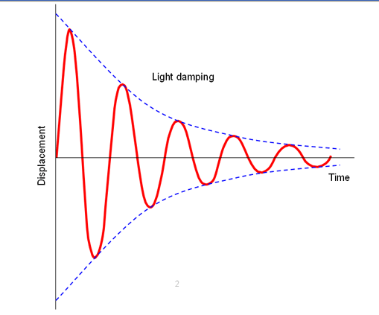
Application (1) - expression evaluation
“5.0*sin(time*10.0)*exp(-time*2.0)”
Notes:
Runtime expression evaluation in your demotool

Slide 79
Application (2) - Shader Minifier
uniform int time;
float sum(vec3 v) { return v.x + v.y + v.z; }
float foo(vec3 v, float k) {
float tmp = 1.;
int i_count = 4;
for (int i = 0; i < 5 * i_count; ++i)
tmp /= k;
return tmp * v.sts;
}
uniform int r;float t(vec3 r){return r.r+r.g+r.b;}float t(vec3 r,float t){float o=1.;for(int r=0;r<20;++r)o/=t;return o*r.rgr;}

Slide 80

Application (3) - Structure Synth
[...]
16 * { rz 20 color white } hbox
{ z -1 s 100 100 1 } box
rule hbox { r}
rule r { forward }
rule r { turn }
rule r { turn2 }
rule r { turn4 }
rule r { turn3 }
rule forward md 90 > r {
dbox
{ rz 2 x 0.1 shrink } forward
}
rule turn md 90 > r {
dbox
{ rz 2 x 0.1 shrink } turn
}
rule turn2 md 90 > r {
dbox
{ rz -2 x 0.1 shrink } turn2
}
[...]
Notes:
Structure Synth by Mikael Hvidtfeldt Christensen

