Slide 1
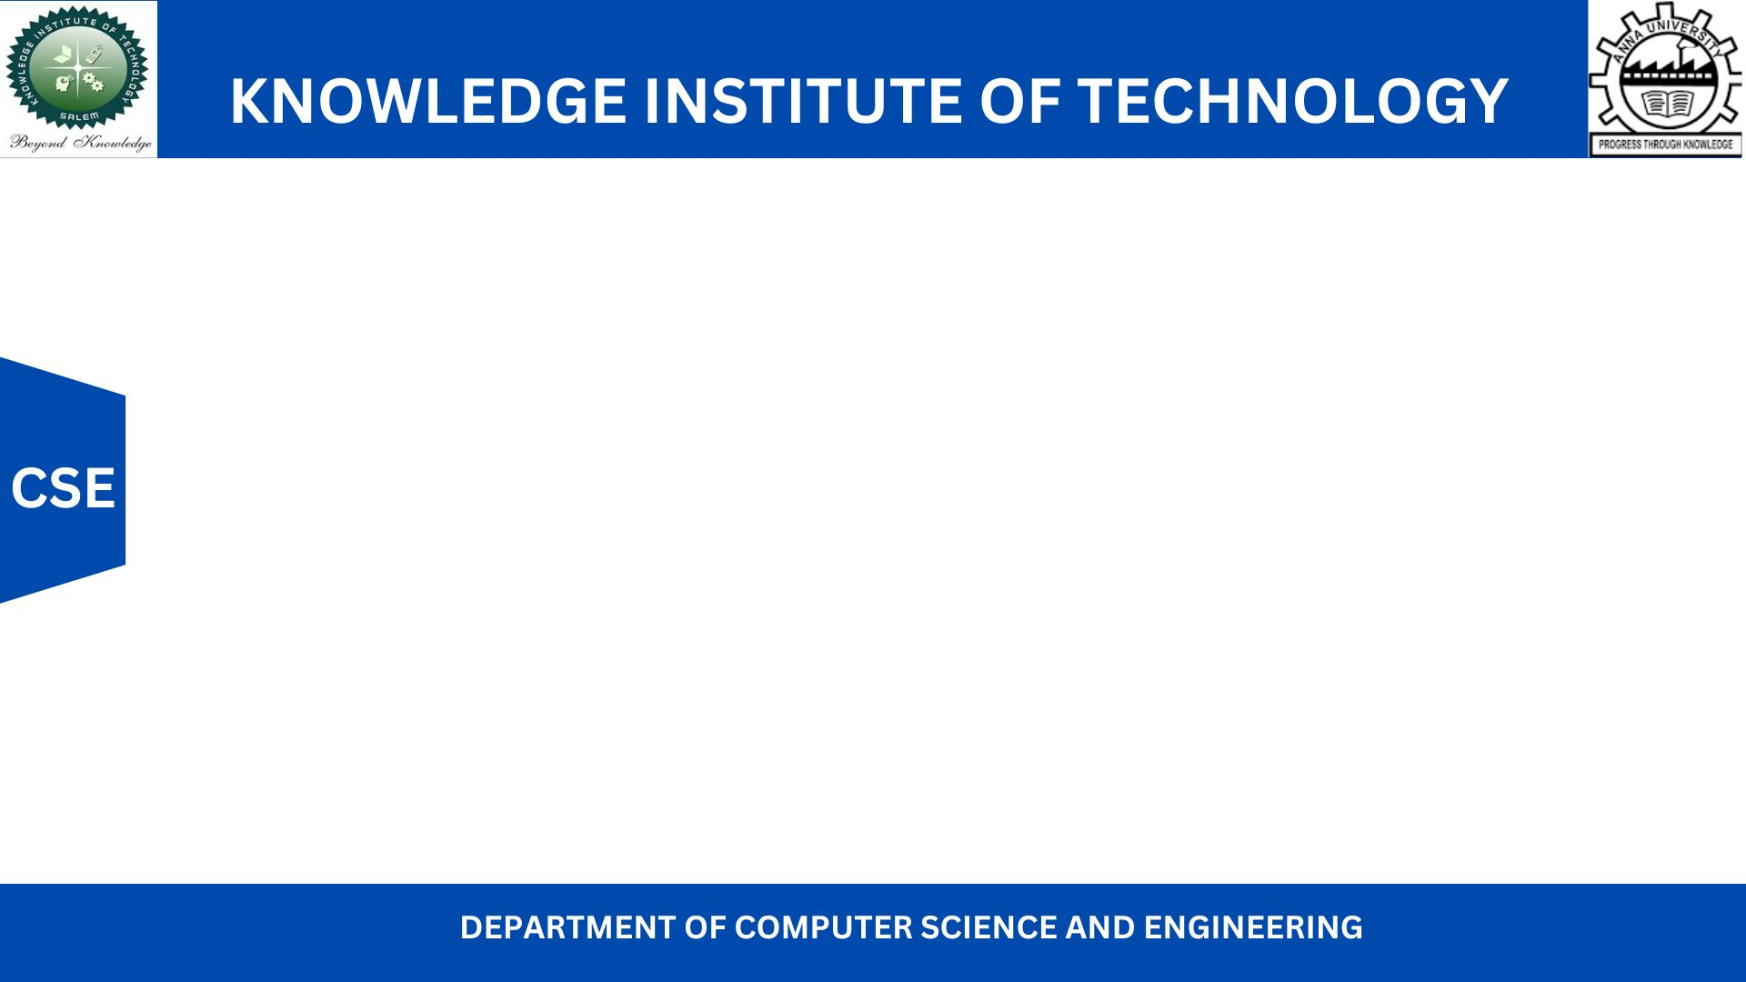
INDIAN FOOD EXPLORATION DATA ANALYSIS
Presented by
KEERTHIVASAN N (611220104070)
MEIROOPASRI R (611220104118)
POORNASRI S (611220104119)
REVATHI A (611220104122)
UNDER THE GUIDANCE OF
Mr. J. MURUGESAN ( IT )
ASSISTANT PROFESSOR,
DEPARTMENT OF COMPUTER SCIENCE AND ENGINEERING

Slide 2
INTRODUCTION
Data analytics is a method of applying quantitative and qualitative techniques to analyze data, aiming for valuable insights. With the help of data analytics, we can explore data and we can even draw conclusions about our data.
The aim of this project is to perform Exploratory Data Analysis (EDA) on a dataset related to Indian food. Exploratory Data Analysis is a crucial step in data analysis that helps in understanding the dataset, discovering patterns, and extracting insights. In this project, we will explore various aspects of Indian cuisine, such as ingredients, recipes, regional variations, and popularity.

Slide 3
ABSTRACT
The literature review demonstrates the growing interest in applying EDA techniques to explore Indian food datasets. These studies have provided valuable insights into the ingredients, regional variations, popularity, and nutritional aspects of Indian cuisine
EDA has proven instrumental in unraveling the intricacies of Indian food, shedding light on the diversity, flavors, and cultural significance associated with this culinary heritage.
Future research can further leverage EDA to explore new dimensions of Indian food, such as the impact of globalization, dietary preferences, and the fusion of traditional and modern culinary practices.

Slide 4
LITERATURE SURVEY
PAPER-I
TITLE: Exploratory Data Analysis of Indian Cuisine Ingredients Exploratory Data Analysis of Indian Cuisine Ingredients
AUTHOR: Gupta et al, 2018
This study focuses on analyzing a dataset of Indian cuisine ingredients using EDA techniques. The authors explore the frequency and distribution of ingredients, identifying the most commonly used spices, herbs, and vegetables. They also investigate the regional variations in ingredient preferences, highlighting the distinct flavor profiles across different Indian states.

Slide 5
LITERATURE SURVEY
PAPER-II
TITLE:Exploring Regional Variations in Indian Food: An EDA Approach
AUTHOR: Sharma and Jain ,2019
This research delves into regional variations in Indian food
by employing EDA techniques on a dataset comprising recipes
from different states. The authors examine the prevalence of specific dishes, ingredients, and cooking methods within each region. They uncover regional specialties, uncovering the unique culinary traditions that define Indian cuisine.

Slide 6
LITERATURE SURVEY
PAPER-III
TITLE: EDA of Popular Indian Dishes on Social Media"
AUTHOR: Patel and Shah ,2020
This study utilizes EDA to analyze the popularity of Indian dishes on social media platforms. The authors collect data from various social media sources and explore metrics such as user ratings, reviews, and mentions. They identify popular dishes, trends, and emerging flavors, providing insights into the changing preferences of consumers.

Slide 7
LITERATURE SURVEY
PAPER-IV
TITLE :Nutritional Analysis of Indian Food: An EDA Perspective
AUTHOR: Chatterjee and Saha ,2021
Focusing on the nutritional aspects of Indian cuisine, this research conducts EDA on a dataset comprising nutritional information of Indian dishes. The authors analyze the calorie content, macronutrient distribution, and common ingredients contributing to specific nutritional values. They highlight the balance and diversity of Indian food, providing valuable insights for health-conscious individuals.

Slide 8
DRAWBACKS IN EXISTING SYSTEM
The user interface may not be the most intuitive, we feel that there is room for improvement.
Its data visualization features require configuration to integrate with third-party tools.
Errors and fake analysis of literacy rate may be occur.
Lack of access to computers and the internet or who limited digital literacy skills may face disadvantages in education and the job market.

Slide 9
PROPOSED SOLUTION
Indian food EDA can be a valuable resource for both enthusiasts of Indian cuisine and professionals in the food industry..
It can help users discover new recipes, restaurants, and food trends while offering insights into the rich culinary traditions of India.
In our effort, we have tried to predict the Literacy Rates of each state using a reduced set of features.
The scalability of our project is very huge, especially covering the people on the different types of food and Ingriediants

Slide 10
ADVANTAGES
Lower costs—reduces maintenance due to complete report coverage and a zero-footprint environment.
Faster results—shorten reporting time due to seamless integration and adaptive authoring.
Improved decision-making—reports and dashboards present data in easily-understood formats.
Ability to use a variety of charts—crosstabs, bar or 3D bar, pie or doughnut, line, gauge, funnel, scatter, dot density, waterfall, and so forth.

Slide 11
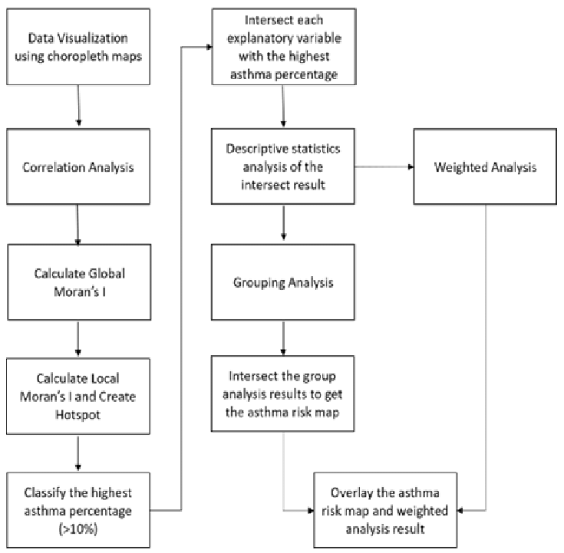
DATAFLOW DIAGRAM

Slide 12
SYSTEM SPECIFICATION
HARDWARE USED:
Processor -AMD/INTEL
RAM -4GB Hard Disk -256 GB
SOFTWARE USED:
Language - HTML, CSS and Javascript
Framework - Flask
Package Manager & Build Tool - PIP
Database - IBM_DB2

Slide 13
MODULES
1. Home
Home page of the Project.
2. About
About the Project Web Page.
3. Analysis Page
Dash Board Page
Report Page
Stories Page

Slide 14
MODULE DESCRIPTION
1. Home:
User will know about the site using the home page. It contains other navigation page like services page, team page, about page and analysis page. It act like starting page of the website.
2. About :
In this, it contains about the services provided my the web site. It also contains what food rate analysis have done, past analysis rate surveys , food service details etc...

Slide 15
MODULE DESCRIPTION
3. Analysis Page : It contains about dash boards ,report and stories of the literacy rate analysis, their rate percentage , food based analysis rate , state and area based food analysis.
Dashboards : Here we can see the visualization of the survey which is more understandable in this project.
Reports : Here we will see about the progress made by the project and working of the process

Slide 16
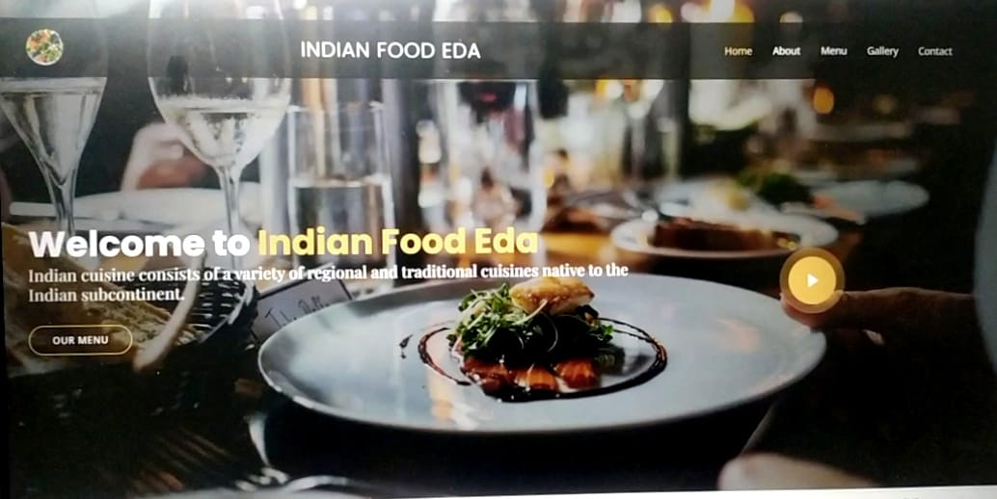
RESULT AND DISCUSSION

Slide 17
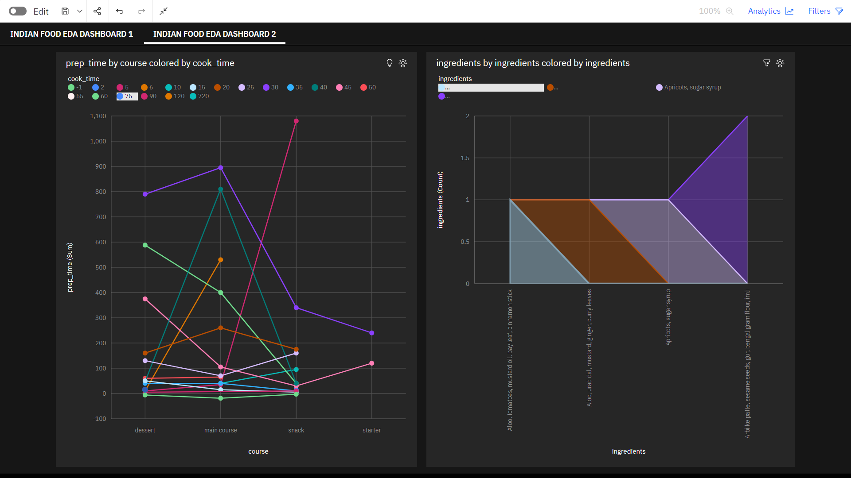
DASHBOARDS

Slide 18
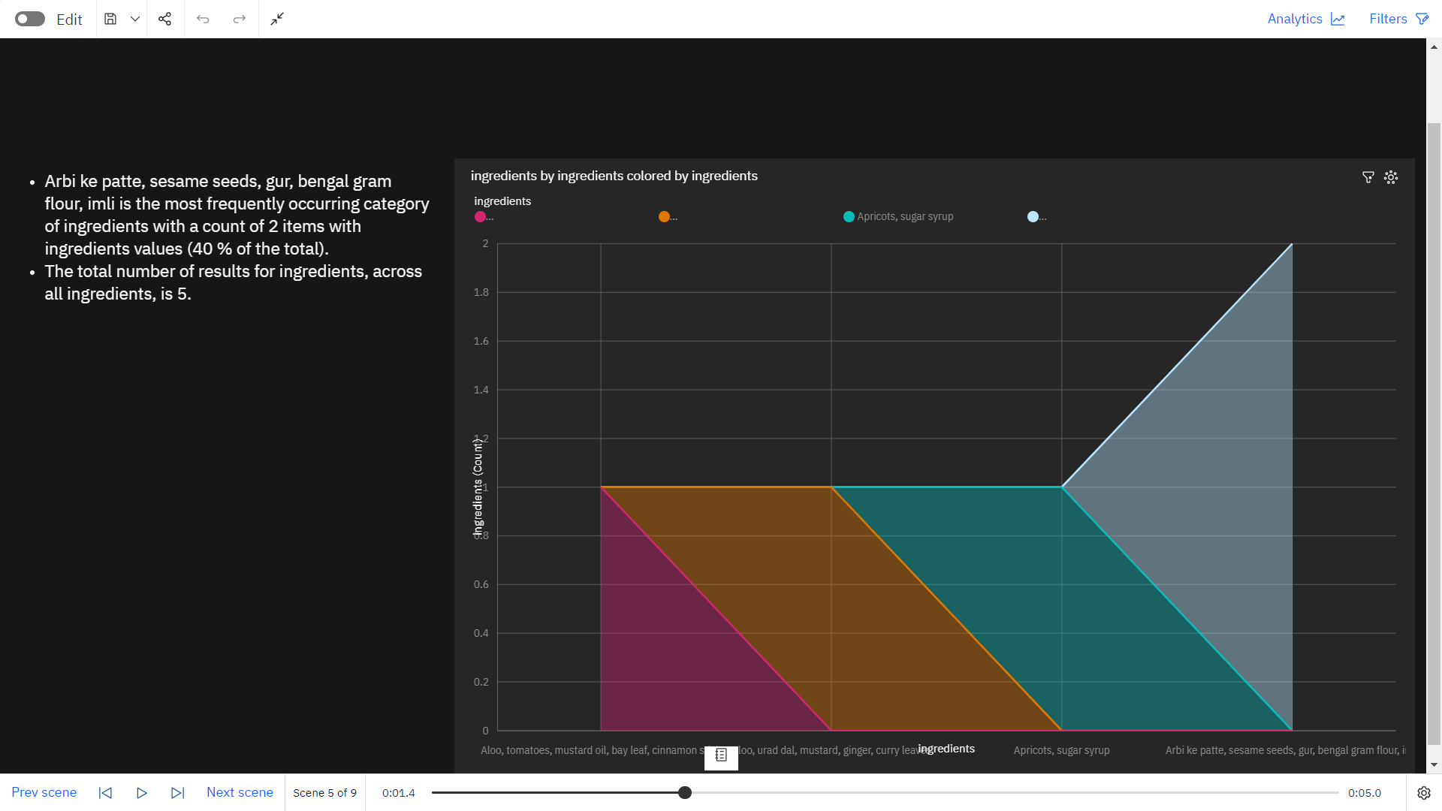

Slide 19
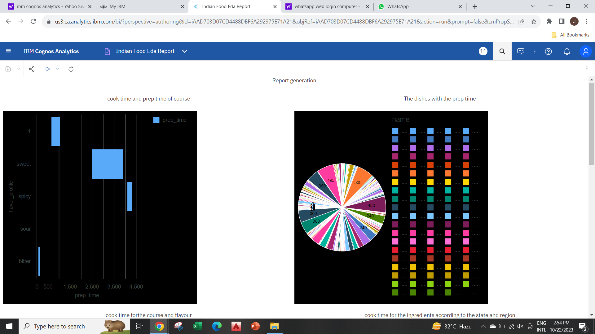
RESULTS & REPORTS

Slide 20
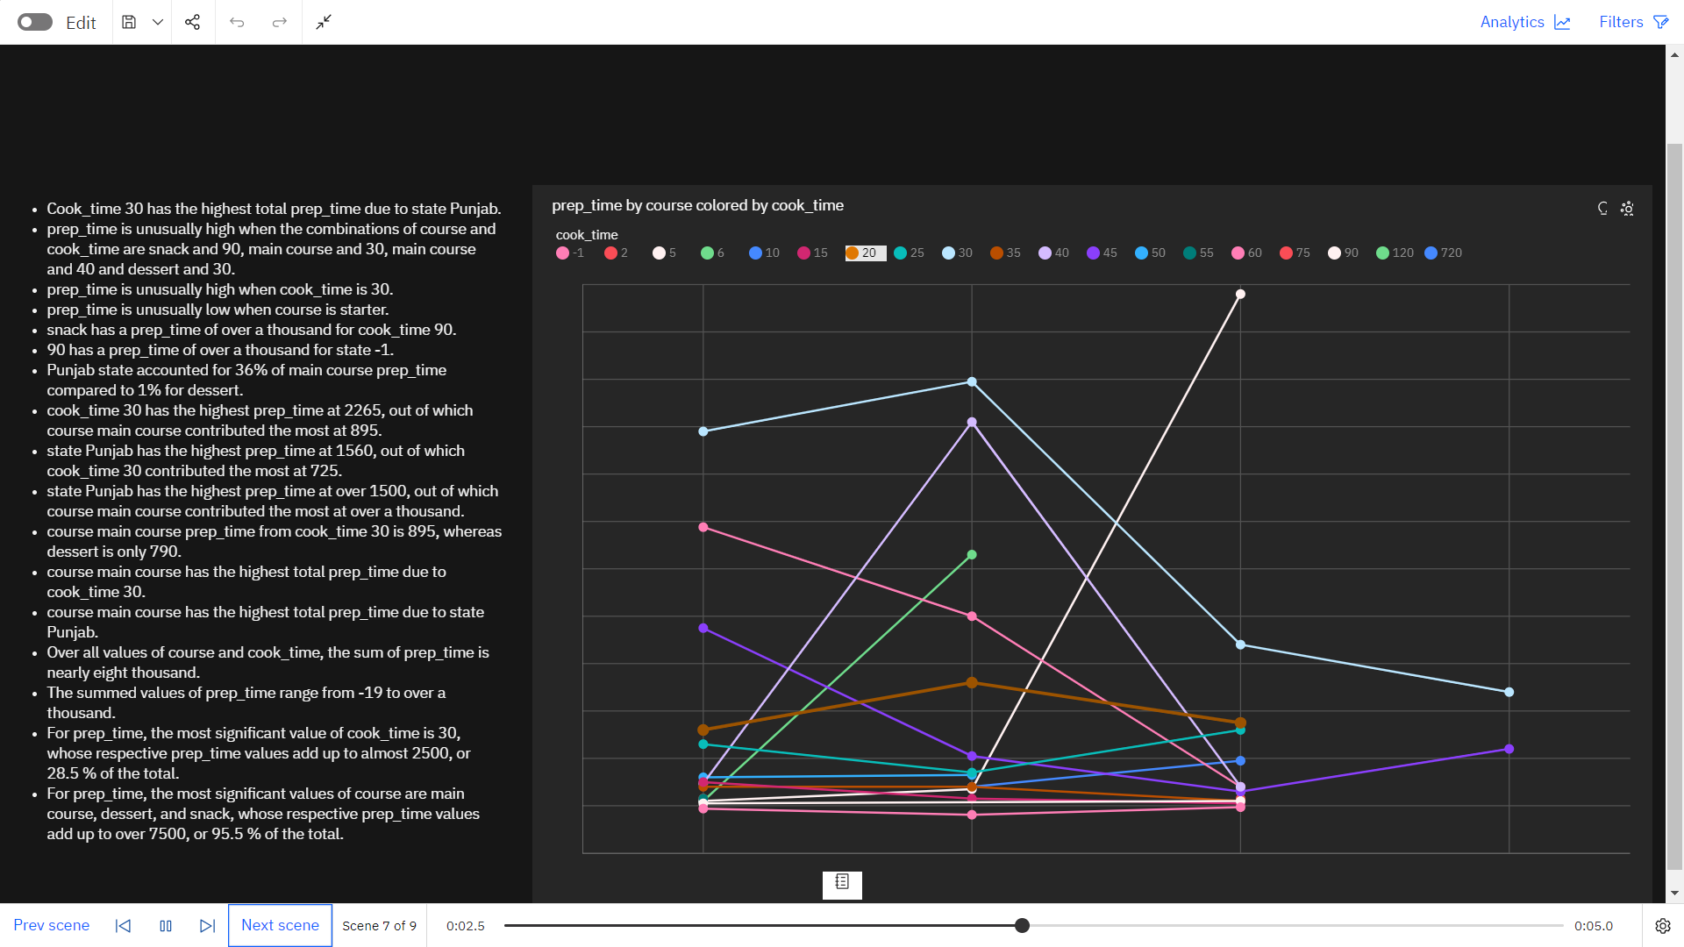

Slide 21
CONCLUSION
EDA on Indian food datasets has a profound social and business impact. It promotes the preservation of culinary heritage, encourages cultural exchange, and raises awareness of health and nutrition. In the business realm, EDA drives menu planning, product development, marketing strategies, and supply chain optimization.
The dataset is uploaded to the database using the IBM cloud and the database is connected to the IBM Cognos Analytics tool. In the IBM Cognos Analytics tool, the data module option is selected and the dataset is pre-processed

Slide 22
THANK YOU

