Slide 1

Weekly Tech presentation
Java concepts
- Tejas Kumar

Slide 2
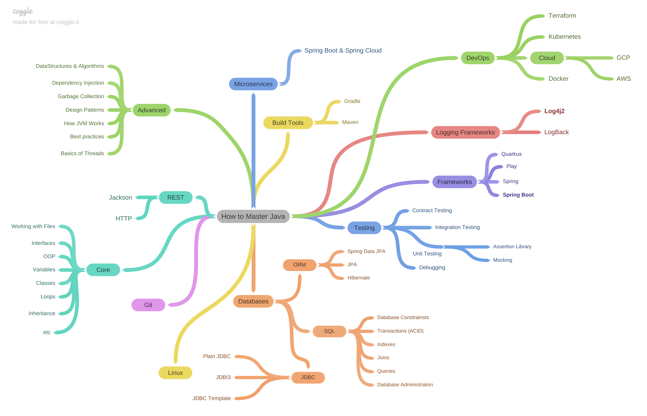
Roadmap

Slide 3
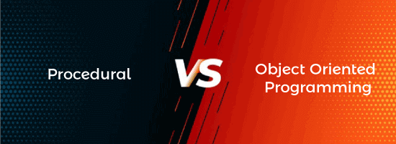

Slide 4
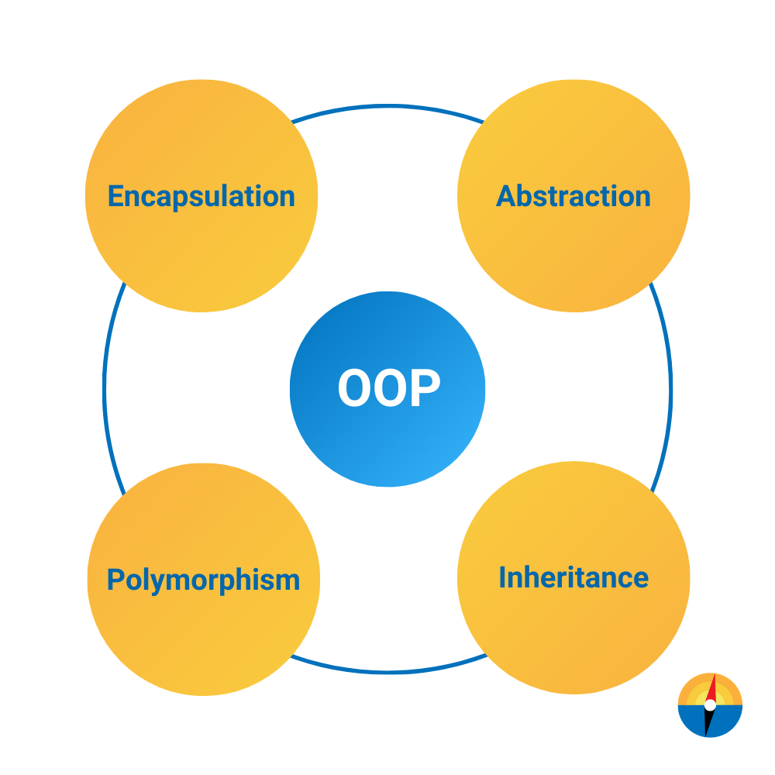
OOP Concepts
1
Abstraction : Hiding of Implementation.
2
Inheritance : Deriving properties from base class to derived class.
3
Polymorphism : Same name but different functions.
4
Encapsulation : Wrapping of code and data into a single unit.

Slide 5
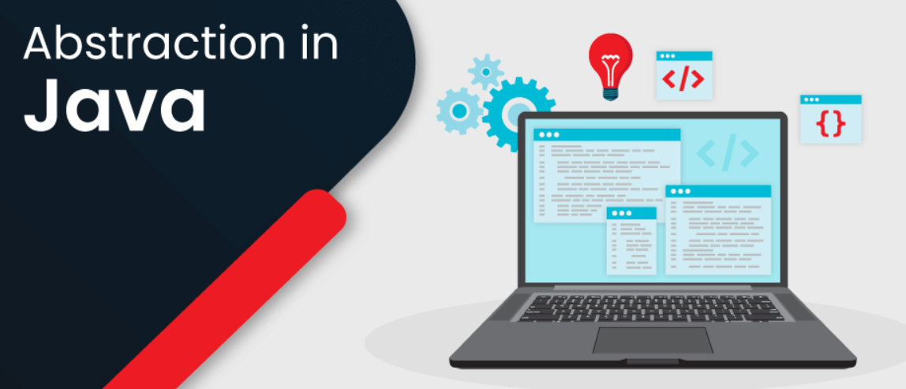
Abstraction

Slide 6
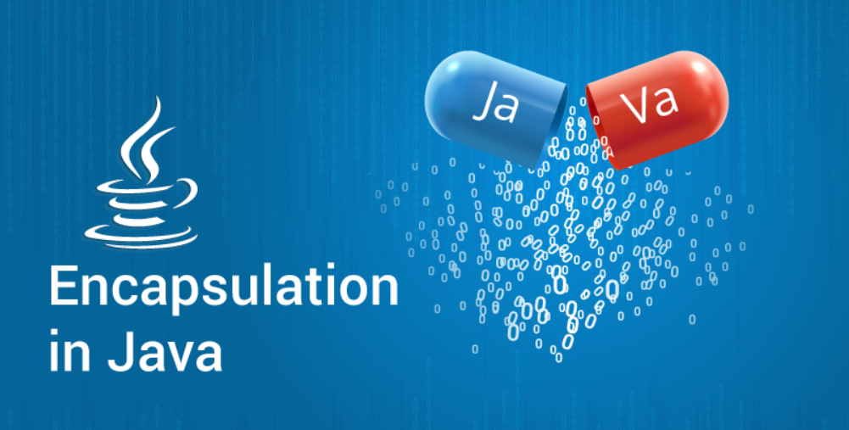
Encapsulation

Slide 7
Encapsulation
Access modifiers:
Specifies the accessibility or scope of method or class.
Different types of access modifiers :
public, private, protected, default.
Non-access modifiers:
Provides other functionalities like synchronizing a method or block, restricting the serialization of a variable, etc.
Different types of non-access modifiers :
static, abstract, synchronized, native, volatile, transient, etc.

Slide 8

Inheritance

Slide 9
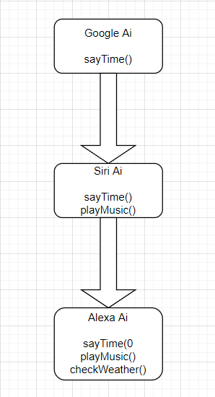
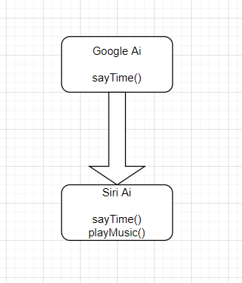
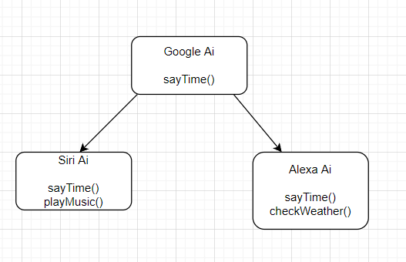
Inheritance
Single Inheritance
Multi-level Inheritance
Hierarchical Inheritance

Slide 10

Polymorphism

Slide 11
Polymorphism
Method overloading :
Same function name but different parameters and occurs in same class.
s.playMusic();
s.playMusic("Thunder");
Method overriding :
Same function name and same parameters and occurs in different classes using inheritance.
t.sayTime(); //outputs base class method before overriding.
t.sayTime(); //outputs child class method after overriding.

Slide 12

Refer recording and java program for implementation.

