Slide 1
IBM University Engagement Project Submission
“Exploring the Power of Agentic AI with IBM Granite and LangFlow”

Slide 2

Project Tile – Research-agent
Domain of Project – Education
Student Name | Recent Passport Photo | Email ID | Mobile number [WhatsApp]
Revathi CV |  | revathicv1210@gmail.com | 9061952871
Recommended font style and size:
Font Style: Arial
Font Size (Heading): 28
Font Size (Content): 20

Slide 3
Problem Statement -
Problem Statement : Research-agent
The Challenge A Research Agent is an AI system designed to assist with academic and scientific
research tasks. It can autonomously search for literature, summarize papers, and organize references.
Using natural language processing, it understands research questions and retrieves relevant
information.
The agent can generate reports, suggest hypotheses, and even draft sections of research papers.
It saves time by automating repetitive tasks like citation management and data extraction.
Research Agents enhance efficiency, accuracy, and innovation in both academic and industrial R&D.
The Objective
The primary objective of this project is to develop an AI-powered Research Agent that assists researchers, students, and professionals in conducting academic and scientific research more efficiently. The system automates the process of searching for relevant research papers, summarizing key findings, organizing references, generating research hypotheses, and creating structured research reports.

Slide 4
Objectives
To develop an intelligent research assistant that automates literature search across multiple academic sources.
To retrieve relevant research papers based on the user's research query.
To generate concise and meaningful summaries of research papers using Artificial Intelligence.
To organize and manage research citations in standard academic formats.
To assist researchers by generating possible research hypotheses from the collected literature.
To automatically generate well-structured research reports, reducing manual effort.
To provide an easy-to-use web interface using Streamlit for seamless interaction.
To improve the speed, accuracy, and efficiency of academic research through AI and Natural Language Processing techniques.

Slide 5
Proposed Solution -
The proposed system is an AI-powered Research Agent developed using IBM Cloud Lite, IBM watsonx.ai Studio, and IBM Granite foundation models to automate academic and scientific research tasks. The system enables users to search scholarly literature, generate concise summaries, organize citations, suggest research hypotheses, and create structured research reports.
The Research Agent retrieves relevant papers from trusted academic sources such as arXiv, CrossRef, Europe PMC, and Semantic Scholar based on the user's research query. IBM Granite models analyze the retrieved information to generate accurate summaries, identify research gaps, and produce meaningful hypotheses. The system also manages references in standard citation formats and automatically generates a comprehensive research report.
A user-friendly Streamlit interface allows users to enter research topics, explore retrieved papers, view AI-generated summaries, and download the final report. IBM Cloud Lite provides the cloud infrastructure, while IBM watsonx.ai and IBM Granite power the intelligent reasoning, summarization, and report generation capabilities.

Slide 6
 | Purpose
Python | Core programming language used for developing the Research Agent.
IBM Cloud Lite | Cloud platform used to host and manage AI services and project resources.
IBM watsonx.ai Studio | Used to develop, test, and integrate AI models.
IBM Granite Foundation Models | Used for natural language understanding, summarization, hypothesis generation, and report generation.
Streamlit | Builds the interactive web-based user interface.
 | .
Technology Used

Slide 7
OpenAI API / IBM Granite API (depending on your implementation) | Generates AI-powered summaries, keywords, and research insights.
arXiv API | Retrieves research papers from the arXiv repository.
CrossRef API | Searches published academic articles and metadata.
Europe PMC API | Retrieves biomedical and life science research papers.
Semantic Scholar API | Provides research paper search and citation information.
Git & GitHub | Version control and project hosting.

Slide 8
Langflow component Used -
Chat Input
  Accepts the user's research query.
Prompt Template
  Formats the user's query for IBM Granite.
IBM Granite Model (LLM)
  Extracts keywords.
  Summarizes research papers.
  Generates hypotheses.
  Creates report sections.
API Request / HTTP Request Components
  Connects to:
    arXiv API
    CrossRef API
    Europe PMC API
    Semantic Scholar API

Slide 9
5.Text Splitter (Optional):Splits long abstracts before sending them to the LLM.
6.Parser / Output Parser:Extracts keywords and formats the LLM response.
7.Python Function Component:Deduplicates papers.
  Sorts by citations.
  Organizes references.
  Builds the report.
8.Report Generator
  Compiles the introduction, literature review, hypotheses, conclusion, and references.
9.Streamlit Output
  Displays:
    Retrieved papers
    AI summaries
    Hypotheses
    References
    Download options (Markdown/JSON)

Slide 10
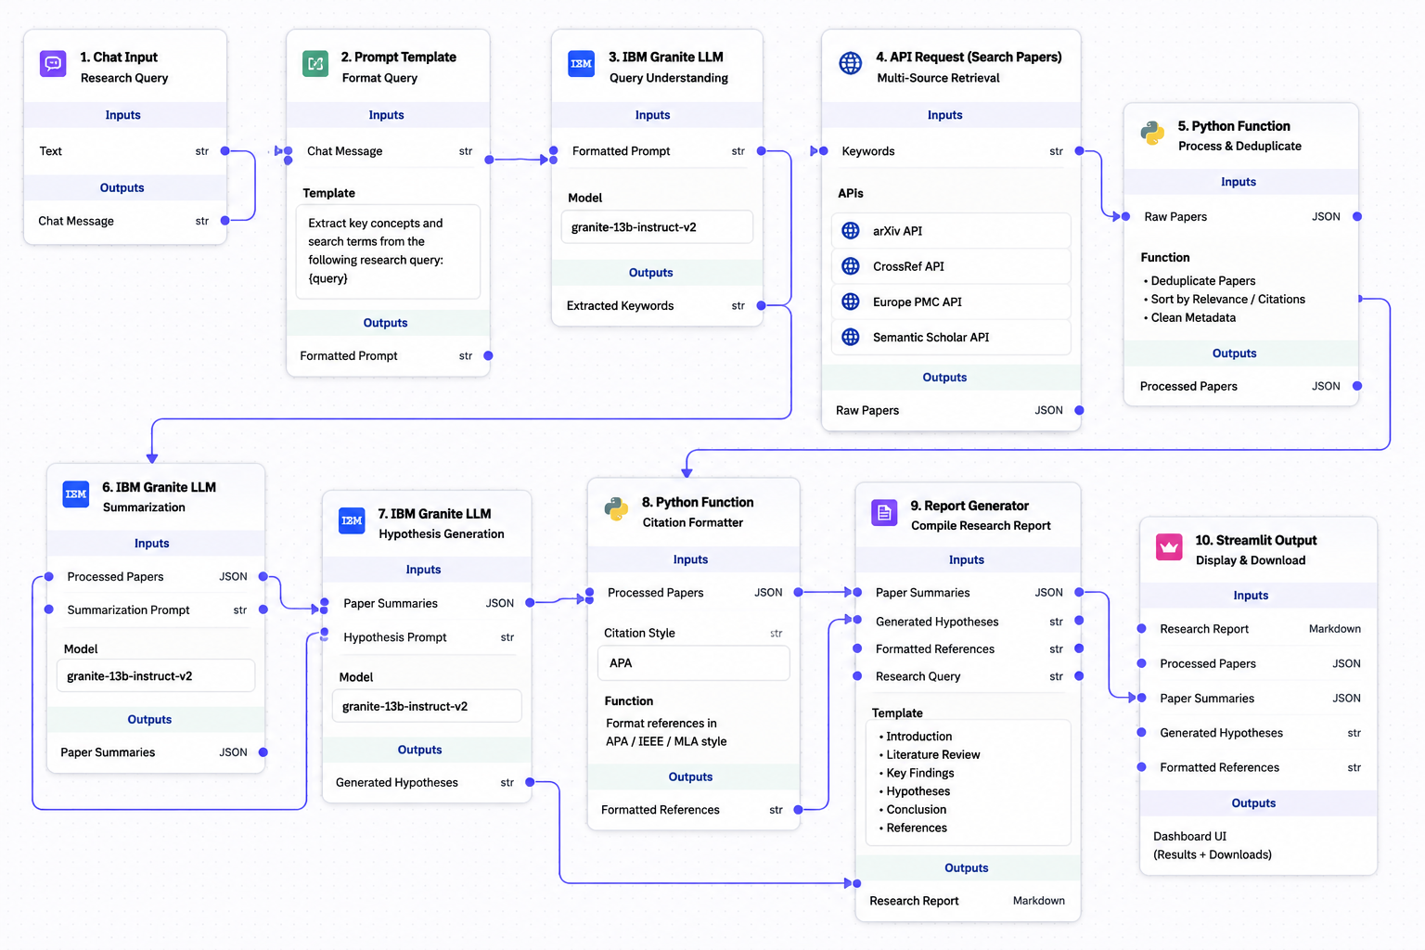
Langflow workflow -

Slide 11
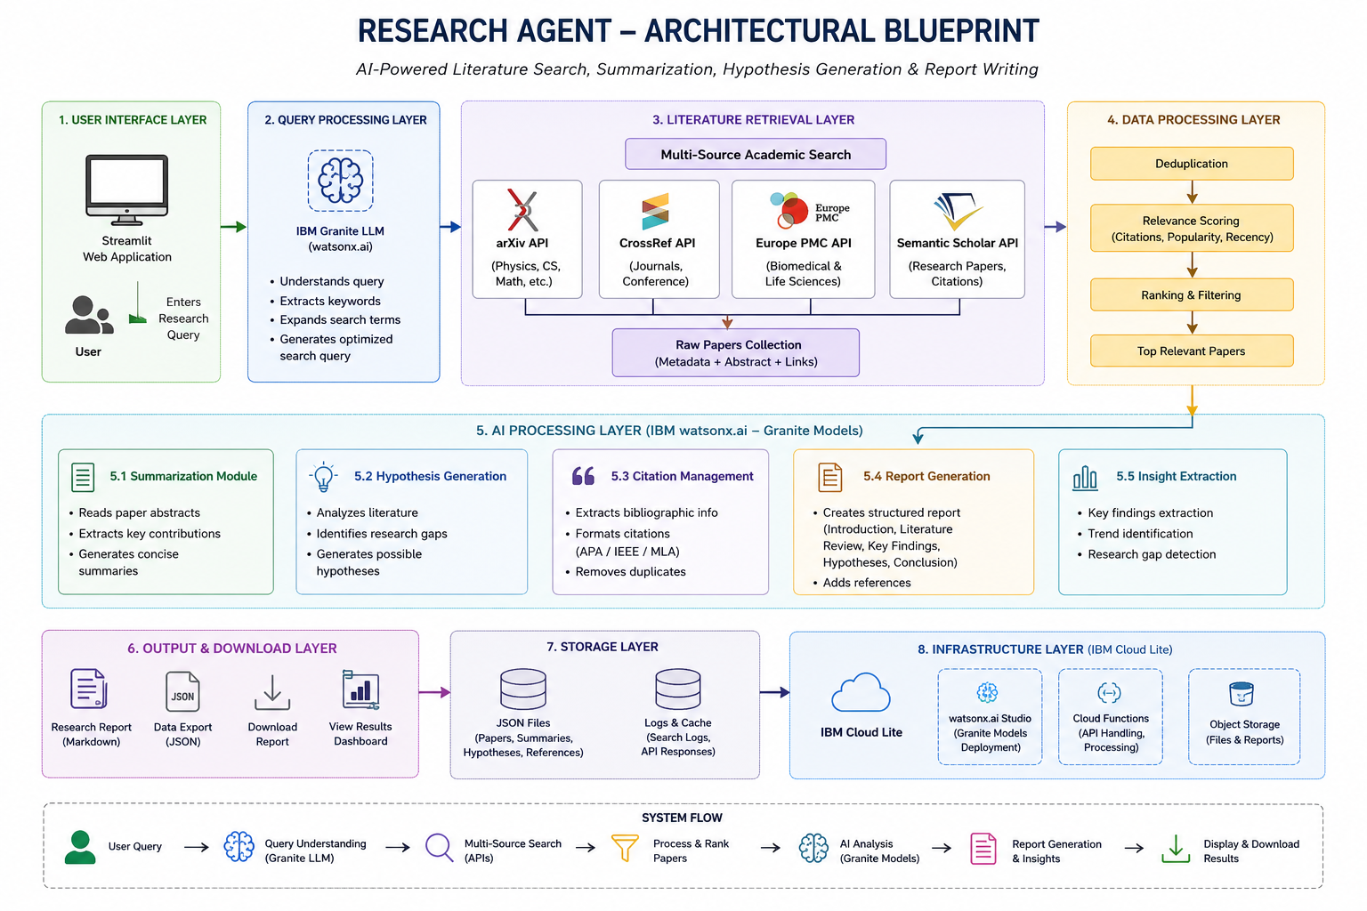
Architecture blueprint

Slide 12

Role of Agentic AI in the solution
Agentic AI serves as the intelligent decision-making component of the Research Agent. Instead of simply responding to user queries, it autonomously coordinates multiple research tasks such as understanding the research topic, selecting appropriate academic databases, retrieving relevant papers, summarizing key findings, generating research hypotheses, organizing citations, and compiling a structured research report.
IBM Granite models, deployed through IBM watsonx.ai, provide the reasoning and language understanding capabilities required for these tasks. The agent dynamically processes user input, retrieves the most relevant information from sources such as arXiv, CrossRef, Europe PMC, and Semantic Scholar, and transforms the collected knowledge into meaningful insights.

Slide 13
By automating the complete research workflow, Agentic AI reduces manual effort, improves the quality and accuracy of literature reviews, supports evidence-based research, and significantly accelerates academic and industrial research activities.

Slide 14
Novelty and Uniqueness
The proposed Research Agent introduces an intelligent AI-driven research assistant that automates the complete academic research workflow, from literature retrieval to report generation. Unlike conventional search engines that only provide a list of research papers, this system understands the user's research intent, retrieves relevant literature from multiple trusted academic sources, summarizes the findings, identifies research gaps, generates novel hypotheses, manages citations, and compiles a structured research report.
The integration of IBM Granite Large Language Models through IBM watsonx.ai enhances the system's reasoning, summarization, and report-writing capabilities. By incorporating Agentic AI, the Research Agent autonomously performs multiple interconnected research tasks with minimal human intervention, making the research process faster, more efficient, and highly intelligent.

Slide 15
Uniqueness of the Project
End-to-End Research Automation – Automates the entire research process, from query understanding to final report generation.
Multi-Source Literature Retrieval – Simultaneously searches multiple academic databases such as arXiv, CrossRef, Europe PMC, and Semantic Scholar to provide comprehensive research coverage.
IBM Granite-Powered Intelligence – Uses IBM Granite Models for advanced reasoning, summarization, hypothesis generation, and academic report writing.
Agentic AI Workflow – Coordinates multiple AI tasks autonomously, including literature retrieval, analysis, citation management, and report generation.
Automatic Research Gap Identification – Helps researchers identify unexplored areas and generate potential research directions.
Integrated Citation Management – Automatically formats references in APA, IEEE, MLA, or Chicago styles.
Interactive Web Interface – Provides a user-friendly Streamlit dashboard for entering research queries, viewing summaries, and downloading reports.
Cost-Effective Cloud Deployment – Built using IBM Cloud Lite, making the solution suitable for students, researchers, and educational institutions without requiring expensive infrastructure.

Slide 16
Git Hub Link
Please create public github repository (Enable Add README button while creating repository) with format –
Please test and Paste the working Github URL –https://github.com/revuz1210-source/research-agent
·
·
·

Slide 17
Future Scope
Enhance Agentic AI with autonomous planning and decision-making.
Integrate IEEE Xplore, ACM, Springer, and PubMed.
Support PDF, image, and graph analysis.
Predict emerging research trends using AI.
Enable collaborative research workspaces.
Add personalized paper recommendations.
Develop a voice-enabled research assistant.
Implement knowledge graph visualization.
Scale deployment using IBM Cloud.
Support multilingual research and plagiarism detection.
·
·
·

Slide 18
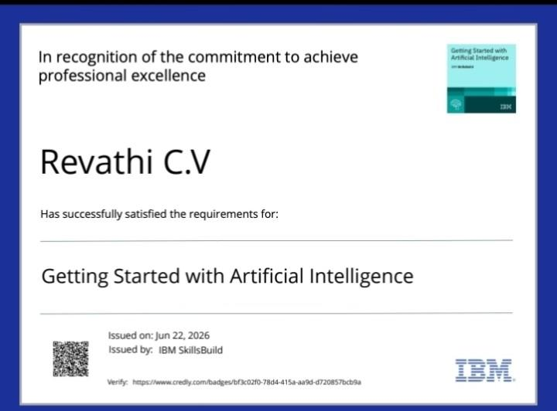
Certificates Earned:
Please add your credly certificate

Slide 19
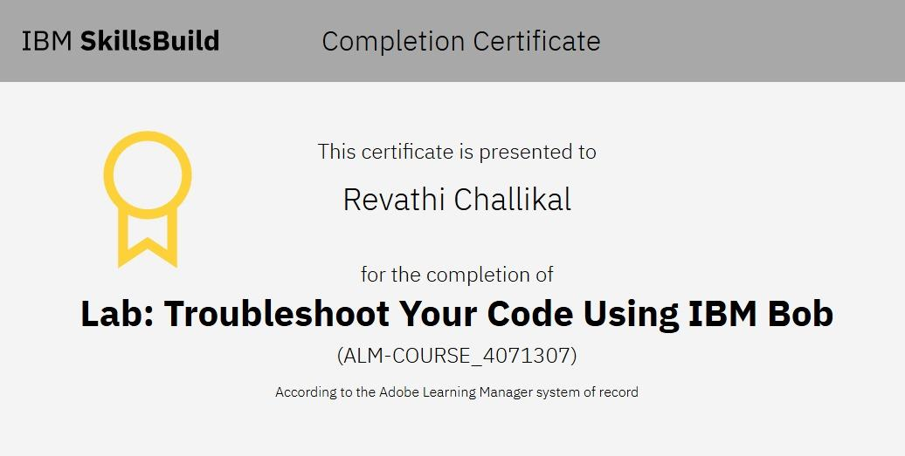
Certificates Earned:​
Add your IBM BOB Certificate

Slide 20


