Slide 1




PORTFOLIO
REVALDY ARRAHMAN
Revaldy
Arrahman
Data Analyst
Data Engineer
Information Systems student
Internship & early-career opportunities
PYTHON SQL ANALYTICS
DATA PORTFOLIO
01
Notes:
Name, education and career interests supplied by user. Cover illustration generated using ImageGen. Illustration contains no project data or measured performance.
Visual icons: bundled Lucide library (ISC license).

Slide 2

PROFILE
REVALDY ARRAHMAN
About me
A strong academic foundation, with practical experience working with data
Information Systems
3.84
Universitas Bina Sarana Informatika
GPA
I enjoy finding patterns, checking data quality
and making results easy to understand.
Semester 7
CAREER FOCUS
Data Analyst
Data Engineer
Explore data and communicate insights
through analysis and dashboards.
Develop reliable data preparation
and database workflows.
DATA PORTFOLIO
02
Notes:
User-provided profile: Information Systems student, Universitas Bina Sarana Informatika, semester 7, GPA 3.84. GPA scale not provided. Career statements indicate interest and development direction rather than production engineering experience.
Visual icons: bundled Lucide library (ISC license).

Slide 3

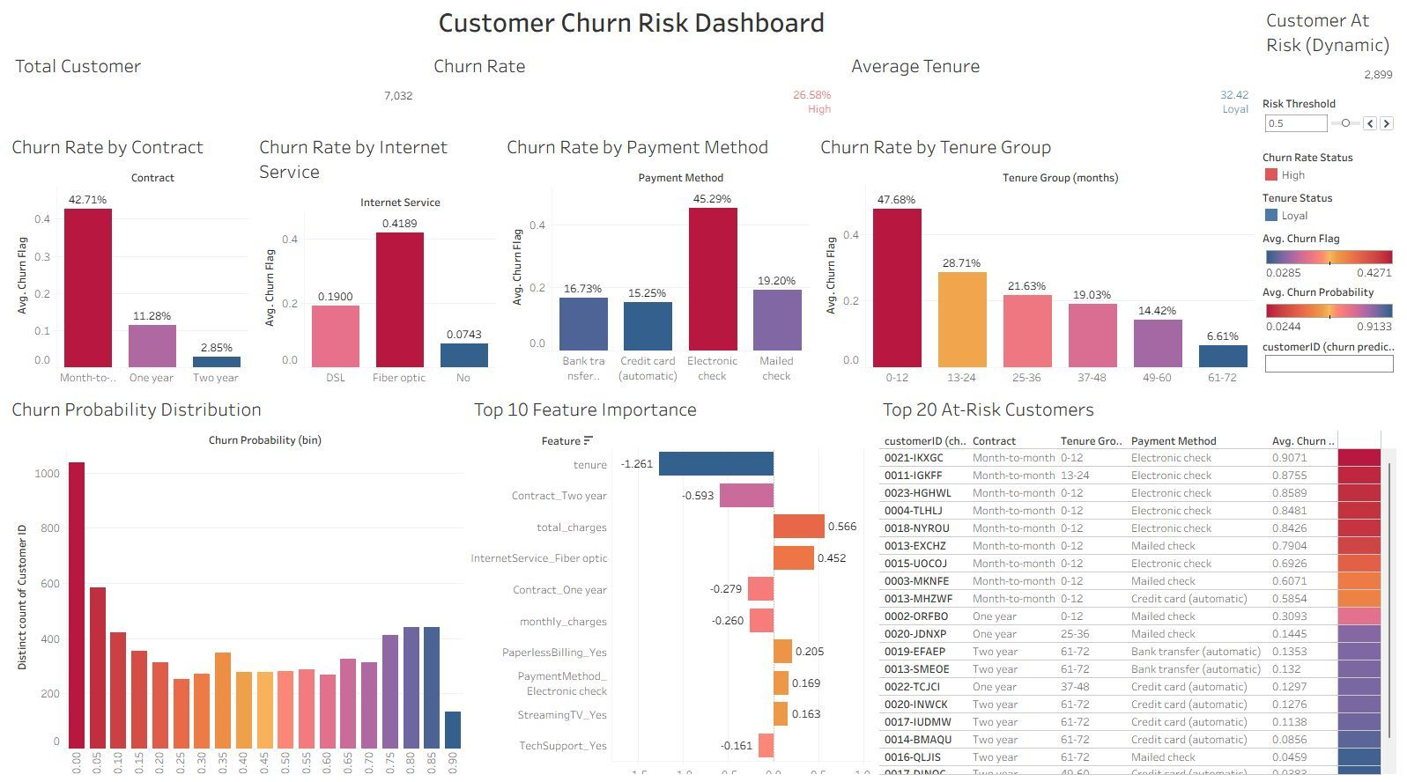

SELECTED PROJECT 01
REVALDY ARRAHMAN
Customer churn analysis
Customer behavior, risk scoring and a Tableau dashboard
PROBLEM
ACTUAL PROJECT DASHBOARD
Identify churn risk and
understand the main drivers.
DATA / TOOLS
Telco customer dataset
SQL, Python, SQLite, Tableau
PROCESS
Clean data with SQL. Explore
patterns and train a balanced
logistic regression model.
KEY INSIGHT
Monthly contracts: 42.7% churn.
Two-year contracts: 2.85%.
7,032 clean records 26.58% churn 77% recall / 50% precision
DATA PORTFOLIO
03
Notes:
Sources: Customer_Churn_Analysis_Telecom (7).pdf pages 6, 7, 11, 13; ANALISA_CHURN_TELEKOMUNIKASI (2).ipynb cells 5, 9, 12, 13, 25, 26. Raw 7043 customers, 7032 cleaned after dropping 11 missing total-charge records. Contract churn rates 42.709677% monthly and 2.848665% two year. Balanced logistic regression test churn recall 0.77, precision 0.50, test support 1407. Dashboard is Tableau Public, not Power BI. Image copied from supplied PDF, preserves its original colors and content. Associations do not establish causation.
Visual icons: bundled Lucide library (ISC license).

Slide 4

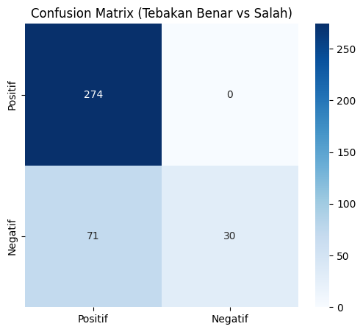
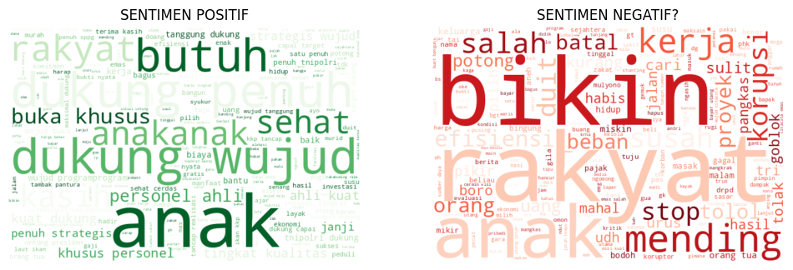
SELECTED PROJECT 02
REVALDY ARRAHMAN
MBG sentiment analysis
Indonesian text classification with TF-IDF and Multinomial Naïve Bayes
PROBLEM
NOTEBOOK CONFUSION MATRIX
WORDS IN THE DATA
Classify sentiment in social media
posts about the MBG program.
DATA / TOOLS
1,875 positive / negative posts
Python, NLTK, Sastrawi, scikit-learn
PROCESS
AUTOMATIC LABEL COUNTS
Clean, tokenize and stem text.
Create automatic labels, then train.
RESULT / LEARNING
81.07% notebook test accuracy.
Negative-class recall needs work.
375 TEST POSTS
AUTO-GENERATED LABELS
Paper reports 90.11%. The notebook output shown here reports 81.07%.
DATA PORTFOLIO
04
Notes:
Academic team project. Sources: analisa_sentimen_MBG.ipynb cells 2, 17, 19, 23, 27, 28; MBG supplied paper pages 13-15. Notebook loads 3459 posts; 3333 remain after preprocessing; 1875 positive/negative auto-labeled records; class counts positive1437/negative438; test375; saved accuracy81.07%; negative recall0.30. Targets generated by a keyword lexicon, neutral data removed. This measures agreement with automatic labels, not independent human-validated public sentiment. The supplied paper reports90.11% and uses different confusion matrix, counts and test support. Images on this slide and metrics all follow the same supplied notebook output. No results re-run or altered. Individual contribution within academic team not specified.
Visual icons: bundled Lucide library (ISC license).

Slide 5

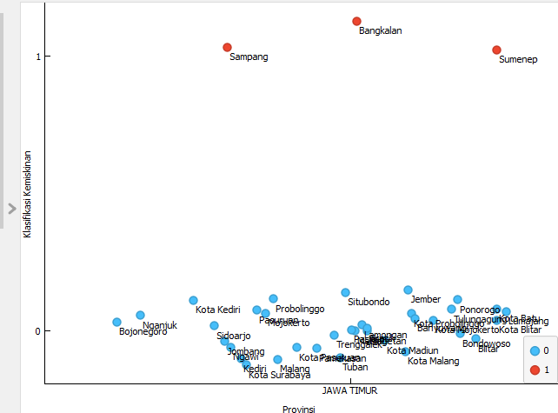
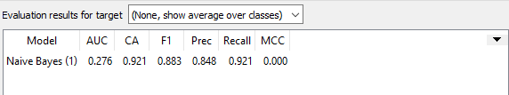
SELECTED PROJECT 03
REVALDY ARRAHMAN
East Java poverty classification
An academic team project using socioeconomic indicators and Naïve Bayes
PROBLEM
ORANGE ANALYSIS / ORIGINAL PAPER FIGURE
Explore poverty categories across
East Java’s cities and regencies.
PAPER EVALUATION
DATA / TOOLS
Regional socioeconomic data
Python and Orange
5-fold cross-validation
Naïve Bayes
PROCESS
Compare class statistics.
Calculate Bayes probabilities
and evaluate classifications.
REGIONAL PATTERN
92.1%
0.276
Accuracy alone does not confirm
reliable class discrimination.
Poverty class in the paper:
Sampang, Bangkalan, Sumenep.
Accuracy in paper
AUC in paper
DATA PORTFOLIO
05
Notes:
Academic team project; Revaldy Arrahman is a coauthor. Sources: Analisa Klasifikasi Tingkat Kemiskinan di Jawa Timur.pdf pages13-16; KLASIFIKASI_KEMISKINAN_JAWA_TIMUR_MENGGUNAKAN_METODE_NAIVE_BAYES.ipynb cells2-9. Source screenshot is a scatter plot of class labels, not independent proof of predictive performance. Paper reports CA0.921,AUC0.276,MCC0.00,F10.883. Figure and printed paper text place Sampang, Bangkalan, Sumenep in class1 and other regions in class0. Notebook illustrates class statistics and manual Bayes calculations; numerical/manual input inconsistencies prevent treating it as a validated predictor. Reported metrics shown with explicit paper attribution and limitation. Crop removes desktop/tool panels and preserves chart content and class labels.
Visual icons: bundled Lucide library (ISC license).

Slide 6

TOOLKIT
REVALDY ARRAHMAN
Skills across the data workflow
A practical toolkit for preparing, exploring and communicating data
Prepare & query
Analyze & report
Work & collaborate
Python
SQL
PostgreSQL
Power BI
Microsoft Excel
Google Sheets
Google Workspace
Microsoft Office
Data cleaning
Structured data processing
Exploratory analysis
Charts and reporting
Teamwork
Documentation and communication
PROJECT TOOLS
pandas scikit-learn SQLite Tableau Orange
DATA PORTFOLIO
06
Notes:
User-declared skills: Python,SQL,PowerBI,MicrosoftExcel,GoogleSheets/GoogleWorkspace,PostgreSQL,MicrosoftOffice,data processing. Project-evidenced tools from supplied notebooks and PDFs: pandas,scikit-learn,SQLite,Tableau,Orange. No proficiency percentages or measured skill levels assigned.
Visual icons: bundled Lucide library (ISC license).

Slide 7


EXPERIENCE
REVALDY ARRAHMAN
Hands-on experience in data operations
Data administration at the Ministry of Agriculture, plus workplace operations experience
Kementerian Pertanian
HOK PROGRAM / DATA OPERATIONS SUPPORT
PT Palapa
Alta Utama
Managed and processed sugarcane farmer records
from multiple regions across Indonesia.
VOCATIONAL SCHOOL INTERNSHIP
Managed e-commerce
operations.
Farmer
Data
Data
Validation
Data
Processing
Verification
Fund
Disbursement
Supported validation and processing through the Ministry’s system,
helping records progress toward fund disbursement.
Helped configure network
printing on employee PCs.
DATA PORTFOLIO
07
Notes:
Both experiences from user description. HOK shown as primary data-relevant experience. Five-stage diagram depicts the program process; support through disbursement does not imply Revaldy personally approved or disbursed funds. No dates/formal job titles or performance metrics supplied. PT Palapa Alta Utama was a vocational school PKL internship, involved e-commerce operations and assisting network-printing configuration.
Visual icons: bundled Lucide library (ISC license).

Slide 8





WORKING STYLE
REVALDY ARRAHMAN
A clear process, with care at every step
I focus on the question, the quality of the data and the explanation of the result
Define
Prepare
Analyze
Validate
Communicate
Understand the question
and expected output.
Check data types, missing
values and structure.
Explore patterns and
compare useful results.
Check assumptions
and model trade-offs.
Explain what the findings
mean and their limits.
STRENGTHS I BRING
Detail-oriented
Collaborative
Adaptable
Problem-solving
DATA PORTFOLIO
08
Notes:
Workflow synthesized from project steps and data operations experience. User-declared strengths: teamwork, detail-oriented, quick adaptation and interest in solving problems using data. No independently measured behavioral outcomes claimed.
Visual icons: bundled Lucide library (ISC license).

Slide 9


CONTACT
REVALDY ARRAHMAN
Let’s Turn Data
Into Impact.
Revaldy Arrahman
Open to Data Analyst & Data Engineer opportunities
EMAIL
[Add email address]
LINKEDIN
[Add LinkedIn URL]
GITHUB
[Add GitHub URL]
QR placeholder
Portfolio website
DATA PORTFOLIO
09
Notes:
Contact placeholders requested by user. QR icon is a visible placeholder, not a working QR code. Replace it with a real QR once the portfolio URL is available.
Visual icons: bundled Lucide library (ISC license).

