Slide 1
Summer Internship Final Presentation
Under Guidance of:
- Ajay Sathyanath
- Sahil Patani
By
- Rewa Jayant Kale
- Sana Ghaus

Slide 2
Overview
Elasticsearch (ES)
Open-source full-text search and analytics engine
NoSQL Database
Search with inverted index
Kibana
Sense
Discover, Dashboard, Visualize
Hive
Index Data into ES
Logstash
Open source data Collection
Filter for multiple operations on fields
Marvel
Monitor ES

Slide 3
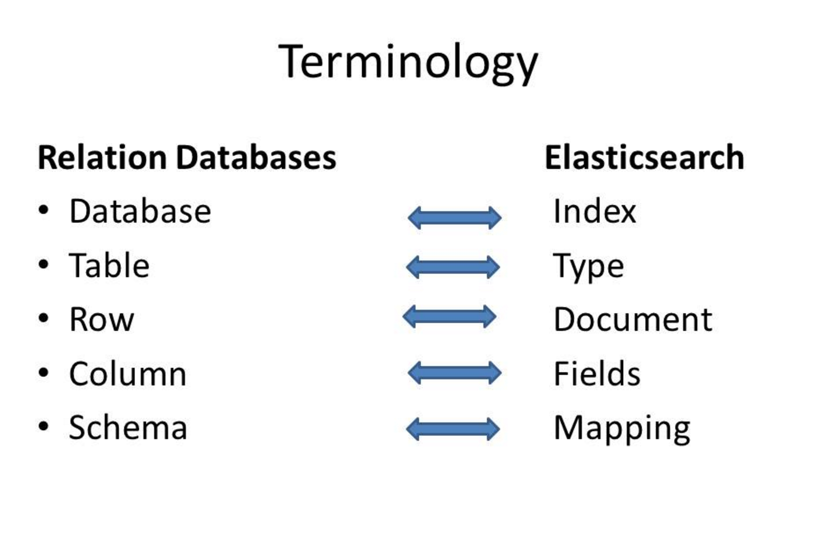
Elasticsearch

Slide 4
Queries
Kibana- Sense
Aggregations – Computations, calculations
Filters
Compound queries using bool

Slide 5
Indexing Data to ES using HIVE
Sandvine Data from HIVE to ES
Template in ES with required mapping
HIVE external table on ES node
Insert by partitions from HIVE to ES

Slide 6
Translation of IP Address to Geo Point Datatype
In Sandvine Data : Convert ”framedip” field to “ip” and then get location coordinates.
IP address as 'string’
IP address as '0.000.00.000'
Geo_point in ES with longitude and Latitude
Geohash in Kibana for Visualization and Analysis

Slide 7
Initial Approach
Hive to ES to map string as IP
Template/mapping in ES
External table in HIVE
ES to Logstash to ES to change IP to Geo_point coordinates
.conf file with input,output and geo-ip filter in logstash

Slide 8
Final Approach
Performance/Indexing Rate
Elasticsearch – Logstash – Elasticsearch
4K Documents/second
Hive – Elasticsearch
60-70K Documents/second
One step only : Hive to Elasticsearch
UDF, compiled, jar creation, created temporary function
Func(IP, required transformation,data base used)

Slide 9
Visualizations and Dashboards
Unique IP count per hour
HTTP Commands, Successes, Failures, GET failures, POST Failures per hour
Successes and Failures of http commands
Unique URL count per hour
Unique IP addresses for failures

Slide 10
Deliverables
Put data from HIVE to ES
Program of converting ”ip address” field to its location coordinates.
Dashboard of all visualizations for sandvine customer dataset.

Slide 11
Thank You! Questions?

