Slide 1
Machine Learning
Under supervised: Dr: Nesma ibrahim​

Slide 2
Machine Learning types
Supervised learning
Data and corresponding labels are given
Unsupervised learning
only Data are given and labels are provided
Reinforcement learning

Slide 3
Machine Learning Algorithms
KNN : k-nearest neighbors
SVM : support vector machines
LR : linear regression
Decision tree:
CT : classification tree
RT : regression tree
Random foreast

Slide 4
KNN (k-nearest neighbor)
K-Nearest Neighbors (KNN) is a simple yet effective algorithm used for both classification and regression tasks in machine learning. Here's a brief overview of how KNN works:
KNN is a type of instance-based learning, also known as lazy learning, where the model doesn't explicitly learn from a training dataset. Instead, it memorizes the entire dataset and makes predictions based on the similarity between new instances and existing data points.

Slide 5
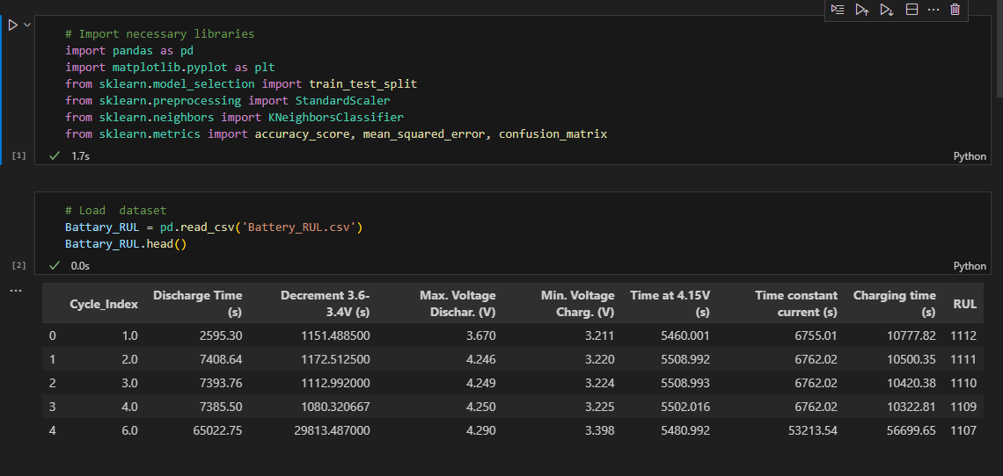
The code and the output of KNN classification

Slide 6
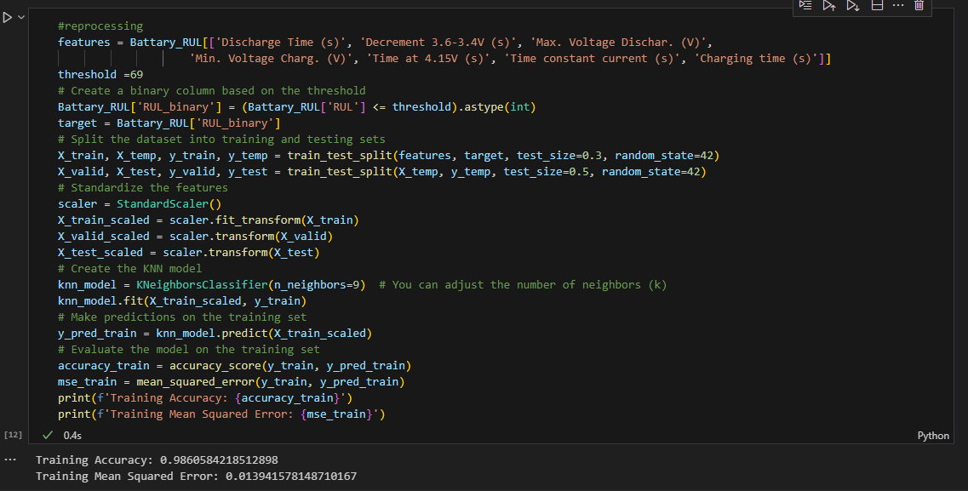

Slide 7
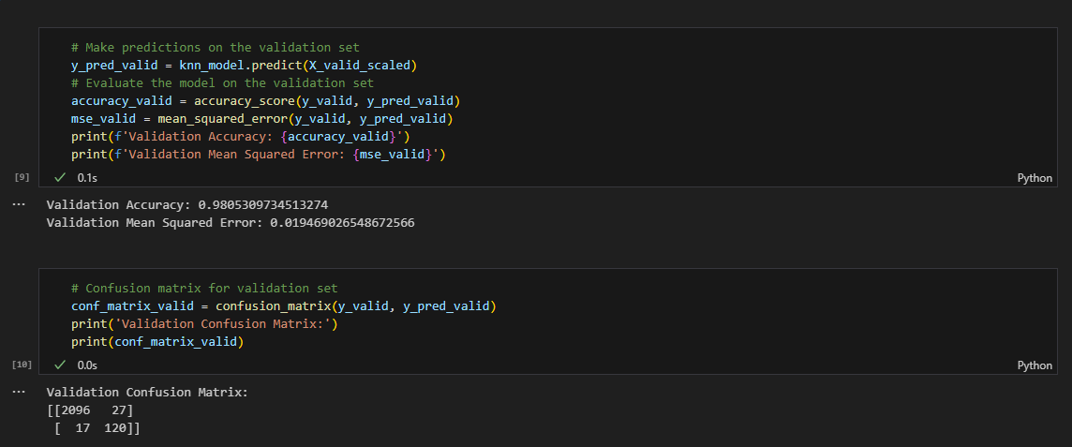

Slide 8
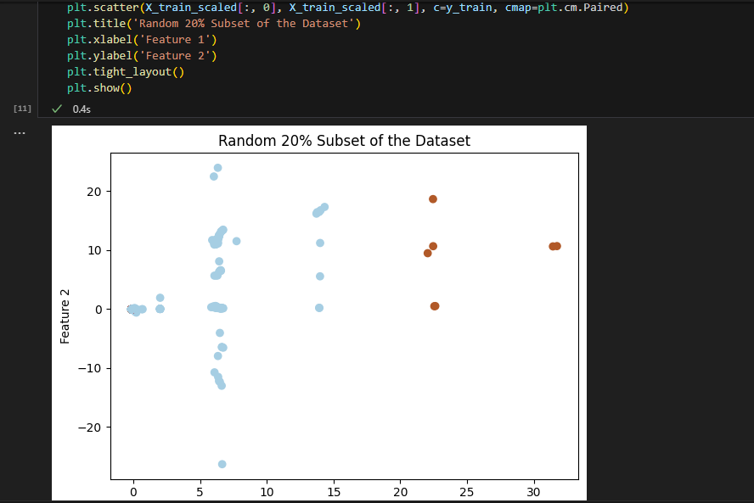

Slide 9
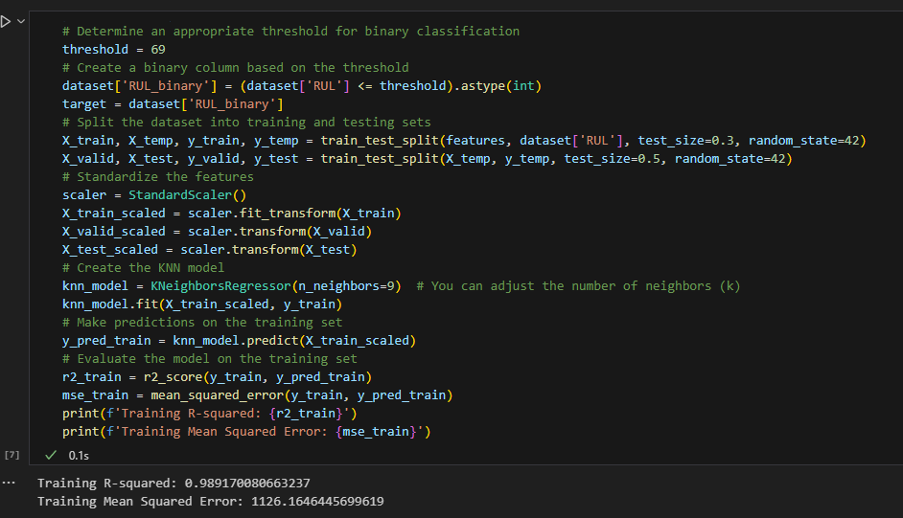
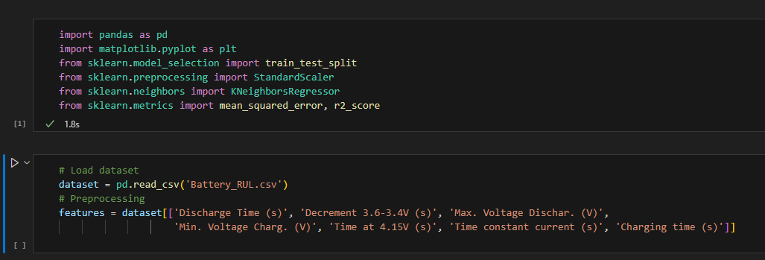
The code and the output of KNN regression

Slide 10
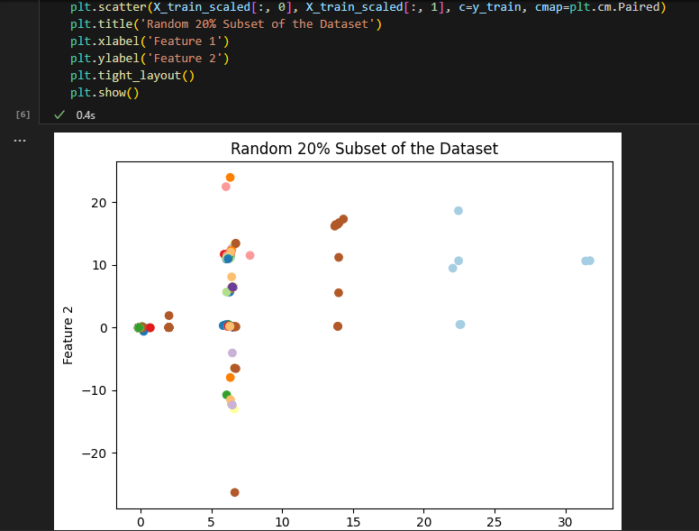
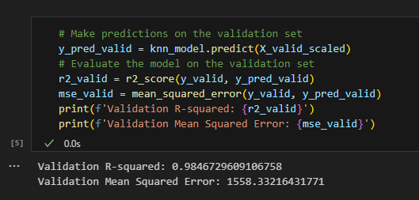

Slide 11
SVM
Support Vector Machine (SVM) is a powerful supervised machine learning algorithm used for both classification and regression tasks. SVM works by finding the optimal hyperplane that separates data points of different classes in the feature space. Here's an overview of how SVM works.
SVM is particularly effective in high-dimensional spaces and is capable of handling both linear and non-linear relationships between features.

Slide 12
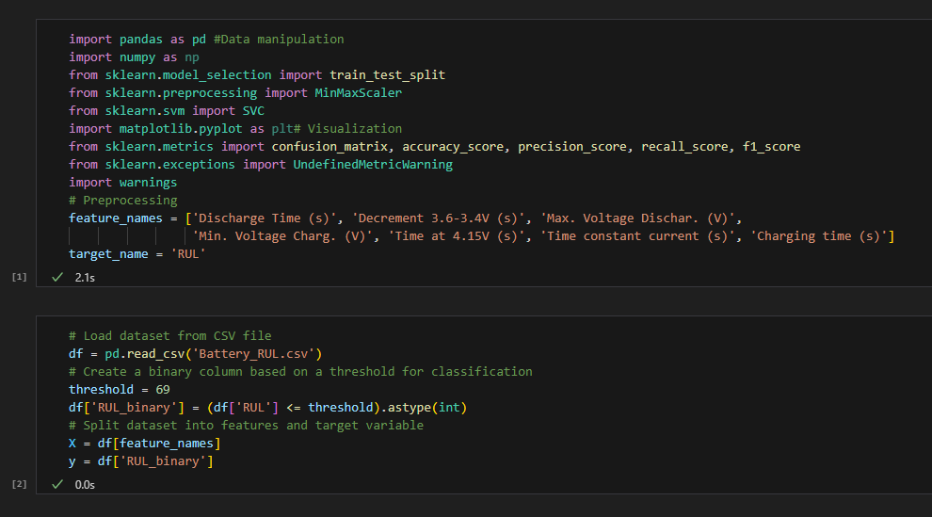
The code and the output of svm classification

Slide 13
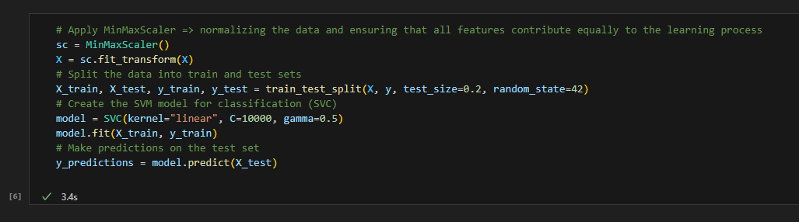
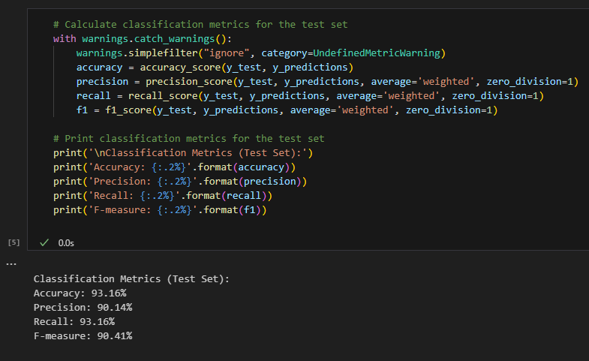

Slide 14
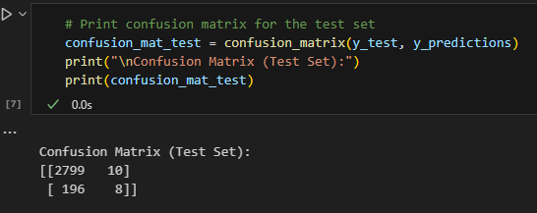

Slide 15
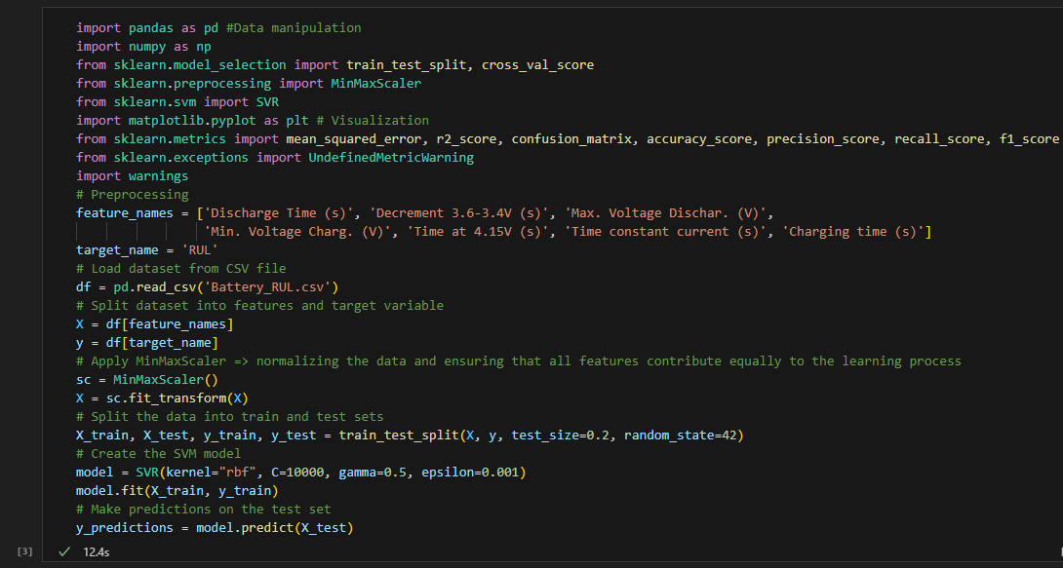
The code and the output of svm regression

Slide 16
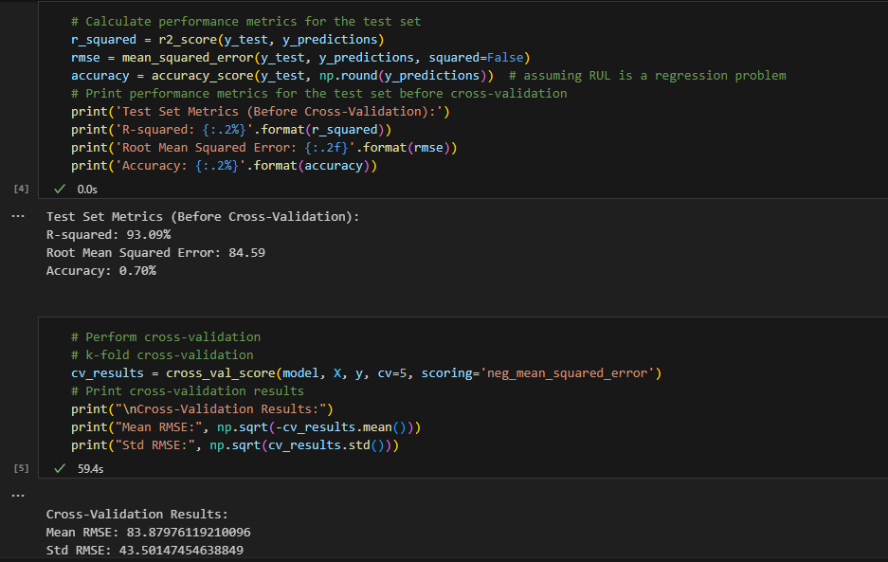

Slide 17
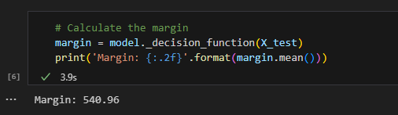
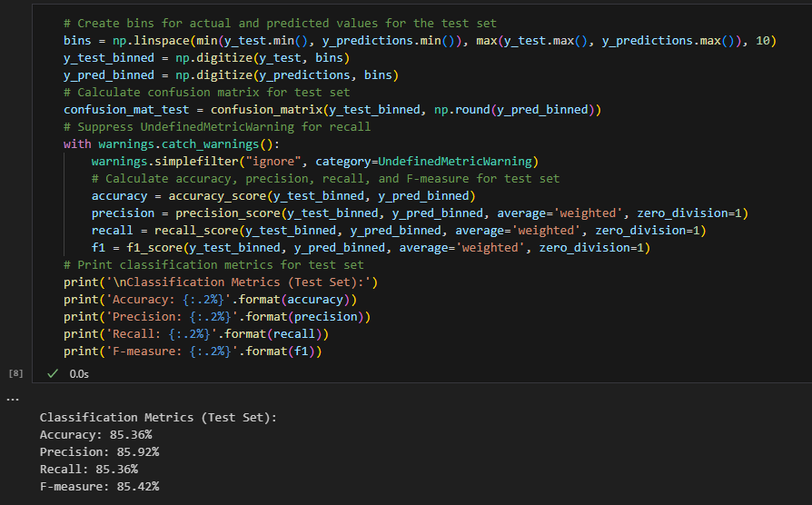

Slide 18
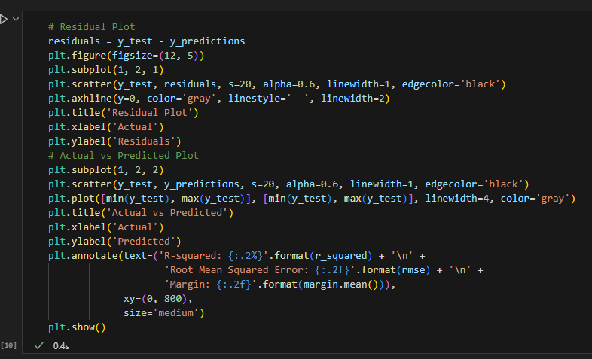
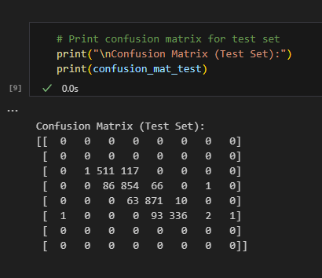

Slide 19
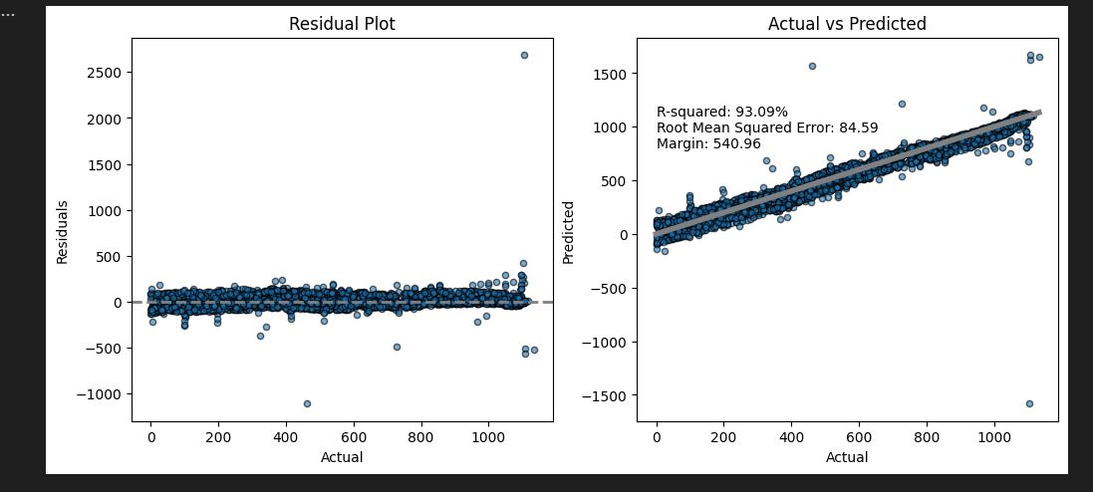

Slide 20
Linear Regression (LR)
Linear Regression (LR) is a simple yet powerful supervised machine learning algorithm used for predicting a continuous outcome variable (also called the dependent variable) based on one or more predictor variables (independent variables). Here's an overview of how linear regression works
Linear regression establishes a linear relationship between the input features and the target variable. The goal is to find the best-fitting line that minimizes the sum of the squared differences between the observed and predicted values.

Slide 21
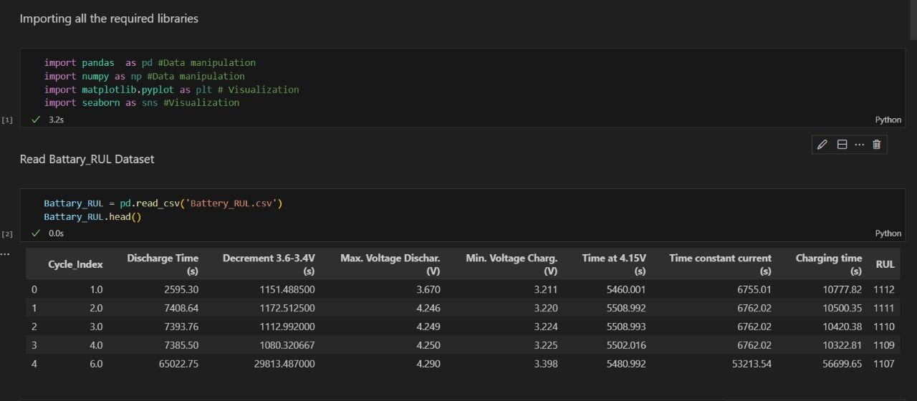
The code and the output of linear regression

Slide 22
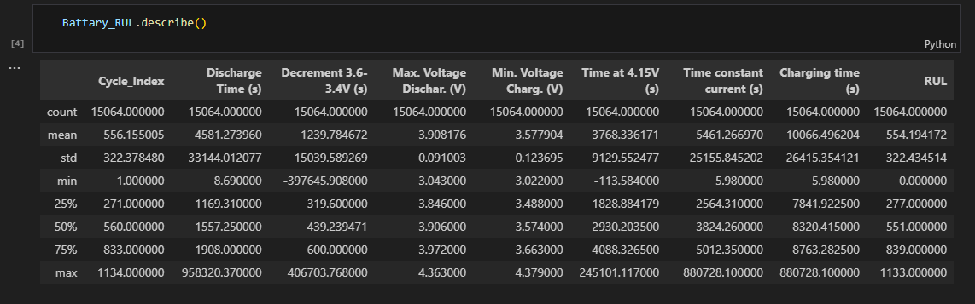
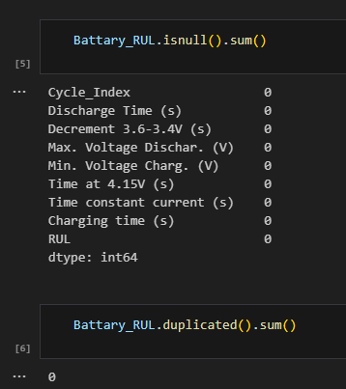

Slide 23

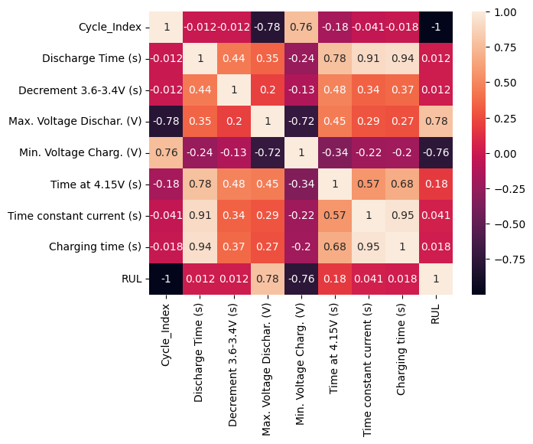

Slide 24
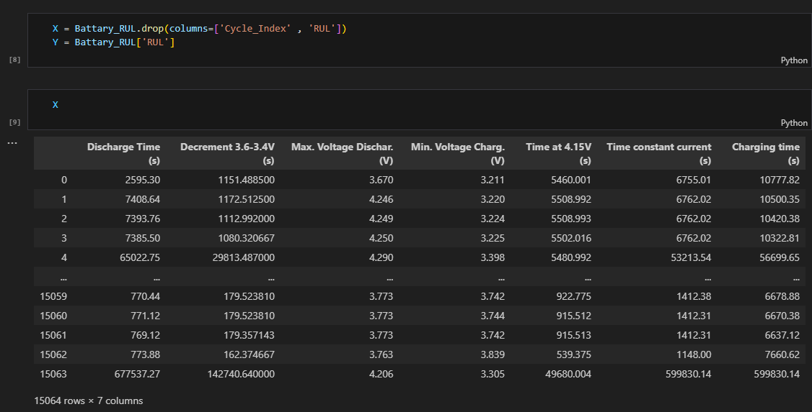

Slide 25
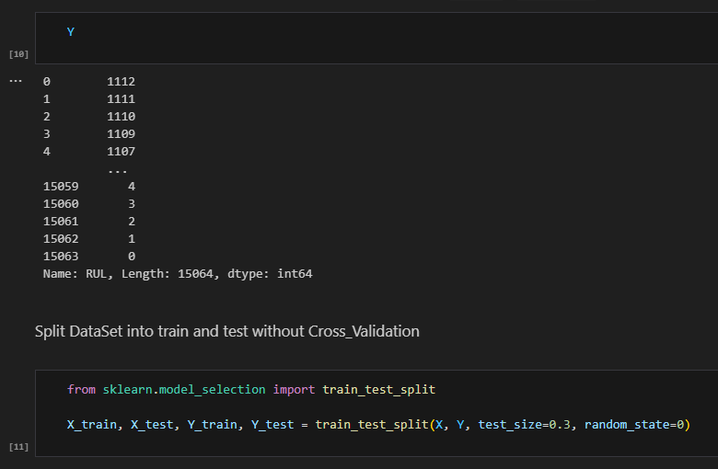
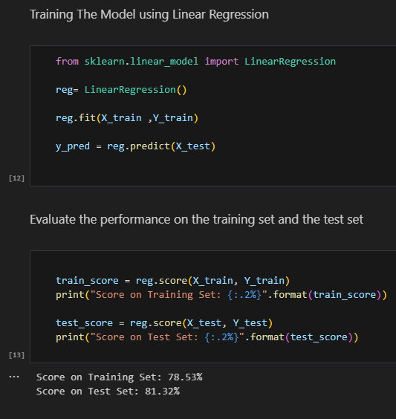
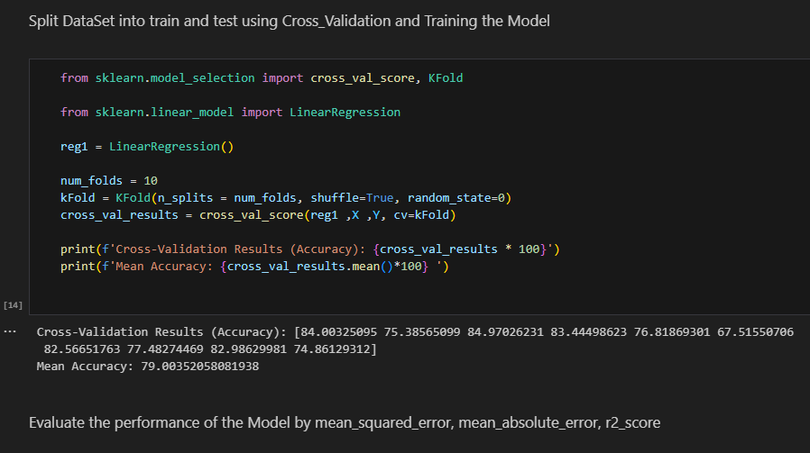

Slide 26
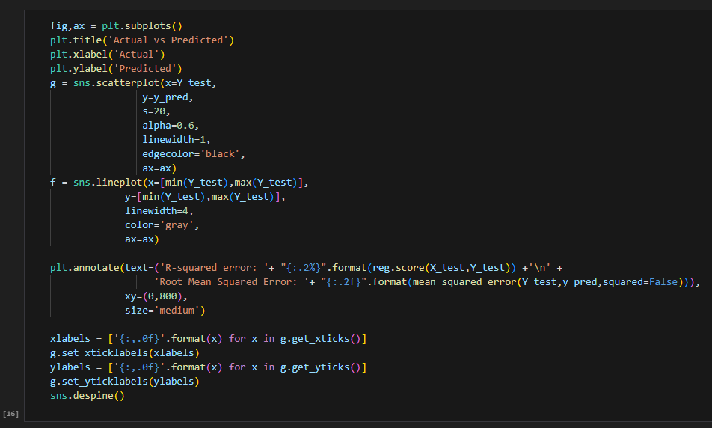
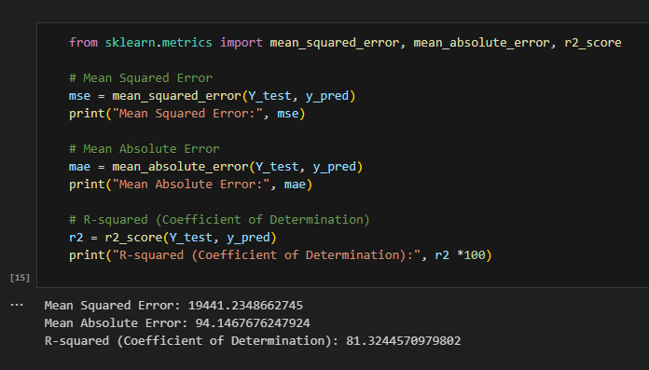

Slide 27
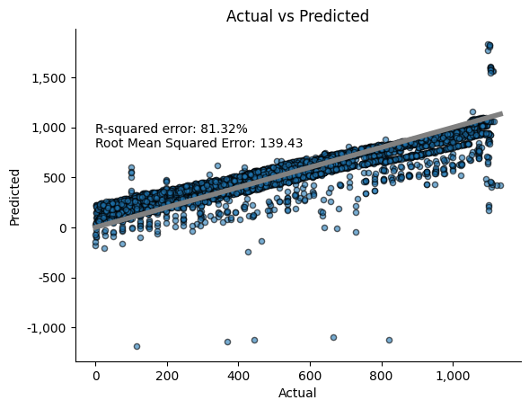

Slide 28
Decision tree classification
Decision Tree Classification is a popular supervised machine learning algorithm used for both classification and regression tasks. Here, I'll focus on Decision Trees for classification.
A Decision Tree is a tree-like model where each node represents a decision based on the value of a particular feature. It recursively splits the dataset into subsets based on the features that best separate the classes.

Slide 29
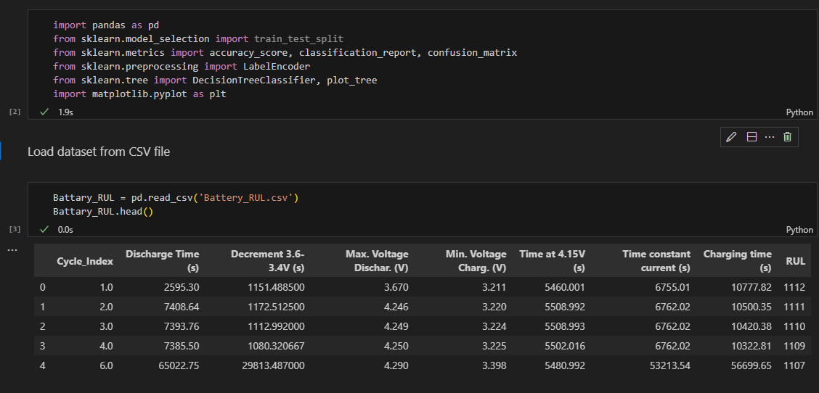
The code and the output of decision tree classification

Slide 30
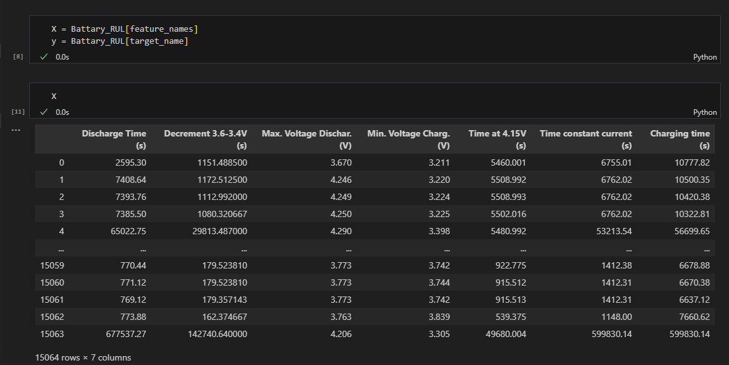
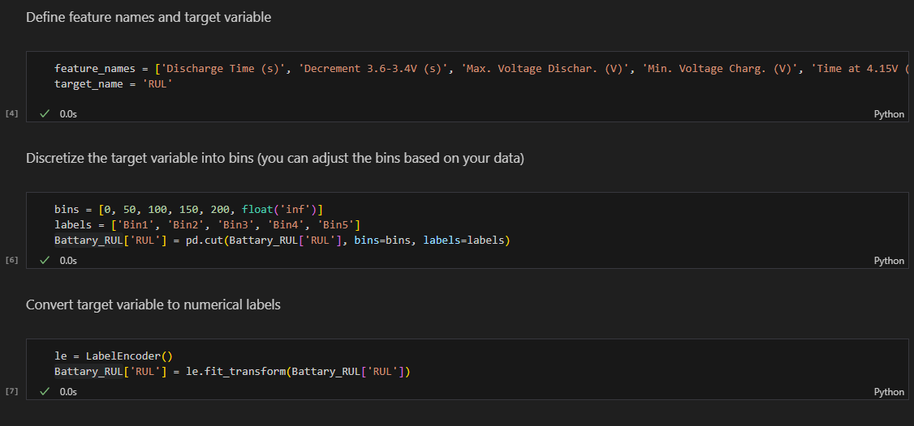

Slide 31
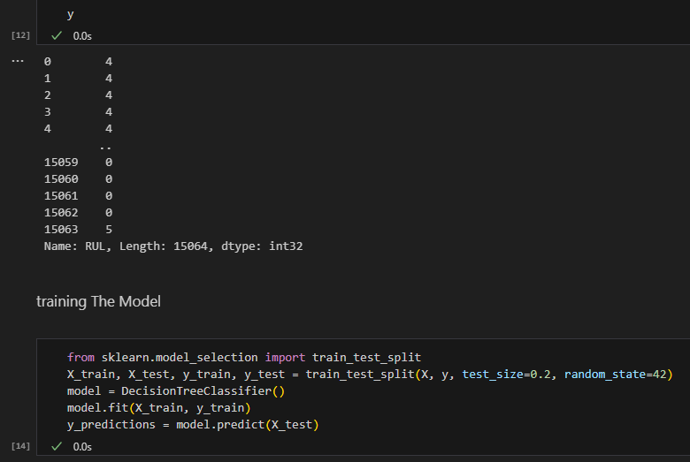

Slide 32
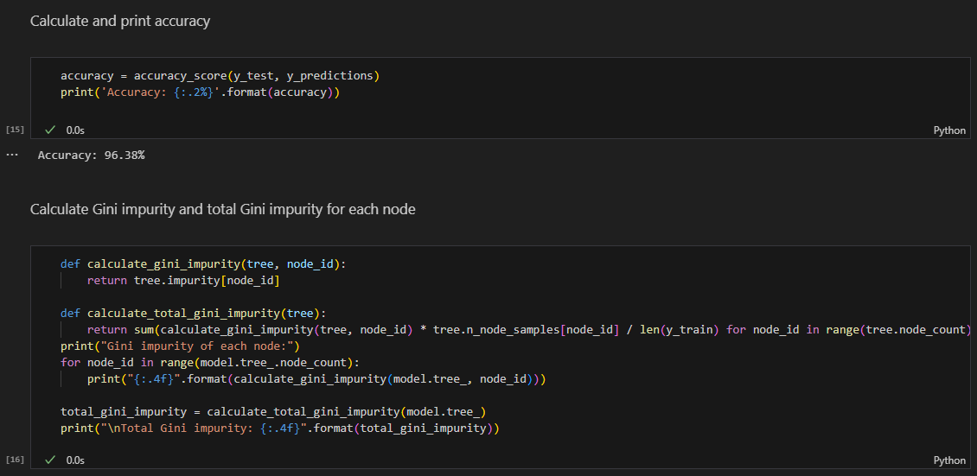
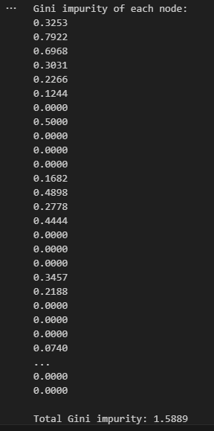

Slide 33
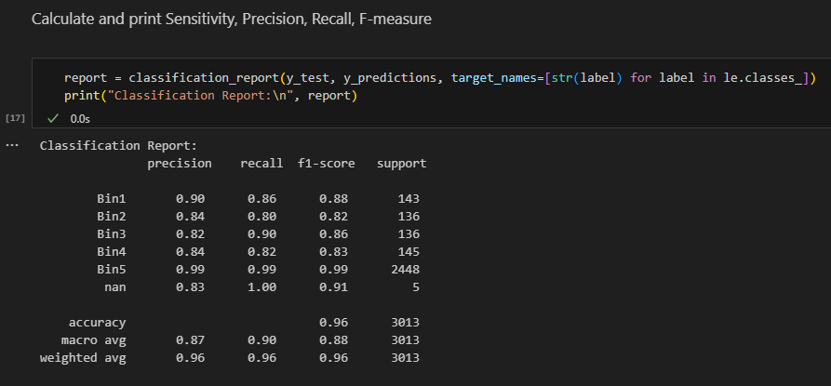
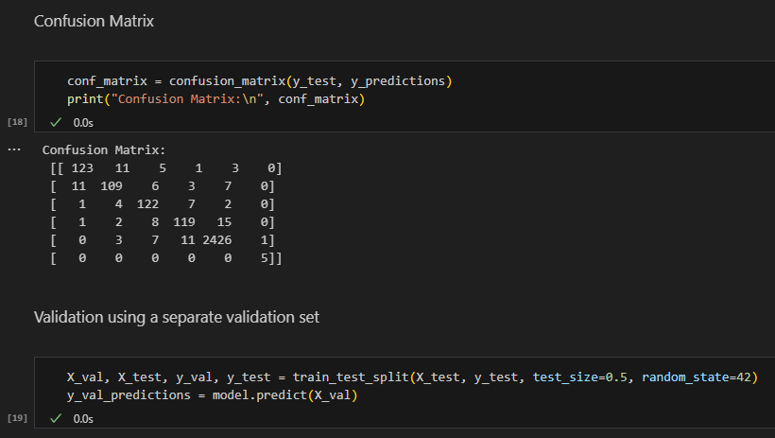

Slide 34
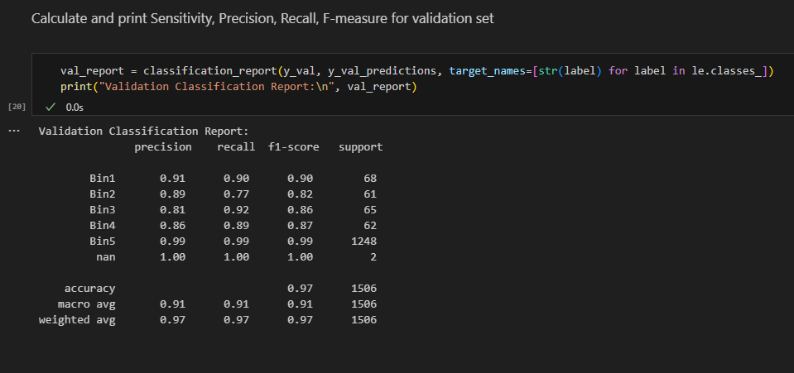
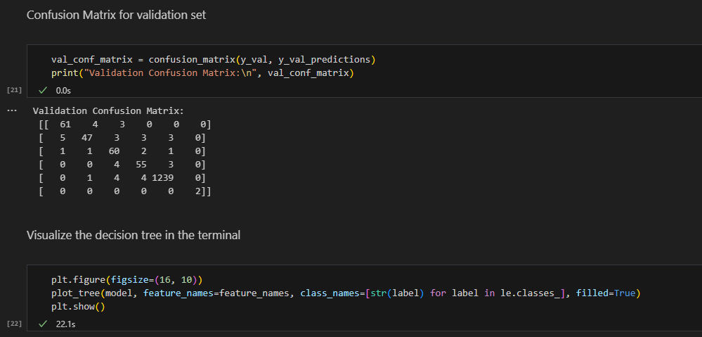

Slide 35
Decision tree regression
Decision Tree Regression involves creating a tree-like model that predicts the target variable based on the input features. In the case of regression, the predicted output is a continuous value rather than a class label.
To make a prediction for a new sample, it traverses the tree from the root to a leaf node based on the feature values of the sample.
The predicted value for the sample is the average target value of the training samples in the leaf node.

Slide 36
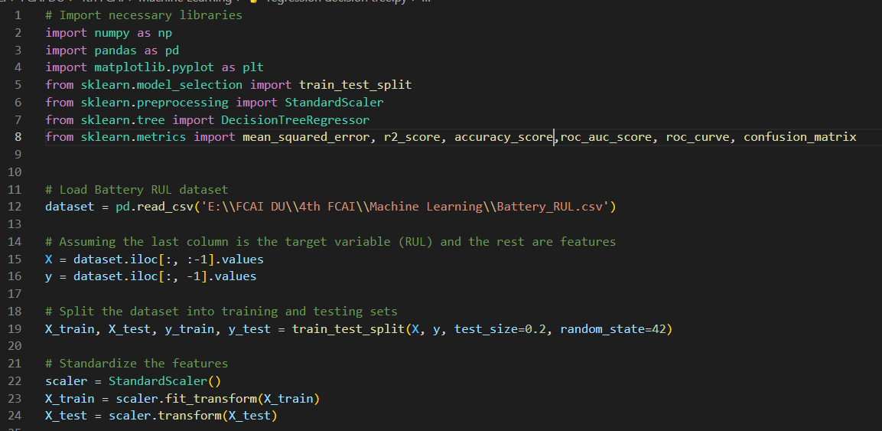
The code

Slide 37
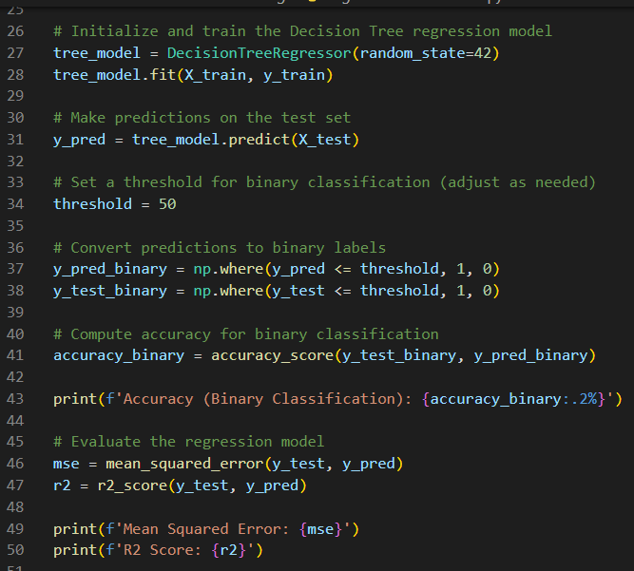
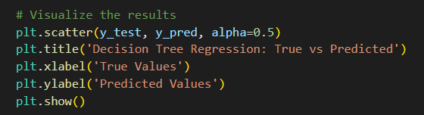

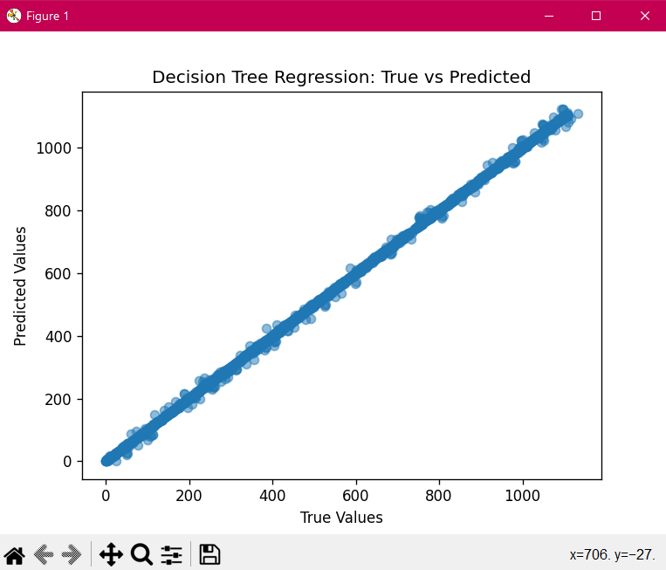
The code

Slide 38
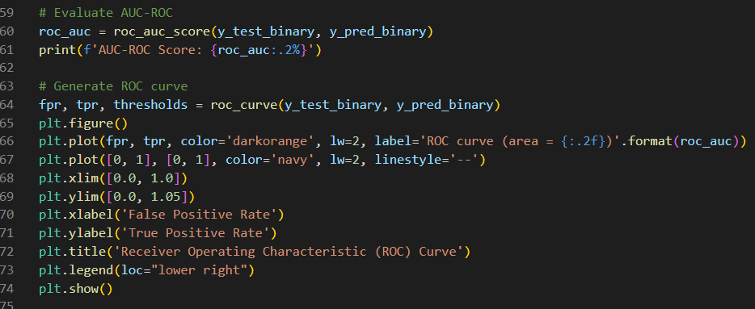
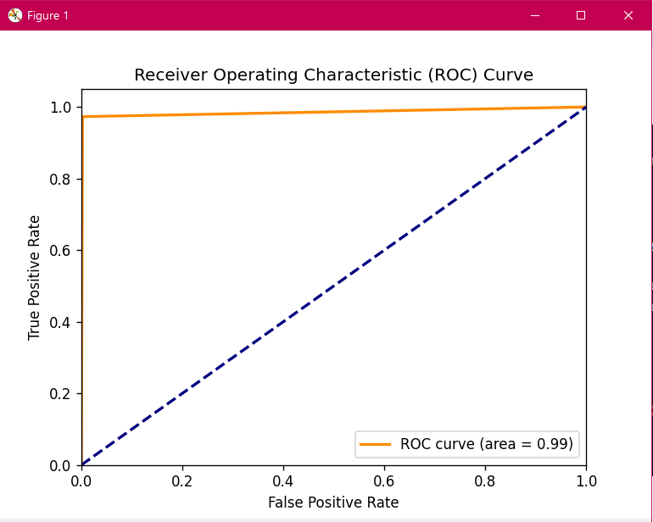

The code

Slide 39
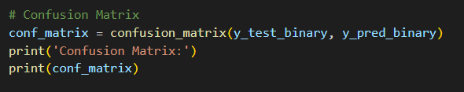

The code

Slide 40
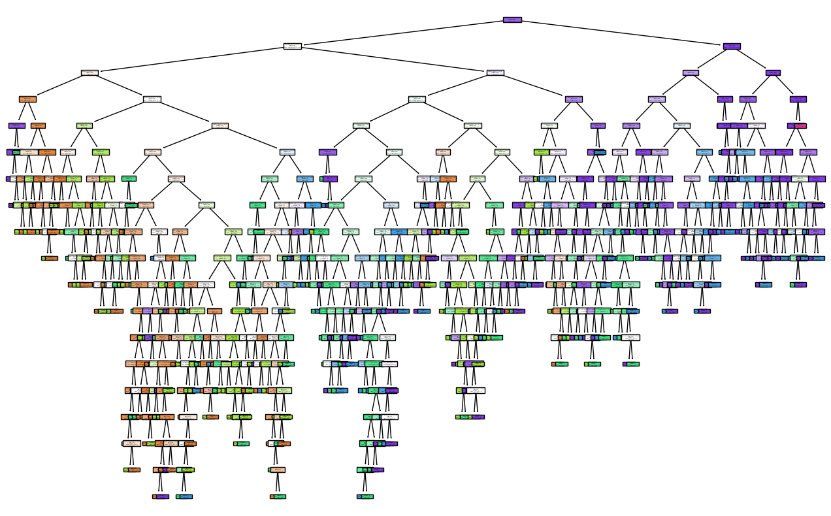

Slide 41
RANDOM FOREST
Random Forest is an ensemble learning method based on decision tree classifiers. It is used for both classification and regression tasks, and it builds multiple decision trees during training to improve the overall accuracy and control overfitting. Here's an overview of how Random Forest works:
Random Forest builds a "forest" of decision trees and merges their predictions to achieve better accuracy and robustness compared to individual trees.

Slide 42
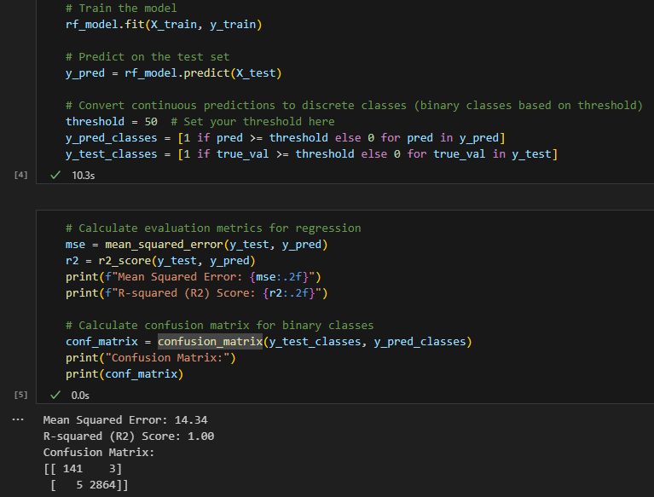
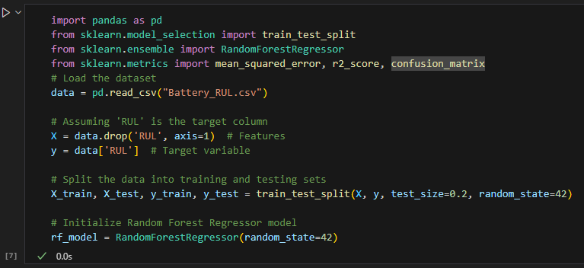
The code and the output of random foreast

Slide 43



Slide 44
DECISION TREE REGRESSION
Decision Tree Regression is a variant of the decision tree algorithm used for regression tasks. While traditional decision trees are designed for classification problems, decision tree regression predicts a continuous target variable rather than a categorical one. Here's an overview of how Decision Tree Regression works
Decision Tree Regression models the relationship between input features and a continuous target variable by recursively partitioning the data into subsets and assigning a constant value (usually the mean) to each subset.

Slide 45

team
Rewan ahmed ABD-ELGHFAR
SARA ABD ELKADER MOHAMED
AYA SABRY EL SORADY
ALAA ATEF SAFAN
MARYAM GAMAL DAWOOD
OMNYA MOHAMEDMNEGM

Slide 46
THANK YOU

