Slide 1
Heart Diseases Prediction

Slide 2
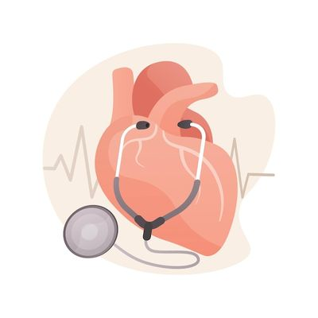
Agenda
Heart Diseases overview
Dataset creation
Algorithms used
Output

Slide 3
Heart Diseases Overview
In the last few years the world has witnessed substantial increase in heart diseases spread
AI and pattern recognition can be used to detect and predict diseases in general and are useful in medical field

Slide 4
Dataset GUI Code

Slide 5
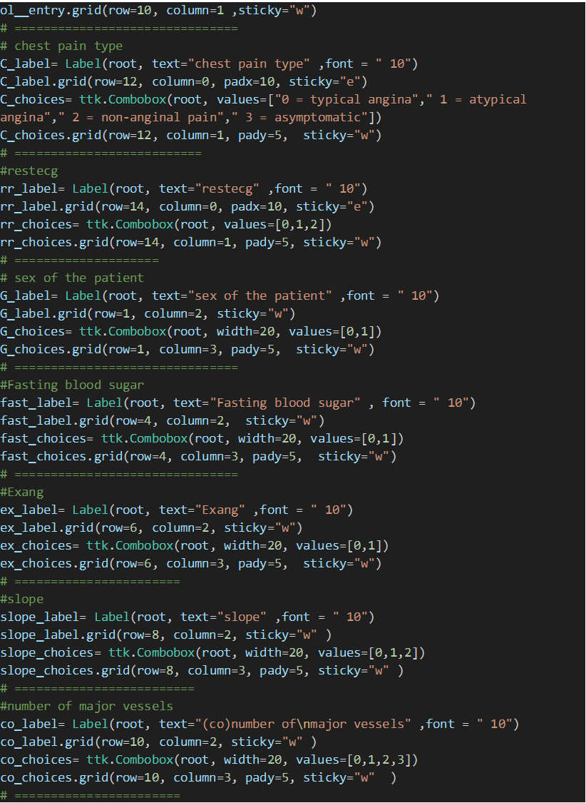

Slide 6
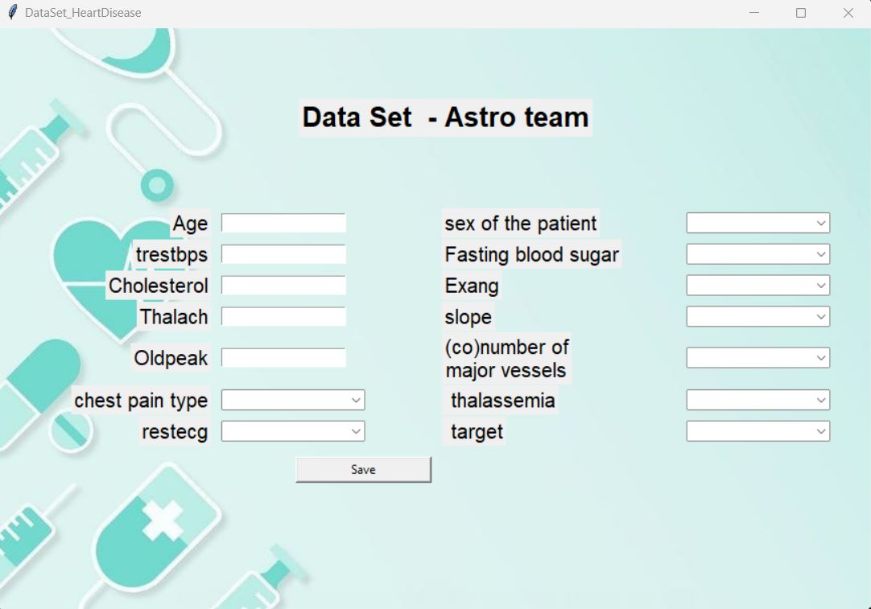
Dataset GUI
We created the dataset GUI. The doctor enters the patient data including if he has heart disease or not.

Slide 7
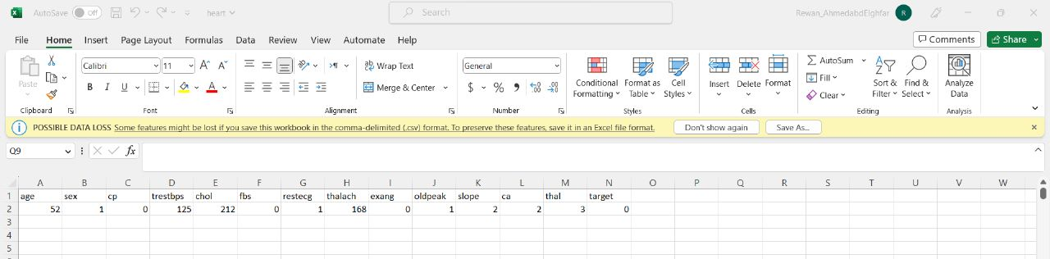
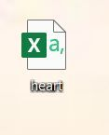
The creation of dataset

Slide 8
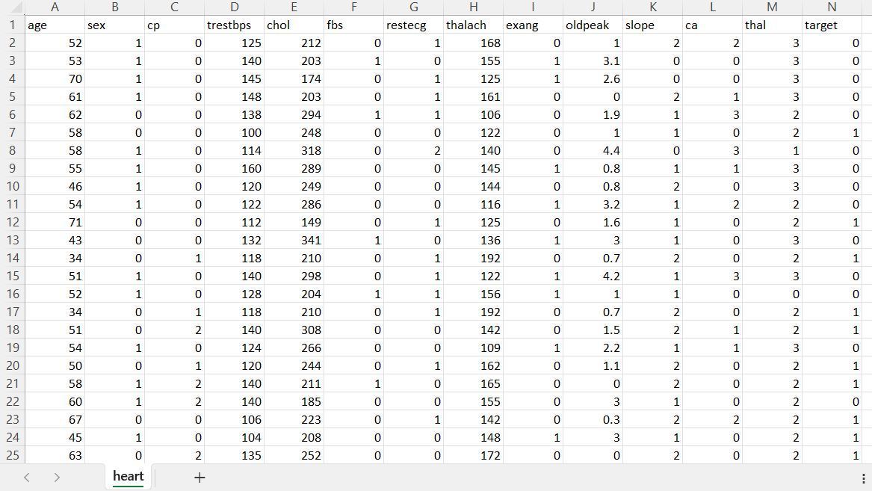

Slide 9
NAÏVE BAYES
Define a function to load the heart disease
01
Define a function to split the data into training and test sets
02
function to summarize the data by calculating the mean and standard deviation of each feature.
03
calculate probability and update class
04
calculate the accuracy of the model
05

Slide 10
NAÏVE BAYES CODE

Slide 11



Slide 12
SVM
Import the dataset
01
Explore the data to figure out what they look like
02
Pre-process the data
03
Divide the data into training and testing sets
05
Train the SVM algorithm
06
Spilt the data into attributes and labels
04
Make some predictions
07
Evaluate the result of the algorithm
08

Slide 13
SVM CODE

Slide 14


Slide 15
Logistic regression

Slide 16
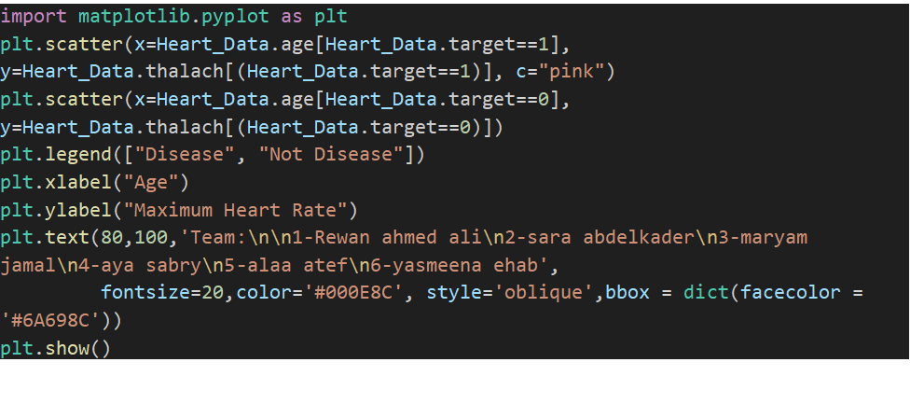
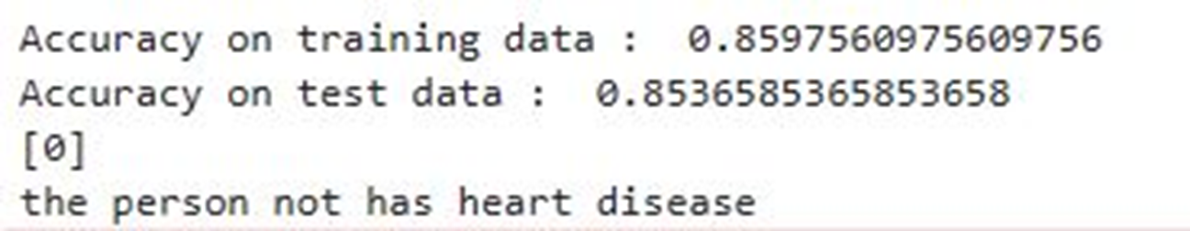
The Output

Slide 17
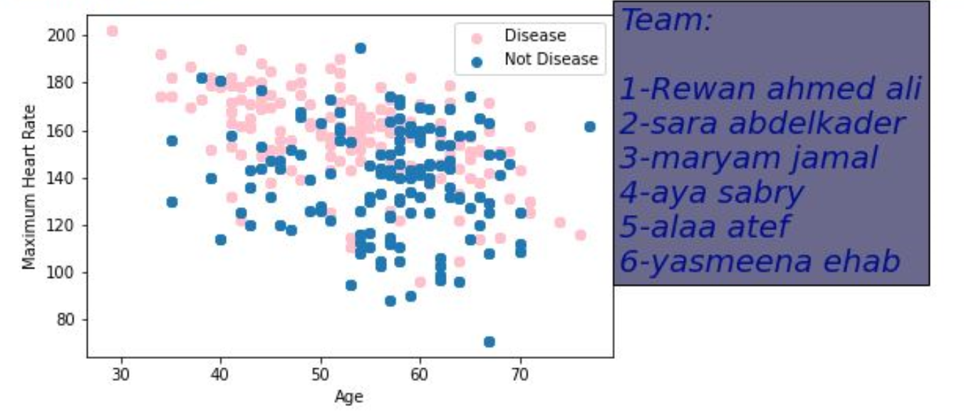

Slide 18
Summary
We created a heart disease system using 3 kinds of algorithm
First one was naive Bayes the accuracy was 0.82%
Then the logistic regression with accuracy 0.85% which is more accurate
Second one is SVM with accuracy 0.81%

Slide 19
Team
1- Rewan Ahmed Ali
2- Sara Abdelkader
3- Mariam Jamal
4- Aya Sabry
5- Alaa Atef
6- Yasmeena Ehab

Slide 20
Thank you

