Slide 1
Visualization of Bubble sort

Slide 2
The Algorithm used:
Bubble Sort:
works by repeatedly swapping the adjacent elements if they are in the wrong order.
If list[j] is greater than list[j+1] then swap these adjacent elements, else move on

Slide 3
The analysis of bubble sort
Worst and Average Case Time Complexity: O(N)².
The worst case occurs when an array is reverse sorted.
Best Case Time Complexity: O(N).
The best case occurs when an array is already sorted

Slide 4
The libraries we used
Tkinter as tk: for making GUI and button
Datetime: for calculating algorithm implementation
Random: used to return a random number between a range

Slide 5

The description
We used tkinter library to represent bubble sort algorithm in graphical GUI
We used canvas widget to make a window and to create the bars
Datetime library for calculating the required time for implementing the algorithm
names() is function to display the team members names on window
Complexity() is function to display the time complexity on window
Swap() is function to replace the bars position
Build() is function to build the length list that the bars length will be inserted and identify the maximum and minimum bars

Slide 6
The description
Bubble_sort() is to sort by swapping between bars by using nested for loop
Animate() is to show the movement of sorting bars
Counter() is to count while sorting until the all bars are sorted.
Counting_command() to make the bubble sort algorithm, the timer and the fast button to start the sorting without using timer.

Slide 7
The time complIxity is O(n²)

Slide 8
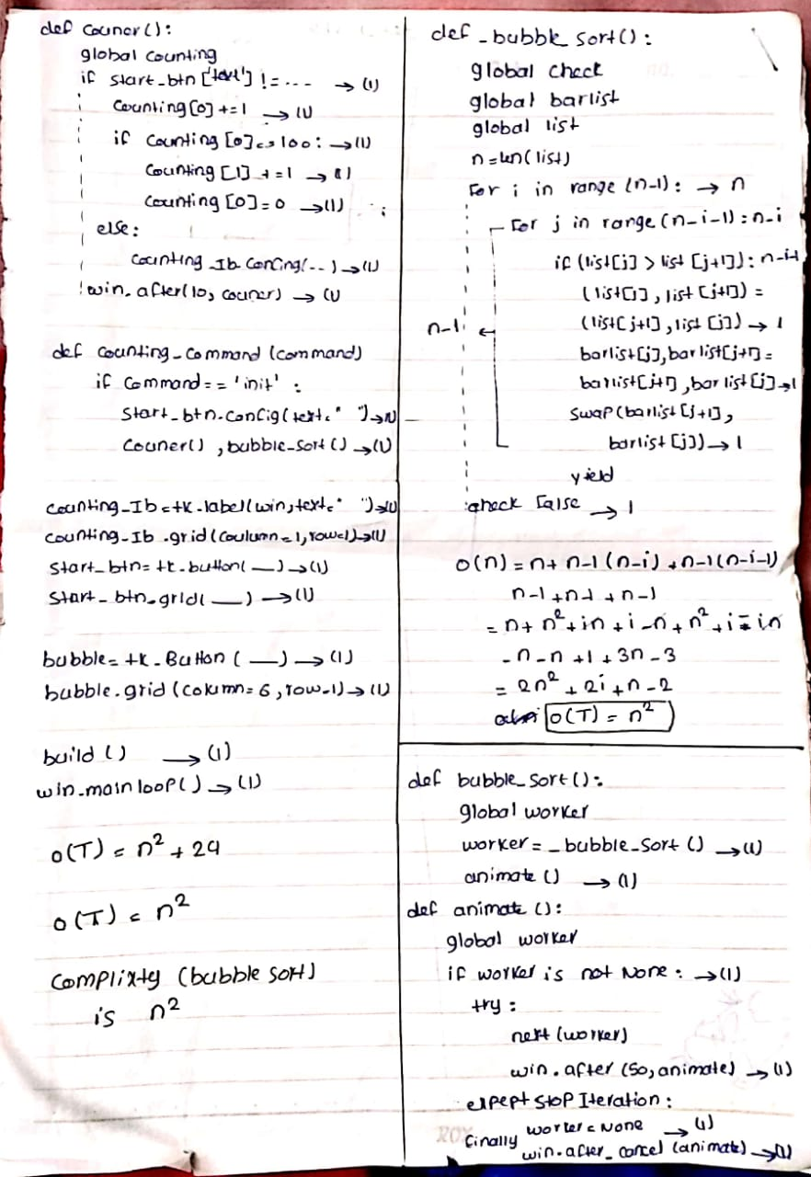
Calculating the time complIxity

Slide 9
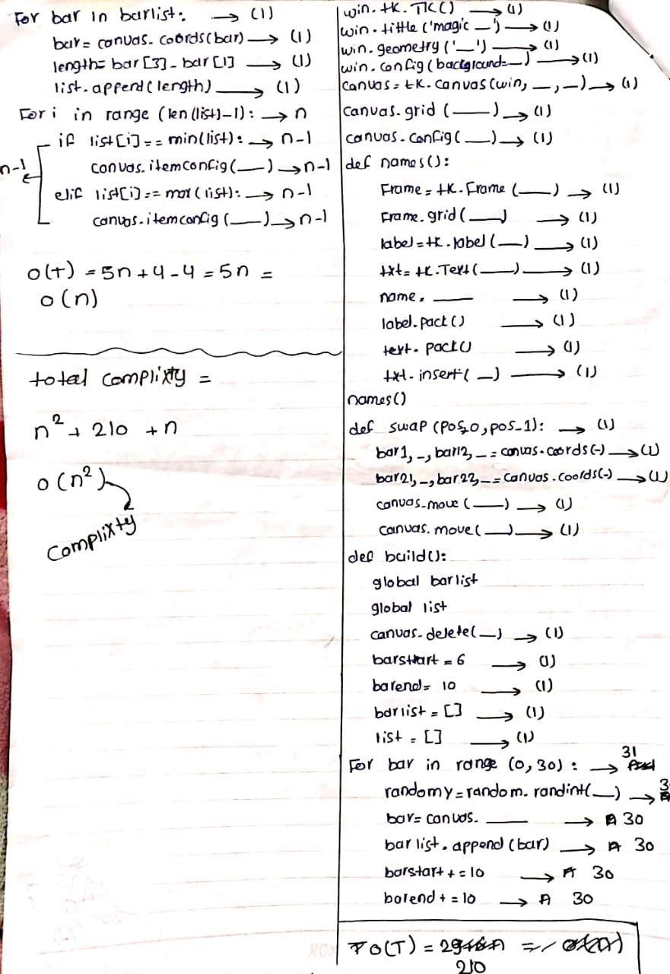
Calculating the time complIxity

Slide 10
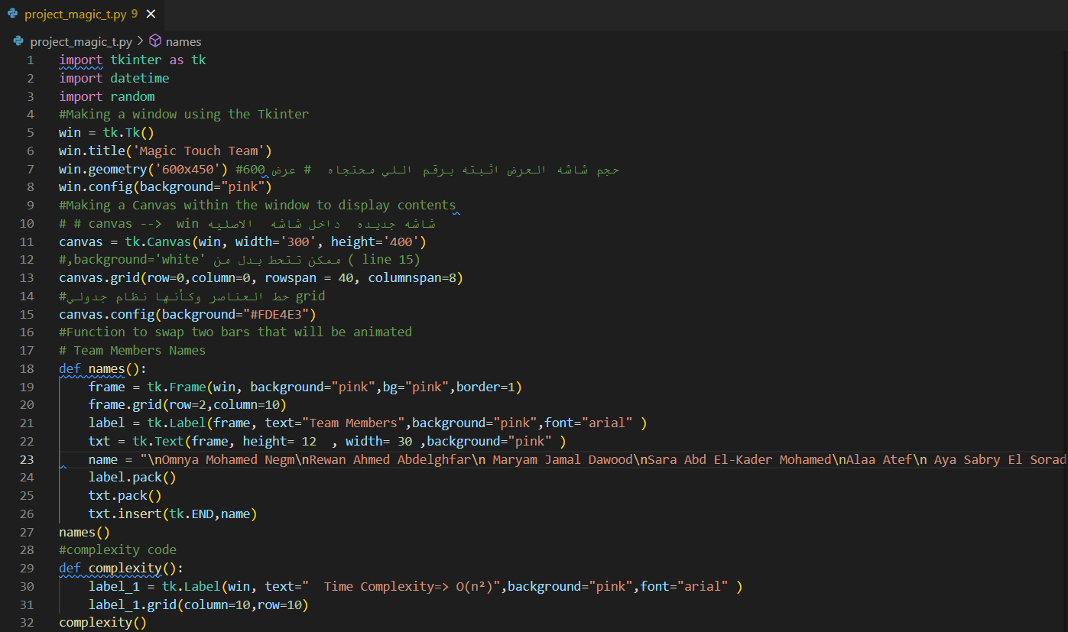
The code

Slide 11
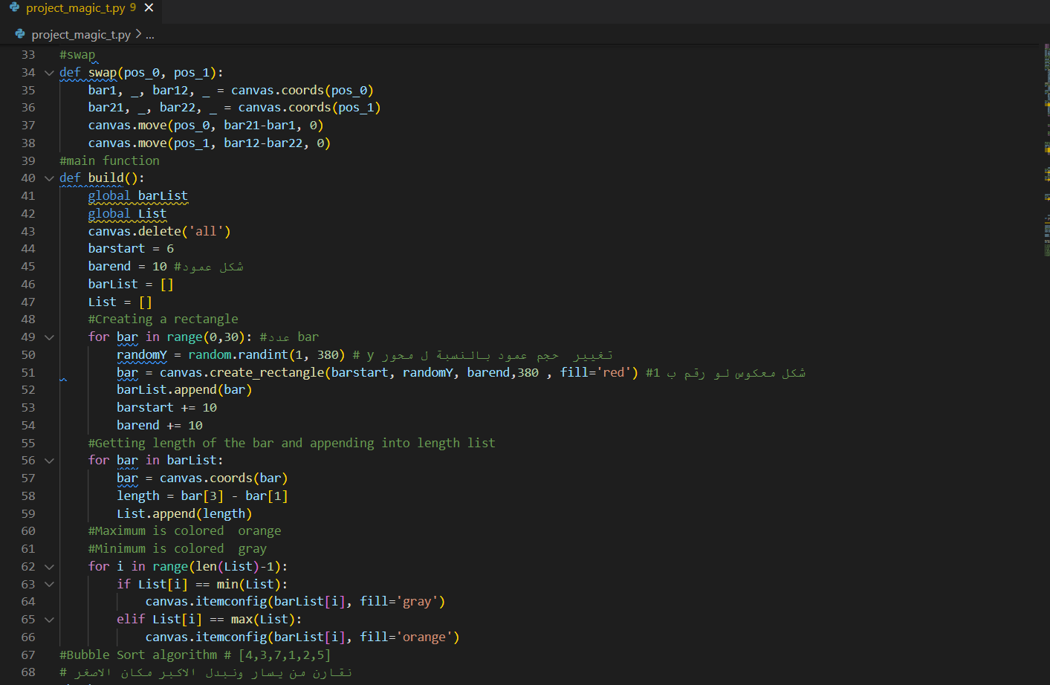

Slide 12
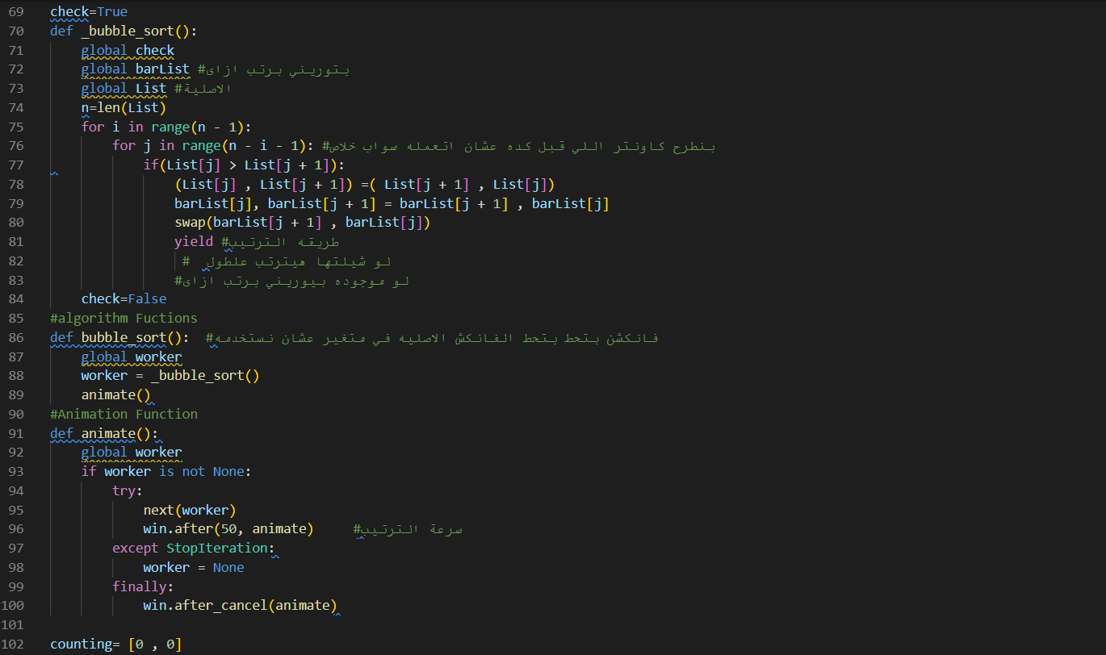

Slide 13
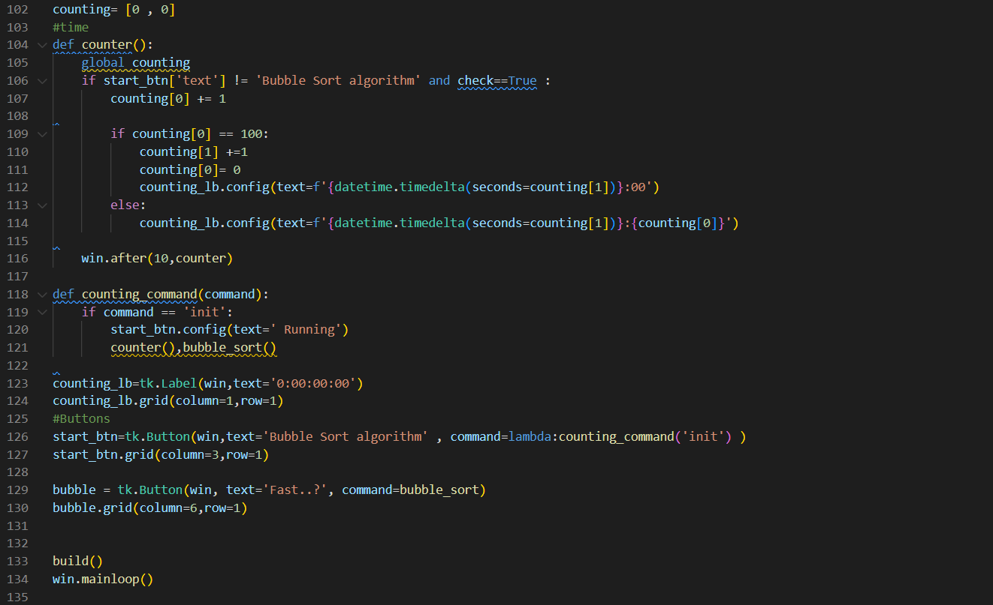

Slide 14
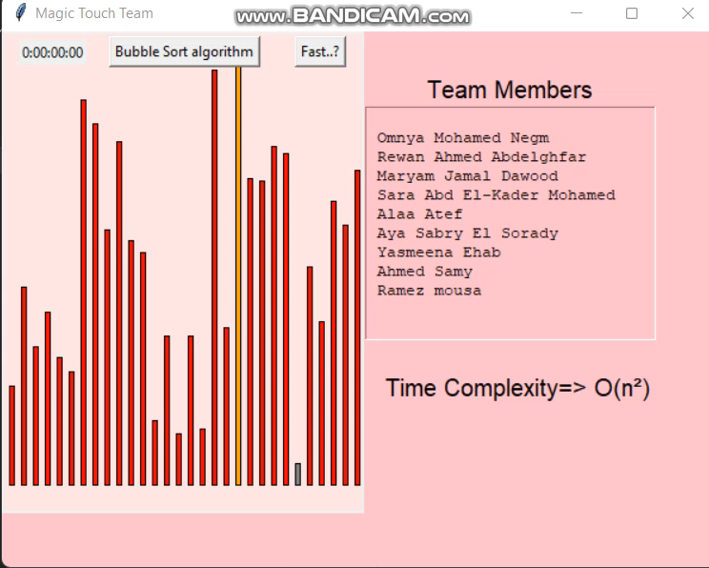
Bubble Sort Algorithm

Slide 15
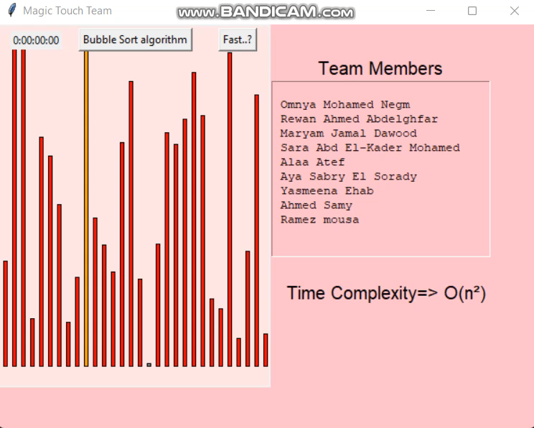
Sort without
using timer

Slide 16
Team members:
CS:. IS:
Rawan Ahmed AbdElghfar Omnia Mohamed Negm
Sara Abd Elkader mohamed
Aya Sabry El Sorady
Maryam Jamal Dawood
Alaa Atef
Yasmeena Ehab
Ahmed Samy
Ramez Mousa

