Slide 1

Review of Statistical Concepts and Problem Set Requirements & Tips TA: Xingruo (Summer) Zhang September 2023

Slide 2
Contents
Course Requirements
Interaction Effects
Likelihood Ratio Test

Slide 3
Contents
Course Requirements
Interaction Effects
Likelihood Ratio Test

Slide 4
Course Requirements
This is a graduate-level class. Previous knowledge of multiple linear regression (MLR) and generalized linear model (GLM), and some coding experience, are assumed.
Concepts like logistic regression and conditional probabilities will only be briefly covered in this class.
Use of STATA is required for this class. If you cannot use STATA for any reason, email Don and/or me.
Using Excel for plots are okay, but I CANNOT give you partial credits if the plots are wrong.
Communication
We encourage you to use Ed Discussion, and I will be checking the forum daily.
Please include me in all communication regarding problem sets.
Please allow 24hr response time on weekdays and 48hrs on weekends.
Last-minute questions are strongly discouraged.
Notes:
Don’t freak out if you have never used STATA before, I am always here as a resource if you have any coding-specific problem. The purpose of this class is not to learn STATA coding after all. We require you to use STATA because it is a commercial software, so everything is very standardized. There are many packages in R that does the same thing, but the syntax and logic behind them are all different. Not all the packages have the same functionalities, so it is very likely that you cannot do everything that the problem sets required just using one package.

Slide 5
Attendance is REQUIRED!!!
Notes:
Don’t freak out if you have never used STATA before, I am always here as a resource if you have any coding-specific problem. The purpose of this class is not to learn STATA coding after all. We require you to use STATA because it is a commercial software, so everything is very standardized. There are many packages in R that does the same thing, but the syntax and logic behind them are all different. Not all the packages have the same functionalities, so it is very likely that you cannot do everything that the problem sets required just using one package.

Slide 6
Purposes of Problem Sets
You can consider these problem sets as mini data analysis projects.
There might be more than one approach towards the same question. So, you need to use your thinking as a statistician to make the decision.
My grading will focus on pointing you towards the right direction for the next time, not punishing you.
Missing parts: -1 ~ 2/part; Major point: -0.5; Minor point: - 0.25
You can still get an A if you miss a few points in the problem sets.

Slide 7
Problem Set Requirements
One PDF
no do file or log file needed
If you are explaining the same thing multiple times, please be consistent everywhere
Otherwise, points will still be deducted for any wrong answer(s) included
Answer to each part of the questions should be clearly labeled
Codes and STATA outputs attached where they are referenced (not at the end of the document)
Use “Courier New” font for code and output if you copy-paste code and STATA output
Starting from problem set 2
I will deduct a maximum of 3 points if I find the submission extremely hard to understand
E.g. no code, a cluster of screenshots without explanation what they refer to
Notes:
Don’t freak out if you have never used STATA before, I am always here as a resource if you have any coding-specific problem. The purpose of this class is not to learn STATA coding after all. We require you to use STATA because it is a commercial software, so everything is very standardized. There are many packages in R that does the same thing, but the syntax and logic behind them are all different. Not all the packages have the same functionalities, so it is very likely that you cannot do everything that the problem sets required just using one package.

Slide 8
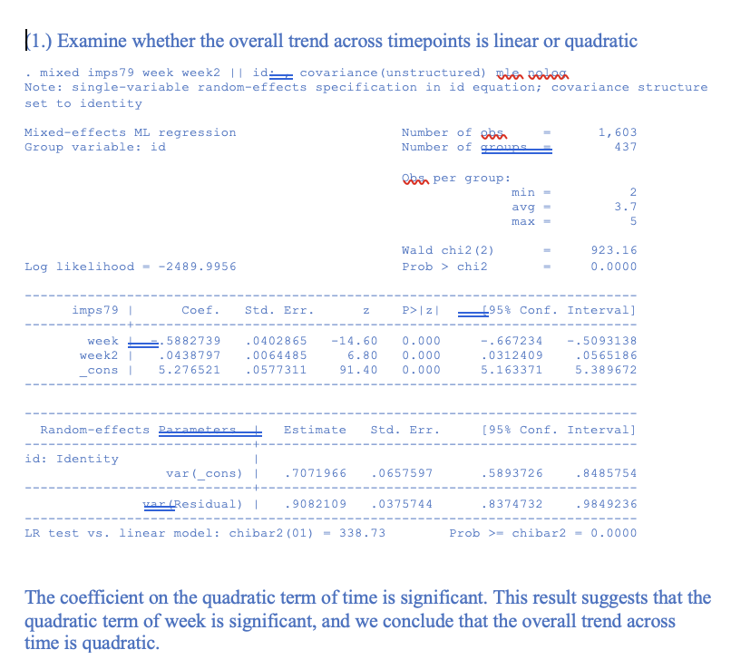
* This is an example for formatting, not a suggested answer to any problem on the problem set
code here
STATA output here
Interpretation/Answer to question here

Slide 9
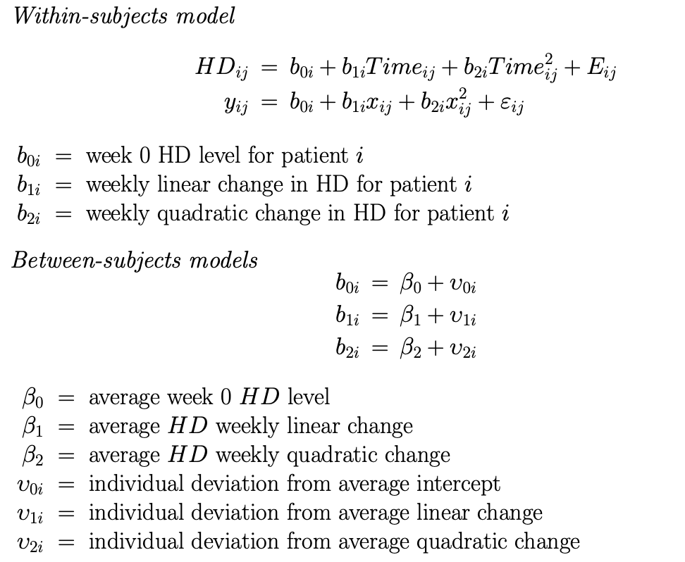
When you are asked to "write down the model", please interpret each parameter/parameter estimate.
Example

Slide 10
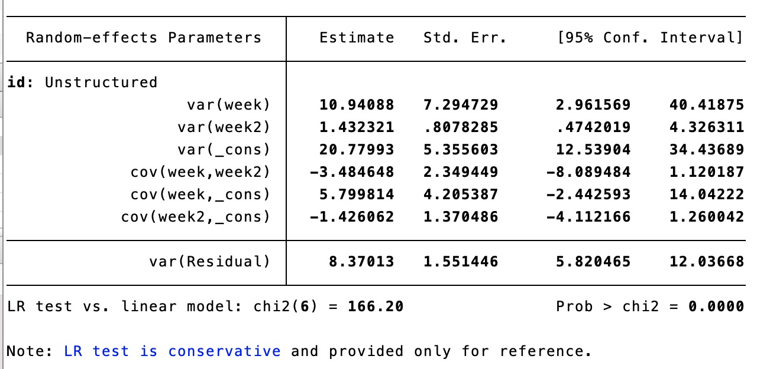
Interpretation of STATA Output of Random Effects
These are the estimated variances of the random effects, not the random effects themselves.

Slide 11
Contents
Course Requirements
Interaction Effects
Likelihood Ratio Test
Material from: https://www.medicine.mcgill.ca/epidemiology/joseph/courses/EPIB-621/interaction.pdf

Slide 12
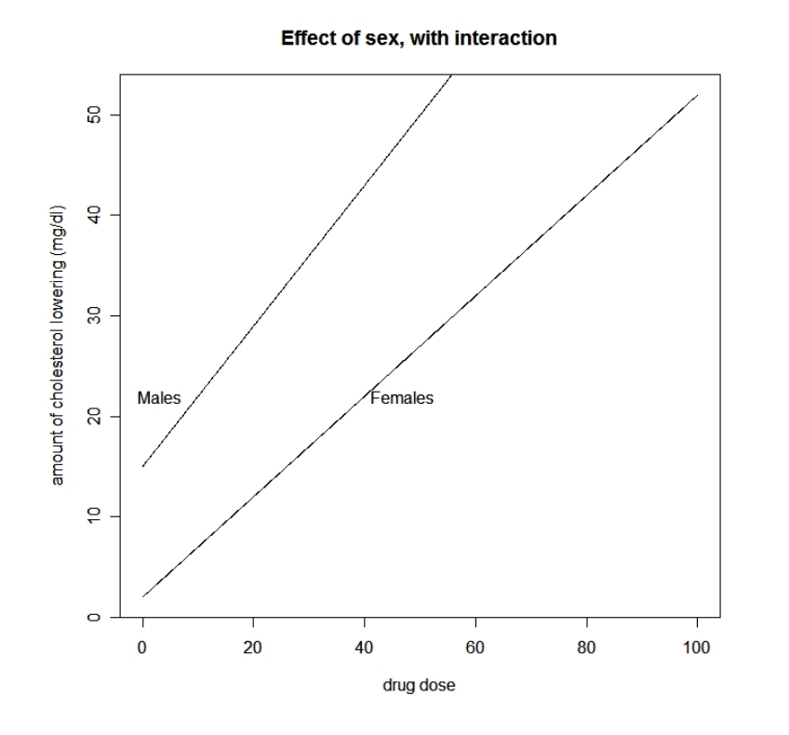
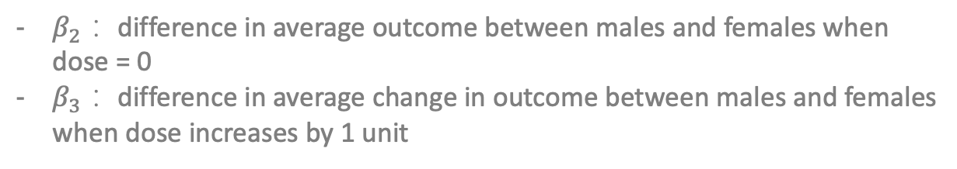
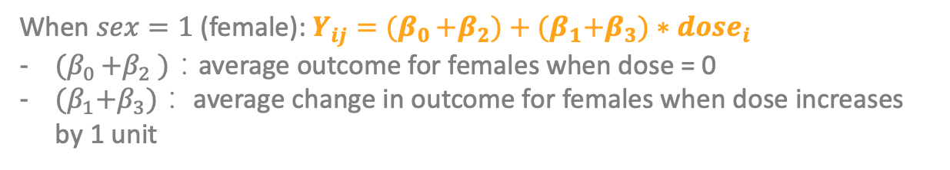
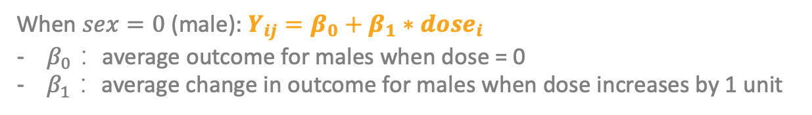
Interaction – Categorical * Continuous
$$E(Y_{i})=β_{0}+β_{1}∗dose_{i}+β_{2}∗sex_{i}+β_{3}∗dose_{i}∗sex_{i}$$
When $sex=0$(male): $Y_{ij}=β_{0}+β_{1}∗dose_{i}$
$β_{0}$： average outcome for males when dose = 0
$β_{1}$： average change in outcome for males when dose increases by 1 unit
When $sex=1$(female): $Y_{ij}={(β}_{0 }+β_{2})+{(β}_{1}+β_{3})∗dose_{i}$
${(β}_{0 }+β_{2} )$：average outcome for females when dose = 0
${(β}_{1}+β_{3})$： average change in outcome for females when dose increases by 1 unit
$β_{2}$： difference in average outcome between males and females when dose = 0
$β_{3}$： difference in average change in outcome between males and females when dose increases by 1 unit

Slide 13
Interaction – Rule of Thumb
Plug in covariate values to explore what each parameter represents!
* Covariate = predictor = independent variable = X

Slide 14
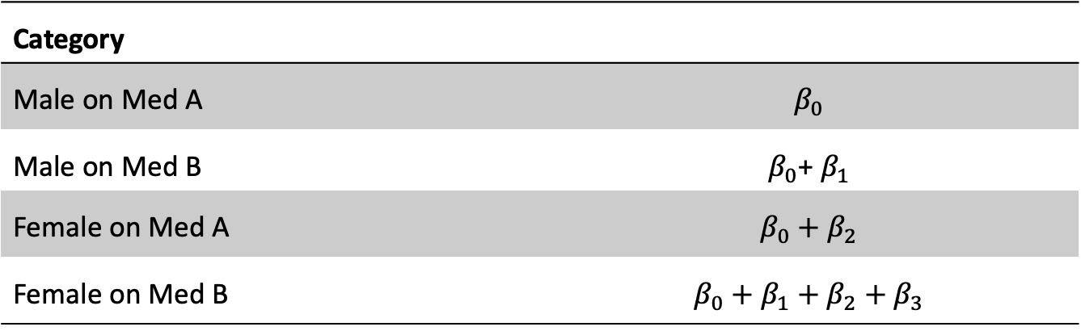
Interaction – Categorical * Categorical
$$E(Y_{i})=β_{0}+β_{1}∗medicine_{i}+β_{2}∗sex_{i}+β_{3}∗medicine_{i}∗sex_{i}$$
Category
Male on Med A | $$β_{0}$$
Male on Med B | $β_{0}$+ $β_{1}$
Female on Med A | $$β_{0}+β_{2}$$
Female on Med B | $$β_{0}+β_{1}+β_{2}+β_{3}$$

Slide 15
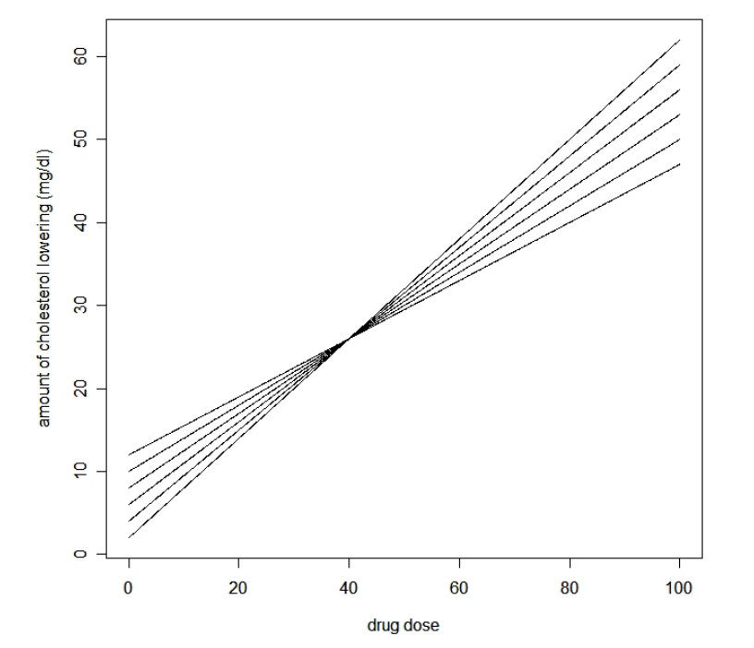
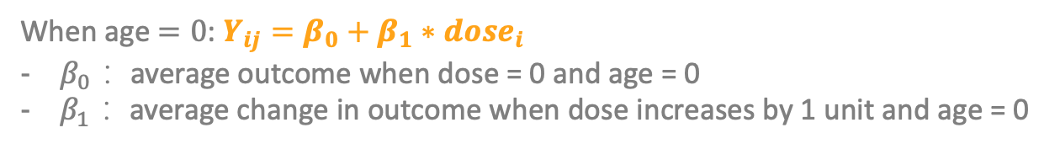
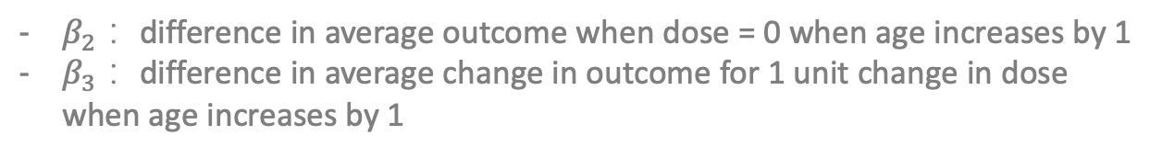
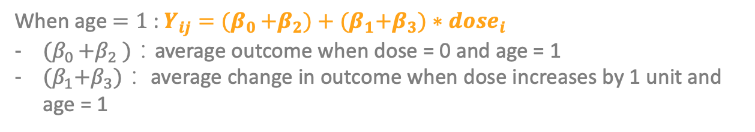
Interaction – Continuous * Continuous
$$E(Y_{i})=β_{0}+β_{1}∗dose_{i}+β_{2}∗age_{i}+β_{3}∗dose_{i}∗age_{i}$$
When age $=0$: $Y_{ij}=β_{0}+β_{1}∗dose_{i}$
$β_{0}$： average outcome when dose = 0 and age = 0
$β_{1}$： average change in outcome when dose increases by 1 unit and age = 0
When age $=1$: $Y_{ij}={(β}_{0 }+β_{2})+{(β}_{1}+β_{3})∗dose_{i}$
${(β}_{0 }+β_{2} )$：average outcome when dose = 0 and age = 1
${(β}_{1}+β_{3})$： average change in outcome when dose increases by 1 unit and age = 1
$β_{2}$： difference in average outcome when dose = 0 when age increases by 1
$β_{3}$： difference in average change in outcome for 1 unit change in dose when age increases by 1
* Can also be interpreted as the effect of on the effect of age, but less practical meaning here

Slide 16
Contents
Course Requirements
Interaction Effects
Likelihood Ratio Test

Slide 17
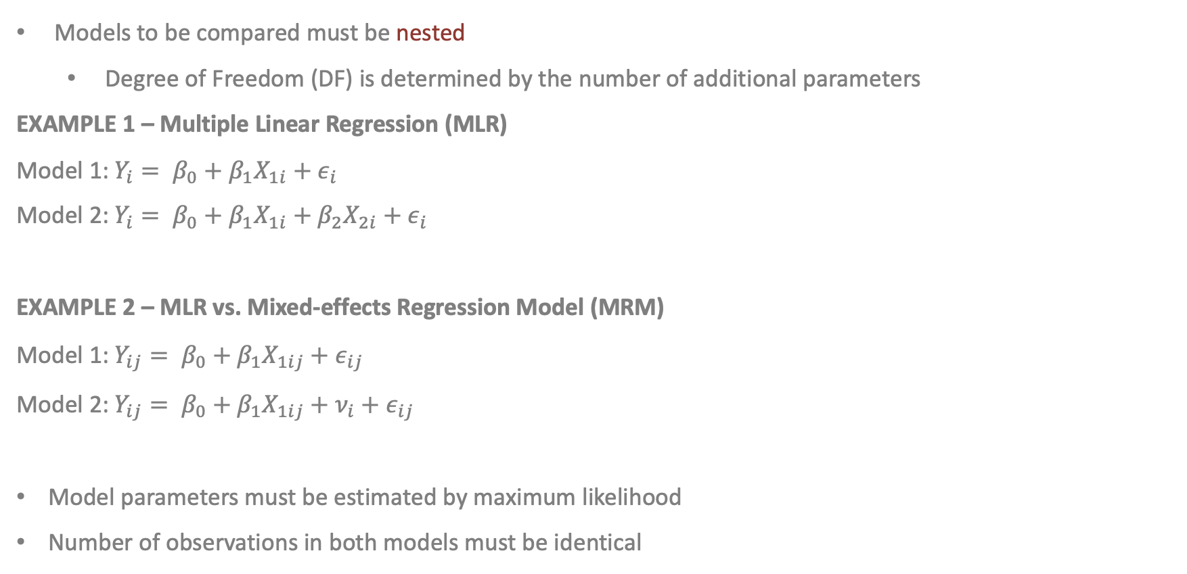
Likelihood Ratio Test
Models to be compared must be nested
Degree of Freedom (DF) is determined by the number of additional parameters
EXAMPLE 1 – Multiple Linear Regression (MLR)
Model 1: $Y_{i}= β_{0}+β_{1}X_{1i}+ε_{i}$
Model 2: $Y_{i}= β_{0}+β_{1}X_{1i}+β_{2}X_{2i}+ε_{i}$
EXAMPLE 2 – MLR vs. Mixed-effects Regression Model (MRM)
Model 1: $Y_{ij}= β_{0}+β_{1}X_{1ij}+ε_{ij}$
Model 2: $Y_{ij}= β_{0}+β_{1}X_{1ij}+ν_{i}+ε_{ij}$
Model parameters must be estimated by maximum likelihood
Number of observations in both models must be identical

Slide 18
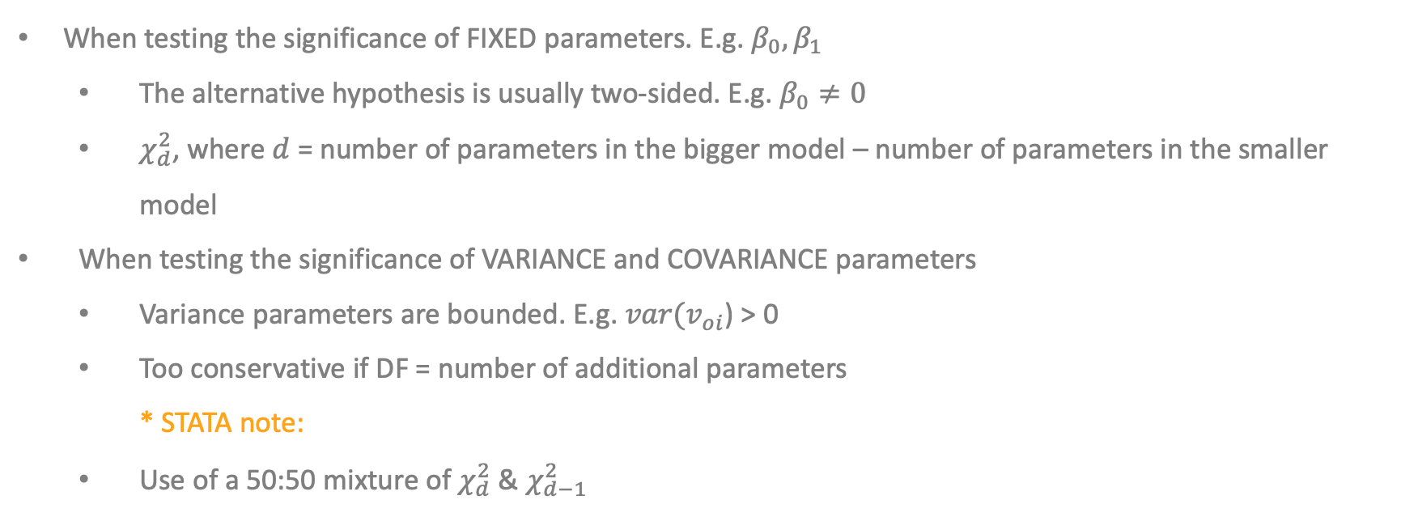
Likelihood Ratio Test for Random Effects (textbook Chapter 6.2)
When testing the significance of FIXED parameters. E.g. $β_{0},β_{1}$
The alternative hypothesis is usually two-sided. E.g. $β_{0}≠0$
$χ_{d}^{2}$, where $d$ = number of parameters in the bigger model – number of parameters in the smaller model
When testing the significance of VARIANCE and COVARIANCE parameters
Variance parameters are bounded. E.g. ${var(v}_{oi}$) > 0
Too conservative if DF = number of additional parameters
* STATA note:
Use of a 50:50 mixture of $χ_{d}^{2}$ & $χ_{d−1}^{2}$

Slide 19
Likelihood Ratio Test – Important Components
Null Hypothesis
Degree of Freedom (DF)
Calculation and result of test statistic(s)
P-value(s)/critical value(s)
* You need to include all these components when doing an LRT for the problem sets.

