Slide 1
PAPER DEEP DIVE · AUGUST 2026
OpenRFM vs
TabPFN-Rel
The architectural fork
OpenRFM
Learn the relational representation
Two routes to relational in-context learning
TabPFN-Rel
Engineer the relational view
Research-group discussion deck
Both finish with tabular ICL
OpenRFM · arXiv:2606.04320 | TabPFN-Rel / RelArena-α · arXiv:2608.16319
01
Notes:
Opening framing: both systems use in-context learning at prediction time, but they place relational reasoning in different parts of the pipeline. OpenRFM learns a reusable relational encoder and adds a batch-level ICL head; TabPFN-Rel flattens the database with deep feature synthesis and applies a frozen tabular foundation model. The papers use different task suites and evaluation protocols, so this is a mechanism comparison, not a head-to-head leaderboard.
[Sources]
- OpenRFM — https://arxiv.org/abs/2606.04320
- RelArena-α / TabPFN-Rel — https://arxiv.org/abs/2608.16319
[/Sources]

Slide 2
CORE COMPARISON
Same goal, different place for relational reasoning
The key distinction is not ‘Transformer vs Transformer’—it is learned structure vs engineered structure.
OPENRFM
TABPFN-REL
Relational DB
RT encoder
Batch ICL
Relational DB
DFS → table
sampled BFS
query context
→
pretrained on
relational corpora
→
TabICL / TabPFN
over query embeddings
frozen at the
cutoff time
→
aggregates over
join paths
Topology remains inside the model
→
Frozen TabPFN-3
ICL over flat rows
Topology collapses before the model
Shared idea
Prediction is conditional on labeled support rows; the disagreement is how each row should encode its relational world.
Sources and methodological caveats are in speaker notes
02
Notes:
OpenRFM uses two axes of ICL: relation-level attention within each query context and batch-level attention across independently sampled support/query examples. TabPFN-Rel uses deep feature synthesis to materialize a single table and then asks TabPFN-3 to perform conventional tabular ICL. The two approaches could be composed: learned relational embeddings and engineered aggregates can become two feature branches feeding one batch-level ICL head.
[Sources]
- OpenRFM Sections 3–4 — https://arxiv.org/html/2606.04320
- TabPFN-Rel Section 2.2 — https://arxiv.org/html/2608.16319v1
[/Sources]

Slide 3
OPENRFM · DIAGNOSIS
RT’s ‘zero-shot’ prediction is relation-level ICL
A query succeeds only when its sampled relational walk exposes enough labeled support—and the prior teaches the model to use it.
Support reachability ρ
How often a query’s sampled BFS context reaches labeled task-table rows
Corruption probes reveal two regimes
ρ .002
Lazy / frozen-feature
st-outc
RT AUC .493 · JUICE .715
RT-PluRel barely changes when relational features are shuffled or randomized.
st-adv
ρ .006
RT R² −.017 · JUICE .470
Feature learning
driver-top3
ρ .893
Co-training or held-out real-data pretraining makes predictions depend on relational features.
RT AUC .824 · high reachability
Diagnosis
Two bottlenecks: sparse reachable labels + a pretraining prior that does not force support-sensitive relational reasoning.
Sources and methodological caveats are in speaker notes
03
Notes:
OpenRFM interprets the Relational Transformer as a kernel-regression-like in-context learner over labels encountered in each BFS relational walk. Low label reachability leaves an underdetermined support set. The reported examples illustrate the correlation rather than prove causality by themselves. Feature and label corruption experiments then show that PluRel-style synthetic pretraining often leaves the model in a lazy regime where relational features are weakly used.
[Sources]
- OpenRFM Sections 3.1–3.2 and Table 3 — https://arxiv.org/html/2606.04320
- OpenRFM paper — https://arxiv.org/abs/2606.04320
[/Sources]

Slide 4
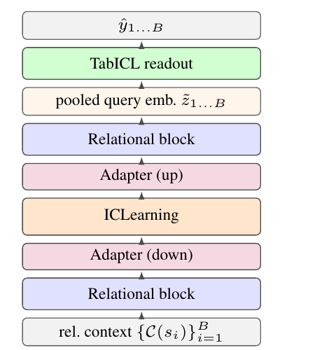
METHOD / OPENRFM
Dual-stage ICL repairs the missing support channel
Relation-level attention builds each example; batch-level attention lets examples teach one another.
Two axes of adaptation
Horizontal
Vertical
ŷ
RT blocks attend within
each query’s relational walk
→
TabICL attends across B
support/query examples
→
batch
prediction
Pretraining prior
Support-identifiable latent h
Inject controllable homophily into synthetic label generation, then continue pretraining on a synthetic + held-out-real mixture with a prototype loss for multi-class tasks.
Figure 2 · cropped from the OpenRFM paper
Design rule
Normalize RT embeddings before TabICL; the full end-to-end 2D attention design failed.
Sources and methodological caveats are in speaker notes
04
Notes:
The deployed design is a practical bridge rather than one monolithic 2D Transformer. The paper reports that full end-to-end 2D attention reached low training loss but failed on downstream regression with R-squared around minus 4.3 and near-constant predictions. The stable recipe uses pooled relational embeddings, normalization and the original TabICL encoder/ICL stack; interleaving ICL layers between relational blocks gives limited task-dependent gains. TabICLv2 limits context to 2048 rows, so OpenRFM uses support-side ensembling over disjoint draws.
[Sources]
- OpenRFM Section 4 and Figure 2 — https://arxiv.org/html/2606.04320
- Embedded figure crop — /Users/zhewu/Documents/Research/tmp/openrfm_tabpfn_deepdive_20260821/assets/openrfm_fig2_stack.png
[/Sources]

Slide 5
OPENRFM · EVIDENCE
The batch-ICL head is the largest single gain
More data is not automatically better; the objective and bridge determine whether relational signal is used.
Cumulative ablation
What to believe
Setup
Bin-AUC
MRR
R²
4.92
mean rank across 24 tasks
(best in the reported suite)
RT-PluRel
.66
N/A
.11
+ TabICL batch ICL
.76
.58
.12
No task-specific training
+ homophily synth.
.78
.56
.13
21.2 min total on rel-stack; versus 15.2–17.8 h for per-task RDL-GNN / RelGT in the paper’s setup.
+ real data
.75
.50
.12
+ prototype loss
.79
.58
.14
Bridge ablation
+ 8× support ensemble
.80
.58
.23
Normalization is critical; the original TabICL encoder beats a linear adapter; interleaving is inconsistent.
v1 preprint · different suite from RelArena
Sources and methodological caveats are in speaker notes
05
Notes:
Table 5 is cumulative. Adding the batch-level TabICL head raises binary AUC from 0.66 to 0.76—the largest single classification gain. Adding real data naively hurts; the prototype objective recovers performance. Eight support ensembles matter most for regression. Figure 3 reports OpenRFM at 4.92 mean rank over a 24-task mixed suite. Efficiency numbers are from one rel-stack benchmark on a single A6000; JUICE's displayed 13.6 minutes excludes 14 minutes of text encoding according to the caption. These results should not be compared numerically to RelArena Elo.
[Sources]
- OpenRFM Figure 3 and Tables 4–6 — https://arxiv.org/html/2606.04320
- OpenRFM paper — https://arxiv.org/abs/2606.04320
[/Sources]

Slide 6
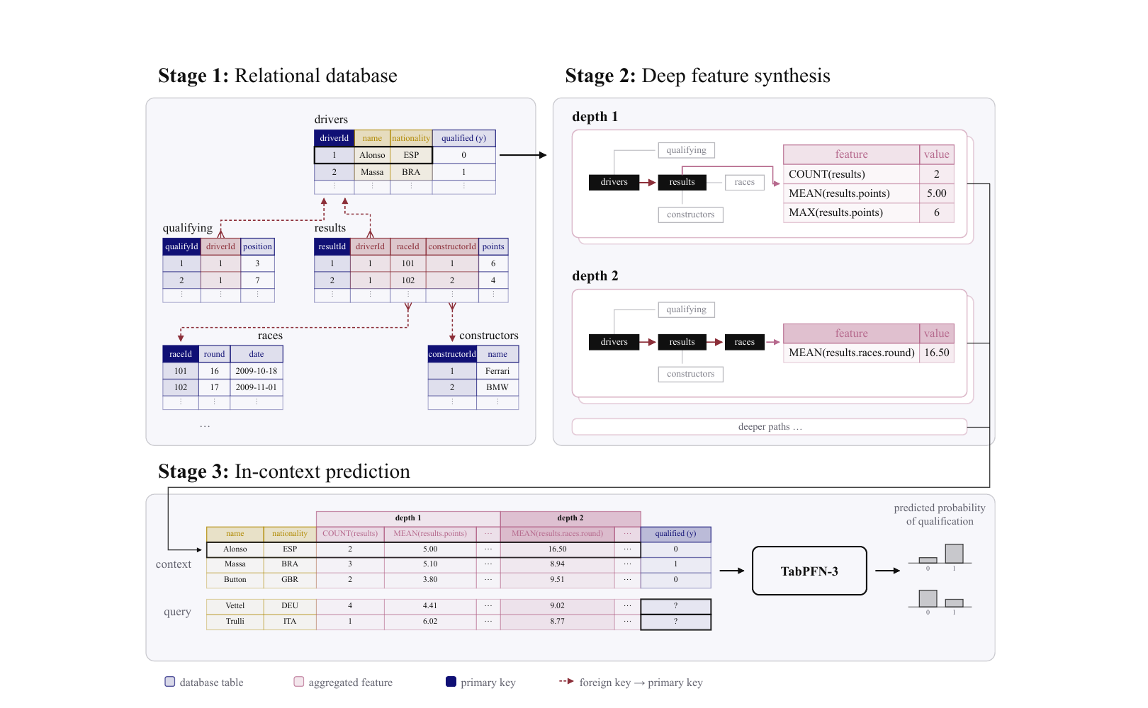
TABPFN-REL · MECHANISM
Flatten first; let a frozen tabular FM adapt in context
The harness is simple, strong and label-rich—its relational inductive bias lives in feature synthesis.
Release configuration
DFS depth
2 / 3 / 4
Estimators
8
Context / estimator
100k
sampled from the 400k most recent candidates
Test context
train + validation labels
API adds raw anchor-table text; OSS is text-free.
Figure 1 · official TabPFN-Rel pipeline
Sources and methodological caveats are in speaker notes
06
Notes:
TabPFN-Rel freezes the relational database at a temporal cutoff, enumerates primary-key/foreign-key join paths with deep feature synthesis and materializes one flat row per entity-cutoff. TabPFN-3 receives labeled context rows and unlabeled queries. Depth is selected from 2, 3 or 4 using an inner database frozen at the validation cutoff; final evaluation uses a database frozen at the test cutoff. The released setup uses eight estimators, each with 100,000 context rows sampled from the 400,000 most recent candidates. Thus it is no-gradient adaptation, but not zero-label adaptation.
[Sources]
- TabPFN-Rel Section 2.2 and Figure 1 — https://arxiv.org/html/2608.16319v1
- Embedded official figure — /Users/zhewu/Documents/Research/tmp/openrfm_tabpfn_deepdive_20260821/assets/tabpfn_pipeline.png
[/Sources]

Slide 7
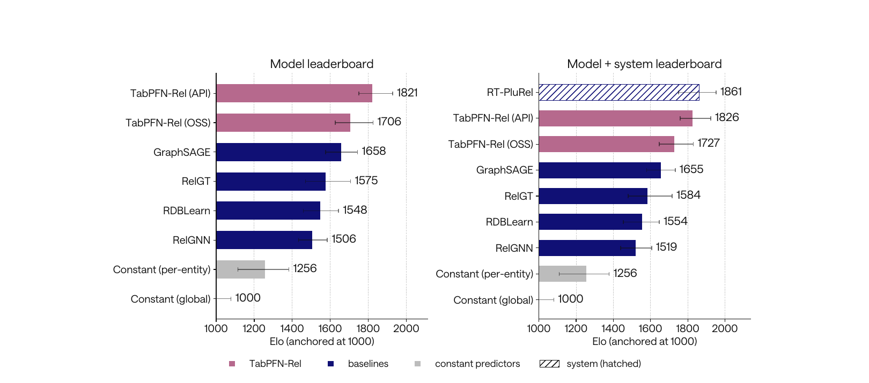
TABPFN-REL · EVIDENCE
#1 standardized model—yet not the #1 overall system
RelArena-α makes the result interpretable, and also exposes the remaining confounders.
Readout
1821
API model Elo
1706
OSS · no text
1861
RT-PluRel system
Important
Only TabPFN-Rel and RT-PluRel beat the per-entity constant on all 21 tasks.
Figure 2 · 21 RelArena-α entity-forecasting tasks
one seed; entity forecasting only
CPU feature synthesis excluded from headline runtime
API→OSS gap is dominated by two text-heavy tasks
depth 2 is often competitive; deeper paths grow rapidly
Sources and methodological caveats are in speaker notes
07
Notes:
The left panel is the standardized model leaderboard: TabPFN-Rel API ranks first at 1821 Elo, followed by OSS at 1706, GraphSAGE at 1658 and RelGT at 1575. The right panel includes separately categorized systems; RT-PluRel is 1861 and TabPFN-Rel API 1826. Elo is anchored at 1000 and relative to the submitted field. The paper emphasizes that text columns are critical mainly on rel-event/user-ignore and rel-avito/user-clicks. It also reports that preprocessing is expensive and excluded from its main runtime comparison. Temporal-boundary behavior is not yet perfectly uniform across method families.
[Sources]
- RelArena-α Figure 2 and Sections 3.2–3.3 — https://arxiv.org/html/2608.16319v1
- Embedded official figure — /Users/zhewu/Documents/Research/tmp/openrfm_tabpfn_deepdive_20260821/assets/tabpfn_elo.png
- RelArena repository — https://github.com/PriorLabs/relarena
[/Sources]

Slide 8
SYNTHESIS
The missing experiment: equal support + equal compute
Today’s papers answer different questions; a common protocol would reveal when learned topology earns its cost.
Dimension
OpenRFM
TabPFN-Rel
Common test
Relational representation
learned RT embedding
DFS aggregate columns
same temporal snapshots
Relational pretraining
yes: synth. + real
none in harness
held-out databases
Support budget
≤2,048; usually 1,024 × 8
100k × 8
0 / 8 / 32 / 128 / 1k / 100k
Published benchmark
24-task mixed suite
21 RelArena tasks
RelArena + link / retrieval tasks
Main bottleneck
reachable labels + prior
feature synthesis + context
wall-clock + memory + accuracy
RelGT-FM hypothesis
Learned graph encoder → normalization → batch ICL
Testable prediction
OpenRFM-like models should win at low labels and on topology-dependent tasks; TabPFN-Rel should remain formidable when aggregates + abundant labels suffice.
+ optional cheap DFS residual branch
Sources and methodological caveats are in speaker notes
08
Notes:
This final slide separates evidence from hypothesis. OpenRFM and TabPFN-Rel are not presently comparable: OpenRFM predates TabPFN-Rel, uses a filtered 24-task mixed suite and a much smaller context; TabPFN-Rel uses the 21-task RelArena entity-forecasting suite with up to 800,000 context-row uses across eight estimators. A decisive experiment would lock identical snapshots, task definitions, support budgets and full pipeline wall-clock, then add held-out-database tests and task families where flattening is structurally lossy. The proposed RelGT-FM hybrid borrows OpenRFM's normalized batch-ICL bridge and keeps TabPFN-Rel-style aggregates as a residual/control branch. The predicted regime split is an inference, not a published result.
[Sources]
- OpenRFM — https://arxiv.org/abs/2606.04320
- RelArena-α / TabPFN-Rel — https://arxiv.org/abs/2608.16319
- RelGT — https://arxiv.org/abs/2505.10960
[/Sources]

