Slide 1
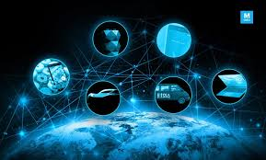
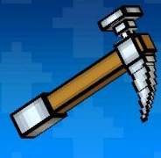

Tech Miners
Mahzad Khoshlessan
Sobha Rani Erva
Usha Sushma Gottipati
Eileen Wong

Slide 2
Smart way to insure
InSmart App

Slide 3

Problem Statement
Manual and tedious process to apply for insurance
Customers fill hundreds of fields to check for eligibility/premium, which is waste of time, and not at all fun!
Not many options for “pay per use” kind of insurance

Slide 4

Our solution!
Use public APIs to get small-business related information including the business type, geo-location, etc
Image Recognition: Use Neural networks and AI for handwriting recognition from physical forms that the customers/brokers can upload into the app with a single click
Speech Recognition: Customers can talk to the app and dictate the form data instead of typing the values, making it a fun experience for them! Use ML and AI speech recognition techniques to achieve this

Slide 5
App flow
Call APIs to get business data
User permission to share geo-location?
Start
Show location options from geo-location API
Get additional info from customer
Mobile app
Upload Image with filled physical form
Give voice commands to enter the data via speech
Customer to enter location manually
Rules engine
Risk score for each category
Success
IOT offers displayed to customer
Rules engine
Display premium
Response from provider APIs
Send inputs to insurance provider APIs

Slide 6
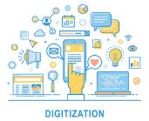

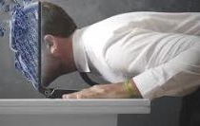
Benefits
Digitize the application process for friction-less experience for both customers and brokers/providers
Increase the customer base by providing more personalized offers by using emerging technologies like IOT
Humanize the whole experience of applying for an insurance

Slide 7
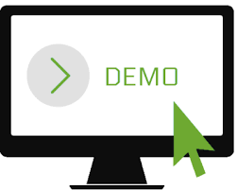

Slide 8
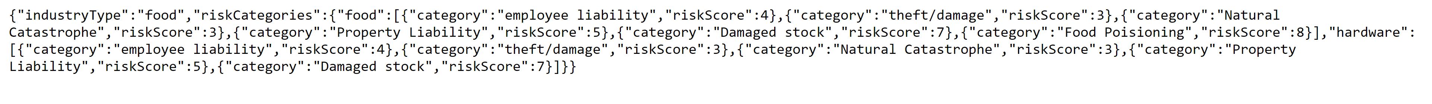
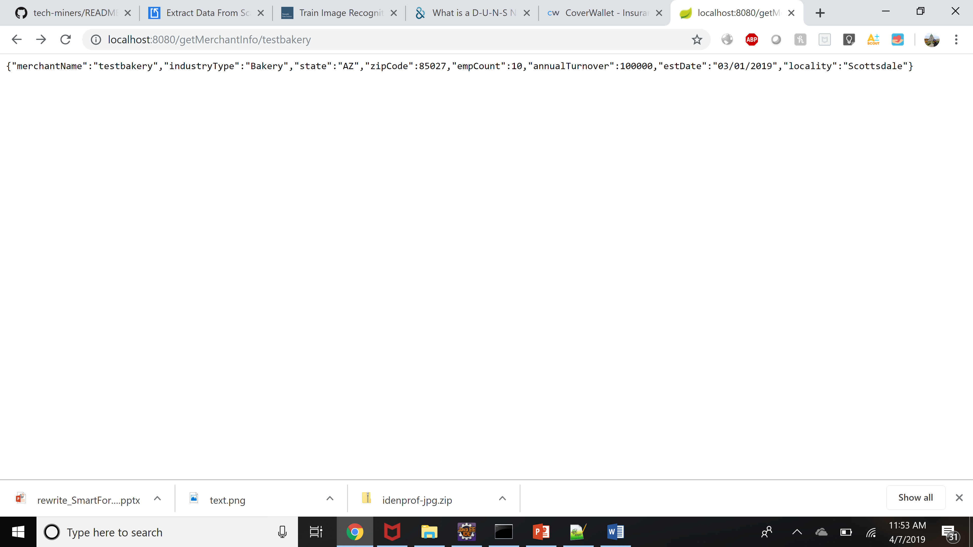
Github URL: https://github.com/rewritehackathon/tech-miners/blob/master/README.md
Prototypes/wireframes:
https://xd.adobe.com/view/d3d13631-f3fc-4823-7741-c271e09742ae-a5e0/
Sample API response:

Slide 9
Thank you!

