Slide 1


INST741 Comparison Analysis of Danmu and Comment on bilibili.com
Yue Liu

Slide 2




2
Agenda
Introduction of bilibili.com and Danmu
Motivation and Hypothesis
Comparison Results
Limitation

Slide 3
3
Introduction of bilibili.com and Danmu
Introduction:
A video sharing website themed around anime, manga, game, music, dancing, science, entertainment, movie, drama, and fashion based in China
Great achievement:
Three millions views and 350 thousand active users per day
High user engagement and user retention
Thor: Ragnarok Teaser Trailer on YouTube: 12,663,837 views/36,772 comments
A game video on bilibili: 1 million views/41000 Danmu (advanced comment)
Danmu
As “bullet”, a kind of comment function that enable audience to “shoot” their comments immediately onto the video they’re watching.
Notes:
First, let me introduce this website. Bilibili is a video sharing website themed around anime, manga , game, music and other topics based in China. Having developed from 2009, they have created a great achievement: three millions daily view and 350 thousand daily active users. And they are niche website and their target users are people who enjoy ACG culture that means anima, comic and games. Because a strong economic and cultural connection exists between anime, manga and games in the Japanese market, ACG is used to describe this phenomenon in relative fields. As I said, this website is a very interesting and successful website, not only because of their high daily views and active users, but also they have a extremely high user engagement and user retention.
Today I searched the most popular video on both youtube and bilibili. Currently : Thor trailer on youtube has 12 million views and thirty six thousand comments. On the other hand, a game d video on bilibilki only got 1 million views but 40 thousand danmu.
Roughly, you can see, bilibili has ten times user engagement than youtube. That’s one reason why I focus on this website

Slide 4

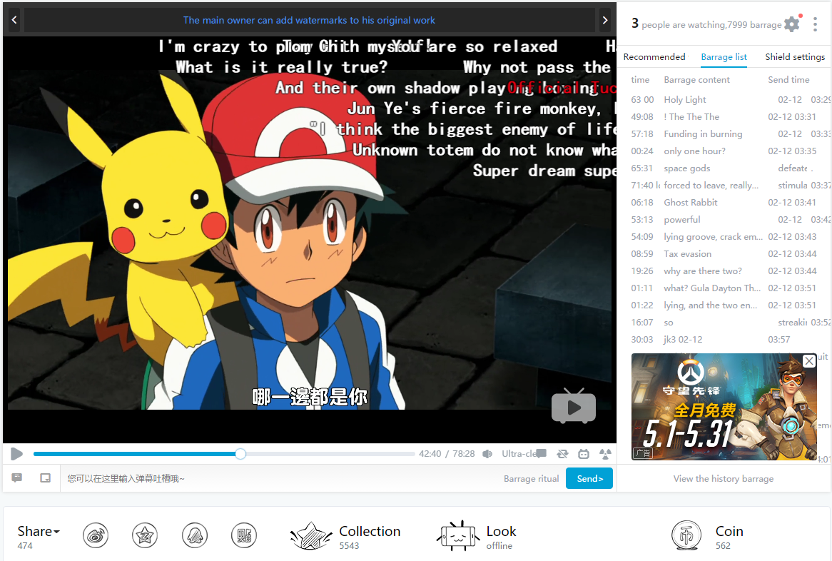
4
Notes:
And next: what is danmu. Literally, danmu is “bullet”, a kind of comment function that enable audience to “shoot” their comments immediately onto the video they’re watching, usually on the top of the video.
It has multiple advantages: danmu function creates chat room experience in which users feel like watching and playing together with others, even they watched the video not in the same time. So there is a high synchronization with other users. In addition, when using typical comments under the video, people have to describe what scene they are trying to discuss before making their real comments. However, when using danmu, the comments are on the perfect timing and users don’t need to describe what their comments about.
And then, because of danmu, the video can always attract users’ attention. From my own experience, not all videos can attract audience attention from the beginning to the end. Some plots are boring and audience can go to the bathroom. However, with danmu, when people feel boring and want to close the video, they can read the danmu and go back to the video after a few seconds. As a result, danmu improve user engagement and help to build a website culture.
Effect:
Creates a chat room experience in which users feel like watching and playing together with others
High synchronization with other users
Comments on appropriate timing
Always attract users’ attention
Improve user engagement

Slide 5
5
Motivation and Hypothesis
Motivation: “social media usage during television viewing made individuals feel like they were watching the shows in a group setting” (Cohen & Lancaster, 2014)
Hypothesis:
Users have different behavior pattern when using danmu and traditional comment from the perspectives of attitude, word frequency, the length of comment, etc.
Notes:
Higher sentiment analysis score, the length of danmu should be short
different pattern based on word frequency
Even they should have different aim

Slide 6
6
Comparison Results
Data collection:
scraping comments (56,655) and danmus (108,459) from 18 game videos on bilibili.com Build
Building dictionary-based sentiment analysis:
Split each comment and danmu into word list and removing stop words
finalSentiScore=notWords + degreeWords + sentiWords
e.g. “not very good “ = (-1) ^ 1 * 1.25 * 0.747127733968
Comparison Results:
Comments have a higher sentiment analysis score than danmu (1.075 vs 0.402)
The number of danmu is extremely larger than comments (4413 vs 15023)
The length of danmu is shorter than comments (15.83 vs 7.836)
Word frequency:
Danmu: more emotional-based (e.g. “LOL”, “2333”)
Comment: more opinion/video-based (e.g. “updates”, “Finally, I waited for the latest video”)
Notes:
Sentiment analysis, two sample t-test, word frequency

Slide 7
7
Limitation
Various limitations：
Scraped comments and danmu only from game video and popular updaters
Chinese words segmentation
XXX YYY ZZZ (in English) vs XXXYYYZZZ(in Chinese)
Dictionary-based sentiment analysis
The evaluation is depend on polarity lexicon that was derived from human raters and previous researcher’s intuitions
Difference between the dictionary and analyzed context
Notes:
Gaming category 人气主播
中文分词 和英语不一样 更加取决于字典
Dictionary-based sentimeny analysis 的结果取决于字典本身 （而我给的字典是来自于twitter的，和视频播放的情况不太一样）

Slide 8
THANKS

