Slide 1
Smart Waste management System Using Arduino Uno

Slide 2
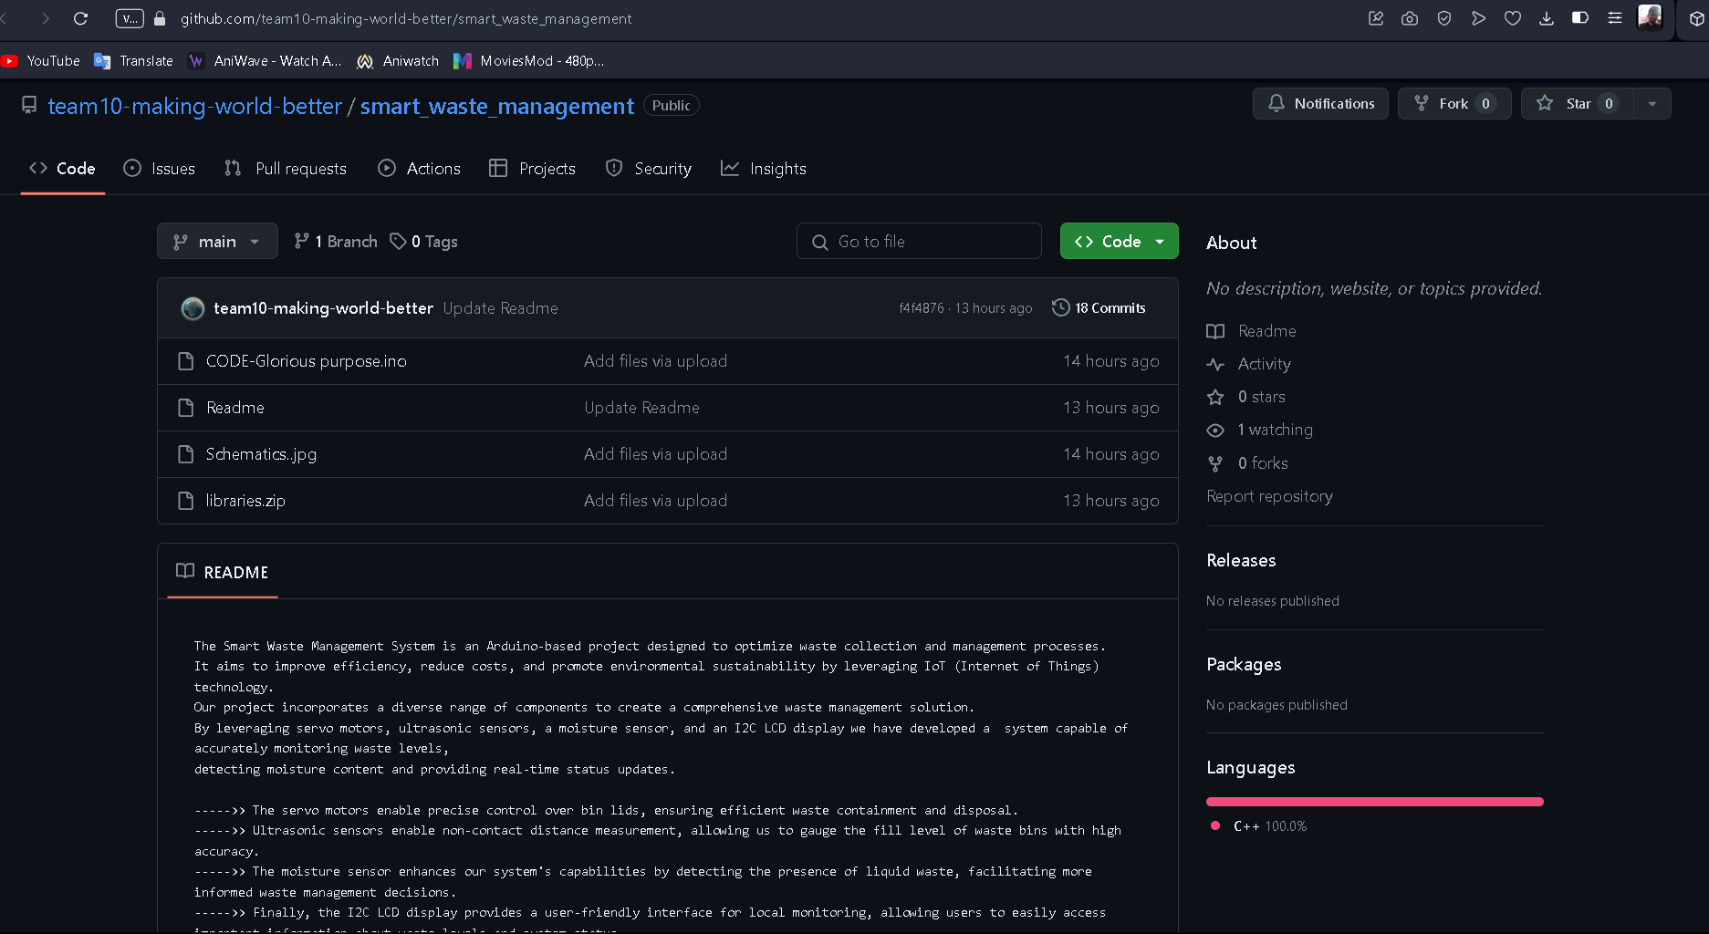
Here is our github link
GitHub - team10-making-world-better/smart_waste_management

Slide 3






CULPRITS
NAME: Anuska Saha
DEPT: AIML
YEAR: 2nd
UNI ROLL: 10930622022
NAME: Shreyan Ghosh
DEPT: AIML
YEAR: 2nd
UNI ROLL: 10930622019
NAME: Abhishreya Das
DEPT: AIML
YEAR: 2nd
UNI ROLL: 10930622061
NAME: Md Rehan Farooque
DEPT: AIML
YEAR: 2nd
UNI ROLL: 10930622032
NAME: Anwesha Guha
DEPT: AIML
YEAR: 2nd
UNI ROLL: 10930622021
NAME: Raquib
DEPT: AIML
YEAR: 2nd
UNI ROLL: 10930622044

Slide 4
Abstract
A system is proposed to effectively manage waste in urban areas without the need for continuous manual monitoring. The current challenge of disorganized and unsystematic waste collection is addressed through the implementation of an embedded IoT system capable of monitoring individual dumpsters for waste accumulation. This system includes an automated mechanism for segregating wet and dry waste. A mechanical setup is employed to separate the two types of waste into distinct containers, with sensors utilized to detect their presence. Moisture sensors are utilized to identify the presence of waste or dry conditions. A Servo motor is utilized in the waste segregation process. Additionally, ultrasonic sensors are integrated into both containers to measure waste height, enabling precise waste quantity measurement. In the event that one of the containers reaches capacity, an alert message is automatically sent to the relevant personnel.

Slide 5
Introduction
Cities all throughout the world struggle with trash management in complex urban settings, frequently turning to labor-intensive techniques like dumpster surveillance. But this conventional method often fails, resulting in inefficiencies and unhygienic circumstances marked by containers that are either overfilled or underutilized. A novel approach to garbage management has surfaced in response to these issues, and it involves integrating dumpsters into an advanced monitoring system. When dumpsters get close to capacity thresholds, this system uses cutting-edge technology to notify designated workers so that they can take prompt action to avoid overflow. The system also includes mechanisms for separating dry and moist garbage, which increases its efficiency in recycling and waste disposal projects. This system promotes environmental stewardship and streamlines waste management procedures by integrating cutting-edge technology with sustainable practices.

Slide 6
Existing System OVERVIEW
In India, waste management systems vary widely depending on the region and level of urbanization. Many cities face challenges such as inadequate infrastructure, lack of proper segregation at the source, and limited resources for collection and disposal.
There is no systematic approach towards clearing the dumpsters, manual systems in which employees clear the dumpsters periodically.
Employees are unaware of the need of cleaning of a particular area, which results in very less effective in keeping the city clean.

Slide 7
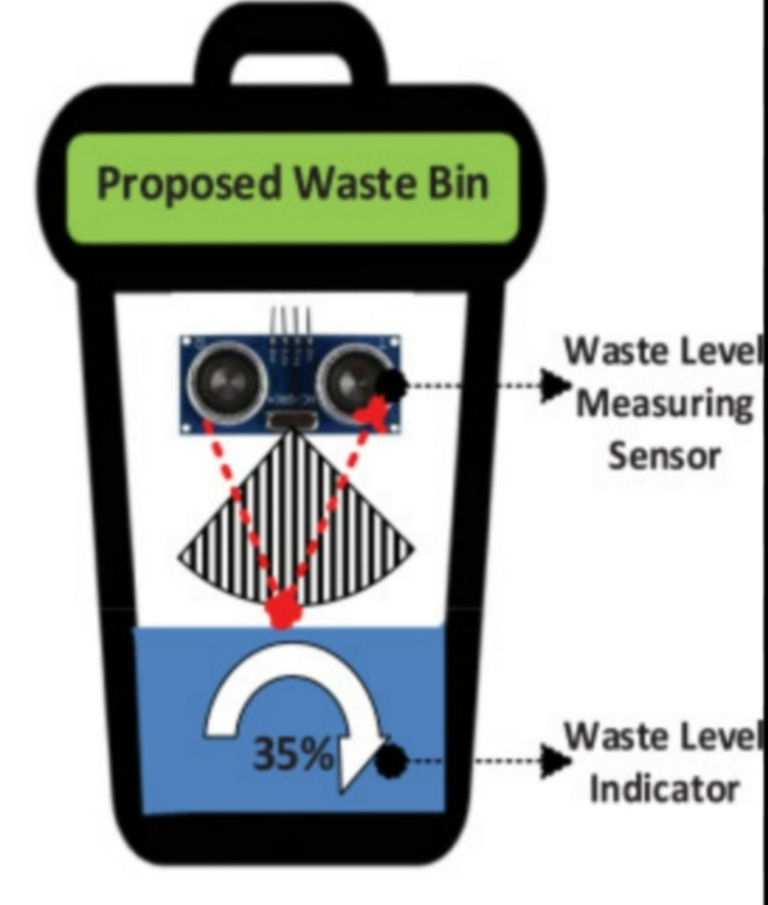
Solution
The figure in next slide represents an integration of Smart Waste Management System with a Arduino UNO chip, ultrasonic and soil moisture sensor. Ultrasonic sensor measure distances by using ultrasonic waves. The sensor emits an ultrasonic wave and receives the reflected wave back from the target.
Moisture Sensor measures the volumetric water content in the garbage. Reflected microwave radiation is affected by the soil moisture and is used for segregating dry and wet wastes
Servo motor which is connected to the digital pins of Arduino is used for segregating wet and dry wastes properly.
We are using LCD monitor for the display.

Slide 8
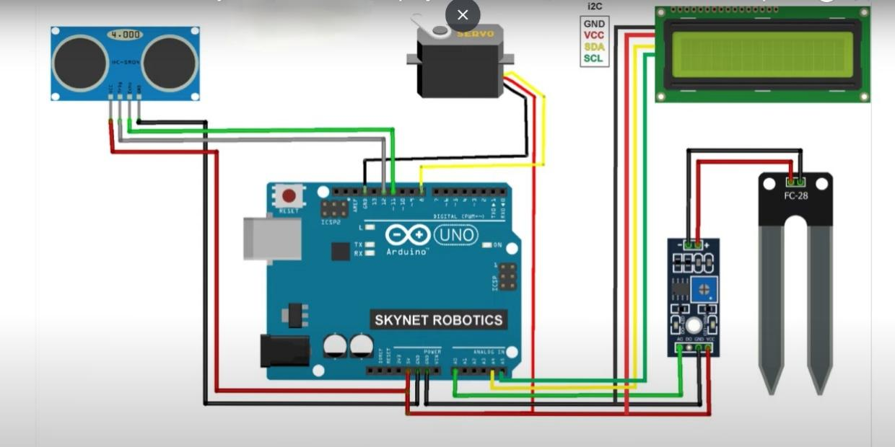
SCHEMATIC DIAGRAM
We will be using an
Ultrasonic sensor
LCD
Moisture sensor
Servo motor.
NOTE that this setup is based on I2C protocol

Slide 9
RAW CODE
SERVO motor:-
void segregateWaste(bool isDryWaste) {
if (isDryWaste) {
servo.write(180); // Rotate servo clockwise for dry waste
}
else {
servo.write(0); // Rotate servo anticlockwise for wet waste }
delay(2000);
servo.write(90); // Reset servo position
}
MAIN body:-
if (!isWasteDetected) {
if (moistureLevel > wetWasteThreshold) { lcd.clear();
lcd.print("Dry Waste Detected"); segregateWaste(true); // Rotate servo clockwise for dry waste
isWasteDetected = true; }
else {
lcd.clear();
lcd.print("Wet Waste Detected"); segregateWaste(false); // Rotate servo anticlockwise for wet waste
isWasteDetected = true; }
}

Slide 10
Conclusion
Efficiency: Smart waste management systems streamline waste collection processes by utilizing sensor technology to monitor waste levels in bins. This data enables optimized routing for collection vehicles, reducing unnecessary trips and fuel consumption.
Cost Reduction: By optimizing collection routes and schedules based on real-time data, smart waste management systems can significantly reduce operational costs for municipalities and waste management companies. This efficiency leads to savings in fuel, labor, and maintenance expenses.
Environmental Impact: Smart waste management systems contribute to environmental sustainability by minimizing the amount of waste sent to landfills. Timely collection and sorting of waste materials facilitate recycling and proper disposal, reducing pollution and conserving natural resources.
Smart City Integration: Smart waste management systems are part of broader smart city initiatives, integrating with other urban infrastructure systems such as transportation, energy, and water management.

Slide 11
Future Scope
The potential applications of Arduino technology in smart waste management systems are numerous and appear promising.
Improvements in data analytics and sensor technology will improve the precision of waste management and monitoring, enabling more precise forecasts and optimizations.
By automating decision-making procedures, the integration of AI and machine learning can enable flexible solutions to waste management problems.
Scalability addresses the requirement for waste management globally by providing chances for implementation in a variety of metropolitan contexts. Working together, government agencies, businesses, and academic institutions can spur innovation and customize solutions for specific regions.
These technologies have the potential to manage agricultural and industrial waste outside of cities, which would improve sustainability all around.
Thus future waste management strategies will be smarter, more effective, and environmentally sustainable thanks to continued technological developments, broader acceptance, and interdisciplinary collaborations.

Slide 12
THANK YOU

