Slide 1

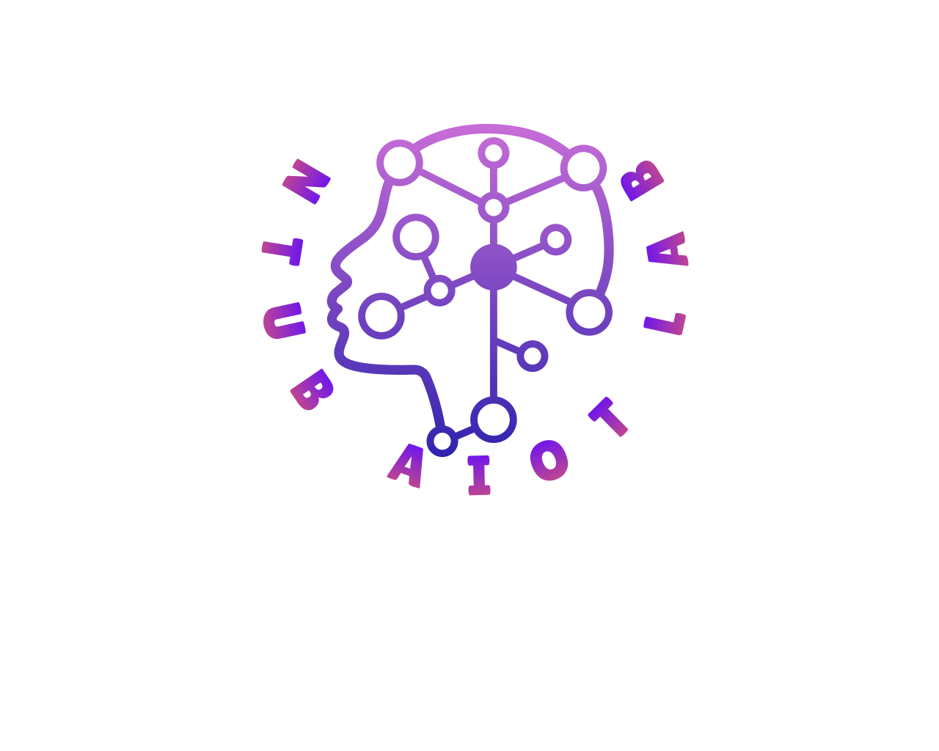

Slide 2

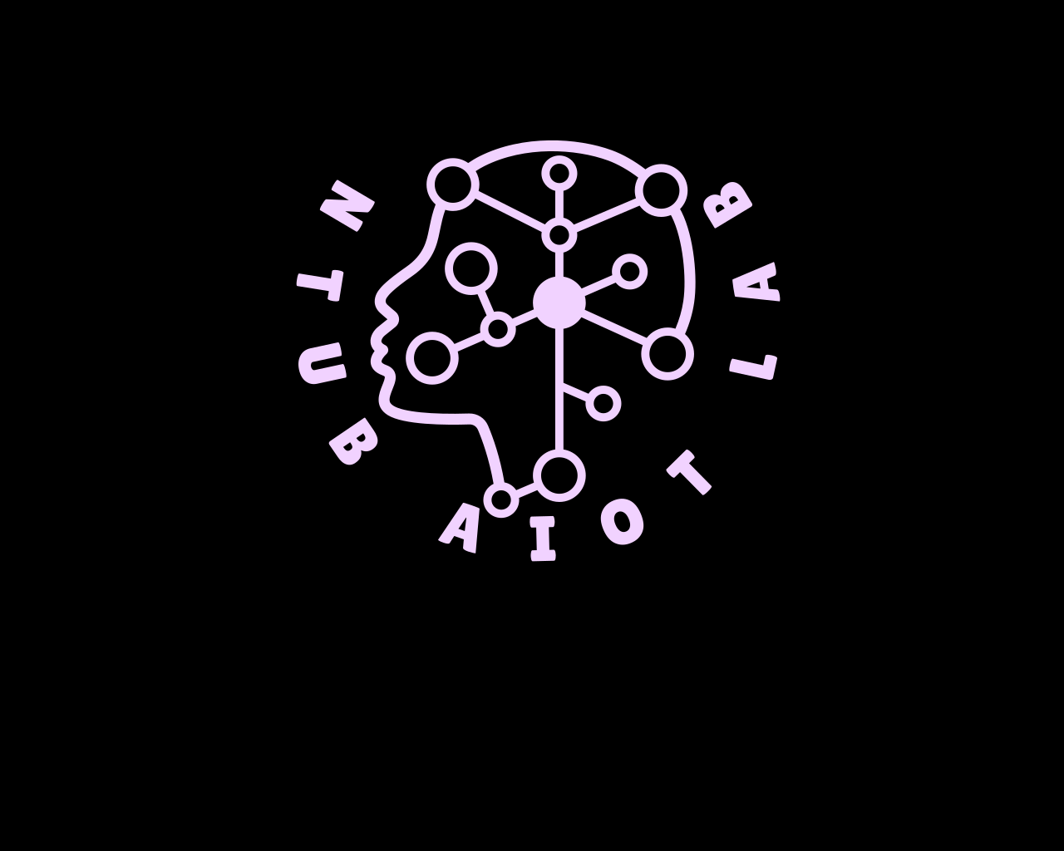

Slide 4




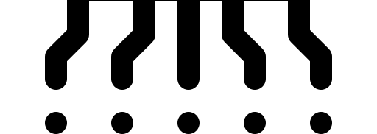

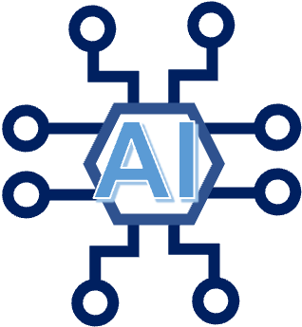
IoT
NTUB

Slide 5
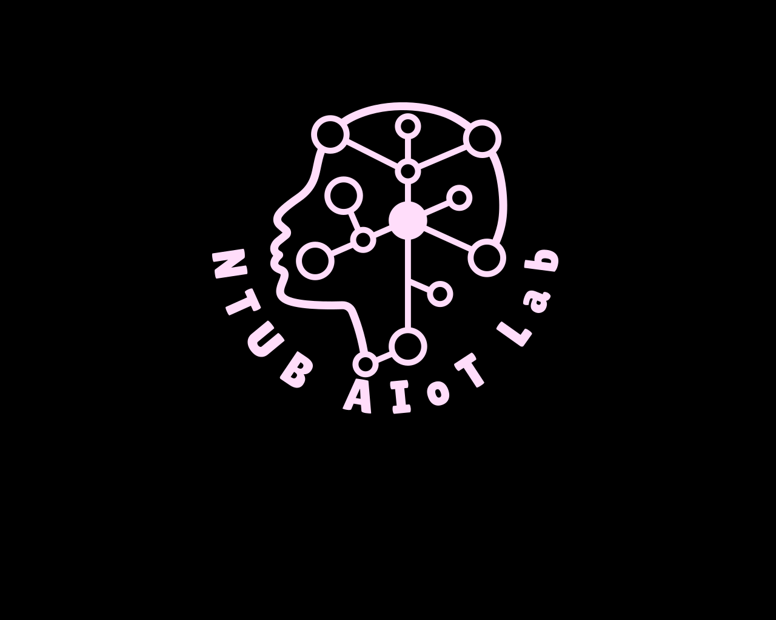

Slide 6
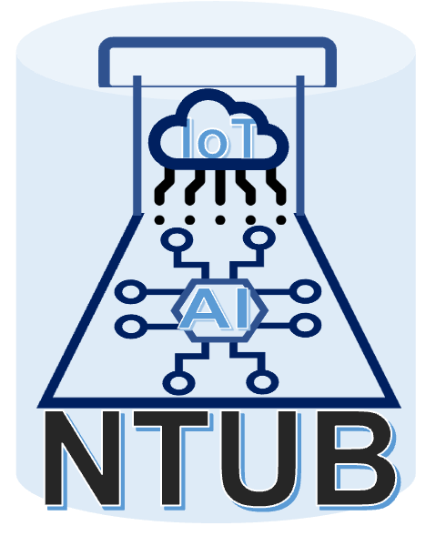

Slide 7
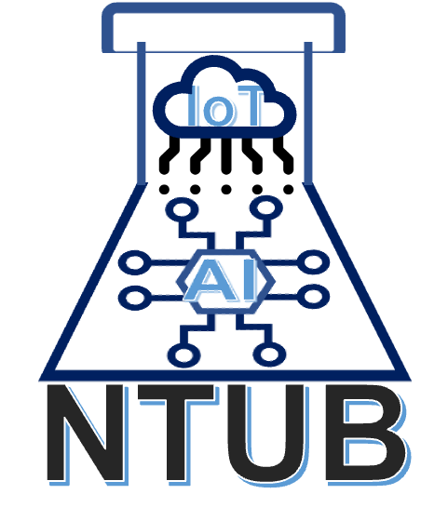
人工智慧及物聯網實驗室
The Artificial Intelligence of Things Lab

Slide 8
人工智慧及物聯網實驗室
The Artificial Intelligence of Things Lab

