Slide 1
Azure Arc, How did I help you?
Rex de Koning

Slide 2
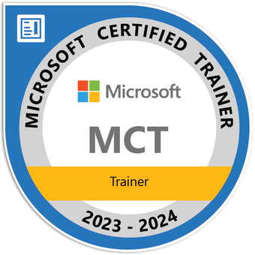




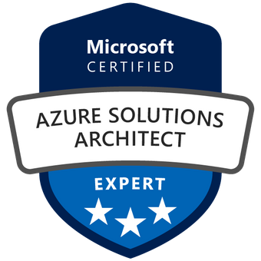
Rex de Koning
Powershell automation
Cloud Engineer @ InSpark

Slide 3
Agenda
Azure Arc
Private Link Scope
Problem creating Private LinkScope
Problem health status

Slide 4
Azure Arc
“Azure Arc is a bridge that extends the Azure platform to help you build applications and services with the flexibility to run across datacenters, at the edge, and in multicloud environments. Develop cloud-native applications with a consistent development, operations, and security model.”
Microsoft

Slide 5
Private Link Scope
Azure Arc Private Link Scope connects private endpoints (and the virtual networks they're contained in) to an Azure resource, in this case Azure Arc-enabled servers.

Slide 6
Problem creating Private LinkScope
Recurring errors when creating Private Link Scope
Same for:
Portal
CLI
Pwsh
REST-API

Slide 7
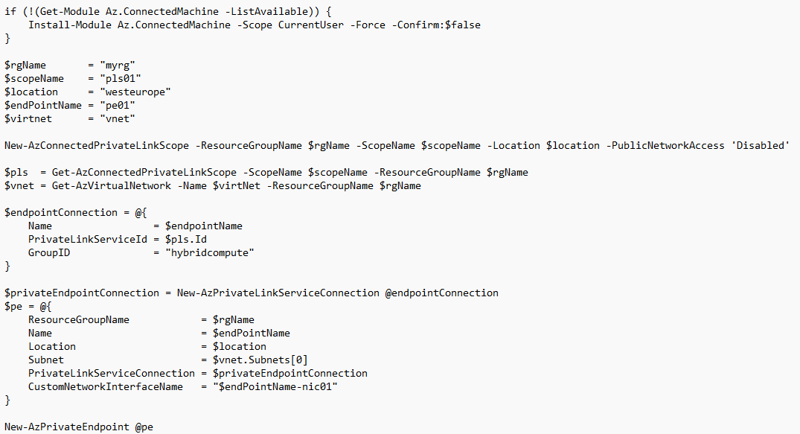
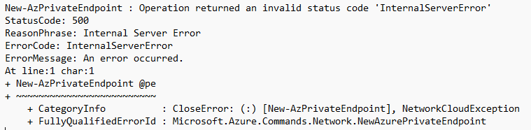
Problem creating Private LinkScope

Slide 8
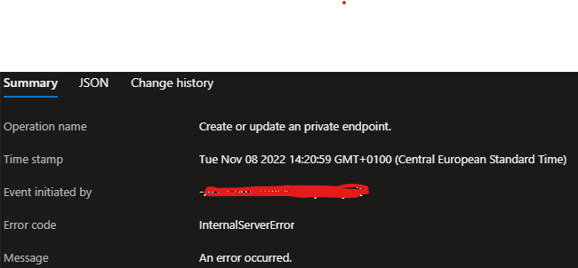
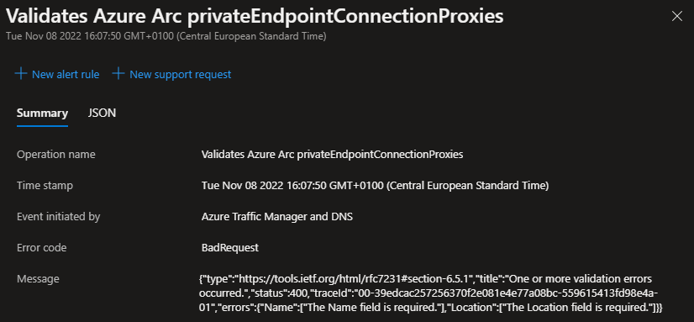
Problem creating Private LinkScope

Slide 9
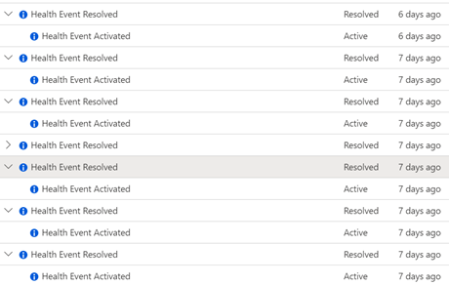
Problem Health Status

Slide 10
Please fill in the evaluation in the Yellenge App Thank you very much!

Slide 11
After lunch 13:00 Emanuele Bartolesi
Automate your tenant with PowerShell and Azure Functions

