Slide 1
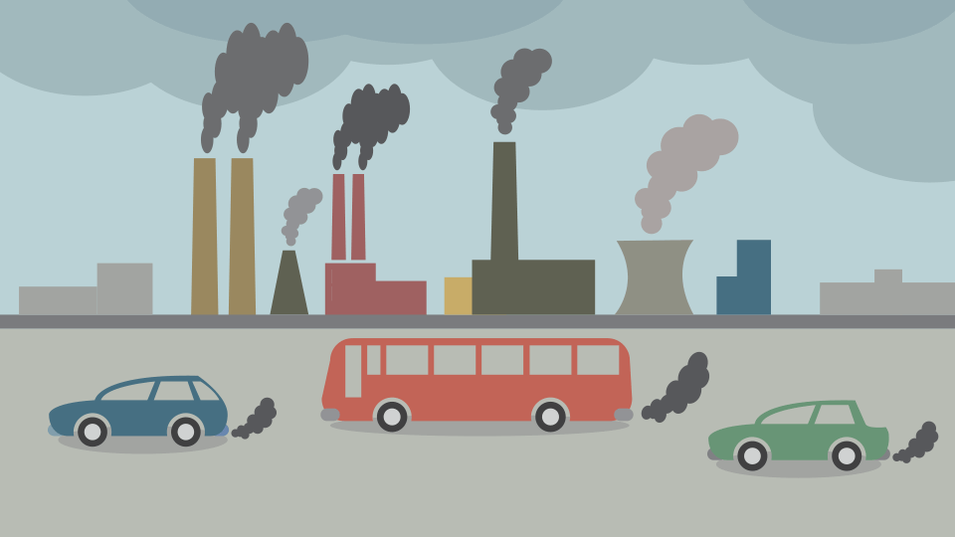
Air Pollution in India - Clustering
Presented by Artem Ramus

Slide 2
Introduction
This data set comprises three types of air pollutant in India for specific cities. Additional column is "State".
Inspiration: derive meaningful insights about the air pollution in India by dividing the data to categories by common properties similarity.
Link to the dataset at Kaggle: https://www.kaggle.com/adityadeshpande23/pollution-india-2010

Slide 3
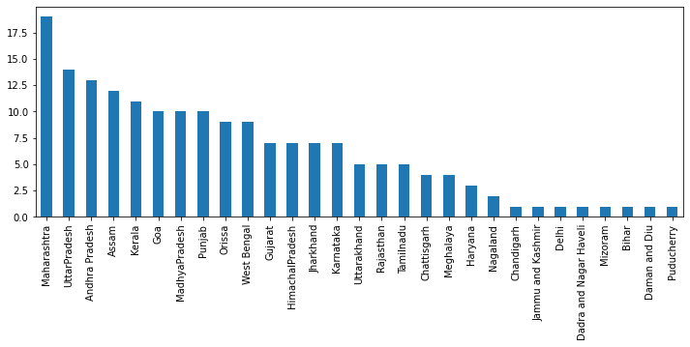
Data Analysis
There is 181 cities as 29 states. Cities per state are shown below

Slide 4
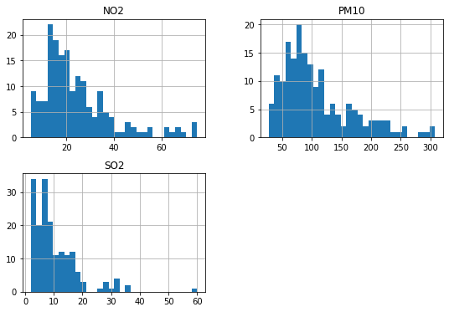
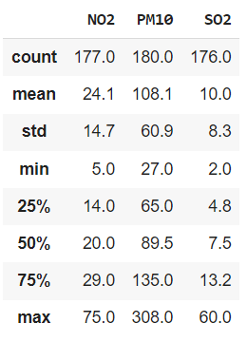
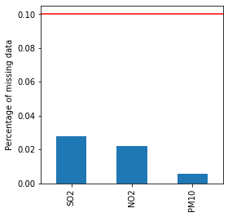
Data Analysis
There is 3 pollutants - NO2, PM10, SO2. Statistical distribution is shown below:

Slide 5
Data Analysis
The 5 most polluted states with NO2 are West Bengal, Delhi, Bihar, Jharkhand and Maharashtra
The 5 least polluted states with NO2 are Puducherry, Kerala, Meghalaya, Mizoram and Nagaland
The 5 most polluted states with PM10 are Delhi, Jharkhand, Bihar, Uttar Pradesh and Haryana
The 5 least polluted states with PM10 are Kerala, Mizoram, Dadra and Nagar Haveli, Puducherry and Daman and Diu
The 5 most polluted states with SO2 are Uttarakhand, Jharkhand, Maharashtra, Gujarat and Uttar Pradesh
The 5 least polluted states with SO2 are Himachal Pradesh, Meghalaya, Mizoram, Nagaland andS Chandigarh

Slide 6
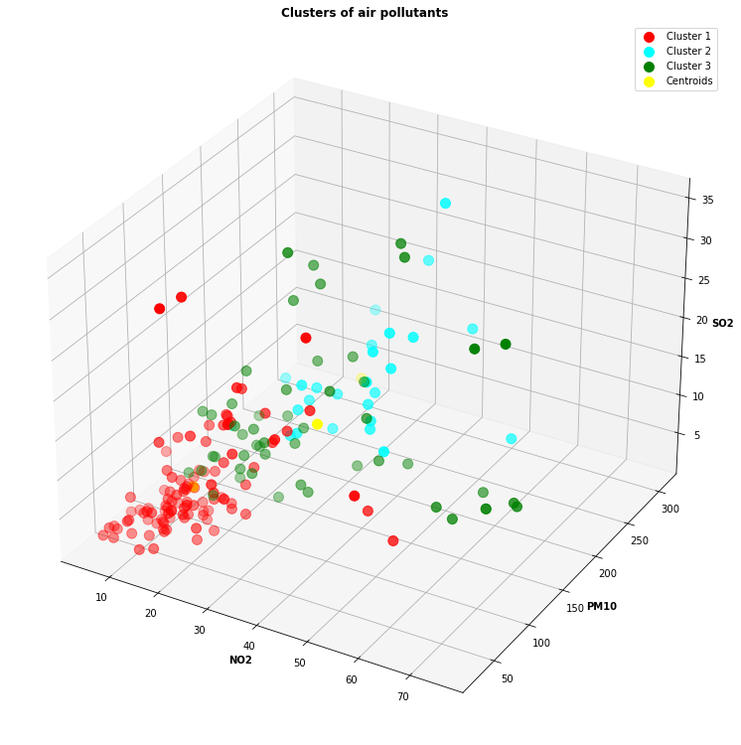
Results
Cluster 1 'NO2' min and max are 5.0 and 56.0
Cluster 1 'PM10'min and max are 27.0 and 97.0
Cluster 1 'SO2'min and max are 2.0 and 32.0
Cluster 2 'NO2' min and max are 6.0 and 55.0
Cluster 2 'PM10'min and max are 181.0 and 308.0
Cluster 2 'SO2'min and max are 3.0 and 30.0
Cluster 3 'NO2' min and max are 11.0 and 75.0
Cluster 3 'PM10'min and max are 99.0 and 175.0
Cluster 3 'SO2'min and max are 2.0 and 35.0

Slide 7
Methodology
The data set is checked for duplicates, null values and homogeneous features.
Data distribution is checked with histogram, distribution and box plots for skewness and outliers.
Numerous clustering models are engaged, based on co-location and density.
K-mean model was chosen as the most suitable because of spatial characteristics. 3 clusters were chosen with the elbow method as the most representative.

Slide 8
The end
Thank you for your attention!

