Slide 1

Recruit’em
You’ve come to the right place
Designed by,
Aakash B
Divakar R
Hackathon from HE (Recruit-a-thon)

Slide 2
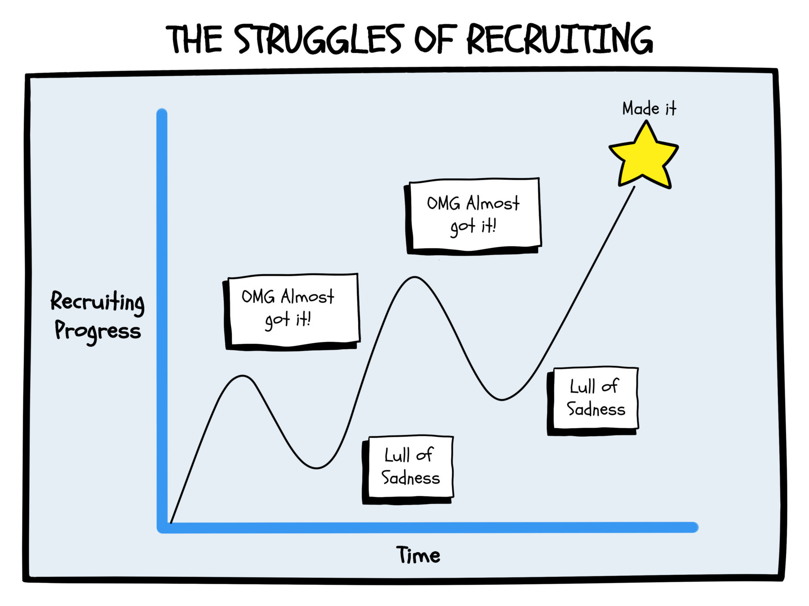
Theme
Recruiting candidates has been a tedious job so far, we believe thus automating this process enhances the big firms to save ample amount of time thus we have built an automatic recruitment process with the use of state-of-art advanced NLP model thus saving time and managing work efficiently…

Slide 3


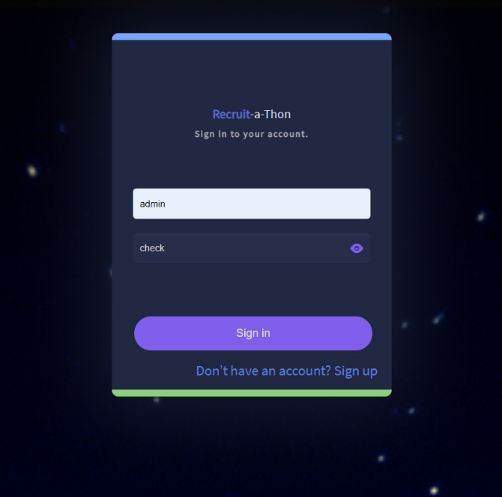


Application Source
Github Repo
Recruit'em
We kindly recommend you to checkout the GitHub repo and the work we had put in via commit.
Please run the scripts manually as the Heroku doesn’t support inbuilt mailing system we designed for our application.
Script to Trigger: app.py

Slide 4
COMPARISON
Conventional Process
Automated Workflow
Older methodologies involve usage of hard copy(paper) and storage, analyzing takes tedious man power.
Screening and arranging meetings takes time and less efficient.
Improper documentation of workflow by recruitment management.
Robust to improper pattern of various resumes.
Candidate selection and managements are harder.
Automated large volumes of resume data management
Inbuilt resume parser manages large volumes of data and stores them onto database in a consolidated format.
Analysis and graphical recommendation system provides a biased decision of hiring the candidates.
Automated meeting scheduler and notification prompts to manage workflow effectively.
Candidates get intimation instantaneously towards each step in the recruitment process.

Slide 5









Technology Stack
Front End
Back End

Slide 6
Work Flow
Mail Box
Flask Dashboard
Scheduler
Mail Downloader
Process Logger
NLP Model Resume Parser
Feature Extraction
Database Load
Interview Mail System

Slide 7
What we learnt !
Team Management Skills
Continuous Integration and Continuous Deployment
Git Skills – Our commits speak our effort 😎
Learned new NLP model and its features.
Flask framework and Bootstrap.
Challenges Faced
Heroku Deployment was a complete mess as we weren’t able to use the SMTP system we designed for our application.
Usage of scheduler during deployment was a big issue

Slide 8
End Results
Continuous Email Integration delivering pipeline to the system backend.
State-of-Art Resume Parser.
Secure Database and Interface with Cryptographic Hashes.
Automatic Data retention system and Analyzer.
Enabled Key Filtering system with integrated recommended job profiler.

Slide 9
Feedback…!
We believe the entire application can be enhanced with given time & work. We are open to suggestions, please mail us in case of any concern.
Click to mail

